Slide 1
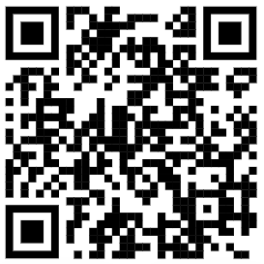
Elder Mistreatment
www.PollEv.com/learners
Dr. Julia Hiner
Fellowship Program Director
Associate Professor
Joan & Stanford Alexander Division of Geriatric & Palliative Medicine
Department of Internal Medicine
McGovern Medical School
University of Texas Health Science Center Houston || UTHealth Houston
https://www.dolmanlaw.com/wp-content/uploads/2016/11/Learning-about-elder-abuse-300x200.jpg

Slide 2
Disclosures
None.

Slide 3
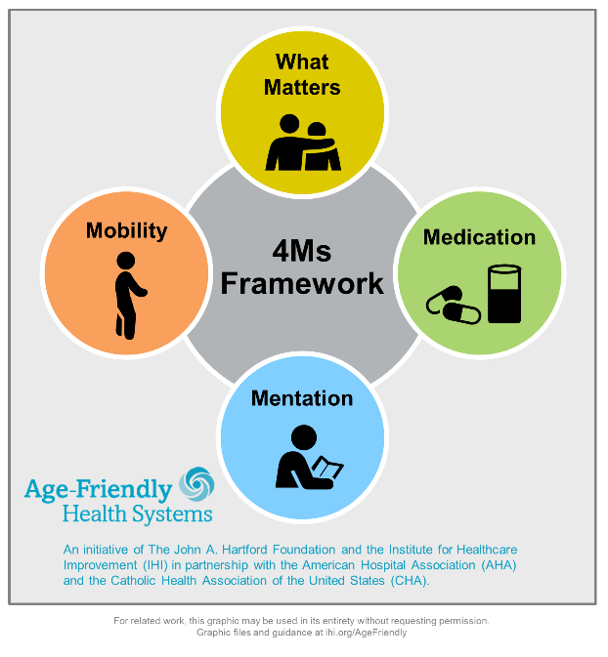
Learning Objectives
Define elder abuse, neglect, and exploitation
Identify risk factors for and signs of elder abuse, neglect, and exploitation
Describe legal responsibilities of healthcare professionals in reporting concerns for elder mistreatment
Utilize Adult Protective Services in cases of suspected abuse, neglect, and exploitation
Connect the 4Ms Framework to elder mistreatment

Slide 4
Mistreatment
“A single or repeated act, or lack of appropriate action, occurring within any relationship where there is an expectation of trust, which causes harm or distress to an older person.”

Slide 5
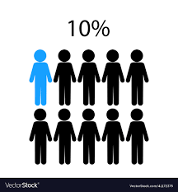
Incidence
No cognitive impairment: Cognitive impairment / dementia:
1 in 24 cases reported to authorities (WHO 2018)

Slide 6
Notes:
Poll Title: Do not modify the notes in this section to avoid tampering with the Poll Everywhere activity. More info at polleverywhere.com/support What forms of mistreatment have you encountered in your clinical practice? https://www.polleverywhere.com/multiple_choice_polls/EJ78WSehdWU8szVWAHq0d?state=opened&flow=Default&onscreen=persist

Slide 7
Up to 60% of physicians have never asked their older adult patients about mistreatment.
A study focused on Adult Protective Services cases indicated that physicians reported merely 1.4% of suspected cases.

Slide 8
*Neglect, emotional abuse, exploitation
>
physical abuse & sexual abuse
Mistreatment
Financial
Exploitation
Abuse
Neglect
Physical
Emotional
Sexual
Caregiver
Self
Physical
Medical
Mental
Health

Slide 9
Mistreatment
YOU!
Financial
Exploitation
Abuse
Neglect
Physical
Emotional
Sexual
Caregiver
Self
Physical
Medical
Mental
Health

Slide 10
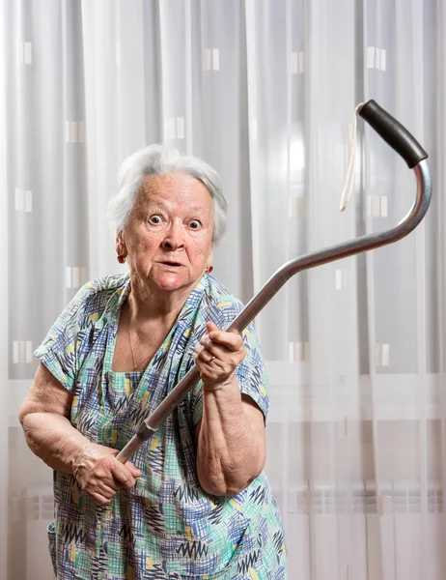
Risk Factors
Age
Female
Low socioeconomic status
Non-white race
Cognitive impairment
Decisional incapacity
Neuropsychiatric behaviors
(e.g., agitation, aggression)
Functionally dependent
Interpersonal violence
Traumatic events
Substance use
Long-term caregiving needs
Neuropsychiatric behaviors ... Manifestations of suffering

Slide 11
Caregiver Risk Factors
Known perpetrators: 60% are family members
Substance use
Mental health diagnoses
Financial dependence
Childhood abuse
History of violence
Excessive workload
Known perpetrators: 2/3 nursing home workers admit to mistreatment
In nursing homes:
Negative attitudes about aging / older adults
Low pay/status
Low morale

Slide 12
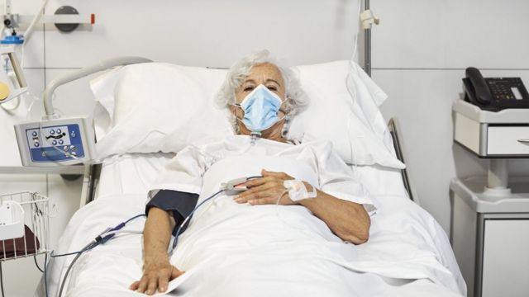
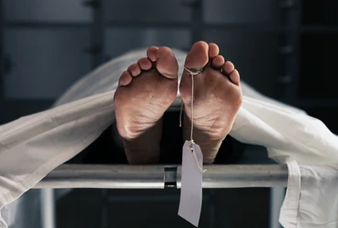
Consequences

Slide 13
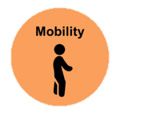
Physical Abuse
Definition Examples Signs
Intentional use of physical force against another, with or without an object, regardless of resultant harm
Pushing, shoving, kicking, hitting, slapping, hair pulling, restraining, force-feeding, burning, cutting, stabbing, shooting, scratching, biting
Implausible / inconsistent stories, injuries that are: defense, flexor, internal, head/face, non-extremity, object-shaped

Slide 14
Sexual Abuse
Definition Examples Signs
Intentional sexual contact against non-consenting or consent-incapable another, regardless of resultant harm
Rape, sexual assault, human trafficking, nudity, indecent exposure, photography, videography, touching, sexual advances, lewdness, flashing, quid pro quo
STIs, retained biologic material, behavior or mood changes, injuries to: oral cavity, genitals, buttocks/anus, breasts

Slide 15
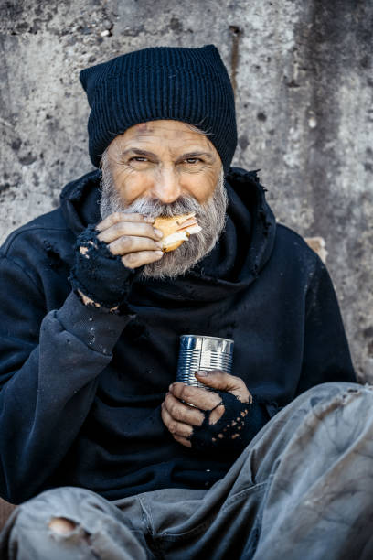
Case
Mr. Richard Blythe is an 83 year old widowed Caucasian male veteran who presents to the ED on a cold morning in January. He has diabetes mellitus, atrial fibrillation, and hypothyroidism.
His daughter’s family had video chatted with him for a virtual holiday dinner recently, but were alarmed to find him dressed in 3 jackets, unshaven, thinner, and confused.
Despite her ordering him a “ready-to-heat-and-eat” dinner, he was seen to be eating cold soup out of the can.

Slide 16
Notes:
Poll Title: Do not modify the notes in this section to avoid tampering with the Poll Everywhere activity. More info at polleverywhere.com/support Click on: Physical Neglect https://www.polleverywhere.com/clickable_images/UN37XmLgmMjDvjIH3gmeI

Slide 17
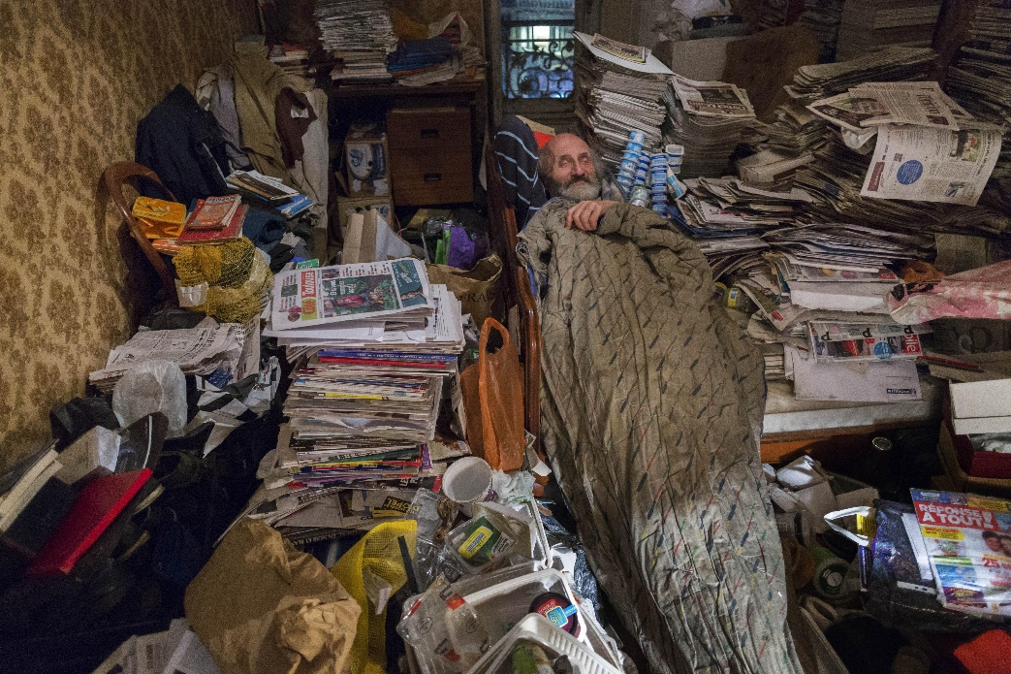
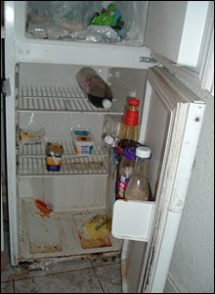
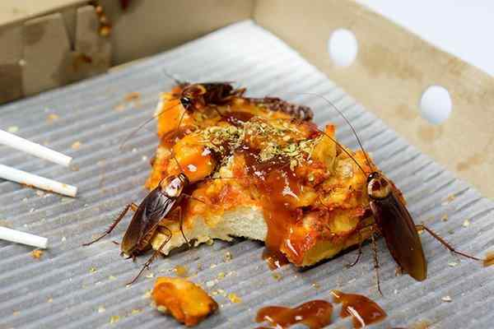
Case, continued
Concerned, his daughter flew to Houston to see her dad in person to see if she could help.
Upon arriving at his house, she found it to be cold and dark. Stacks of paper were noted on the coffee table, floor, and bed, some of which looked like 2nd Notices for unpaid bills.
There was minimal food in the refrigerator or pantry; the trash was very full. His pants were mildly stained around the groin. A few roaches were seen milling around old containers of take-out.

Slide 18
Notes:
Poll Title: Do not modify the notes in this section to avoid tampering with the Poll Everywhere activity. More info at polleverywhere.com/support Click on: Physical Neglect https://www.polleverywhere.com/clickable_images/uINGMBYUDiA1YRLlp0WQd

Slide 19
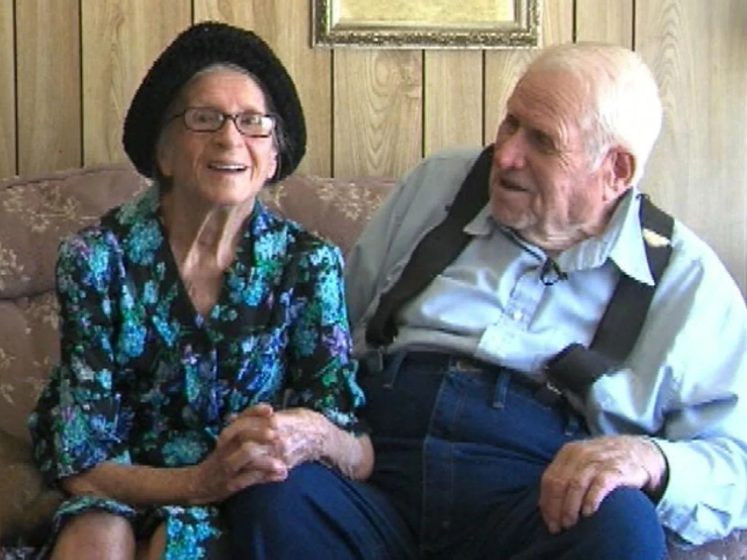
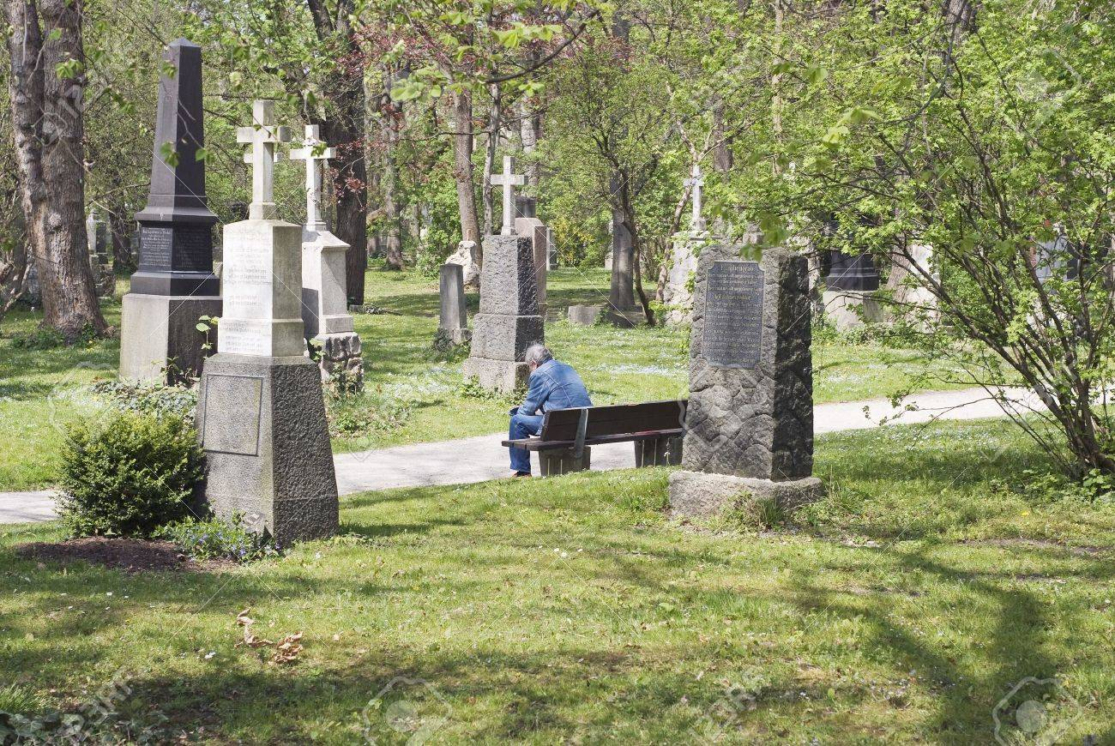
Case, continued
At the hospital, the daughter notes to the ED nurse that her father hasn’t been himself since his wife died of leukemia 5 months ago.
The patient agrees, tearfully shaking his head, saying he misses her, her “wonderful cooking,” and “having a partner during game night with friends”. He expresses that he is bored without her, and often feels hopeless, like his life is empty. He struggles to sleep because he “hears her voice at night”. He has started drinking “just two or three shots of whiskey nightly to fall asleep faster” as a result.

Slide 20
Notes:
Poll Title: Do not modify the notes in this section to avoid tampering with the Poll Everywhere activity. More info at polleverywhere.com/support Click on: Mental Health Neglect https://www.polleverywhere.com/clickable_images/XBVcKqGxmLNS6hUjHa4EH

Slide 21
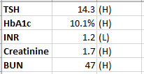
Case, continued
The nurse reviewing his medication box for comprehensive medication history notes it is still full, despite it being Tuesday. The patient shrugs, stating he “forgets sometimes” and “doesn’t see the point anyway” since he “doesn’t even know what the medications are for”. His last doctor visit was “before COVID”.
He doesn’t have his glasses or dentures with him and has long, dirty fingernails.

Slide 22
Notes:
Poll Title: Do not modify the notes in this section to avoid tampering with the Poll Everywhere activity. More info at polleverywhere.com/support Click on: Medical Neglect https://www.polleverywhere.com/clickable_images/RSnkcDIt7V8CFYngEtLVC

Slide 23
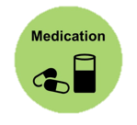
Self-Neglect: Physical, Medical, Mental Health
Definition Examples Signs
Not fulfilling care obligations of oneself resulting in risk of or actual harm, regardless of intent
Failure to arrange for adequate food, water, clothing, shelter, healthcare, hygiene, physical aids, safety (ADLs/IADLs)
Pressure injuries, poor dentition, contractures, unsafe home, inadequate hygiene/grooming, infestations/bites, cognitive changes, infrequent med usage, missed appts, failure to thrive, missing supplies, poor nutrition/H2O

Slide 24
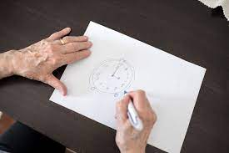
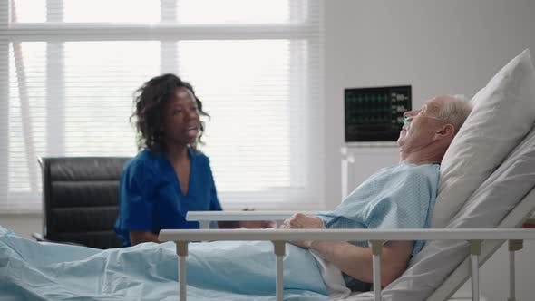
Case, continued
The ED physician calls for a Geriatric Medicine admission to the Acute Care for Elderly (ACE) unit.
Preliminary management is initiated, including cognitive testing.
Knowing that many types of mistreatment are connected, the ACE unit team decides to investigate the neglect further.

Slide 26
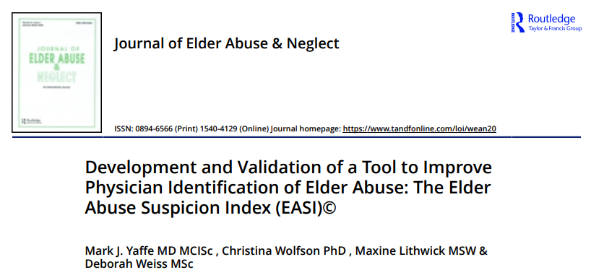
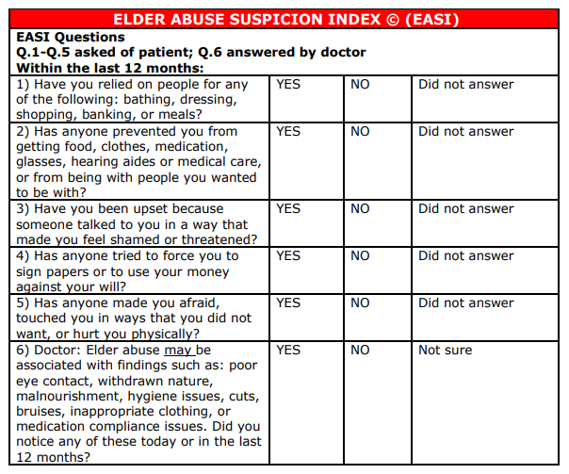

Slide 27
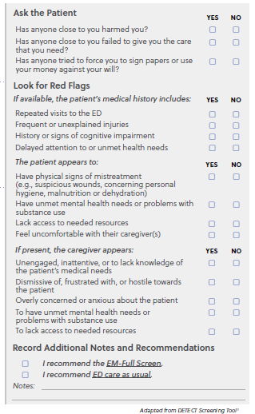
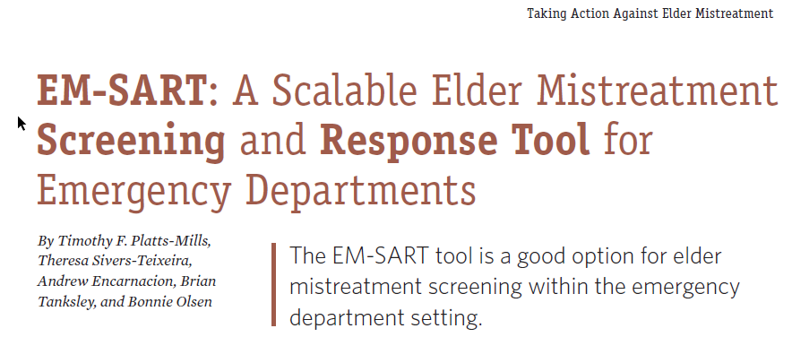
Screening Tools: EM-SART

Slide 28
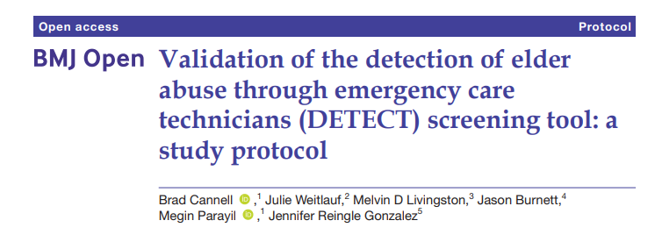
Screening Tools: DETECT

Slide 29
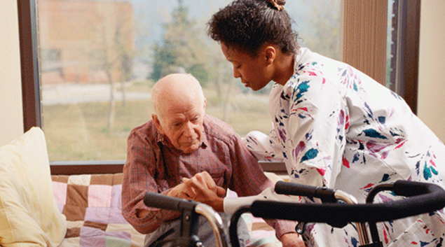
Case, continued
Concern is raised that he may not be safe to return home. The patient disagrees, but later accepts an in-home caregiver as a compromise after seeing his daughter become tearful and worried.
Mr. Blythe is discharged home after completing his IV antibiotics.

Slide 30
Case, continued
Initially, all seems well. Mr. Blythe enjoys playing checkers and doing crossword puzzles with his new caregiver, noting only that she has a “strong personality”.
Two weeks later, Mr. Blythe leaves a voicemail noting his caregiver was “too busy” to take him to the local senior center, and told him he “doesn’t need anyone” but the caregiver around. He sounds somewhat anxious and rushed, talking quietly before abruptly hanging up.

Slide 31
Notes:
Poll Title: Do not modify the notes in this section to avoid tampering with the Poll Everywhere activity. More info at polleverywhere.com/support Click on: Caregiver Neglect and/or Emotional Abuse https://www.polleverywhere.com/clickable_images/8XXFN0JcFrUG3YYeHbuL3

Slide 32
Emotional, Psychological, or Verbal Abuse
Definition Examples Signs
Intentional verbal / non-verbal action against another, regardless of resultant harm
Berating, harassing, intimidating, threatening action or inaction, infantilizing, isolating, manipulating, cursing
Changes in: behavior, mood, self-care, socialization, self-esteem, outlook

Slide 33
Caregiver Neglect & Abandonment
Definition Examples Signs
Not fulfilling care obligations of another resulting in risk of or actual harm, regardless of intent
Preventing appropriate access to food, water, clothing, shelter, healthcare, hygiene, physical aids, safety; leaving unattended
Stockholm Syndrome/clinginess to caregiver, healthcare distrust, treatment plan interference, financial dependence, troublesome caregiver personal history, isolating, severe punishments, infantilizing, manipulations

Slide 34
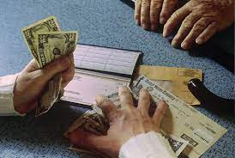
Case, continued
The daughter tries to call her father back, but cannot reach him for over a week as his caregiver always says he is busy, sleeping, or taking a shower. The phone is noted to be off the hook some evenings as well.
Review of Mr. Blythe’s bank account reveals three Zelle transfers to the caregiver for $225, $400, and $650 in the last two weeks with memos stating “to help you out” and “for your daughter’s condition”. His savings are dwindling.

Slide 35
Notes:
Poll Title: Do not modify the notes in this section to avoid tampering with the Poll Everywhere activity. More info at polleverywhere.com/support Click on: Financial Exploitation https://www.polleverywhere.com/clickable_images/U4Kq8y8ZQMT6q4uMBUnTs

Slide 36
Financial or Economic Abuse, Exploitation
Definition Examples Signs
Intentional improper or illegal use of another’s funds, assets, property, resources, belongings, regardless of resultant harm
Stealing, forgery, “skimming”, contractual coercion / alteration, unwanted POA, scams, fraud, threats of fiscal ruin, age-/disability-targeted financial manipulation, new lines of credit / loans
New/changed: self-care, legal documents, “friends” or “partners”, spending habits, credit score, POA, property ownership, missing items

Slide 37
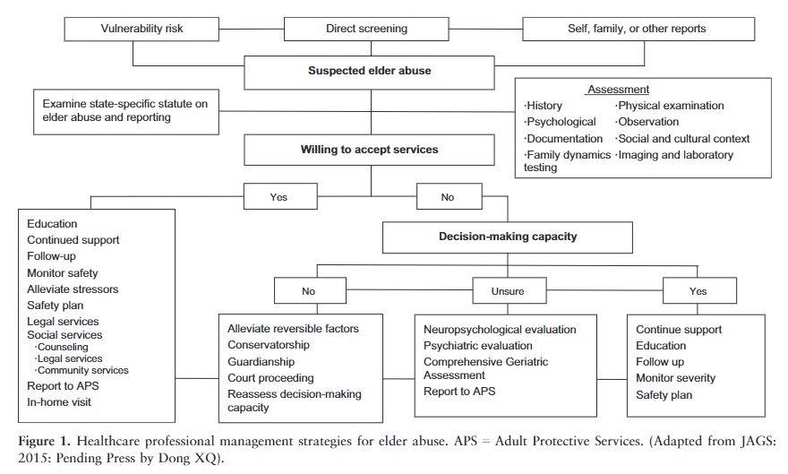

Slide 38
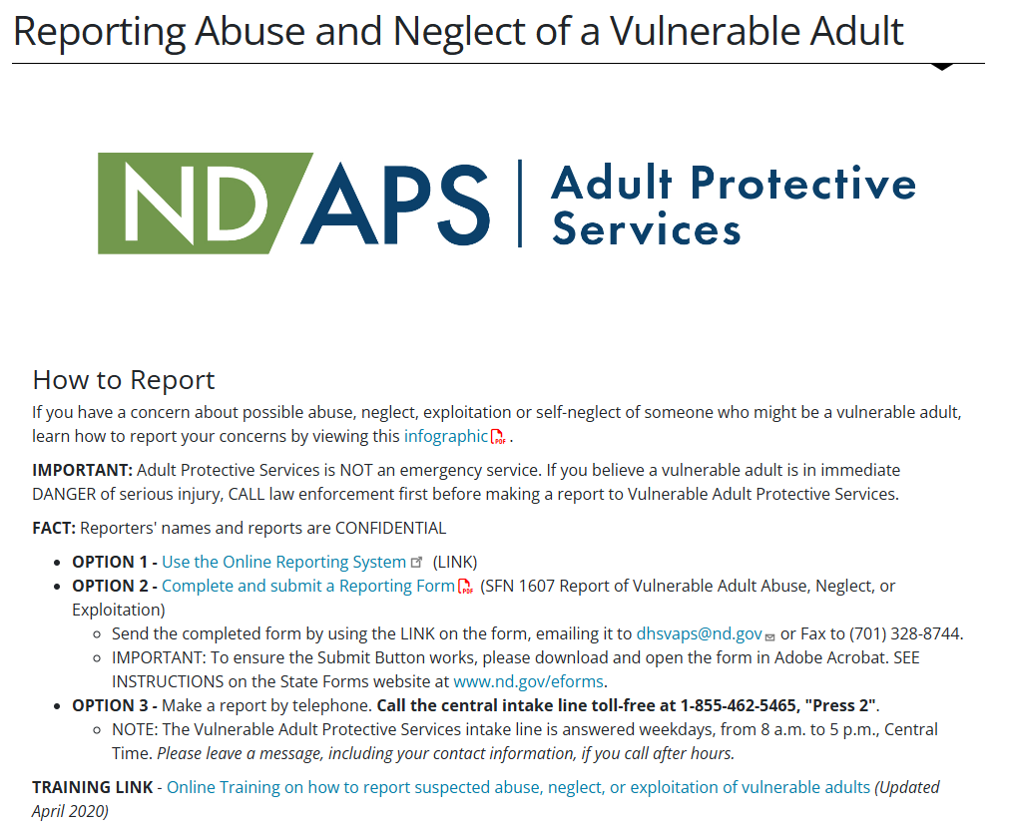
https://www.hhs.nd.gov/adults-and-aging/reporting

Slide 39
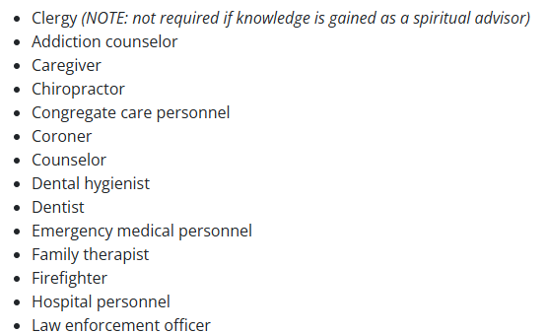
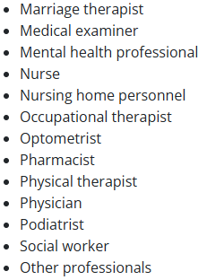
Mandatory Reporters
(…AND, ANYONE ELSE, TOO!)
Any person required to report who willfully fails to do so is guilty of an infraction and subject to a fine up to $1,000.

Slide 40
Summary
Mistreatment is pervasive and often missed
Mistreatment has obvious, but also subtle and insidious signs
Mistreatment is expensive to society (billions of dollars)
Risk factors exist for victims and perpetrators
Mentation and mobility matter a lot in older adults, because when those are lacking, an older adult may be at risk of not having access to medical care and things they enjoy … and at risk for mistreatment!
If you suspect it, report it! It’s the ethical and legal thing to do.

Slide 41
Additional References
“Definitions|Elder Abuse|Violence Prevention|Injury Center|CDC.” Centers for Disease Control and Prevention, Centers for Disease Control and Prevention, 28 May 2019, www.cdc.gov/violenceprevention/elderabuse/definitions.html.
“Elder Abuse.” World Health Organization, World Health Organization, 8 June 2018, www.who.int/news-room/fact-sheets/detail/elder-abuse.
Durso, Samuel C., and Gail M. Sullivan. Geriatrics Review Syllabus: a Core Curriculum in Geriatric Medicine. 9th ed., American Geriatrics Society, 2016, https://geriatricscareonline.org/toc/geriatrics-review-syllabus9th-edition/B023.
“Signs and Symptoms of Abuse.” Elder Abuse, Standford Medicine, elderabuse.stanford.edu/screening/signs.html.
“Texas Department of Family and Protective Services (DFPS).” Texas Adult Protective Services (APS), DFPS, www.dfps.state.tx.us/adult_protection/.
“Texas Estates Code 1002.017 – Incapacitated Person.” LawServer, LawServer, 2018, www.lawserver.com/law/state/texas/tx-codes/texas_estates_code_1002-017.
“Elder Abuse Statistics & Facts : Elder Justice.” NCOA, 15 June 2018, www.ncoa.org/public-policy-action/elder-justice/elder-abuse-facts/.
“Mandatory Reporting Requirements: The Elderly Texas.” RAINN, Mar. 2020, apps.rainn.org/policy/policy-state-laws.cfm?state=Texas&group=5&_ga=2.230623516.1662478575.1586195018-24979697.1586195018.

Slide 42
Questions?

