Slide 1
Atypical Presentations of Common Diseases in Older Adults
Donald a. Jurivich, do
Eva gilbertson distinguished professor of geriatrics
University of north Dakota smhs
Notes:
Why do we want to know about Atypical presentations ? 1. Often under taught, 2. common and 3. hard to recognize.

Slide 2
Goals
Report how symptoms may differ in older than younger adults
Recognize common illnesses that present differently in old relative to young adults

Slide 3
Usual script for understanding disease
Typical collection of signs and symptoms
Triad of wild, wet and wobbly for recognizing NPH
Pericarditis: sharp chest pain (95%) relieved with sitting or leaning forward, tachycardia, pericardial friction rub.

Slide 4
What is an atypical presentation ?
when an older adult presents with a disease state that is missing some of the traditional core features of the illness usually seen in younger patients.
May account for 20 – 50 % of disease presentations in older adults
Notes:
zM

Slide 5
Who is at risk for atypical presentations ?
Increasing age (especially age 85 years or older)
Multiple medical conditions (“multi-morbidity”)
Multiple medications (or “polypharmacy”)
Cognitive impairment
Residing in a care institution or functional dependency

Slide 6
Atypical presentations usually include one of three features
vague presentation of illness
e.g., generalized weakness or “I hurt all over”
altered presentation of illness
e.g., reflection of chest problems as abdominal discomfort or abdominal issues as upper torso complaints (right shoulder pain with GB disease)
Not reporting illness and attributing to old age
i.e., under reporting

Slide 7
What are clues for atypical presentation ?
Change in
Behavior
Function
Cognition

Slide 8
What are the consequences of not understanding atypical presentations ?
Provider perspective:
worse outcomes
missed diagnoses
missed opportunities for treatment

Slide 9
What are the consequences of not understanding atypical presentations ?
Patient perspective:
Lack of knowledge (eg., MI mistaken for indigestion)
Social factors (it will pass, don’t bother others)
Dependency and Lack of caregiver
Lack of transportation,
Fear of being hospitalized,
Risk of losing independence

Slide 11
Five common disease states in which atypical presentations may be seen
Infections
Cardiovascular disease
Acute abdomen
Hyperthyroidism
Depression

Slide 12
Infections: general differences
Typical
Atypical
Fever
Chills
Sweats
Afebrile
Altered mental status
Dehydration

Slide 13
Urinary Tract Infections (UTI)
Typical
Atypical
Dysuria
Frequency
Urgency
Suprapubic pain
+ / - bloody urine
Worsening incontinence
Apathetic / Confusion / delirium
Increased nocturia
Lack of well being / change in function
Falls
Urinary tract infections in older women: a clinical review. JAMA. 2014 Feb;311(8):844-54

Slide 14
Diagnosis of UTI
positive urine culture (≥10⁵ CFU/mL)
no more than 2 uropathogens
pyuria (≥10 leukocytes/microL or + leukocyte esterase or nitrites* )
WBC casts = upper urinary tract infection
* 75% sensitive, 82% specific for UTI

Slide 15
Note
Cranberry juice does not prevent or treat UTI’s

Slide 16
Pneumonia
TYPICAL
ATYPICAL
Fever
Cough (dry or productive)
Dyspnea
Pleuritic pain
Chills / Rigors
Non febrile
Abdominal pain
Confusion
Tachypnea
+ / - Tachycardia

Slide 17
Pneumonia Tests
ATYPICAL
TYPICAL

Slide 18
Pneumonia signs
TYPICAL
ATYPICAL
Fever
Increased RR
Reduced O2 sat
Tachycardia
Elevated WBC
Elevated CRP (50 – 100 mg / dL)
Afebrile or 2ºF elevation
Normal to high normal RR
Reduced O2 sat
Hypo or hyperactive delirium
Notes:
In the 133 included patients (median age, 83 years [interquartile range: 78-89]), one-year mortality was 26%. In univariate analysis, the relative difference of CRP levels had the highest area under the receiver operating characteristic curve (0.70; 95% confidence interval [CI] 0.60-0.80). A decrease of CRP levels of more than 67% between admission and discharge had 68% sensitivity and 68% specificity to predict survival.

Slide 19
Pneumonia in older adults
Drivers of tachypnea are reduced with age
Respiratory rate may not increase until respiratory failure (low O2, high CO2 or both)
Dehydration may preclude sputum production
May not auscultate egophony or feel vocal fremitus

Slide 20
COVID19
TYPICAL
ATYPICAL
Fever
Sore throat
Cough
Coryza
Loss of appetite
Abdominal discomfort
Conjunctivitis
Falls / syncope
Confusion

Slide 21
Case report
91F who resides in a nursing home with moderate dementia, falls, diabetes, peripheral neuropathy, hypertension and generalized osteoarthritis is found by the nurse at dinner time lying in bed. She is arousable but wants to be left alone. She states that she is not hungry because she has a stomach ache and is tired.

Slide 22
What additional evaluations should the RN do ?

Slide 23
Suggested tests when hypo – active delirium is suspected
Vitals signs, including orthostasis, temperature, pulse ox, and glucometer
Confusion Assessment Method
Request tests for U/A, Covid, Flu and RSV, chem panel, CBC
Oral or subcutaneous hydratation

Slide 24
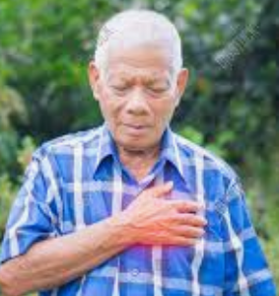
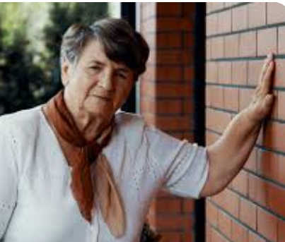
Heart disease
TYPICAL
ATYPICAL
68 M smoker and HL
78 M past smoker, COPD, DMII
Central chest pain
Radiation to left arm
Crushing sensation
+ / - diaphoresis
Malaise, feeling unwell
More short of breath
Epigastric pain
Pale

Slide 25
Acute abdomen
TYPICAL
ATYPICAL
severe pain,
diminished or absent bowel sounds
tender firm abdomen
vomiting
fever
change in appetite
mild or no discomfort
constipation
mild tachypnea, and possibly some vague respiratory symptoms
Hypoactive bowel sounds

Slide 26
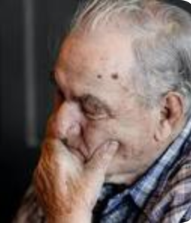
Depression
TYPICAL
ATYPICAL
Low mood, sad, hopelessness
Possible suicidal thoughts
Psychomotor slowing
Sleep disruption
Anhedonia
Unexplained pain or physical complaints (somatization)
Outbursts, Anger, Agitation
Poor appetite
Disinterest
Guilt
Notes:
Older adults tend to pyschosomatacize

Slide 27
Case Report
87M comes to clinic for annual wellness visit. He lost his wife 6M ago. He lives alone now and his adult children live in other cities. They see him during the holidays. He is independent in ADLs and IADLs. He has lost 5 pounds and is worried that he might have cancer. He thinks it might be prostate cancer because he has problems urinating and his back hurts him.

Slide 28
What additional information would you like to know ?

Slide 29
Case Report
PHQ2 screen positive
ALONE scale for loneliness is positive
PHQ9 score is 12 with no suicidal ideation
Weight is 3 pounds less than last year
Back pain had been reported chronically
Medication review indicates that patient stopped finesteride

Slide 30
Hyperthyroidism
TYPICAL
ATYPICAL
Tachycardia
Tremor
Anxious
Lethargy
Depressed mood
Confusion
Weight loss

Slide 31
Case Report
67F with HTN and seasonal asthma presents with 1-week symptom of dyspnea on exertion. She could not tolerate climbing 1 flight of stairs or walking 3 blocks. On review of systems, she reported swelling of her lower extremities, orthopnea, and paroxysmal nocturnal dyspnea. She also noted a 20-lb weight loss over 3 months.

Slide 32
Case report
BP 132/81 mm Hg, HR 103 beats/min, RR 18 breaths/min,
O2 100% on room air.
Physical examination: enlarged thyroid gland and bilateral lower-extremity pitting edema up to the shins.

Slide 33
What is your opinion ?
Hypothyroidism
Hyperthyroidism
New onset heart failure
Asthma exacerbation
Pulmonary embolism

Slide 34
What tests would you like to order ?
Echocardiogram
Pulmonary Function
CBC
Chemistry
D dimer
Troponin
TSH
Free T4
B - ANP
Chest X ray
Lower extremity Doppler
V/Q Scan

Slide 35
Lab Tests
 | Before Methimazole Initiation | 6 Months on Methimazole | Normal Range
Free triiodothyronine, pmol/L | 16.2 |  | 4–7.4
Free thyroxine, ng/dL | 2.92 | 0.94 | 0.8–2.8
Thyroid-stimulating hormone, μIU/mL | <0.05 | 4.52 | 0.35–5.0
PASP, mm Hg | 64 | 30 | <35
mPAP, mm Hg* | 41 | 20 | <20
Thyroid-stimulating immunoglobulin, % | 204 |  | <140

Slide 36
Key points
Apathetic Hyperthyroidism
TSH alone can provide the diagnosis
Majority of cases autoimmune versus cancer
Pulmonary hypertension is unique
Highly responsive to therapy

Slide 37
Summary
Atypical manifestation of disease in late life is common
If there is a change in cognitive or physical status, think about common but atypically presented diseases
The brain is the most sensitive sensor of change in health in older adults

Slide 38
Questions
A 73 year old woman reports increasing tiredness and episodic palpitations with a “racing heart”. Your first concern is:
Hypothyroidism (under active thyroid)
Hyperthyroidism (over active thyroid)
Depression
Atrial fibrillation

Slide 39
Questions
2. Common diseases in older adults that present differently than middle aged adults are often referred to as
Disease outliers
Somatizations
Atypical presentations
Munchhausen Diseases

Slide 40
Questions
3. A nursing home resident falls and is confused. This presentation should prompt thoughts about:
Covid19 infection
Urinary tract infection
Pneumonia
All of the above

