Slide 1
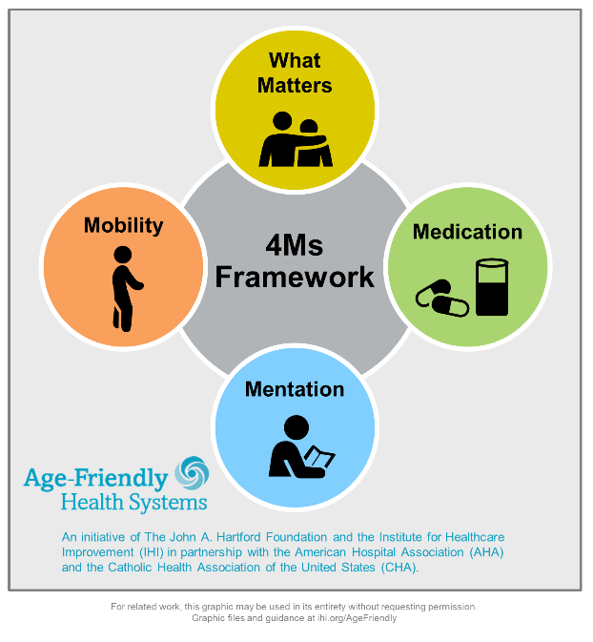
what Matters Most
Lindsey Dahl MD, FACP

Slide 2
objectives
-Understand the difference between ACP, POLST, CODE status
-realize the importance of end of life conversations, the why?
-learn tips on navigating these conversation
-digging deeper into aligning care with what matters
-resources for furthering your knowledge

Slide 3
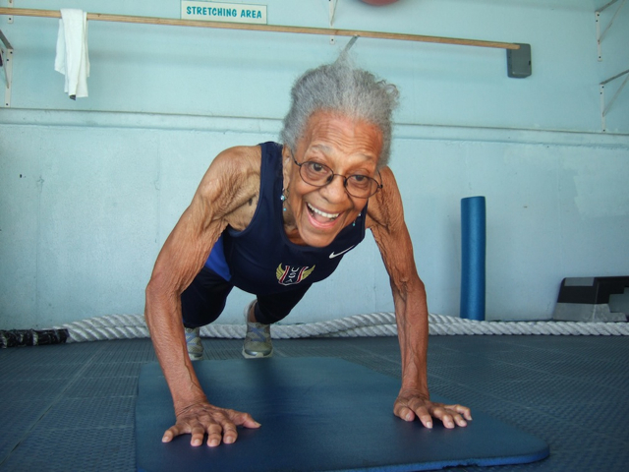
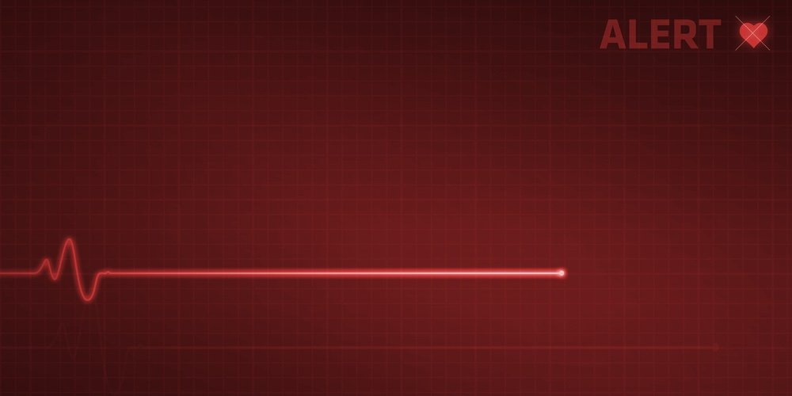
What is death: dr. BJ miller https://www.nytimes.com/2020/12/18/opinion/sunday/coronavirus-death.html
no heartbeat and no breathing, which is obvious enough, or no brain function, which requires an electroencephalogram.
For some of us, death is reached when all other loved ones have perished, or when we can no longer think straight, or go to the bathroom by ourselves, or have some kind of sex; when we can no longer read a book, or eat pizza; when our body can no longer live without the assistance of a machine; when there is absolutely nothing left to try. Maybe the most useful answer I ever came across was the brilliant professor who instructed his daughter that death was what happened when he could no longer take in a Red Sox game.
So, again, what is death? Talking about and around it may be the best we can do, and doing so out loud is finally welcome. Facts alone won’t get you there. We’re always left with the next biggest question, one that is answerable and more useful anyway: What is death to you? When do you know you’re done? What are you living for in the meantime?
We do have fuller ways of knowing. Who doubts that imagination and intuition and love hold power and capacity beyond what language can describe? You are a person with consciousness and emotions and ties. You live on in those you’ve touched, in hearts and minds. You affect people. Just remember those who’ve died before you. There’s your immortality. There, in you, they live. Maybe this force wanes over time, but it is never nothing.

Slide 4
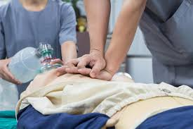
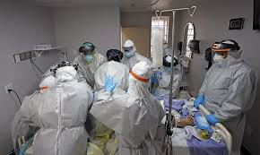
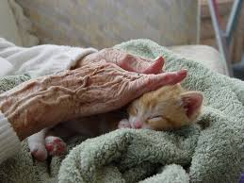
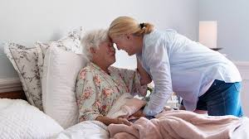
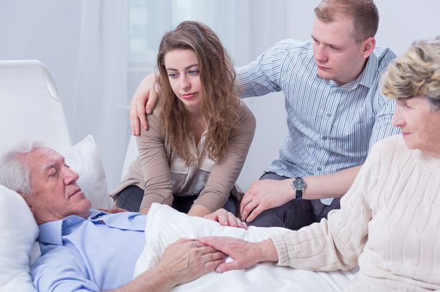
Where do Americans die?
Studies have shown that approximately 80% of Americans would prefer to die at home, if possible. Despite this, 60% of Americans die in acute care hospitals, 20% in nursing homes and only 20% at home. A minority of dying patients use hospice care and even those patients are often referred to hospice only in the last 3-4 weeks of life. However, not every patient will want to die at home. Dying at home is not favored in certain cultures (due to cultural taboos) and some patients may wish not to die at home, out of concern that they might be a burden on the family. Still, it is clear that fewer patients are dying at home than want to do so.

Slide 5
Many people still die in hospitals
If most people do not want to die in hospitals, why are so many deaths in this country still occurring there? There are probably a number of reasons, including:
Death is often unpredictable. Many inpatient deaths occur after long admissions that begin with what seems to be a treatable problem.
An overestimation of the ability of medical care to cure incurable illness or reverse setbacks.
A lack of alternatives. In many parts of the country, dying patients are stuck in the hospital because they need more care than they can get at home and have nowhere else to go.
The “culture” of medicine and availability of medical care. Medical training teaches doctors to diagnose and treat illness, but until recently, trainees learned little about when treatment is futile or how to de-escalate treatment. In addition, studies suggest that more aggressive, inpatient medical care tends to be offered in places where there are more specialists and more hospitals. Doctors may encourage patients to have inpatient treatment with little chance of changing the long-term outcome, perhaps due to an overly optimistic view of the prognosis.
Medical error or “misadventure.” Critically ill individuals have limited capacity to tolerate the downsides of medical treatment, such as side effects or medical errors.
A healthcare system focused on the short term. For example, Medicare will cover inpatient care for a person who has had a stroke. But if that patient preferred to stay at home, care at home would not be covered even though it would be much less costly.

Slide 6
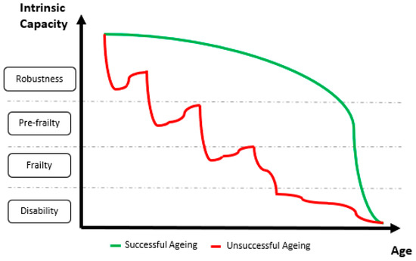
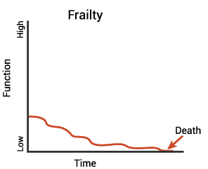
Majority of us will spend the last 4 years of our lives requiring help with at least 1 ADL (dressing, toileting, bathing, eating)
Notes:
Most people are living 2-5 years requiring at least help with 1ADL before death (bathing, dressing, eating, toileting)

Slide 7
Why? Patient examples
Transitions of care –fragmented
Cant make decisions when cognitive problems present
Increased responsibility on family and caregivers
Wishes are not honored if not documented

Slide 8
Language matters
Geripal podcast The language of serious illness ie NEED (if her breathing gets any worse, she will need to be intubated). (She needs to be put on a ventilator or she will die today)
Jama: Reconsidering the language of serious illness
The hidden harms of CPR in the new Yorker by Sunita Puri
Should your heart stop beating do you want CPR to restart it?
Unrealistic success: A mere two per cent of adults over sixty-seven with severe chronic disease, including cancer, are alive six months after CPR, and they often deal with pain, physical debility, and post-traumatic stress disorder. Reversing a death is not the same as restoring a life.
Unrealistic onscreen portrayals: The result, done correctly, is akin to assault. The force of compressions can shatter ribs and breastbones, puncture lungs, bruise the heart, and cause major blood vessels to rupture. Repeated electrical shocks can burn flesh. Even if the procedure restores a heartbeat, brain damage—whether mild memory loss or a vegetative state—occurs in forty per cent of hospitalized patients.

Slide 10
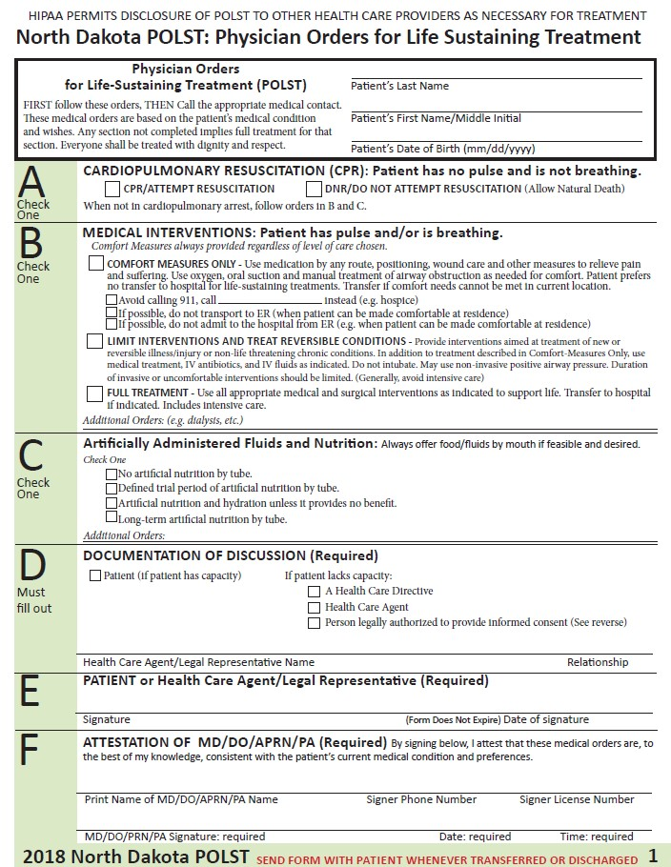
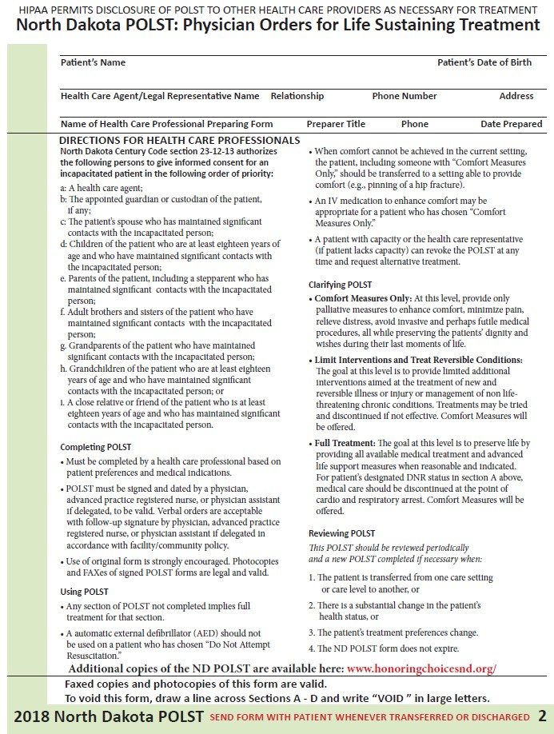
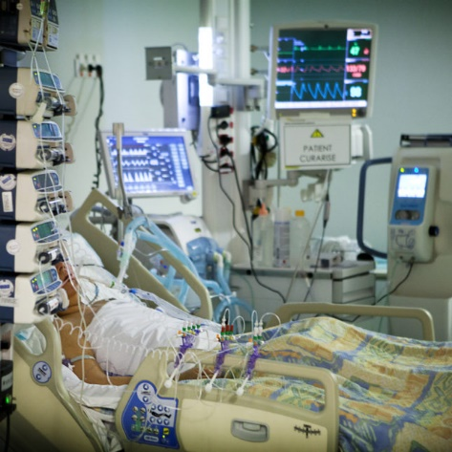
POLST FORM

Slide 11
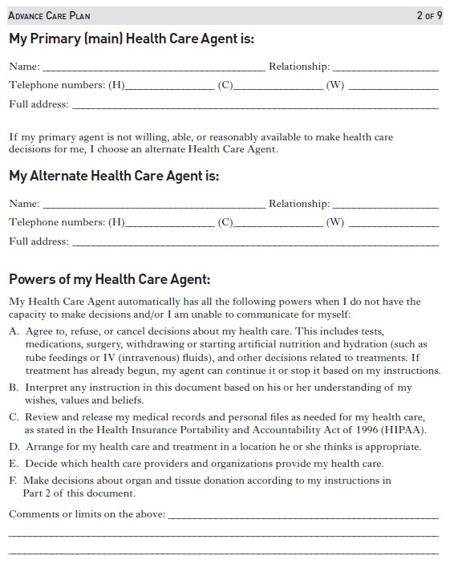
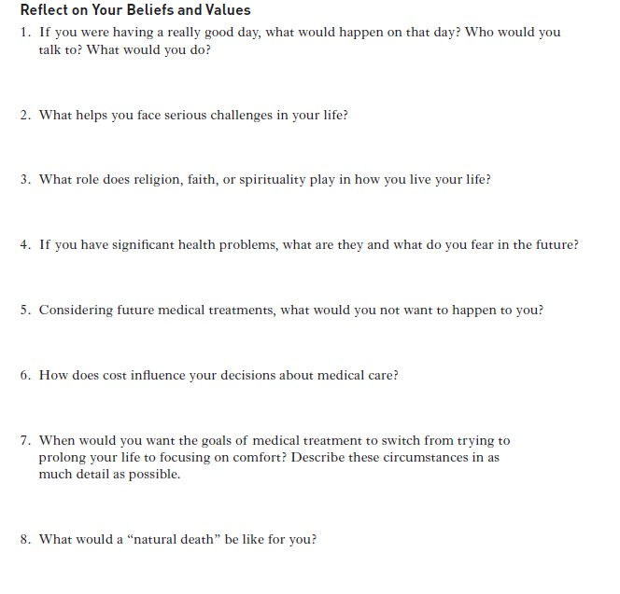
Advanced Care Plan

Slide 12
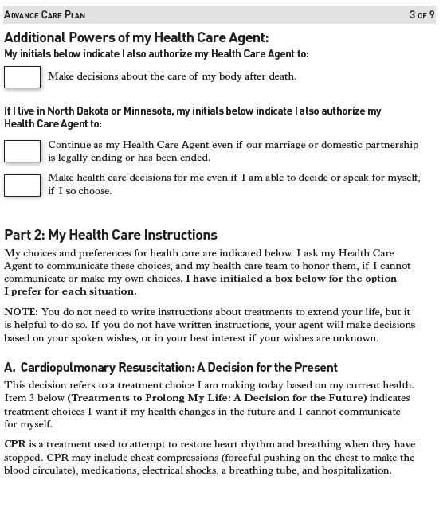
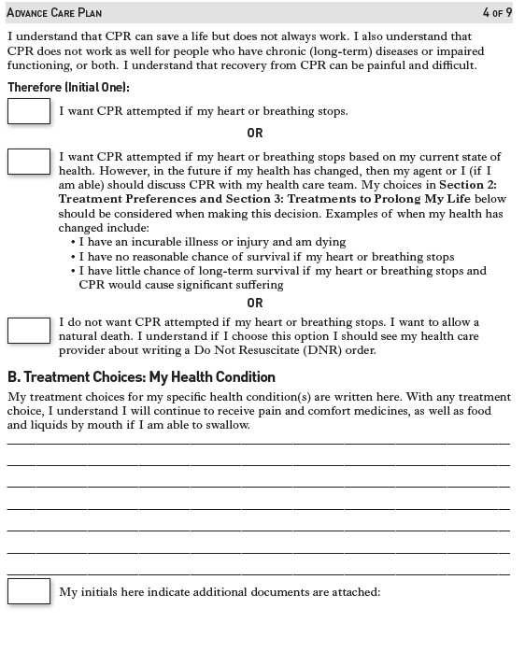

Slide 13
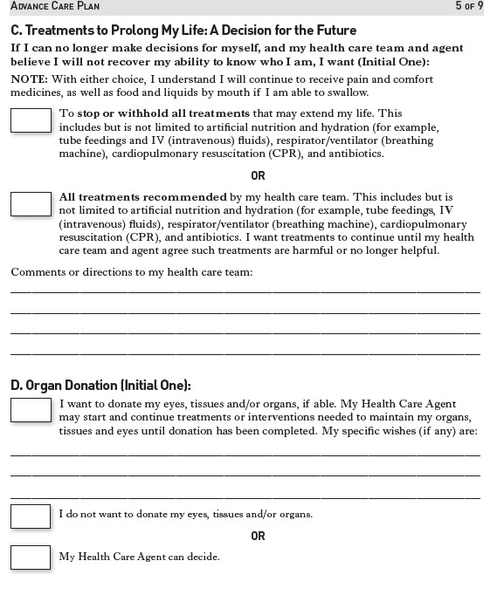
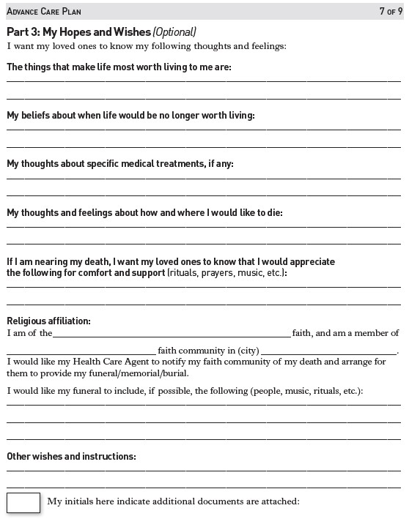

Slide 14
Tips for conversation starters
What matters most to you?
What makes life worth living?
What brings you joy each day?
What are you willing to live without, and still feel life is worth living?
What are your biggest fears and concerns?
What is your understanding of the current situation, and potential outcomes?
What goals are most important to you?
What tradeoffs are you willing to make, and which are you not?

Slide 15
Positive outcomes: when wishes are honored

Slide 16
Patient examples: Digging Deeper into what matters most
Pt is 85y/o wm with h/o chf, copd, gi bleeds..
What matters- to live for 2 years when my grandson gets back from Japan
Still DNR/no invasive procedures but willing to push medications/treatment and not feel good now in effort to live
Pt is 86y/o wm with h/o chf, copd, dm…
What matters- to have energy to play cards with my buddies 2 days a week
Weaned medications in effort to feel the best today even if may decrease length of life

Slide 17
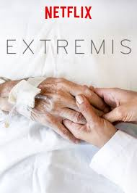
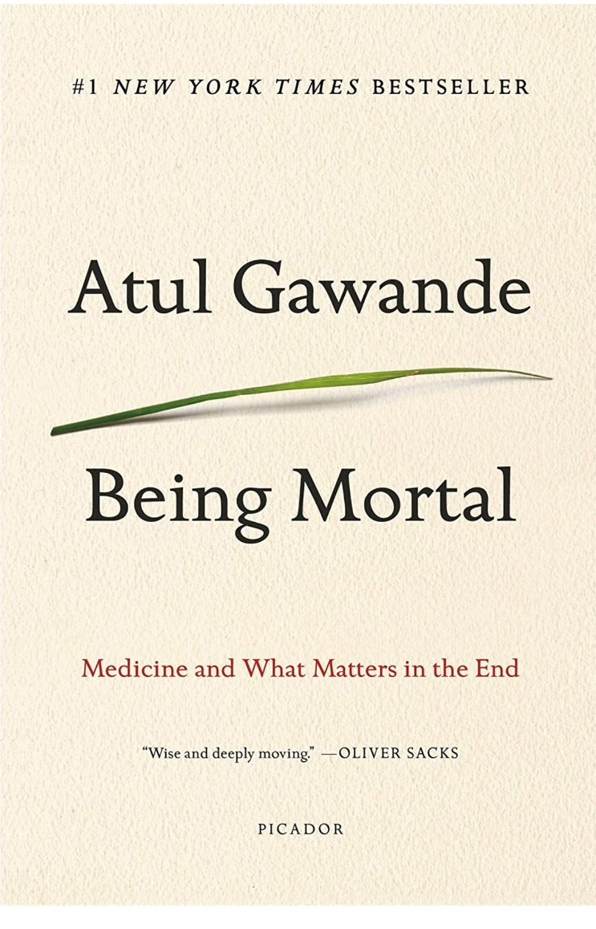
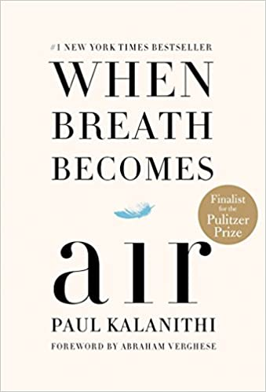
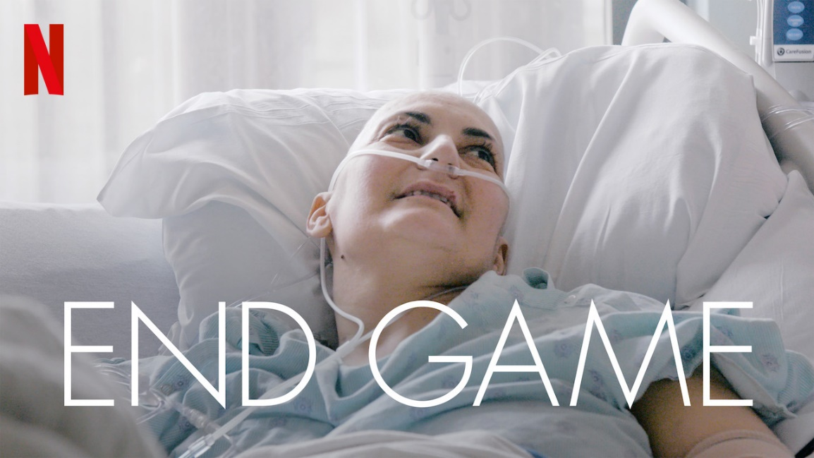

Slide 18
resources
Patientprioritiescare.rg
http://www.ihi.org/resources/Pages/Tools/Conversation-Ready-Toolkit-for-Clinicians.aspx
https://www.youtube.com/watch?v=apbSsILLh28 –ted talk
https://theconversationproject.org/
Netflix: Documentaries Extremis and End Game
https://www.honoringchoicesnd.org/
https://polst.org/
https://www.capc.org/ center to advance palliative care
https://www.pbs.org/wgbh/frontline/film/being-mortal/

