Slide 1
Prognostication

Slide 3
Goals
Understand why prognosis is important to provider – patient shared decision making
Report trajectories for Functional and Absolute Life Spans
Estimate remaining life expectancy

Slide 4
Case report
92M arrives to clinic for surgical clearance entailing a left knee replacement. He looks younger than his stated age and is functionally independent. He has advanced systolic heart failure and severe degenerative osteoarthritis attributed to contact sports in college.
The surgical risk calculator indicates a 10% peri – operative mortality rate.
How does this prognostic index influence the clinical conversation ?

Slide 5
What is prognostication ?
Predict with a high level of certainty that a particular outcome will occur.
Dorina Pantea

Slide 6
Examples
Time to death
Time to significant functional decline
Evard Munch

Slide 7
Why prognosticate ?
Helps inform patient goal setting
Promotes shared decision making
Winslow Homer

Slide 8
Prognostic skills
Understand factors that impact average life expectancy
Effective communication
Understand the potential value versus futility of diagnostic or therapeutic interventions

Slide 9
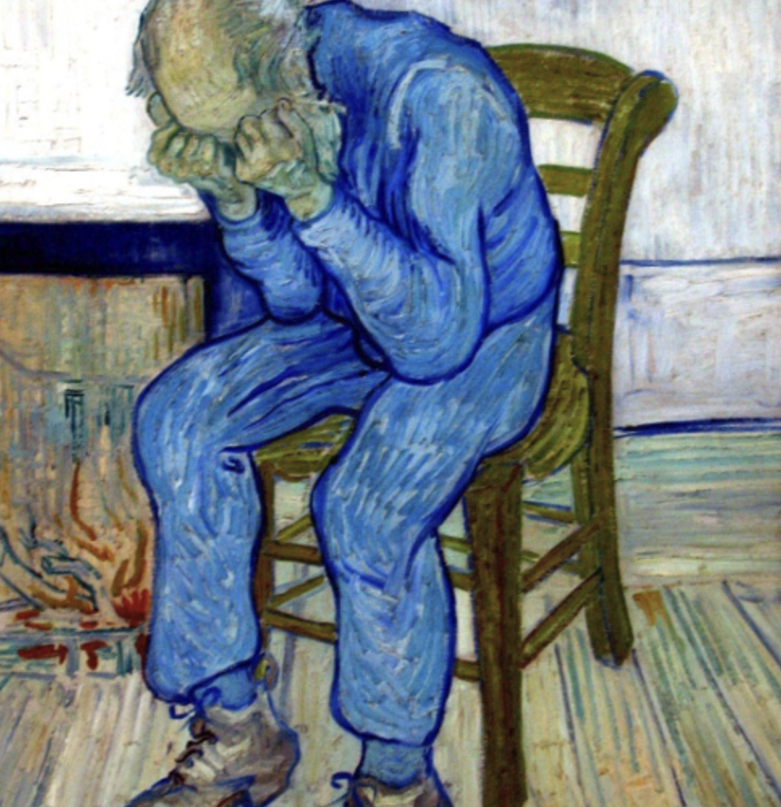
Prognosis can impact health care decisions
Examples:
Life sustaining treatments when there is no hope
Discontinuation of cancer screening
Van Gogh

Slide 10
Health care decisions by patients and their family members depend on data
Example: older veterans told that cardiac arrest in VA hospitals has less than 1% survival.
With this information, the number of patients wanting CPR after a cardiac arrest went from 41% to 22%

Slide 11
Time frames for decision making
< 6 months life expectancy for hospice benefits
< 5 years of remaining life expectancy to suspend health screening
Charles Emile Champmartin
Notes:
Questions arise as to whether the older adult will survive long enough to benefit from therapeutic interventions or diagnostic tests.

Slide 12
Provider – patient discussions go beyond discussions about life expectancy
Understanding of functional recovery
Length of time to maintain independence
Ability to achieve life milestones (e.g., family member’s wedding or birth)
Henri Rousseau

Slide 13
Consider the lag time of an intervention
Will intervention improve quality of life and for how long ?
Could the intervention cause harm ?
Winslow Homer

Slide 14
Barriers to prognosis
Provider discomfort
Lack of knowledge
Topic avoidance due to time factor or not wanting to be purveyor of bad news
Patient avoidance
“Don’t provoke the death spirit”
Resentment of doctors playing “god”
Cultural norms to accept “God’s will” over medical precedant

Slide 15
Estimating prognosis
4 Methods
Clinical judgement
Age – based life expectancy
Published studies
Prognostic indices
Chuck Close

Slide 16
Clinical judgement
Based upon experience
Understanding of patient’s response or lack of response to therapies
Often biased towards overly optimistic prognosis

Slide 17
Age-Based Life Expectancy
Tables of Average life expectancy based on current age
Lots of heterogeneity among older adults
Use “quartile” tables to distinguish between healthy and least healthy

Slide 18
Quartiles of Life Expectancy from National Vital Statistics Report
Women
Men
Age | 75th | 50th | 25th |  | 75th | 50th | 25th
60 | 26.9 | 21.2 | 14.2 |  | 24.3 | 18.3 | 11.4
70 | 22.2 | 16.9 | 10.7 |  | 19.8 | 14.4 | 8.5
75 | 17.8 | 12.9 | 7.6 |  | 15.6 | 10.8 | 6.0
80 | 13.6 | 9.3 | 5.1 |  | 11.8 | 7.7 | 4.0
85 | 9.9 | 6.3 | 3.2 |  | 8.5 | 5.2 | 2.5
90 | 6.9 | 4.1 | 1.9 |  | 5.9 | 3.4 | 1.6
95 | 4.7 | 2.6 | 1.2 |  | 4.1 | 2.3 | 1.0

Slide 19
Reference to published studies
Survival data from oncology studies
Limitation: older adults are rarely include in clinical studies

Slide 20
Prognostic indices
Risk of stroke from atrial fibrillation (CHADS2)
Pressure ulcer risk (Braden Scale)
Fall risk (Berg Scale)
Seattle Heart Failure index
ePrognosis
Salvador Dali

Slide 21
Dementia
FAST Scale ( > stage 7a for hospice )
Advance Dementia Prognostic Tool (ADEPT)
10 -12 years life expectancy after diagnosis
Extra-pyramidal symptoms reduce life expectancy to 8 – 9 years

Slide 22
Cancer
Moving target with new therapies and biologics
Functional status often predicts prognosis
Diego Rivera

Slide 23
Heart Failure
Prognostic tools: Seattle Heart Failure Model and EFFECT
Hospitalization frequency and functional status predicts death
Frieda Kahla

Slide 24
COPD
BODE Index: based on wt, FEV1, dyspnea score, and 6MWT

Slide 25
End – stage Renal Disease
Dialysis (75+)
1 YR survival 59%
5 YR survival 13%
Nursing home placement accelerates mortality

Slide 26
Caveats
Can not compare indices from community dwelling to nursing home bound older adults
Race and gender differences
Wealth and other Social Determinants of Health

Slide 27
Communicating Prognosis
Evaluate patient
Understanding
Readiness
Expectations
Emotional IQ
Katsushika Hokusai

Slide 28
SPIKES mnemonic for delivering bad news
6 step, structured protocol
Susanne Odelskog

Slide 29
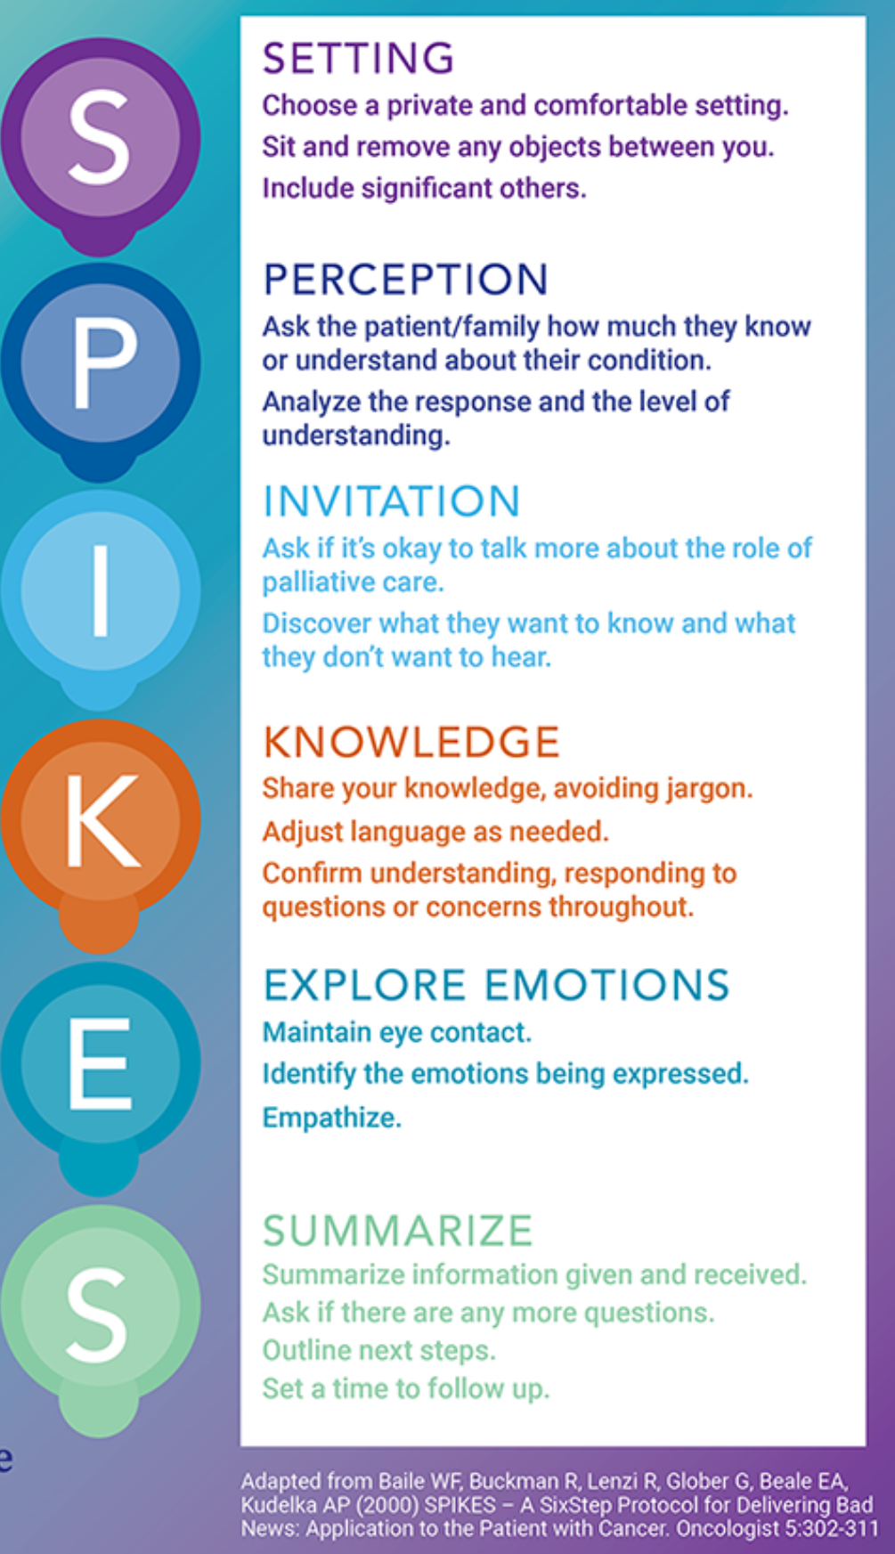

Slide 30
Prognosis and Population Health

Slide 31
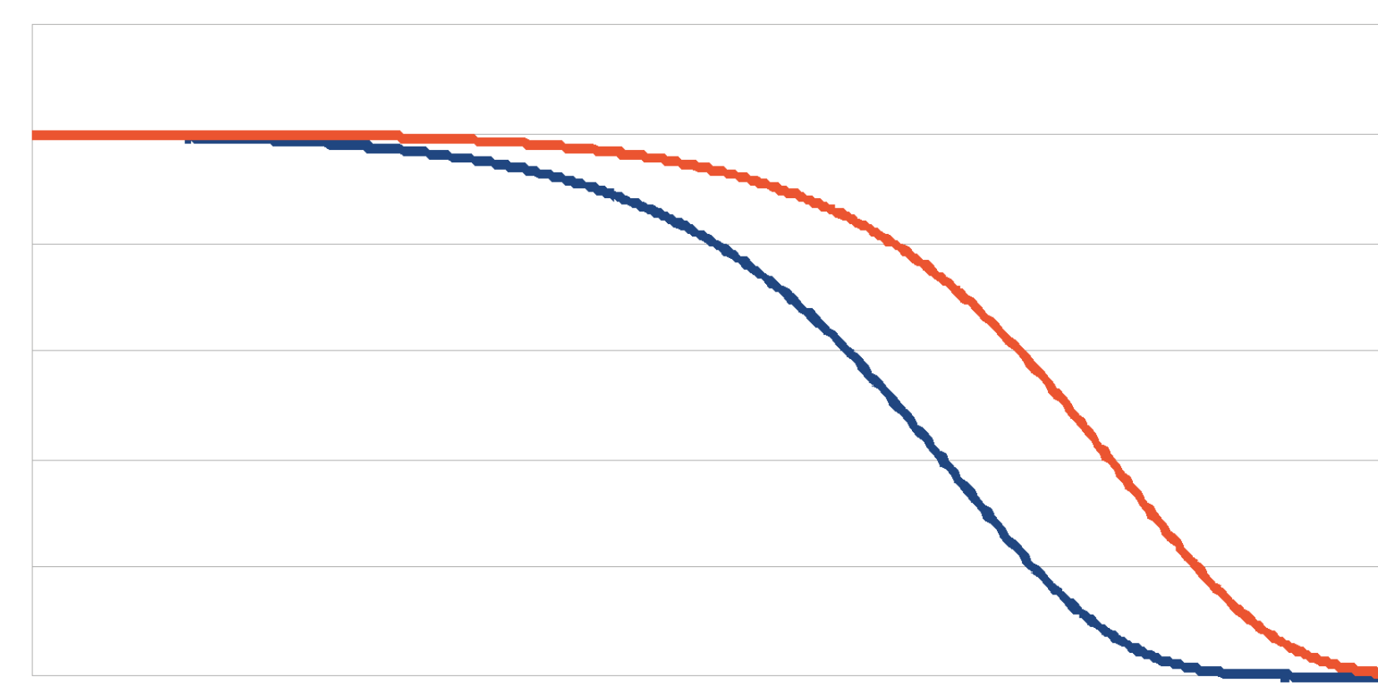
Absolute life span
Functional Life Span
AGE

Slide 32
Biological versus Chronological Age

Slide 33
Help improve the prognosis for healthy lifespans
Food as medicine
Mobility Plan
Socialization / belonging
Purpose

Slide 34
Summary
Engage older adults with What Matters Most to them in the context of their prognosis
Use lifespan tables (CDC and Vital Stats)
When appropriate, use chronic disease indices
SPIKE mnemonic for conveying bad news
Champion healthy lifespans

Slide 35
Resources
Vital statistics
ePrgonosis web site
Dakota Geriatrics web site

