Slide 1
Delirium

Slide 2
Goals
Define the different types of delirium
Recognize delirium risk factors
Report impact of delirium on patient outcomes
Demonstrate how to assess delirium
Prevent and manage delirium

Slide 3
Definition (DSM-5):
a disorder of attention and awareness that develops acutely and tends to fluctuate
“Acute Brain Failure”
“Attenuated Delirium” is persists for weeks - months
Notes:
Girard TD, Thompson JL, Pandharipande PP, et al. Clinical phenotypes of delirium during critical illness and severity of subsequent long-term cognitive impairment: a prospective cohort study. Lancet Respir Med 2018; 6: 213-222. doi: 10.1016/S2213-2600(18) 30062-6.

Slide 4
Delirium
3 types: hypoactive, hyperactive, and mixed
(can cycle through repeatedly)
Under-diagnosed
Potentially PREVENTABLE (30 – 40 %) and REVERSIBLE

Slide 5
Why does delirium occur ? Pathophysiology
Multi-factorial
Cholinergic deficiency
Acute inflammation
Elevated serum S-100B, TNF, CRP, IL1 IL6
Notes:
Anti cholingeric drugs precipitate delirium (atropine, scopolamine) as well as drugs with anti – cholinergic attributes such as diphenhydramine, opioids and anti depressants

Slide 6
Risk factors
Main factors
Other factors
Age
Medical complexity
Dementia
Functional impairment
End of life
Hospitalization
Medication profile
Alcohol excess / withdrawal
Sensory impairment
Male gender
Depressive symptoms
Bed rest
Restraints / indwelling devices
Pain

Slide 7
Reversible causes of delirium
Drugs
Electrolytes
Lack of drugs
Infection
Reduced sensory
Intracranial
Urinary
Myocardial / pulmonary

Slide 8
etiological subtypes
Septic
Hypoxemic / hypercapnic
Metabolic
Electrolyte disorders
Withdrawal
Medication – related
Post op sedation
Anti-cholinergics
Idiopathic

Slide 9
When and where does delirium occur ?
75% ICU
33% general hospitalization (half on admission, half acquired)
15% ED
30% long term care
85% end of life
1% out patient settings

Slide 10
Consequence of delirium
Short and long term
Death
ICU – 2-4 fold increased risk of death, both in and out of the hospital
General medical wards – 1.5-fold increased risk of death within 1 YR
ED – approx. 70% risk of death within the next 6M
OR = 2.0 for deathw
Cognitive decline (2.3 X or OR = 12.5)

Slide 11
The high cost of Delirium
Annual US healthcare costs - $164B (2011)
Post – op cognitive impairments up to one year
Physical function is impaired for ≥30 days
Delirium on admission to post acute care 5X mortality in 6M
OR = 2.4 for institutionalization
Delirium in patients with dementia is associated with increased:
cognitive decline
institutionalization
mortality
Notes:
Inouye SK, Westendorp RG, Saczynski JS. Delirium in elderly people. Lancet. 2014 Mar 8;383(9920):911-22. doi: 10.1016/S0140-6736(13)60688-1. Epub 2013 Aug 28. PMID: 23992774; PMCID: PMC4120864.
Delirium as a predictor of mortality in mechanically ventilated patients in the intensive care unit.Ely EW, Shintani A, Truman B, Speroff T, Gordon SM, Harrell FE Jr, Inouye SK, Bernard GR, Dittus RS
JAMA. 2004 Apr 14; 291(14):1753-62.
Postoperative delirium in intensive care patients: risk factors and outcome.Veiga D, Luis C, Parente D, Fernandes V, Botelho M, Santos P, Abelha F
Rev Bras Anestesiol. 2012 Jul; 62(4):469-83.
Ely EW, Shintani A, Truman B, Speroff T, Gordon SM, Harrell FE, Jr, et al. Delirium as a predictor of mortality in mechanically ventilated patients in the intensive care unit. JAMA. 2004 Apr 14;291(14):1753–62. [PubMed] [Google Scholar]
16. Lin SM, Liu CY, Wang CH, Lin HC, Huang CD, Huang PY, et al. The impact of delirium on the survival of mechanically ventilated patients. Crit Care Med. 2004 Nov;32(11):2254–9. [PubMed] [Google Scholar]
17. van den Boogaard M, Schoonhoven L, van der Hoeven JG, van Achterberg T, Pickkers P. Incidence and short-term consequences of delirium in critically ill patients: A prospective observational cohort study. Int J Nurs Stud. 2012 Jul;49(7):775–83. [PubMed] [Google Scholar]
18. Veiga D, Luis C, Parente D, Fernandes V, Botelho M, Santos P, et al. Postoperative delirium in intensive care patients: risk factors and outcome. Rev Bras Anestesiol. 2012 Jul;62(4):469–83.
19. Pitkala KH, Laurila JV, Strandberg TE, Tilvis RS. Prognostic significance of delirium in frail older people. Dement Geriatr Cogn Disord. 2005;19(2–3):158–63. [PubMed] [Google Scholar]
20. Buurman BM, Hoogerduijn JG, de Haan RJ, Abu-Hanna A, Lagaay AM, Verhaar HJ, et al. Geriatric conditions in acutely hospitalized older patients: prevalence and one-year survival and functional decline. PLoS One. 2011;6(11):e26951. [PMC free article] [PubMed] [Google Scholar]
21. Leslie DL, Zhang Y, Holford TR, Bogardus ST, Leo-Summers LS, Inouye SK. Premature death associated with delirium at 1-year follow-up. Arch Intern Med. 2005 Jul 25;165(14):1657–62.
22. Han JH, Shintani A, Eden S, Morandi A, Solberg LM, Schnelle J, et al. Delirium in the emergency department: an independent predictor of death within 6 months. Ann Emerg Med. 2010 Sep;56(3):244–52. e1.
Cognitive trajectories after postoperative delirium.Saczynski JS, Marcantonio ER, Quach L, Fong TG, Gross A, Inouye SK, Jones RN
N Engl J Med. 2012 Jul 5; 367(1):30-9.
3. Bickel H, Gradinger R, Kochs E, Forstl H. High risk of cognitive and functional decline after postoperative delirium. A three-year prospective study. Dement Geriatr Cogn Disord. 2008;26(1):26–31. [PubMed] [Google Scholar]
24. Krogseth M, Wyller TB, Engedal K, Juliebo V. Delirium is an important predictor of incident dementia among elderly hip fracture patients. Dement Geriatr Cogn Disord. 2011;31(1):63–70.
Outcomes of older people admitted to postacute facilities with delirium.Marcantonio ER, Kiely DK, Simon SE, John Orav E, Jones RN, Murphy KM, Bergmann MA
J Am Geriatr Soc. 2005 Jun; 53(6):963-9.
28. Fong TG, Jones RN, Shi P, Marcantonio ER, Yap L, Rudolph JL, et al. Delirium accelerates cognitive decline in Alzheimer disease. Neurology. 2009 May 5;72(18):1570–5. [PMC free article] [PubMed] [Google Scholar]
29. Fong TG, Jones RN, Marcantonio ER, Tommet D, Gross AL, Habtemariam D, et al. Adverse outcomes after hospitalization and delirium in persons with Alzheimer disease. Ann Intern Med. 2012 Jun 19;156(12):848–56. [PMC free article] [PubMed] [Google Scholar]
30. Gross AL, Jones RN, Habtemariam DA, Fong TG, Tommet D, Quach L, et al. Delirium and Long-term Cognitive Trajectory Among Persons With Dementia. Archives of internal medicine. 2012;172(17):1–8. [PMC free article] [PubMed] [Google Scholar]

Slide 12
Delirium assessment
< 50% of delirium recognized by healthcare workers
Confusion Assessment Method (CAM)
Acute change / fluctuating
Inattention
Disorganized thinking
Altered consciousness
Ultra brief tool
Ask to state months of the year backwards and state day of the week

Slide 13
Differential diagnosis of delirium
75% hypoactive
25% hyperactive
Hypoactive delirium versus depression or dementia
Hyperactive delirium versus mania, bipolar or agitated depression

Slide 14
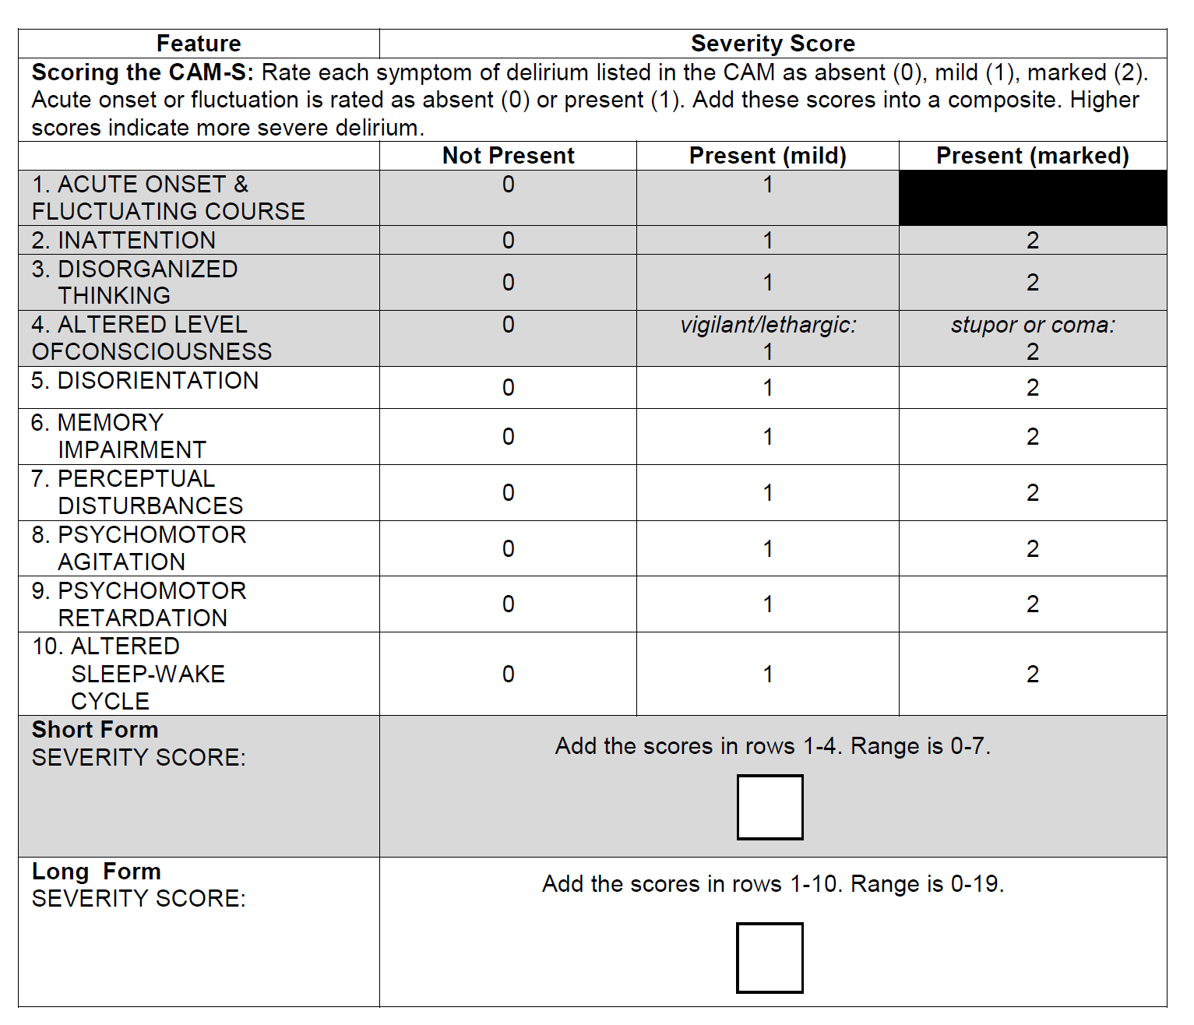
Range of delirium severity
CAM-S (score 0 – 19)
10 features

Slide 15
History around delirium
What is the time course ?
What are other symptoms ?
Fever
SOB
Medication changes: new or withdrawal
Substance use and withdrawal

Slide 16
Physical exam
Vitals
Pulse ox
Glucometer
Papilledema / Anisicora ?
Neurological asymmetry ?
Asterixis ?
Battle’s sign, Racoon’s eyes, bruises ?

Slide 17
Laboratory tests
No neuroimaging unless lateralizing signs OR if suspect bilateral subdural hematoma
CBC
Electrolytes / renal / LFTs
U/A
Urine toxicology
Blood culture
CXR
ECG
Blood gas

Slide 18
Management
Medication adjustments
Treat infections
Manage fluids (hydrate or restrict if salt retaining state)
Treat hypoxia, hypercapnia, hypotension, severe anemia
Disimpaction
Treat pain

Slide 19
Manage behaviors
Non pharmacological treatment
Go with the flow
Reassure
Lighting
Address neurosensory deprivation (eyesight, hearing)
Orientation (clocks and calendars)

Slide 20
Manage behaviors
Low dose anti – psychotics if delusions, hallucinations or harm to self
Haloperidol 0.25 – 0.5 mg every 4 hours (po, IM, IV)
Limit 3 mg
Risperidone 0.25 – 0.5 mg every 4 hours (po)
Limit 2 mg
Olanzapine, Quetiapine, Ziprasidone
Pimavanserin for PD psychosis
Lorazepam 0.25 – 0.5 mg every 8 hours (po, IV): mostly EtOH withdrawal
Notes:
Studies on anti-psychotics are not robust. They are used as off – label. No placebo cotn\rolled studies, and mostly evidence of changes in severity and not duration, nor do the studies address conversion of hyperactive to hypactive delirium
12 studies found that anti-psychotics did not alter severity or duration of delirium, did not change LOS or mortality
Haldol and risperdone have the least sedation but highest risk of EPS. Olanzapine and quetiapine are more sedating and less EPS

Slide 21
If medications or restraints used:
Monitor efficacy
Reassess
Document
De-escalate as soon as possible

Slide 22
Management
Scheduled toileting
Avoid restraints
Family members / sitters
Repositioning with hypoactive delirium
Sleep hygiene (no vitals at night, avoid sedatives)
Reduce clutter and noise
Reorient
Family education / training

Slide 23
Recovery
Slow recovery associated with advance age, illness severity, and pre-existing dementia
Recovery can take weeks to months
Unresolved delirium post hospitalization has a high 1 YR mortality

Slide 24
Care transitions
Hospitals, EDs and SNFs need to know cognitive baseline of older adult.
Need clear documentation of delirium
Chart abstraction, n = 149, only two documented ED or Hospital cases of “acute mental status change”. No mention of delirium.
Intensive therapy in SNF does not short delirium duration
Avoid multiple transitions (Hospital → short term SNF → Home)

Slide 25
Prevention
Hospital Elder Life Program (HELP) : multifactorial intervention
Cognition
Hydration
Sleep
Hearing
Vision
Mobility
OR = 0.47

Slide 26
Prevention
Geriatric Consults
30 – 40 % delirium reduction post – op
Equivocal evidence with melatonin

Slide 27
Case report
84F is seen in clinic and expresses loss of appetite and weight loss ever since her husband died 2 months ago. The primary care provider prescribes low dose Remeron because she believes the patient to be depressed and she heard a Geriatric presentation that suggested Remeron to be a potential appetite stimulant.
One week later the patient is taken to the emergency room with new onset of confusion.
What are your next steps ?

Slide 28
Case Report
Confusion Assessment is positive

Slide 29
Summary
Delirium is often under recognized due to 75% of cases being hypoactive
Recognize older adults most at risk
Identify reversible causes of delirium
Preventive measures work !
Avoid delirium – inducing drugs
Emphasize non – pharmacological management of both hypo and hyperactive delirium

