Slide 1
Nutrition and Mobility
“Aging, Muscle Health, and Dietary Intake”
Co-Presenters:
Nathanial Johnson, PhD- UND Assistant Professor Nutrition and Dietetics
and
Amanda Wilson, PT, DPT- UND Teaching Assistant Professor Physical Therapy

Slide 2
Objectives
Describe the importance of adequate nutrition in relation to strength/mobility with an older adult.
Understand the specific nutritional requirements of an older adult.
Complete appropriate strength, nutritional and food insecurity screening with all older adults.
Recognize the importance of referral to a dietician for individualized needs.
Apply knowledge of nutrition and mobility in a case application.

Slide 3
Case Application
Mrs. Smith is a 70-year-old retired teacher who lives alone in a suburban community. She has a history of osteoarthritis in her knees, which limits her mobility and makes it difficult for her to engage in physical activities. Her husband passed away five years ago, and she has been living independently since then. Mrs. Smith enjoys cooking and gardening but has recently been experiencing some challenges in maintaining a balanced diet and staying active due to her arthritis. Mrs. Smith's diet consists mainly of convenience foods and processed meals because she finds it challenging to stand for long periods to cook. She tends to skip meals or opt for quick snacks instead of proper meals. Her diet lacks variety and often lacks essential nutrients. Due to her limited mobility and reduced strength, she has experienced some unintentional weight loss over the past few months, which further exacerbates her weakness and fatigue. She used to enjoy gardening, but now finds it difficult to kneel and bend due to joint pain.

Slide 4
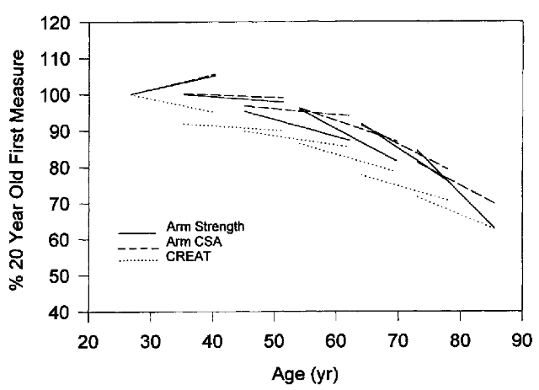
Muscle, Strength, & Aging
Muscle mass and strength declines with age (Metter, 1999)
Older adults use close to their maximum muscle power to stand from a chair (Chiles, 2017)

Slide 5
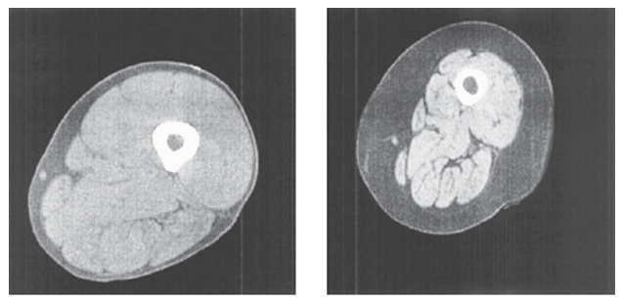
Sarcopenia
-Defined as progressive loss of muscle mass and strength with age.
-Diagnosed by 3 traits, decreased levels of:
1) muscle strength
2) muscle quantity/quality
3) physical performance
-New ICD-10 code for
Sarcopenia as of 2016

Slide 6
The Importance of Skeletal Muscle & Strength
Sarcopenia
Mortality Odds Ratio: 3.60 [2.96, 4.37] (Beudart. 2017)
Disability Odds Ratio: 3.03 [1.80, 5.12] (Beudart. 2017)
≈ 40-50% of bodyweight (Lee, 2000)
≈ 45% of total body proteins (Institute of Medicine, 1999)
Amino Acid Reservoir (Carbone, 2019; Timmerman, 2008)
Muscle is catabolized during/after trauma (Reeds, 1994) and negative energy balance (Layman, 2003)

Slide 7
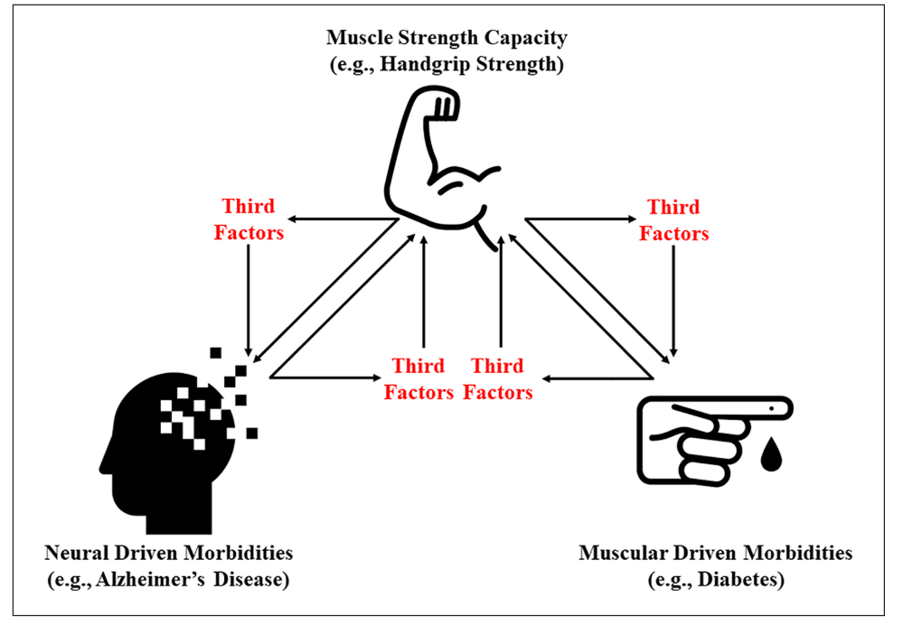
Older Adults & Muscle
Decreased strength is related to:
Diabetes
Cardiovascular disease
Impaired Cognition
Alzheimer's Disease
Disability
Death
McGrath, R., Johnson, N., Klawitter, L., Mahoney, S., Trautman, K., Carlson, C., Rockstad, E., & Hackney, K. J. (2020). What are the association patterns between handgrip strength and adverse health conditions? A topical review. SAGE Open Medicine, 8, 1–12. https://doi.org/10.1177/2050312120910358

Slide 8
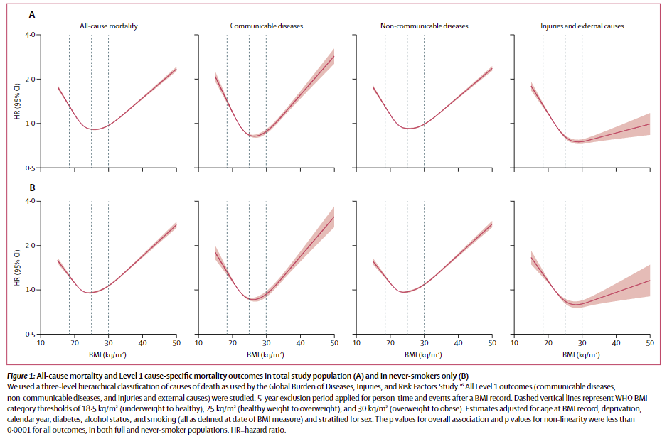
BMI & Mortality
Bhaskaran, K., dos-Santos-Silva, I., Leon, D. A., Douglas, I. J., & Smeeth, L. (2018). Association of BMI with overall and cause-specific mortality: a population-based cohort study of 3·6 million adults in the UK. The Lancet Diabetes and Endocrinology, 6(12), 944–953. https://doi.org/10.1016/S2213-8587(18)30288-2

Slide 9
Contributing factors
Muscle changes
Nervous system changes
Hormonal and immunological changes
Decreased activity level, inactivity
Health status, comorbidities
Nutrition and dietary intake
Age and gender
Loss of Muscle Strength, Power and Mass

Slide 10
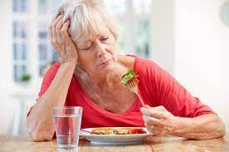
Dietary Intake & Aging
As we get older:
Taste decreases (Barragán, 2018)
Oral health worsens (Hatta, 2021)
Our ability to chew decreases (Fledman, 1980)
Dietary intake decreases by 25% from 40 to 70 (Nieuwenhuizen, 2010)
Predisposing people to nutrient deficiencies
Energy expenditure also decreases (Geisler, 2016)
We can lose muscle tissue and gain fat resulting in sarcopenic obesity (Lee, 2016)

Slide 11
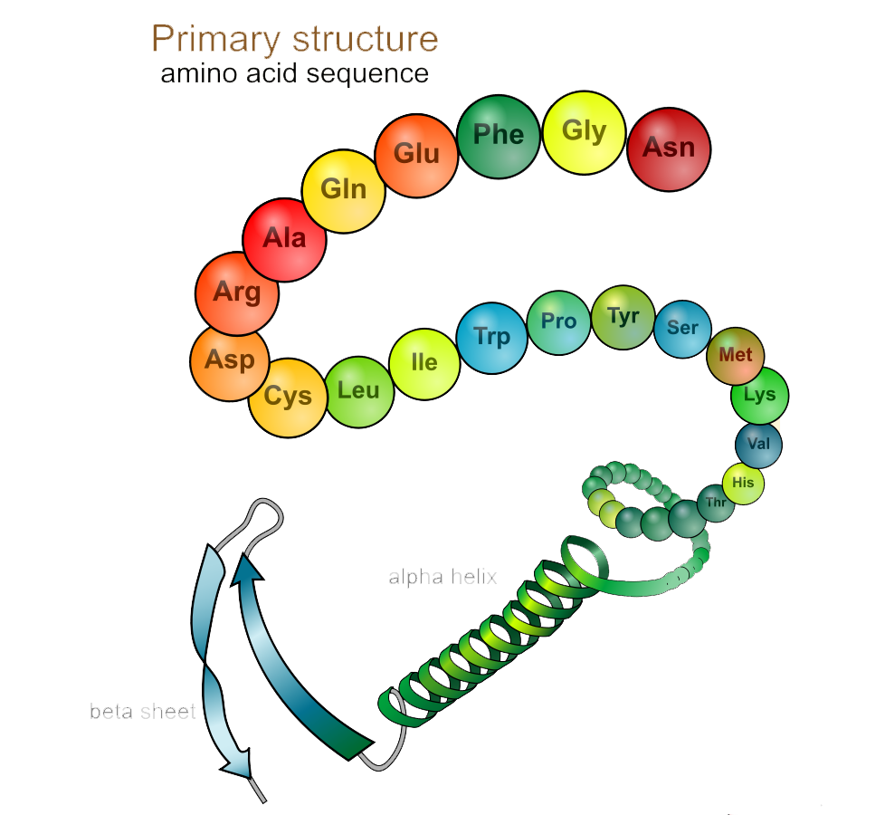
Dietary Protein & Muscle
Dietary protein can directly stimulate muscle protein synthesis (Kim, 2018; Dickinson, 2011; Bauer, 2013; Paddon-Jones, 2009, Bar-Peled, 2014, Gingras, 2001)
By activating the mammalian target of rapamycin complex 1 - mTORC1 (Dickinson, 2011; Bar-Peled, 2014)
mTORC1 controls translation (Gingras, 2001)

Slide 12
Keys to Protein Success
1. Quantity
2. Distribution
3. Quality

Slide 13
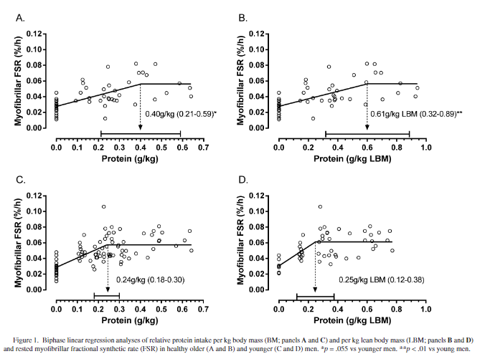
Dietary Protein & Aging
Moore DR, Churchward-Venne TA, Witard O, et al. Protein ingestion to stimulate myofibrillar protein synthesis requires greater relative protein intakes in healthy older versus younger men. Journals of Gerontology - Series A Biological Sciences and Medical Sciences. 2015;70(1):57-62. doi:10.1093/gerona/glu103
The amount of protein needed during one meal to maximally stimulate muscle protein synthesis increases with aging

Slide 14
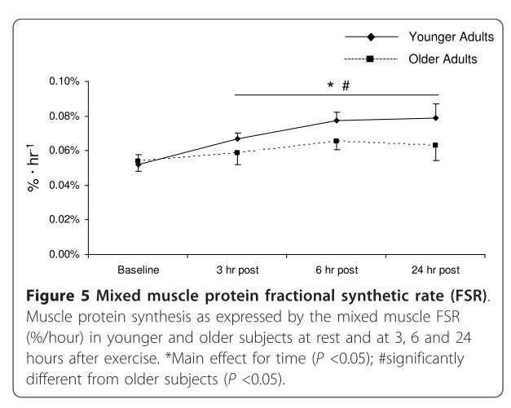
Dietary Protein & Aging
The anabolic response to exercise is blunted with age
Less muscle is produced in response to the same exercise
Fry, C. S., Drummond, M. J., Glynn, E. L., Dickinson, J. M., Gundermann, D. M., Timmerman, K. L., Walker, D. K., Dhanani, S., Volpi, E., & Rasmussen, B. B. (2011). Aging impairs contraction-induced human skeletal muscle mTORC1 signaling and protein synthesis. Skeletal Muscle, 1(1), 11. https://doi.org/10.1186/2044-5040-1-11

Slide 15
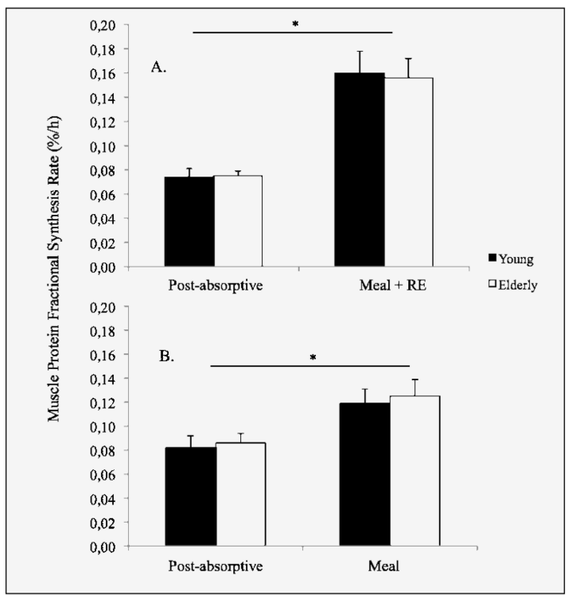
Dietary Protein & Aging
Fry, C. S., Drummond, M. J., Glynn, E. L., Dickinson, J. M., Gundermann, D. M., Timmerman, K. L., Walker, D. K., Dhanani, S., Volpi, E., & Rasmussen, B. B. (2011). Aging impairs contraction-induced human skeletal muscle mTORC1 signaling and protein synthesis. Skeletal Muscle, 1(1), 11. https://doi.org/10.1186/2044-5040-1-11
The anabolic response to exercise is blunted with age
Less muscle is produced in response to the same exercise
Protein intake after exercise alleviates difference
Older adults need protein after exercise

Slide 16
Protein Quantity & Muscle
NIH recommends = 0.8 g/kg/day
Experts in aging and muscle health recommend more
1.0 to 1.2 g/kg/day (Bauer, 2013; Deutz, 2014; Morley, 2010)
Or 25 to 30 g per meal (Paddon-Jones, 2009; Morley, 2010)

Slide 17
Keys to Protein Success
1. Quantity
2. Distribution
3. Quality

Slide 18
Protein Quantity & Muscle
The same studies (Rand, 2003) that informed the 0.8 g/kg/day recommendation only included works where participants ate three or more iso-nutrient meals
Thus, protein intake was exactly evenly distributed
Breakpoint analysis of muscle protein synthesis indicates (Moore, 2015):
0.24 g/kg/meal for younger adults
0.40 g/kg/meal for older adults
Maximally stimulates muscle protein synthesis
In other words, we should not eat all of our protein at once

Slide 19
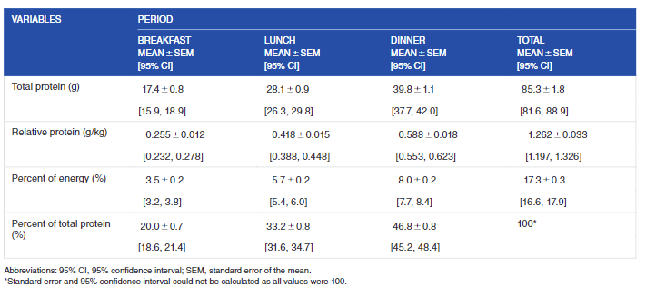
Dietary Protein Intake Distribution
Johnson, N. R., Kotarsky, C. J., Mahoney, S. J., Sawyer, B. C., Stone, K. A., Byun, W., Hackney, K. J., Mitchell, S., & Stastny, S. N. (2022). Evenness of dietary protein intake is positively associated with lean mass and strength in healthy women. Nutrition and Metabolic Insights, 15, 1–9. https://doi.org/10.1177/11786388221101829

Slide 20
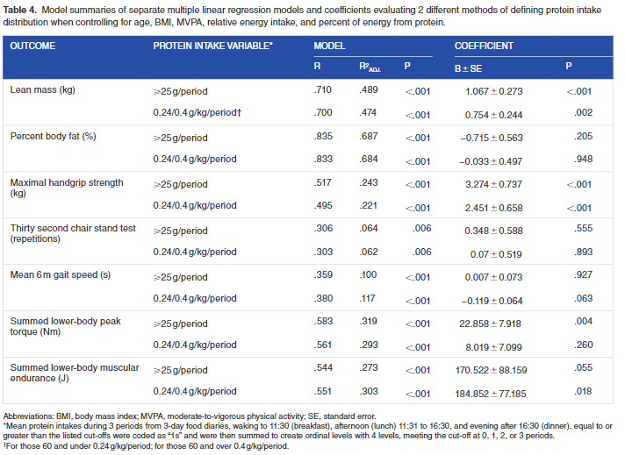
Dietary Protein Intake Distribution
Johnson, N. R., Kotarsky, C. J., Mahoney, S. J., Sawyer, B. C., Stone, K. A., Byun, W., Hackney, K. J., Mitchell, S., & Stastny, S. N. (2022). Evenness of dietary protein intake is positively associated with lean mass and strength in healthy women. Nutrition and Metabolic Insights, 15, 1–9. https://doi.org/10.1177/11786388221101829

Slide 21
Keys to Protein Success
1. Quantity
2. Distribution
3. Quality

Slide 22
Dietary Protein Quality
100≥ Complete protein
99-75 good source of protein
≤75 poor quality protein
Herreman, L., Nommensen, P., Pennings, B., & Laus, M. C. (2020). Comprehensive overview of the quality of plant- And animal-sourced proteins based on the digestible indispensable amino acid score. Food Science and Nutrition, 8(10), 5379–5391. https://doi.org/10.1002/fsn3.1809

Slide 23
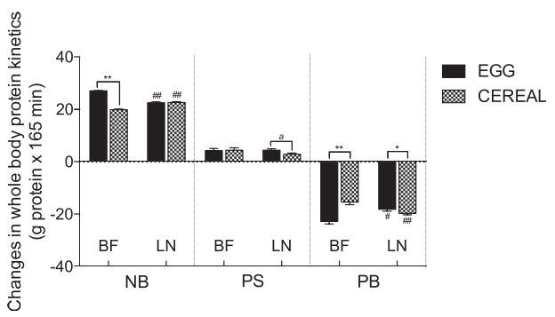
Protein Quality
Animal-based proteins have better protein quality than plant-based proteins
Largely driven by amino acid score
When matched for protein and energy
Egg results in greater EAA and in particular leucine
These differences are associated with greater net protein balance
Kim, I. Y., Shin, Y. A., Schutzler, S. E., Azhar, G., Wolfe, R. R., & Ferrando, A. A. (2018). Quality of meal protein determines anabolic response in older adults. Clinical Nutrition, 37(6), 2076–2083. https://doi.org/10.1016/j.clnu.2017.09.025

Slide 24
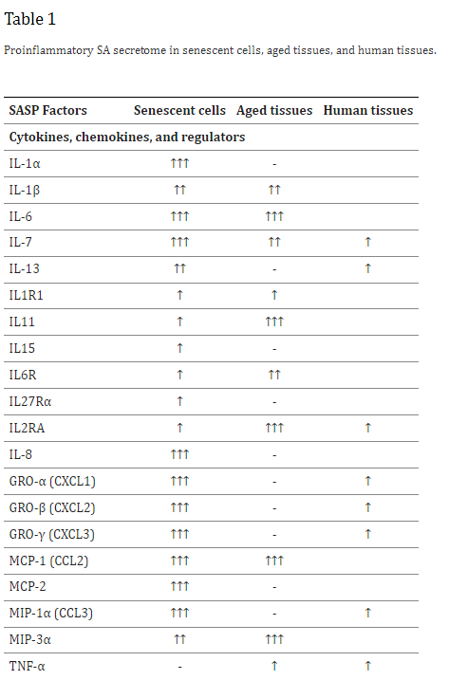
Inflammation & aging
Aging is associated with increased markers of inflammation
Chung, H. Y., Kim, D. H., Lee, E. K., Chung, K. W., Chung, S., Lee, B., ... & Yu, B. P. (2019). Redefining chronic inflammation in aging and age-related diseases: proposal of the senoinflammation concept. Aging and disease, 10(2), 367.

Slide 25
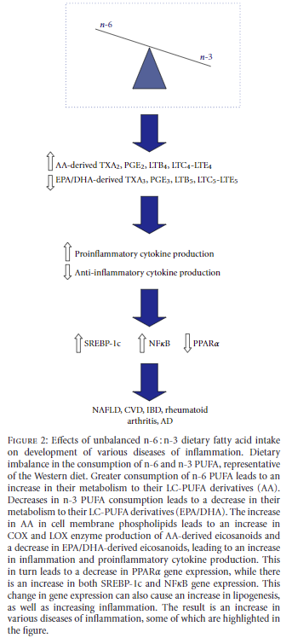
Omega 3:6
Omega-3 and omega-6 are used to create eicosanoids, an autocrine/paracrine hormone
Omega-6s are converted into arachidonic acid and then into proinflammatory hormones
Omega-3s are converted into EPA and then into anti-inflammatory hormones
The omega 3:6 ratio affects inflammation
Patterson, E., Wall, R., Fitzgerald, G. F., Ross, R. P., & Stanton, C. (2012). Health implications of high dietary omega-6 polyunsaturated fatty acids. In Journal of Nutrition and Metabolism (Vol. 2012). Hindawi Limited. https://doi.org/10.1155/2012/539426

Slide 26
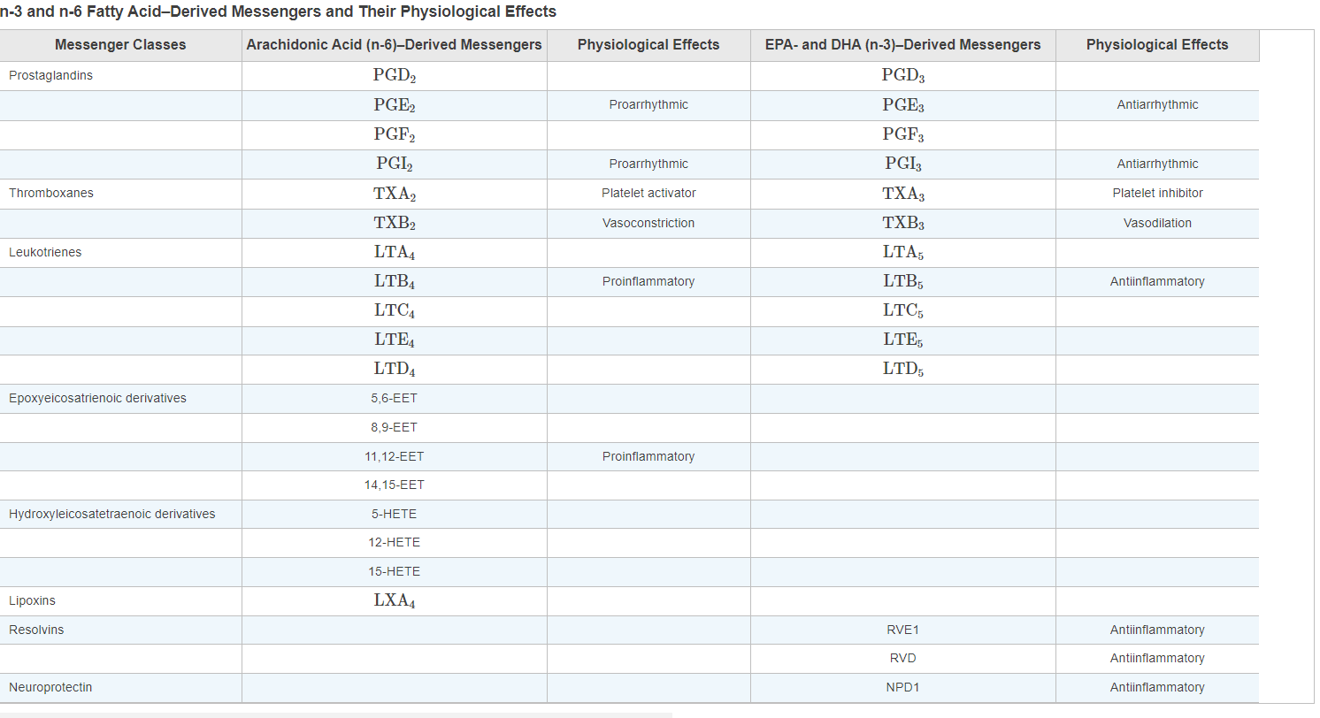
Eicosanoids
Advanced Nutrition and Human Metabolism 8th Edition

Slide 27
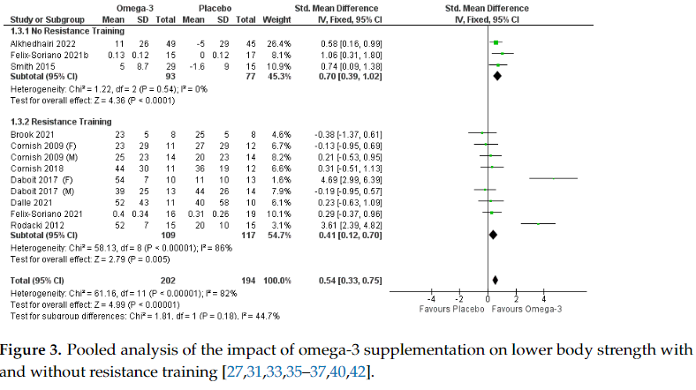
Omega 3 Intake & Strength
Omega 3 supplementation increases muscle strength in older adults
Cornish, S. M., Cordingley, D. M., Shaw, K. A., Forbes, S. C., Leonhardt, T., Bristol, A., Candow, D. G., & Chilibeck, P. D. (2022). Effects of Omega-3 Supplementation Alone and Combined with Resistance Exercise on Skeletal Muscle in Older Adults: A Systematic Review and Meta-Analysis. Nutrients, 14(11). https://doi.org/10.3390/nu14112221

Slide 28
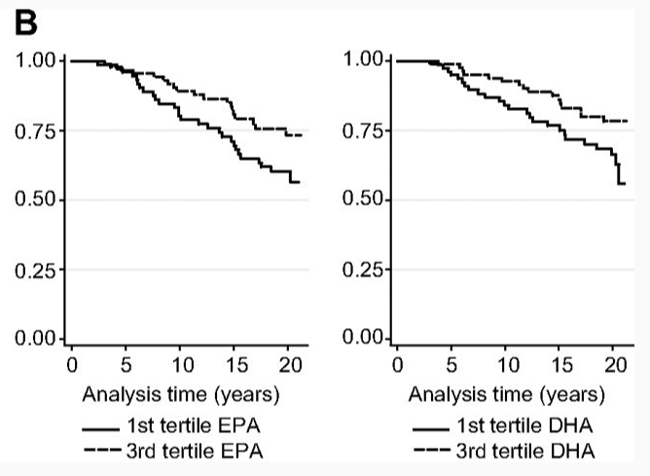
Omega 3 intake & Mortality
Anderson, S. G., Sanders, T. A. B., & Cruickshank, J. K. (2009). Plasma fatty acid composition as a predictor of arterial stiffness and mortality. Hypertension, 53(5), 839–845. https://doi.org/10.1161/HYPERTENSIONAHA.108.123885

Slide 29
Aging & Vitamin D
Older adults produce less provitamin D, or 7-dehydrocholesterol leading to less vitamin D being produced in response to sun exposure
Older adults have decreased expression of 1-hydroxylase, limiting the production of calcitriol
Older adults eat less in general, amplifying the effects of aging on Vitamin D
RDAs
19-70 = 600 IU
>70 = 800 IU

Slide 30
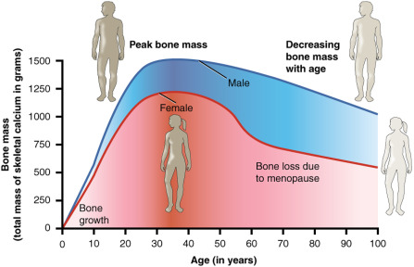
Bones & Aging
Bone mass peaks when we are young
20-30 years
Stays high until 40
High peak bone mass protects us from bone loss
After 40, we lose bone mass
Can be partially reversed with some medications
Women are at greater risk
Lower peak bone mass
Greater loss after menopause due to low estrogen
Estrogen increases expression of vitamin D binding protein
https://en.m.wikipedia.org/wiki/File:615_Age_and_Bone_Mass.jpg

Slide 31
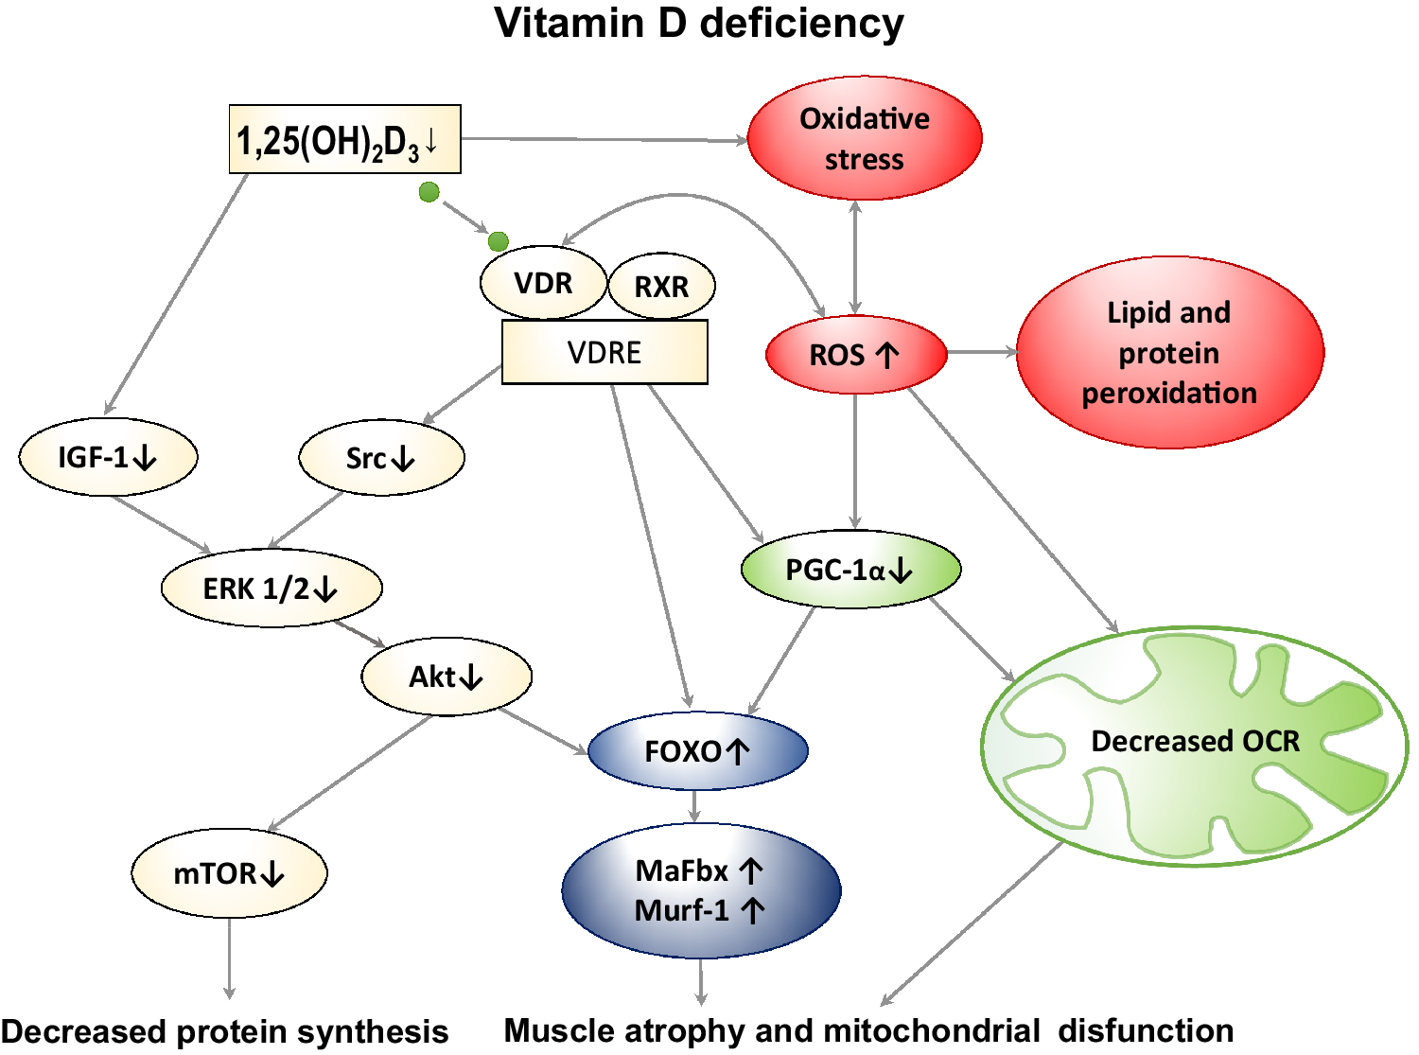
Vitamin D & Muscle Strength
Dzik, K. P., & Kaczor, J. J. (2019). Mechanisms of vitamin D on skeletal muscle function: oxidative stress, energy metabolism and anabolic state. European Journal of Applied Physiology, 119(4), 825–839. https://doi.org/10.1007/s00421-019-04104-x

Slide 32
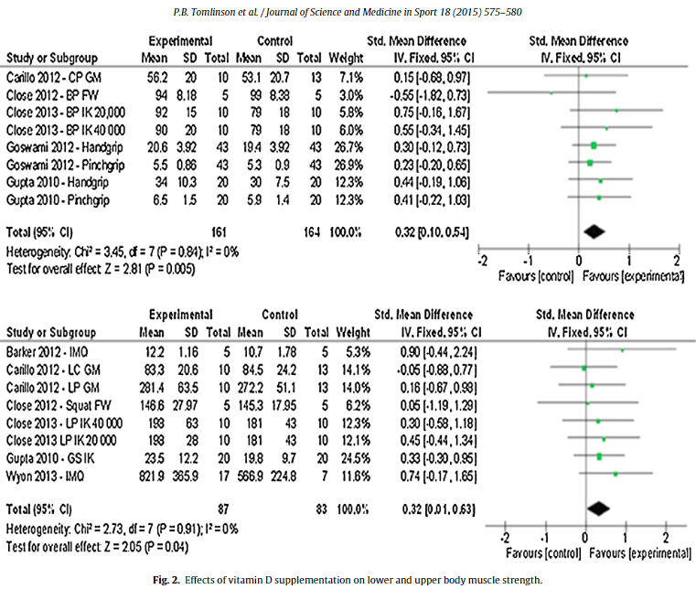
Vitamin D & Muscle Strength
Vitamin D supplementation increases muscle strength
Tomlinson, P. B., Joseph, C., & Angioi, M. (2015). Effects of vitamin D supplementation on upper and lower body muscle strength levels in healthy individuals. A systematic review with meta-analysis. In Journal of Science and Medicine in Sport (Vol. 18, Issue 5, pp. 575–580). Elsevier Ltd. https://doi.org/10.1016/j.jsams.2014.07.022

Slide 33
Vitamin D & Sunlight
If living above 37°latitude, the body can only make vitamin D from May to October
Wickham, R. (2012). Cholecalciferol and Cancer: Is It a Big D3-eal? Journal of the Advanced Practitioner in Oncology, 3(4). https://doi.org/10.6004/jadpro.2012.3.4.6

Slide 34
Issues Making Vitamin D From Sunlight
Increased risk of melanoma with increased sun exposure
Difficulty getting outside during midday
Lower production from sunlight with darker skin
Melanin, the pigment in our skin, absorbs UV-B light
By absorbing EM rays, melanin protects us from skin cancer, but hinders vitamin D production
Need more time in sun if your skin is darker
Decreased production from sunlight with aging
We make less vitamin D as we get older
Sun must be 30°above horizon
Location Matters

Slide 35
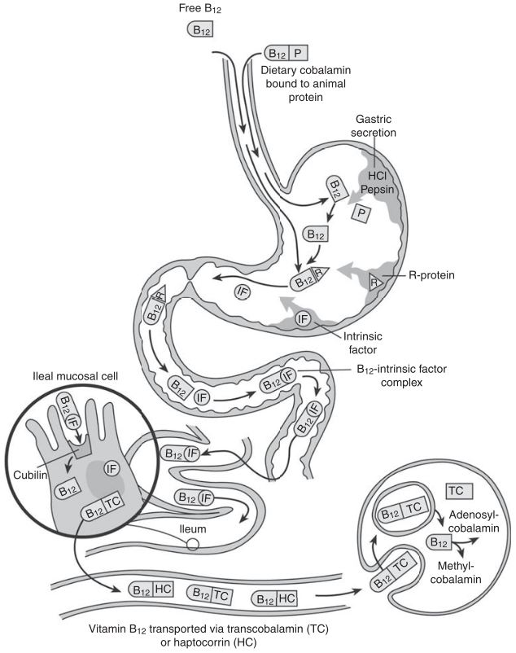
B12 & Aging
Deficiency of B12 or Folate
Pernicious or megaloblastic anemia
Cognitive impairment
Frailty
As we get older, we absorb less B12
Due to reduced production of stomach acid
Use of heartburn medications
Limits Stomach acid secretion
Also, effects folate
Hughes, C. F., Ward, M., Hoey, L., & McNulty, H. (2013). Vitamin B12 and ageing: Current issues and interaction with folate. Annals of Clinical Biochemistry, 50(4), 315–329. https://doi.org/10.1177/0004563212473279

Slide 36
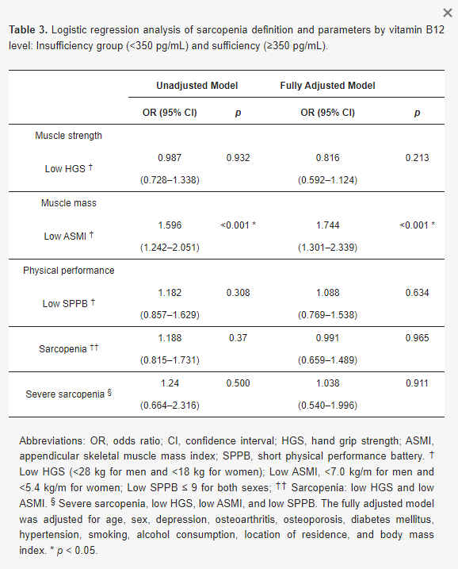
B12
Cobalamin is needed for:
DNA synthesis
Amino acid metabolism
Homocysteine metabolism
Nerve myelination
Decreased serum [B12] is related to decreased muscle mass
Chae, S. A., Kim, H. S., Lee, J. H., Yun, D. H., Chon, J., Yoo, M. C., Yun, Y., Yoo, S. D., Kim, D. H., Lee, S. A., Chung, S. J., Soh, Y., & Won, C. W. (2021). Impact of vitamin b12 insufficiency on sarcopenia in community-dwelling older korean adults. International Journal of Environmental Research and Public Health, 18(23). https://doi.org/10.3390/ijerph182312433

Slide 37
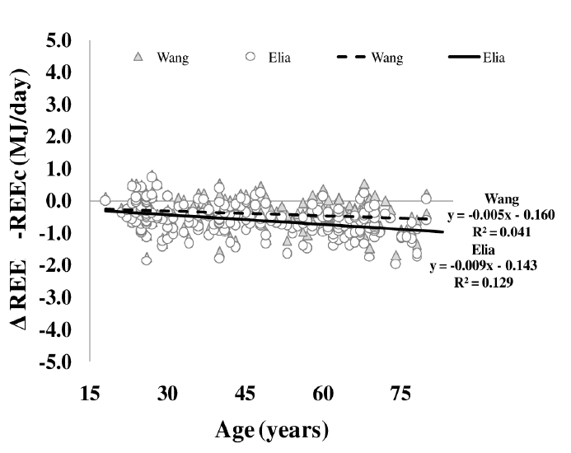
Energy Expenditure & Aging
Geisler, C., Braun, W., Pourhassan, M., Schweitzer, L., Glüer, C. C., Bosy-Westphal, A., & Müller, M. J. (2016). Age-dependent changes in resting energy expenditure (REE): insights from detailed body composition analysis in normal and overweight healthy caucasians. Nutrients, 8(322), 1–11. https://doi.org/10.3390/nu8060322

Slide 38
Older Adults
Older adults need less energy than younger adults, but even if as physically active and same muscle mass need greater intakes of:
Protein
Due to anabolic resistance
Calcium
Due to decreased absorption
Vitamin D
Due to decreased synthesis of vitamin D in skin
Due to decreased rate of the conversion of vitamin D into calcitriol
Vitamin B12
Due to decreased stomach acid production
“Empty Calories” are a big concern for older adults
Choosing nutrient dense food is a priority
Added sugar = empty calories

Slide 39
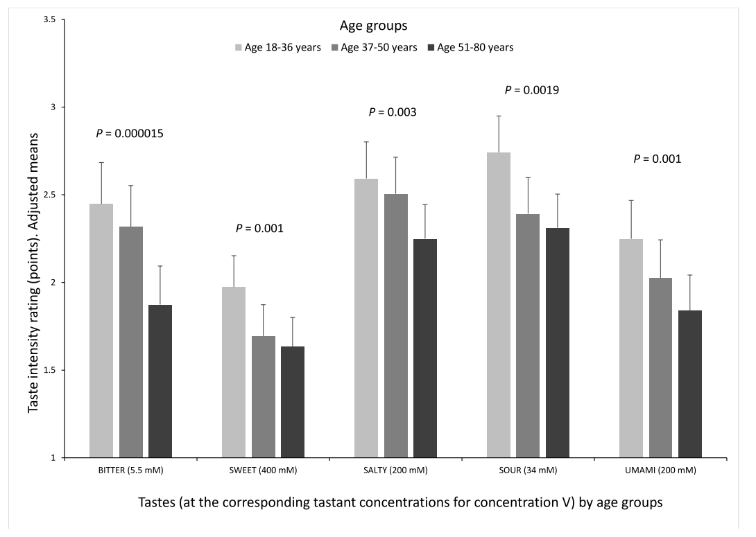
Taste & Aging (1)
Barragán, R., Coltell, O., Portolés, O., Asensio, E. M., Sorlí, J. V., Ortega-Azorín, C., González, J. I., Sáiz, C., Fernández-Carrión, R., Ordovas, J. M., & Corella, D. (2018). Bitter, sweet, salty, sour and umami taste perception decreases with age: Sex-specific analysis, modulation by genetic variants and taste-preference associations in 18 to 80 year-old subjects. Nutrients, 10(10). https://doi.org/10.3390/nu10101539

Slide 40
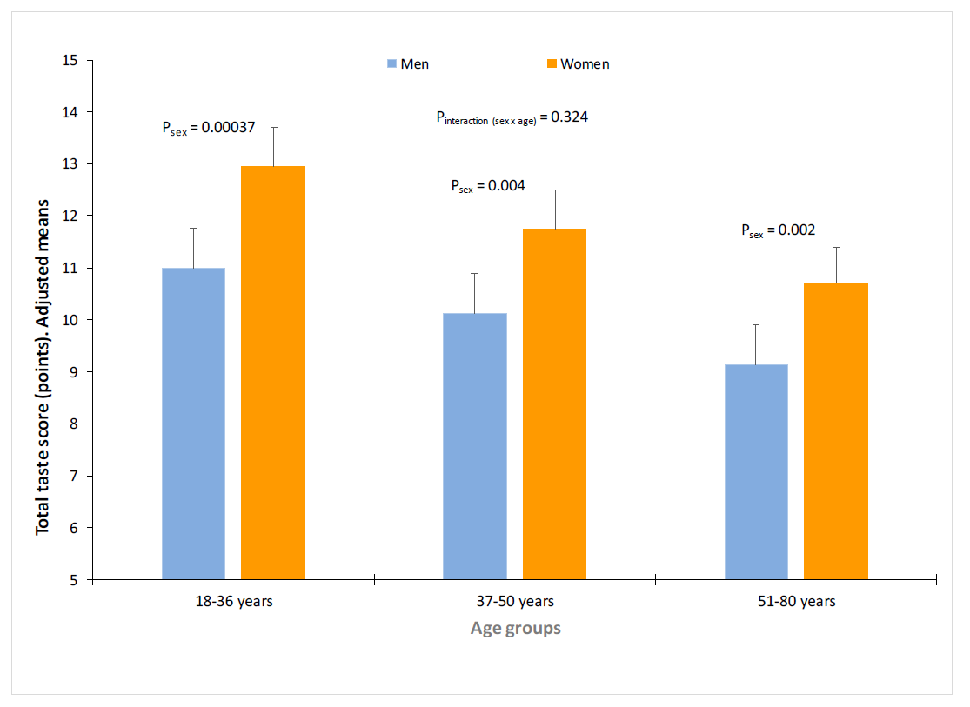
Taste & Sex
Barragán, R., Coltell, O., Portolés, O., Asensio, E. M., Sorlí, J. V., Ortega-Azorín, C., González, J. I., Sáiz, C., Fernández-Carrión, R., Ordovas, J. M., & Corella, D. (2018). Bitter, sweet, salty, sour and umami taste perception decreases with age: Sex-specific analysis, modulation by genetic variants and taste-preference associations in 18 to 80 year-old subjects. Nutrients, 10(10). https://doi.org/10.3390/nu10101539

Slide 41
Taste & Aging (2)
Our perception of taste decreases as we age
Older people prefer food that tastes stronger:
Excess sugar intake
Increasing empty calorie intake
A risk factor for type 2 diabetes mellitus
Excess sodium intake
A risk factor for hypertension

Slide 42
Video Summary #1
Aging results in loss of muscle mass and strength
A factor in disability, mortality, cognitive impairment and other disease and conditions
Due to worsened oral health and ability to chew and taste dietary intake decreases by about 25%
Increased odds of nutrient decencies
Worsened taste increases added sugar and sodium intake
To support muscle older adults need greater intakes of:
Protein
Omega-3s
Vitamin D
Vitamin B12

Slide 43
Video Summary #2
To support muscle older adults need greater intakes of:
Protein
Due to anabolic resistance to exercise and dietary protein
Omega-3 fatty acids
Due to increased inflammation associated with aging
Vitamin D
Due to decreased synthesis of vitamin D in skin
Due to decreased rate of the conversion of vitamin D into calcitriol
Vitamin B12
Due to decreased stomach acid production

Slide 44
Video Summary #3
Energy expenditure decrease as we get older, so older adults need less total energy
But more nutrients than younger adults
Worsened taste increases added sugar and sodium intake
Added sugar are “empty calories” that only provide energy and not other nutrients
Older adults must focus on consuming nutrient dense foods
Nutrient density = nutrient/Calories

Slide 45
Case Application
Mrs. Smith is a 70-year-old retired teacher who lives alone in a suburban community. She has a history of osteoarthritis in her knees, which limits her mobility and makes it difficult for her to engage in physical activities. Her husband passed away five years ago, and she has been living independently since then. Mrs. Smith enjoys cooking and gardening but has recently been experiencing some challenges in maintaining a balanced diet and staying active due to her arthritis. Mrs. Smith's diet consists mainly of convenience foods and processed meals because she finds it challenging to stand for long periods to cook. She tends to skip meals or opt for quick snacks instead of proper meals. Her diet lacks variety and often lacks essential nutrients. Due to her limited mobility and reduced strength, she has experienced some unintentional weight loss over the past few months, which further exacerbates her weakness and fatigue. She used to enjoy gardening, but now finds it difficult to kneel and bend due to joint pain.

Slide 46
Question 1: What are the key nutrition and mobility factors from the case example?
Convenience/processed foods
Lack of essential nutrients
All of which contribute to reduced strength-further impacting mobility
Unintentional weight loss
Limited standing endurance/tolerance for cooking
Lack of ability to garden-less access to healthy foods
Living alone-difficulty in cooking

Slide 47
Question 2: What screening/assessments should be completed within the interdisciplinary team?
SARC-F, score >4 requires further assessment
Grip strength
Chair stand test, 5x
Gait speed
Short Physical Performance Battery (SPPB) SPPB form
DXA
Nutrition screening
Mini Nutritional Assessment (MNA)
Simplified Nutritional Appetite Questionnaire (SNAQ)
Food security screening
USDA

Slide 48
Cruz-Jentoft AJ, Bahat G, Bauer J, et al. Sarcopenia: revised European consensus on definition and diagnosis [published correction appears in Age Ageing. 2019 Jul 1;48(4):601]. Age Ageing. 2019;48(1):16-31. doi:10.1093/ageing/afy169

Slide 49
Sarcopenia test and cut-off scores: European Working Group on Sarcopenia in Older People
Giovannini S, Brau F, Forino R, et al. Sarcopenia: Diagnosis and Management, State of the Art and Contribution of Ultrasound. J Clin Med. 2021;10(23):5552. Published 2021 Nov 26. doi:10.3390/jcm10235552

Slide 50
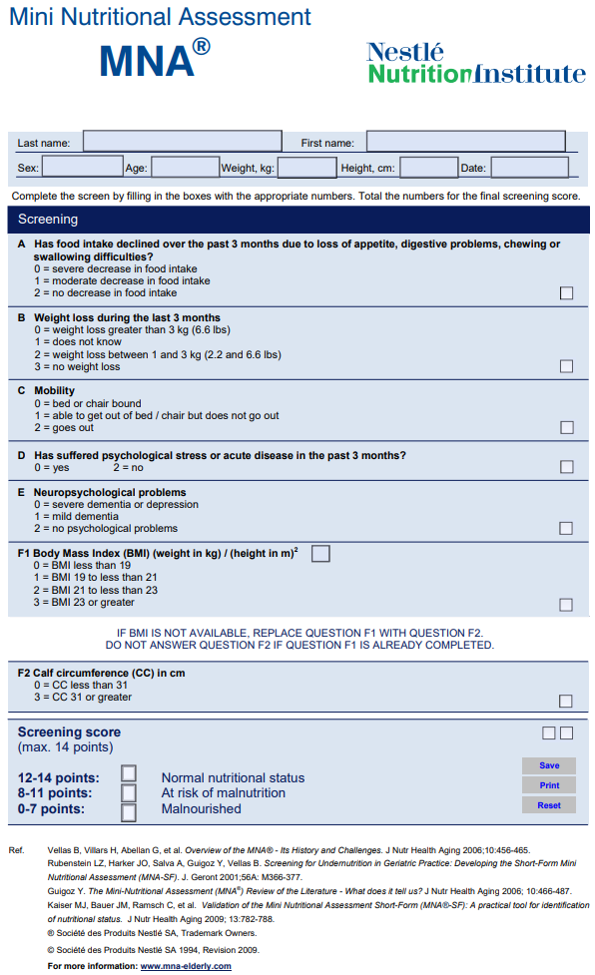
< 11 at risk for malnutrition
<7 malnourished
Mini Nutritional Assessment (MNA) | APTA
What is the MNA®? | MNA Elderly (mna-elderly.com)

Slide 51
SNAQ – Simplified Nutritional Assessment Questionnaire
My appetite is – very poor(1), poor(2), average(3), good(4), or very good (5)
When I eat – I feel full after eating only a few mouthfuls(1), after eating 1/3 of a meal(2), after over ½ of a meal(3), after most of the meal(4) or hardly ever feel full(5)
Food tastes – very bad(1), bad(2), average(3), good(4), or very good(5)
Normally I eat – <1meal(1),1 meal/day(2), 2 meals/day(3), 3 meals/day(4) or > 3 meals/day(5)
< 15 at risk for malnutrition in healthy community-dwelling older adults
Lau S, Pek K, Chew J, et al. The Simplified Nutritional Appetite Questionnaire (SNAQ) as a Screening Tool for Risk of Malnutrition: Optimal Cutoff, Factor Structure, and Validation in Healthy Community-Dwelling Older Adults. Nutrients. 2020;12(9):2885. Published 2020 Sep 21. doi:10.3390/nu12092885

Slide 52
USDA food security questionnaire
Food that (I/we) bought just didn’t last, and we didn’t have money to get more in the last 12 months.
(I/we) couldn’t afford to eat balanced meals in the last 12 months.
In the last 12 months, since last (current month) did you or other adults in your household ever cut the size of your meals or skip meals because there wasn’t enough money for food?
How often did this happen?
In the last 12 months, did you ever eat less than you felt you should because there wasn’t enough money for food?
In the last 12 months, were you ever hungry but didn’t eat because there wasn’t enough money for food?
Raw score: 0-1 High or marginal food security
Raw score: 2-4 Low food security
Raw score: 5-6 Very low food security
Six-item Short Form Food Security Survey Module (usda.gov)
https://www.ers.usda.gov/topics/food-nutrition-assistance/food-security-in-the-u-s/measurement/

Slide 53
Question 3: What would be appropriate for referral(s)?
Meals on wheels
NDSU extension service
Nourish Your Body
https://www.ndsu.edu/agriculture/extension/extension-topics/food-and-nutrition/health-and-nutrition/nourish-your-body
“Cooking for One or Two”
https://www.ndsu.edu/agriculture/extension/publications/cooking-one-or-two
Dietician for individualized plan
Occupational Therapy for meal prep management and modification of hobbies to encourage participation
Physical Therapy for strengthening and management of OA/pain
Social Worker for additional resources/services
MD due to unintentional weight loss, DXA or imaging

Slide 54
Thanks For Your Time!
Any Questions?
Amanda.k.Wilson@und.edu
Nathaniel.Johnson.4@und.edu

Slide 55
References #1
Anderson, S. G., Sanders, T. A. B., & Cruickshank, J. K. (2009). Plasma fatty acid composition as a predictor of arterial stiffness and mortality. Hypertension, 53(5), 839–845. https://doi.org/10.1161/HYPERTENSIONAHA.108.123885
Anker SD, Morley JE, von Haehling S. Welcome to the ICD-10 code for sarcopenia. J Cachexia Sarcopenia Muscle. 2016;7(5):512-514. doi:10.1002/jcsm.12147
Ardeljan AD, Hurezeanu R. Sarcopenia. [Updated 2023 Jul 4]. In: StatPearls [Internet]. Treasure Island (FL): StatPearls Publishing; 2024 Jan-. Available from: https://www.ncbi.nlm.nih.gov/books/NBK560813/
Bar-Peled L, Sabatini DM. Regulation of mTORC1 by amino acids. Trends Cell Biol. 2014;24(7):400-406. doi:10.1016/j.tcb.2014.03.003
Barragán R, Coltell O, Portolés O, et al. Bitter, sweet, salty, sour and umami taste perception decreases with age: sex-specific analysis, modulation by genetic variants and taste-preference associations in 18 to 80 year-old subjects. Nutrients. 2018;10(1539):1-23. doi:10.3390/nu10101539
Bauer J, Biolo G, Cederholm T, et al. Evidence-based recommendations for optimal dietary protein intake in older people: a position paper from the PROT-AGE Study Group. J Am Med Dir Assoc. 2013;14(8):542-559. doi:10.1016/j.jamda.2013.05.021
Beaudart C, Zaaria M, Pasleau F, Reginster JY, Bruyère O. Health outcomes of sarcopenia: a systematic review and meta-analysis. PLoS One. 2017;12(1):1-16. doi:10.1371/journal.pone.0169548
Bhaskaran, K., dos-Santos-Silva, I., Leon, D. A., Douglas, I. J., & Smeeth, L. (2018). Association of BMI with overall and cause-specific mortality: a population-based cohort study of 3·6 million adults in the UK. The Lancet Diabetes and Endocrinology, 6(12), 944–953. https://doi.org/10.1016/S2213-8587(18)30288-2
Bonder B., Bello-Haas V. Functional Performance in Older Adults, 4th edition. F.A. Davis Company; 2018
Carbone JW, McClung JP, Pasiakos SM. Recent advances in the characterization of skeletal muscle and whole-body protein responses to dietary protein and exercise during negative energy balance. Adv Nutr. 2019;10:70-79. doi:10.1093/advances/nmy087
Chae, S. A., Kim, H. S., Lee, J. H., Yun, D. H., Chon, J., Yoo, M. C., Yun, Y., Yoo, S. D., Kim, D. H., Lee, S. A., Chung, S. J., Soh, Y., & Won, C. W. (2021). Impact of vitamin b12 insufficiency on sarcopenia in community-dwelling older korean adults. International Journal of Environmental Research and Public Health, 18(23). https://doi.org/10.3390/ijerph182312433
Chiles Shaffer, N., Fabbri, E., Ferrucci, L., Shardell, M., Simonsick, E. M., & Studenski, S. (2017). Muscle Quality, Strength, and Lower Extremity Physical Performance in the Baltimore Longitudinal Study of Aging. The Journal of Frailty & Aging, 6(4), 183–187. https://doi.org/10.14283/jfa.2017.24
Chung, H. Y., Kim, D. H., Lee, E. K., Chung, K. W., Chung, S., Lee, B., ... & Yu, B. P. (2019). Redefining chronic inflammation in aging and age-related diseases: proposal of the senoinflammation concept. Aging and disease, 10(2), 367.
Committee on Military Nutrition Research, Institute of Medicine. The Role of Protein and Amino Acids in Sustaining and Enhancing Performance. Washington, D.C.: National Academy Press; 1999.Nutr. 2000;72(3):796-803. doi:10.1093/ajcn/72.3.796
Cornish, S. M., Cordingley, D. M., Shaw, K. A., Forbes, S. C., Leonhardt, T., Bristol, A., Candow, D. G., & Chilibeck, P. D. (2022). Effects of Omega-3 Supplementation Alone and Combined with Resistance Exercise on Skeletal Muscle in Older Adults: A Systematic Review and Meta-Analysis. Nutrients, 14(11). https://doi.org/10.3390/nu14112221.
Cruz-Jentoft AJ, Bahat G, Bauer J, et al. Sarcopenia: revised European consensus on definition and diagnosis [published correction appears in Age Ageing. 2019 Jul 1;48(4):601]. Age Ageing. 2019;48(1):16-31. doi:10.1093/ageing/afy169

Slide 56
References #2
Deutz, N. E. P., Bauer, J. M., Barazzoni, R., Biolo, G., Boirie, Y., Bosy-Westphal, A., Cederholm, T., Cruz-Jentoft, A., Krznariç, Z., Nair, K. S., Singer, P., Teta, D., Tipton, K., & Calder, P. C. (2014). Protein intake and exercise for optimal muscle function with aging: recommendations from the ESPEN Expert Group. Clinical Nutrition, 33, 929–936. https://www.sciencedirect.com/science/article/pii/S0261561414001113
Dickinson JM, Fry CS, Drummond MJ, et al. Mammalian target of rapamycin complex 1 activation is required for the stimulation of human skeletal muscle protein synthesis by essential amino acids. J Nutr. 2011;141(5):856-862. doi:10.3945/jn.111.139485
Dzik, K. P., & Kaczor, J. J. (2019). Mechanisms of vitamin D on skeletal muscle function: oxidative stress, energy metabolism and anabolic state. European Journal of Applied Physiology, 119(4), 825–839. https://doi.org/10.1007/s00421-019-04104-x
Feldman RS, Kapur KK, Alman JE, Chauncey HH. Aging and mastication: changes in performance and in the swallowing threshold with natural dentition. J Am Geriatr Soc. 1980;28(3):97-103. doi:https://doi.org/10.1111/j.1532-5415.1980.tb00240.
Fry, C. S., Drummond, M. J., Glynn, E. L., Dickinson, J. M., Gundermann, D. M., Timmerman, K. L., Walker, D. K., Dhanani, S., Volpi, E., & Rasmussen, B. B. (2011). Aging impairs contraction-induced human skeletal muscle mTORC1 signaling and protein synthesis. Skeletal Muscle, 1(1), 11. https://doi.org/10.1186/2044-5040-1-11
Geisler C, Braun W, Pourhassan M, et al. Age-dependent changes in resting energy expenditure (REE): insights from detailed body composition analysis in normal and overweight healthy caucasians. Nutrients. 2016;8(322):1-11. doi:10.3390/nu8060322
Gingras AC, Raught B, Sonenberg N. Regulation of translation initiation by FRAP/mTOR. Genes Dev. 2001;15(7):807-826. doi:10.1101/gad.887201
Giovannini S, Brau F, Forino R, et al. Sarcopenia: Diagnosis and Management, State of the Art and Contribution of Ultrasound. J Clin Med. 2021;10(23):5552. Published 2021 Nov 26. doi:10.3390/jcm10235552
Hatta K, Ikebe K. Association between oral health and sarcopenia: a literature review. J Prosthodont Res. 2021;65(2):131-136. doi:10.2186/jpr.jpor_2019_567
Herreman, L., Nommensen, P., Pennings, B., & Laus, M. C. (2020). Comprehensive overview of the quality of plant- And animal-sourced proteins based on the digestible indispensable amino acid score. Food Science and Nutrition, 8(10), 5379–5391. https://doi.org/10.1002/fsn3.1809
Johnson, N. R., Kotarsky, C. J., Mahoney, S. J., Sawyer, B. C., Stone, K. A., Byun, W., Hackney, K. J., Mitchell, S., & Stastny, S. N. (2022). Evenness of dietary protein intake is positively associated with lean mass and strength in healthy women. Nutrition and Metabolic Insights, 15, 1–9. https://doi.org/10.1177/11786388221101829
Kim IY, Shin YA, Schutzler SE, Azhar G, Wolfe RR, Ferrando AA. Quality of meal protein determines anabolic response in older adults. Clin Nutr. 2018;37(6):2076-2083. doi:10.1016/j.clnu.2017.09.025
Lau S, Pek K, Chew J, et al. The Simplified Nutritional Appetite Questionnaire (SNAQ) as a Screening Tool for Risk of Malnutrition: Optimal Cutoff, Factor Structure, and Validation in Healthy Community-Dwelling Older Adults. Nutrients. 2020;12(9):2885. Published 2020 Sep 21. doi:10.3390/nu12092885
Layman DK, Boileau RA, Erickson DJ, et al. A reduced ratio of dietary carbohydrate to protein improves body composition and blood lipid profiles during weight loss in adult women. J Nutr. 2003;133:411-417. doi:10.1093/jn/133.2.411
Lee DC, Shook RP, Drenowatz C, Blair SN. Physical activity and sarcopenic obesity: definition, assessment, prevalence and mechanism. Futur Sci OA. 2016;2(3):1-19. doi:10.4155/fsoa-2016-0028
Lee RC, Wang Z, Heo M, Ross R, Janssen I, Heymsfield SB. Total-body skeletal muscle mass: development and cross-validation of anthropometric prediction models. Am J Clin Nutr. 2000;72(3):796-803. doi:10.1093/ajcn/72.3.796

Slide 57
References #3
Liu GY, Sabatini DM. mTOR at the nexus of nutrition, growth, ageing and disease. Nat Rev Mol Cell Biol. 2020;21(4):183-203. doi:10.1038/s41580-019-0199-y
Mathai JK, Liu Y, Stein HH. Values for Digestible Indispensable Amino Acid Scores (DIAAS) for some dairy and plant proteins may better describe protein quality than values calculated using the concept for Protein Digestibility-Dorrected Amino Acid Scores (PDCAAS). Br J Nutr. 2017;117(4):490-499. doi:10.1017/S0007114517000125
McGrath, R., Johnson, N., Klawitter, L., Mahoney, S., Trautman, K., Carlson, C., Rockstad, E., & Hackney, K. J. (2020). What are the association patterns between handgrip strength and adverse health conditions? A topical review. SAGE Open Medicine, 8, 1–12. https://doi.org/10.1177/2050312120910358
Metter EJ, Lynch N, Conwit R, Lindle R, Tobin J, Hurley B. Muscle quality and age: cross-sectional and longitudinal comparisons. Journals Gerontol - Ser A Biol Sci Med Sci. 1999;54A(5):B207-B218. doi:10.1093/gerona/54.5.B207
Moore DR, Churchward-Venne TA, Witard O, et al. Protein ingestion to stimulate myofibrillar protein synthesis requires greater relative protein intakes in healthy older versus younger men. Journals of Gerontology - Series A Biological Sciences and Medical Sciences. 2015;70(1):57-62. doi:10.1093/gerona/glu103
Morley, J. E., Argiles, J. M., Evans, W. J., Bhasin, S., Cella, D., Deutz, N. E. P., Doehner, W., Ken, C., Fearon, H., Ferrucci, L., Hellerstein, M. K., Kalantar-, K., Lochs, H., Macdonald, N., Mulligan, K., Muscaritoli, M., Ponikowski, P., Posthauer, M. E., Fanelli, F. R., … Reynolds, D. W. (2010). Nutritional recommendations for the management of sarcopenia. Journal of the American Medical Directors Association, 11(6), 391–396. https://doi.org/10.1016/j.jamda.2010.04.014
Nakai N, Kawano F, Murakami T, Nakata K, Higashida K. Leucine supplementation after mechanical stimulation activates protein synthesis via L-type amino acid transporter 1 in vitro. J Cell Biochem. September 2017:1-8. doi:10.1002/jcb.26371
Nieuwenhuizen WF, Weenen H, Rigby P, Hetherington MM. Older adults and patients in need of nutritional support: review of current treatment options and factors influencing nutritional intake. Clin Nutr. 2010;29(2):160-169. doi:10.1016/j.clnu.2009.09.003
Paddon-Jones D, Rasmussen BB. Dietary protein recommendations and the prevention of sarcopenia. Curr Opin Clin Nutr Metab Care. 2009;12(1):86-90. doi:10.1097/MCO.0b013e32831cef8b
Patterson, E., Wall, R., Fitzgerald, G. F., Ross, R. P., & Stanton, C. (2012). Health implications of high dietary omega-6 polyunsaturated fatty acids. In Journal of Nutrition and Metabolism (Vol. 2012). Hindawi Limited. https://doi.org/10.1155/2012/539426
Reeds PJ, Fjeld CR, Jahoor F. Do the differences between the amino acid compositions of acute-phase and muscle proteins have a bearing on nitrogen loss in traumatic states? J Nutr. 1994;124(6):906-910. doi:10.1093/jn/124.6.906
Risso DS, Giuliani C, Antinucci M, et al. A bio-cultural approach to the study of food choice: the contribution of taste genetics, population and culture. Appetite. 2017;114:240-247. doi:10.1016/j.appet.2017.03.046
Robinson Ramírez-Vélez, M. López Sáez De Asteasu, J.E. Morley, C.A. Cano-Gutierrez, M. Izquierdo, Performance of the Short Physical Performance Battery in Identifying the Frailty Phenotype and Predicting Geriatric Syndromes in Community-Dwelling Elderly. The Journal of nutrition, health and aging. 2021; 25(2):209-217. doi.org/10.1007/s12603-020-1484-3.
Timmerman KL, Volpi E. Amino acid metabolism and regulatory effects in aging. Curr Opin Clin Nutr Metab Care. 2008;11(1):45-49. doi:10.1097/MCO.0b013e3282f2a592
Tomlinson, P. B., Joseph, C., & Angioi, M. (2015). Effects of vitamin D supplementation on upper and lower body muscle strength levels in healthy individuals. A systematic review with meta-analysis. In Journal of Science and Medicine in Sport (Vol. 18, Issue 5, pp. 575–580). Elsevier Ltd. https://doi.org/10.1016/j.jsams.2014.07.022

