Slide 1
PRESSURE INJURIES AND WOUND CARE
Donald A. Jurivich, D.O.
Gilbertson Distinguished Professor of Geriatrics
Notes:
Suggestions for Lecturer
-1-hour lecture
-Use GRS slides alone or to supplement your own teaching materials.
-For strength of evidence (SOE) levels, please see the GRS Teaching Slides site or the GRS inside front cover.
-Refer to Geriatrics Review Syllabus and Geriatrics At Your Fingertips for detailed information on ulcer evaluation, management, and dressings.
-Supplement lecture with handouts, such as the Braden Scale and Norton Scale.

Slide 2
OBJECTIVES
Report the why’s and how’s of pressure injuries with older adults
Describe how to prevent pressure injuries
Apply treatment strategies for different wound stages

Slide 3
TOPICS
Pressure Injury Definition, Risk and Classification
Pressure Injury Assessment and Documentation
Pressure Injury Prevention
Principles of Pressure Injury Treatment
Infectious Aspects of Pressure Injuries
Palliative Care for Chronic Wounds

Slide 4
PRESSURE INJURY IMPACT
3 million US adults
QOL
LOS
30-day readmission
SNF transfer
Death
Costly: $3,500 - $60,000 per patient
CMS quality measure & major risk management
Notes:
Pressure injuries are a designated quality measure in hospitals, long-term care, and home-care settings. As a result of their association with quality of care, pressure injuries have become a major risk management issue. Pressure injury data for skilled nursing facilities is currently published by CMS on the Nursing Home Compare Web site, but as yet there is no federal mandate for publication of pressure injury statistics for hospitals and home care. In addition, pressure injuries have been spotlighted in value-based purchasing and pay-for-performance initiatives. For example, in 2008 the CMS introduced a policy to decline payment to hospitals for certain hospital-acquired conditions that include stage III or IV pressure injuries. These factors have resulted in an evolving standard of care that designates physicians as key players. Many hospitals and long-term care facilities require physician orders for wound care products, dressings, and devices to obtain Medicare reimbursement. Because pressure injuries are an identified geriatric syndrome, geriatrics providers with proper training can play a pivotal role in improving quality of care for this condition.

Slide 5
RISK and UNAVOIDABLE PRESSURE INJURIES
Risk:
Immobility
Skin failure
Multi organ failure
Deep injury / trauma (e.g, falls, MVA)
Failure to thrive / frailty
End of life (palliative)

Slide 6
DIFFERENT TYPES OF CHRONIC WOUNDS
Pressure injuries
Arterial
Venous insufficiency
Diabetic / neuropathic
Nonhealing surgical wounds
Wounds from malignancy
Wounds from autoimmune source or vasculitis
Wounds from trauma and burns (Munchhausen)
Notes:
PAD = peripheral arterial disease
Pressure injuries are one of a diverse group of lesions classified as chronic wounds . Chronic wounds share in common prolonged healing time and interference with normal wound healing that renders them stalled in the inflammatory and proliferative phases. The surface of a chronic wound often harbors an “antihealing environment” with elements that include biofilm, exudate that contains pro-inflammatory cytokines such as matrix metalloproteases and tumor necrosis factor alpha (TNF-α), and lack of pro-regenerative agents such as transforming growth factor (TGF-β), platelet-derived growth factor, and vascular endothelial growth factor.
Conditions leading to chronic wounds include repetitive trauma, decreased vascular perfusion, poor nutrition, poor oxygenation from anemia, diabetes or pulmonary disease, edema that interferes with nutrient delivery, pharmacologic barriers such as corticosteroids and immunosuppressants, incontinence, and biofilms.

Slide 7
CHRONIC WOUND
A chronic wound fails to progress through the healing phases
Hemostasis
Inflammation
Proliferation
Remodeling / contraction
No healing in one month.
Notes:
Neutrophils are involved in the inflammatory phase, phagocytizing debris and microorganisms and providing a first line of defense. Macrophages play an important role in phagocytosis, debriding damaged tissue with proteases, creating granulation tissue, laying down extracellular matrix, and secreting chemotactic and growth factors. Granulation tissue consists of new blood vessels, fibroblasts, endothelial cells, myofibroblasts, and extracellular matrix. Fibroblasts produce collagen that increases the strength of the wound, plus other critical substances such as elastin, fibronectin, glycosaminoglycans, and proteases. Myofibroblasts, descended from fibroblasts, assist in contraction. Keratinocytes are the main cells responsible for epithelialization, the process of migrating across a bed of granulation tissue. Because of the disruption in normal anatomy and disorganization of new collagen, the tensile strength of a healed wound is only 50%–80% of that of undamaged skin.

Slide 8
WHAT IS A PRESSURE INJURY?
localized skin damage
boney prominence
pressure in combination with shear

Slide 9
Stage | Definition
Stage 1 Nonblanchable erythema | Intact skin with nonblanchable redness Dark skin: look for change in coloration Pain, firm / soft, or warmer / cooler
Stage 2 Partial thickness | Partial-thickness dermal loss Shallow open ulcer with a red pink wound bed, No slough. No bruising Blister filled with serum or serosanguinous fluid.
Staging according to the National Pressure Ulcer Advisory Panel
Notes:
The stage 2 category should not be used to describe skin tears, tape burns, incontinence-associated dermatitis, maceration, or excoriation.

Slide 10
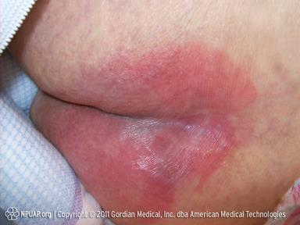
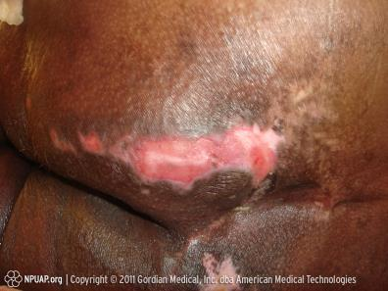
Stage 1
Stage 2

Slide 11
Stage | Definition
Stage 3 Full-thickness tissue loss | Full-thickness tissue loss May see Subcutaneous fat but not bone, tendon, or muscle Slough / biofilm + / - undermining and tunneling Depth varies
Stage 4 Full-thickness tissue loss | Full-thickness tissue loss with exposed bone, tendon, or muscle Slough or eschar + undermining and tunneling Depth varies
Notes:
The bridge of the nose, ear, occiput, and malleolus do not have (adipose) subcutaneous tissue, and Stage 3 or 4 injuries can be shallow. In contrast, areas of significant adiposity can develop extremely deep Stage 3 pressure injuries. Stage 4 injuries can extend into muscle and/or supporting structures (eg, fascia, tendon or joint capsule) making osteomyelitis or osteitis likely to develop.

Slide 12
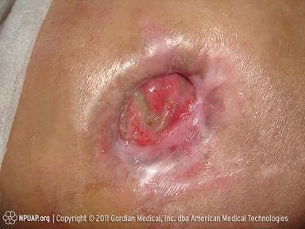
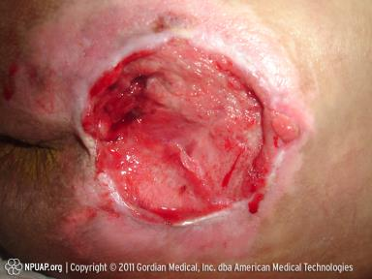
Stage 3
Stage 4

Slide 13
Stage | Definition
Unstageable Full-thickness skin or tissue loss, depth unknown | Full-thickness tissue loss obscured by slough (yellow, tan, gray, green, or brown) and/or eschar (tan, brown, or black) Stable (dry, adherent, intact without erythema or fluctuance) Leave heal eschars alone !

Slide 14
Stage | Definition
Deep tissue injury depth unknown | Purplish or maroon area of intact skin Blood-filled blister Painful, firm, mushy, boggy, warmer, or cooler than adjacent tissue May further evolve and become covered by thin eschar Evolution may be rapid and expose additional layers of tissue, even with optimal treatment

Slide 15
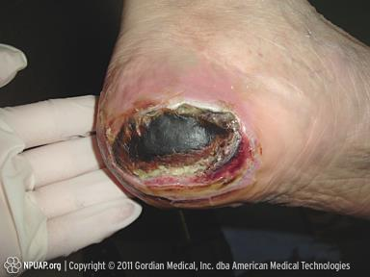
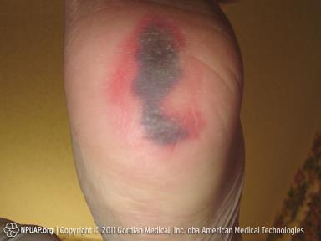
Unstageable, with eschar
Deep tissue injury
Notes:
The heel, the second most common site for pressure injuries after the sacrum, has unique anatomic features that warrant special consideration when evaluating an ulcer. These include thick skin, very little subcutaneous tissue and muscle, and vascular perfusion delivered around the large calcaneus bone that underlies the rear portion of the foot. The foot is also susceptible to circulatory impairment because of atheromatous disease of the leg, microvascular disease from diabetes mellitus, and decreased sensation from peripheral neuropathy of any etiology. Pressure ulcers of the heels often present as blisters. A clear blister over a bony prominence is considered a stage II pressure injury whereas a blood-filled blister is considered DTI.

Slide 16
General approach
evaluated the individual’s clinical condition and pressure ulcer risk factors
defined and implemented interventions consistent with individual needs, goals, and recognized standards of practice, and
monitored and evaluated the impact of the interventions, revising the approaches as appropriate

Slide 17
WOUND DOCUMENTATION
Diagnosis
Stage
Location
Length
Width
Depth
Odor or drainage
tunneling
Wound bed character
Margins /Surrounding skin
Edema
Lymph vs extracellular
Notes:
Supplemental information can include warmth, capillary refill, and presence of pulses, edema, anasarca, and lymphedema.
Documentation of wound progression is an important component of management and should be ongoing, systematic, and consistent. Wounds should be formally assessed at least weekly, with descriptors that include measurements, nature of the wound bed and periwound area, pressure redistribution modalities, treatments in progress, and response to healing. Some authorities recommend a validated healing scale such as the Pressure Sore Status Tool or the Pressure Ulcer Scale for Healing. No single standard exists that mandates the type and extent of information to include in a wound assessment, but the more descriptors the better. Patients with pressure injuries frequently undergo transitions between locations within the health care continuum, and wounds should be thoroughly documented on both admission and discharge from hospitals and long-term care facilities. Similarly, initial home care visits should include thorough skin inspection. Reverse staging is not a recognized standard, because it does not accurately characterize the anatomic and physiologic process that occurs during healing.

Slide 18
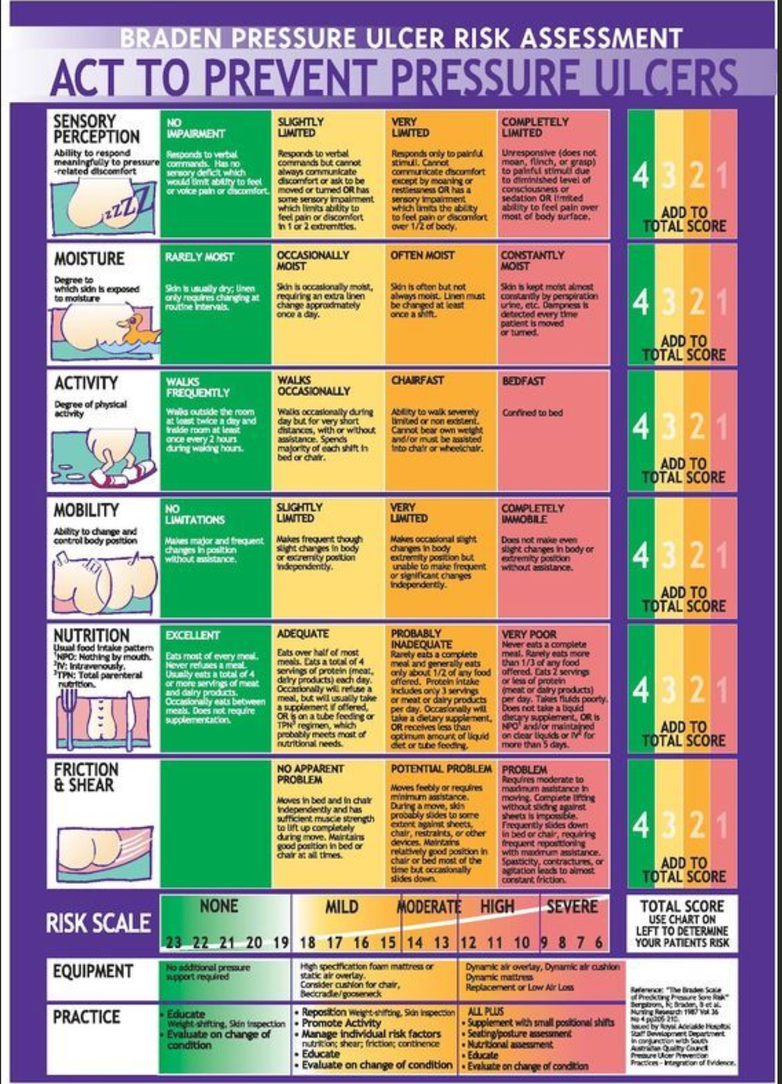
Risk Assessment

Slide 19
RISK FACTORS FOR PRESSURE ULCERATION
Intrinsic Risk Factors | Extrinsic Risk Factors
Dermatitis | Friction
Edema | Immobility
Hypoperfusion | Medical devices
Immobility | Moisture
Long-term corticosteroid use | Pressure
Circulatory impairment | Shear forces
Nutritional compromise
Notes:
Patients >75 years old with malnutrition and weight loss are 3.8 times more likely to develop pressure injuries. Medical devices are increasingly recognized as causes of pressure ulceration. These include external devices such as tubing and orthopedic splints, casts, limb immobilizers, abdominal binders, and CPAP masks. Care plans for patients with external orthopedic devices should always include periodic skin assessment. Pressure injuries can develop over internally placed medical devices such as implantable neurostimulators and pain-control pumps that create new pressure points under the skin.

Slide 20
MOISTURE
Sweat, urine, diarrhea, fistulas, or wound exudate
Increases susceptibility to pressure injuries
loose stools / Clostridium difficile colitis
Strategies to avoid or treat MASD
Moisture barrier creams, absorbable undergarments, continence care, and fecal and urinary diversion devices

Slide 21
MOISTURE-ASSOCIATED SKIN DAMAGE (MASD) (2 OF 2)
Sacrum, with MASD

Slide 22
Strategy to avoid moisture
Creams: hydrophobic
Absorbable undergarments
Continence
Fecal / diversion devices

Slide 23
PREVENTION STRATEGIES
Pillows and foam wedges
Lifting devices and draw sheets
standard for turning and repositioning is every 2 hours
pressure relief schedules and cushioning for sustained sitting
Float the heels
Notes:
Lifting the heels off the mattress by placing a pillow under the legs when supine is called “floating the heels.”

Slide 24
Mattresses
Group 1 gel, foam, or water
Group 2 alternating-pressure air mattresses or low air loss.
Group 3 pressurized silicone-coated beads
Notes:
The terms “static” and “dynamic” are also commonly applied to support surfaces, where the latter refers to powered devices. There is some evidence that a more advanced static mattress or overlay is associated with lower risk of pressure ulcers than a standard hospital mattress; however, there are little data to support the effectiveness of one type of powered device over another (SOE=C). Given the lack of evidence on efficacy of prevention devices, choices are generally made on the basis of ease of use, nursing preference, cost, availability, and reimbursement.

Slide 25
TREATMENT
Holistic, patient-centered
Assess life expectancy & overall health status
Address psychosocial needs
Treat underlying comorbidities
Assess and correct causes of tissue damage
Assess and monitor the wound
Understand patient’s motivation, function and cognition
home environment & family support

Slide 26
TREATMENT
Offloading
Remove debris and necrotic tissue
Addressing moisture balance
Cover with or without bacterial statics
Address pain
Acknowledge advance directives
palliative care ?

Slide 27
MODALITIES
Type | Content | Rationale | Best Use
Gauze | Cotton, polyester | absorptive or protective, | wet to dry
Hydrocolloid | Adhesive pad with moisture-activated, gel-forming material; | Moisture retention | Superficial, clean pressure ulcers with no necrosis or infection
Semi-permeable films | Transparent polymer with acrylic adhesive | Moisture retention | Superficial, clean pressure ulcers with no necrosis or infection
Notes:
These treatments address:
Moisture balance
Bacterial balance

Slide 28
MODALITIES
Type | Content | Rationale | Best Use
Hydrogel | Water in glycerin or cross-linked polymer sheets | Promote moist wound healing and autolytic debridement | Dry wounds; wounds with some necrosis
Foam | Polyurethane | Absorb exudate, cushioning | Control exudate, protect the wound
Alginate | Seaweed derivative | Absorptive dressing | Control of exudate

Slide 29
MODALITIES
Type | Content | Rationale | Best Use
Collagen | gel, powder, paste, or sheet | Deactivates matrix metalloproteases | Partial- or full-thickness wounds with minimal necrosis
Silver- dressings | multiple types of dressings | antimicrobial activity | control of bacteria
Enzymatic debriding agent | Enzyme in a petrolatum vehicle | Selected degradation of denatured collagen | necrosis and slough
Cadexomer iodine dressing | Iodophor in a polysaccharide polymer | Absorbent, antimicrobial | slough, infected wounds

Slide 30
MODALITIES
Type | Content | Rationale | Best Use
Silicone | Inert silicone polymer | Wound protection when no slough | protects the wound and surrounding skin
Activated charcoal | Combined with silver or other vehicles | Control odor | Palliative wounds with odor
Honey | gel or impregnated into other dressing types | Antimicrobial properties, anti-inflammatory | Autolytic debriding agent on noninfected wounds

Slide 31
MODALITIES
Type | Content | Rationale | Best Use
Topical antiseptics | Includes hydrogen peroxide, Dakin’s solution (hypochlorite), povidone-iodine | Reduce bacterial burden of wounds | Can be cytotoxic to healing wounds; use in heavily contaminated or nonhealable wounds
Petrolatum-impregnated gauze | Woven mesh; medical petrolatum and 3% bismuth tribromophenate | Bacteriostatic, nonadherent, retains moisture | Use with larger wounds with minimal necrosis and slough

Slide 32
ADJUNCTIVE THERAPIES
Electrical stimulation
Therapeutic ultrasound
Negative-pressure wound therapy (NPWT)
Hyperbaric Oxygen (HBO) – limited use for pressure injuries
Notes:
NPWT is the application of suction to a wound bed to facilitate healing. The wound is packed with foam and sealed with adhesive membrane, and a vacuum device delivers controlled negative pressure while collecting exudate and debris into a collection chamber or absorptive pad. Since its introduction in the 1980s, NPWT has become a multimillion dollar industry despite the limited evidence in controlled clinical trials for efficacy. NPWT is marketed for all types of wounds, including open abdominal incisions, dehisced surgical wounds, burns, preparation for skin grafts, traumatic wounds, venous stasis ulcers, diabetic foot ulcers, and pressure injuries
The mechanism by which NPWT promotes healing is not known but may include removal of excess fluid, improved circulation, reduced bacterial load, and the mechanical effect of negative pressure. The FDA has issued a safety communication regarding complications of NPWT, including pain, retention of foreign bodies from the dressing, bleeding, infection, death, and complications stemming from power outages. NPWT should not be used over necrotic or infected wounds and is not a substitute for good nursing care with keeping a wound clean. Patients should be carefully selected for NPWT and educated regarding use and risks of the device. NPWT initiation should be cautiously considered in a wound that is not expected to heal; and if no observable improvement is seen after 2 weeks, NPWT should be discontinued.

Slide 33
NUTRITION
Protein 1.5 gm / kg daily

Slide 34
Signs and symptoms of infection
Fever,
increased drainage,
pain,
warmth,
edema,
erythema,
slough,
odor,
worsening of the wound

Slide 35
Infection management
Swab cultures for pus
Topical or systemic antibiotics
Protect from urine and feces
Notes:
Wound cleansers include water, saline, commercial cleansers, and irrigation devices, but these do not remove deeper bacteria. Bioburden can be managed by removing devitalized tissue with debridement, which can be autolytic, enzymatic, mechanical, or surgical. Antiseptics such as povidone-iodine, betadine, peroxide, and Dakin’s solution are generally discouraged because they harm living tissue but can be useful in heavily contaminated wounds when used in limited fashion.
Local treatments include dressings containing antimicrobial compounds such as gentian violet, methylene blue, silver, and cadexomer iodine. Topical antibiotics include mupiricin, neomycin, polymixin B, and bacitracin. Multiple topical antifungals are available, including the imidazole, triazole, and thiazole compounds. Systemic treatment depends on the suspected organisms and clinical setting, and bone infection requires 6 weeks of intravenous therapy. Aggressive treatment and hospitalization should be guided by goals of care and advance directives in conjunction with education of the patient and family.

Slide 36
PALLIATIVE CARE
Poor nutrition, inadequate perfusion, multisystem organ failure, immunocompromise, irreversible anasarca, or a terminal prognosis that prevents the normal healing process

Slide 37
 | THE MNEMONIC “SPECIAL”
S | Stabilize the wound
P | Prevent new wounds
E | Eliminate odor
C | Control pain
I | Infection prophylaxis
A | Absorbent wound dressings
L | Lessen or reduce dressing changes
Notes:
SOURCE: Alvarez OM, Kalinski C, Nusbaum J, et al. Incorporating wound healing strategies to improve palliation (symptom management) in patients with chronic wounds. J Pall Med. 2007;10(5):1161–1189e.

Slide 38
SUMMARY
Older adults are at high risk of developing skin ulcers
Pressure injuries may result in serious morbidity and mortality
Risk assessment and risk factor intervention are key to pressure injury prevention
Many wounds have reduced or no chance of healing. For these wounds, palliative care principles may curtail suffering, improve quality of life, and decrease health care costs.

Slide 39
CASE REPORT
75M fell off a 6′ ladder. Five hours passed before he was found, lying on his back in the yard.
A fractured right femur was repaired.
The admitting nurse documents a 7 $×$10-cm purple-maroon discoloration at the sacral-coccygeal area; skin is intact.
The discoloration is non-blanching and symmetric.

Slide 40
CASE REPORT
How would you classify this skin issue ?
Deep-tissue injury
Stage 1
Stage 2
Stage 3
Notes:
40

Slide 41
CASE 2
How would you classify this skin issue ?
Deep-tissue injury
Stage 1
Stage 2
Stage 3
Notes:
41

