Slide 1
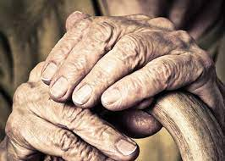
Frailty and Sarcopenia in the Elderly
Lindsey Dahl MD
z

Slide 2
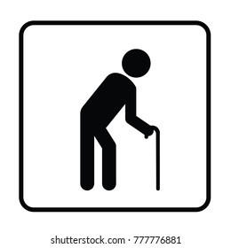
Objectives:
Define and diagnose Frailty
Define and diagnose Sarcopenia
Note adverse outcomes from Frailty and sarcopenia
Identify causes of frailty and sarcopenia
Prevent/Management/Treatment/Care for those with frailty and sarcopenia

Slide 3
Frailty: Definition
Clinical state in which there is an increase in an individual’s vulnerability to developing negative health-related events (disability, hospitalization, institutionalization, death) when exposed to endogenous or exogenous stressors
Progressive age-related decline in physiological systems that results in decreased reserves of intrinsic capacity, which confers extreme vulnerability to stressors and increase risk of adverse outcomes.
Decline in function across multiple systems
Accumulation of multiple deficits
Loss of physical function
Increased vulnerability to stressors/decreased resilience
Decreased homeostatic reserves exposing individual to higher vulnerability to stressors and increased risk of negative health outcomes
Multimorbidity
z

Slide 4
Physiological Frailty

Slide 5
Causes of Frailty
Direct cause unknown: appears to be dysregulation of
inflammation- (inc IL-6 and CRP)
decrease immune function
anemia
increased glucose intolerance, insulin resistance
low DHEA-S and IGF-1
increased cortisol, low testosterone
nutritional derangements
decreased heart rate variability
The number of abnormal systems is stronger predictor of the syndrome of frailty than dysfunction in any one system

Slide 6
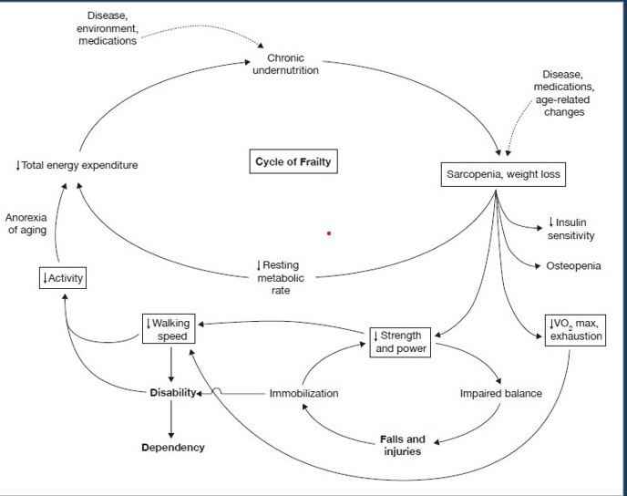
Frailty as physiological process
z

Slide 7
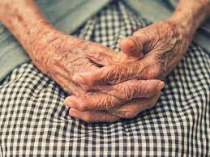

Slide 8
Why does it matter?
Aging population
Higher cost to healthcare system
Increase morbidity and mortality
Increased dependency (need for increased cares, ALFs, LTCs)
Longer hospital stays
Frequent ED visits and hospitalizations
Poor tolerance surgery/chemotherapy

Slide 9
Ways to Assess
Number of phenotypic frailty criteria out of 5
Screening (FRAIL)-validated
Frailty Index (accumulation of deficits/#of deficits considered)
Walking speed and/or grip strength

Slide 10
FRAIL

Slide 11
Edmonton Frailty Scale

Slide 12
Sarcopenia
Age related decline in skeletal muscle mass concomitant with decreased strength and/or function.
Measured by gait speed, hand grip strength
Associated with decreased quality of life, falls, frailty, disability and mortality
Strong association with osteoporosis and fractures

Slide 13
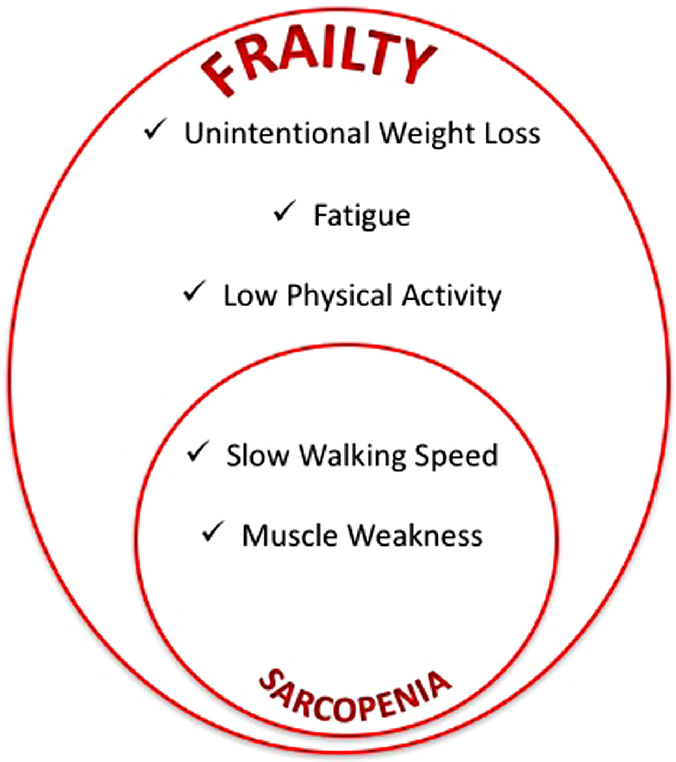

Slide 14
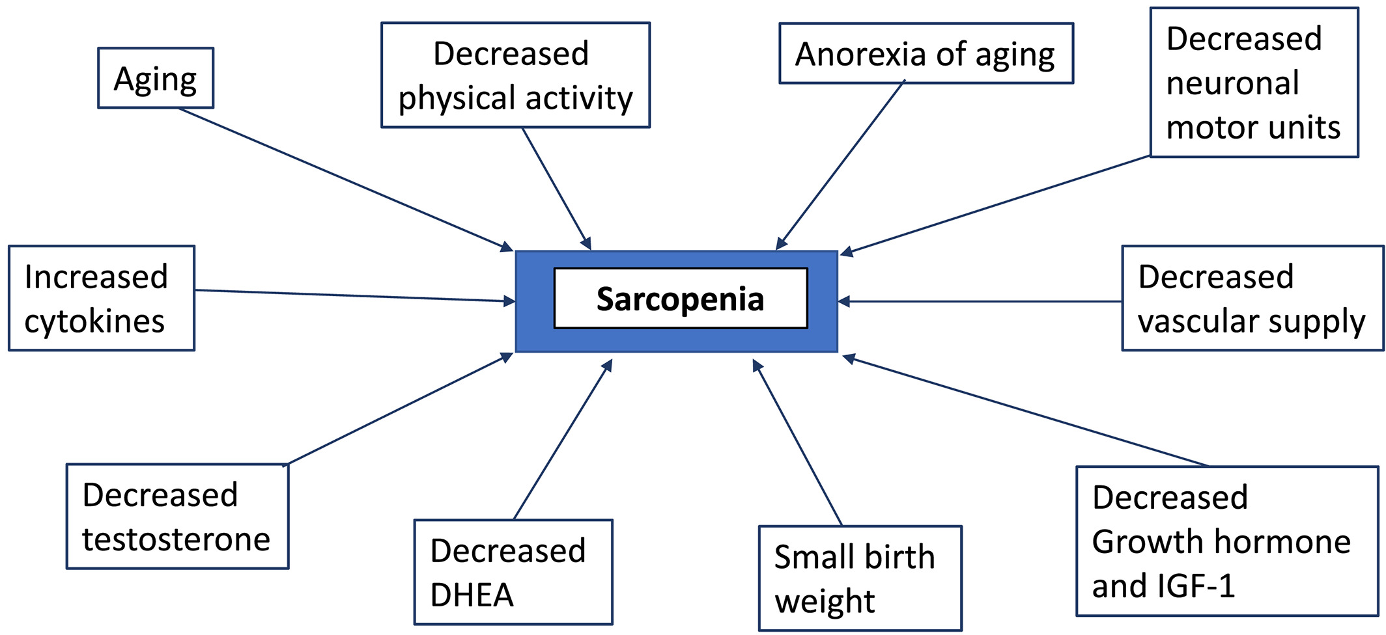
Causes of Sarcopenia
Journal of Cachexia, Sarcopenia and Muscle, Volume: 10, Issue: 5, Pages: 956-961, First published: 15 September 2019, DOI: (10.1002/jcsm.12483)
Notes:
The factors involved in the pathogenesis of primary (age related) sarcopenia.
IF THIS IMAGE HAS BEEN PROVIDED BY OR IS OWNED BY A THIRD PARTY, AS INDICATED IN THE CAPTION LINE, THEN FURTHER PERMISSION MAY BE NEEDED BEFORE ANY FURTHER USE. PLEASE CONTACT WILEY'S PERMISSIONS DEPARTMENT ON PERMISSIONS@WILEY.COM OR USE THE RIGHTSLINK SERVICE BY CLICKING ON THE 'REQUEST PERMISSIONS' LINK ACCOMPANYING THIS ARTICLE. WILEY OR AUTHOR OWNED IMAGES MAY BE USED FOR NON-COMMERCIAL PURPOSES, SUBJECT TO PROPER CITATION OF THE ARTICLE, AUTHOR, AND PUBLISHER.

Slide 15
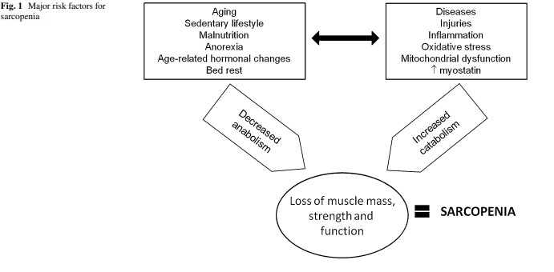

Slide 16
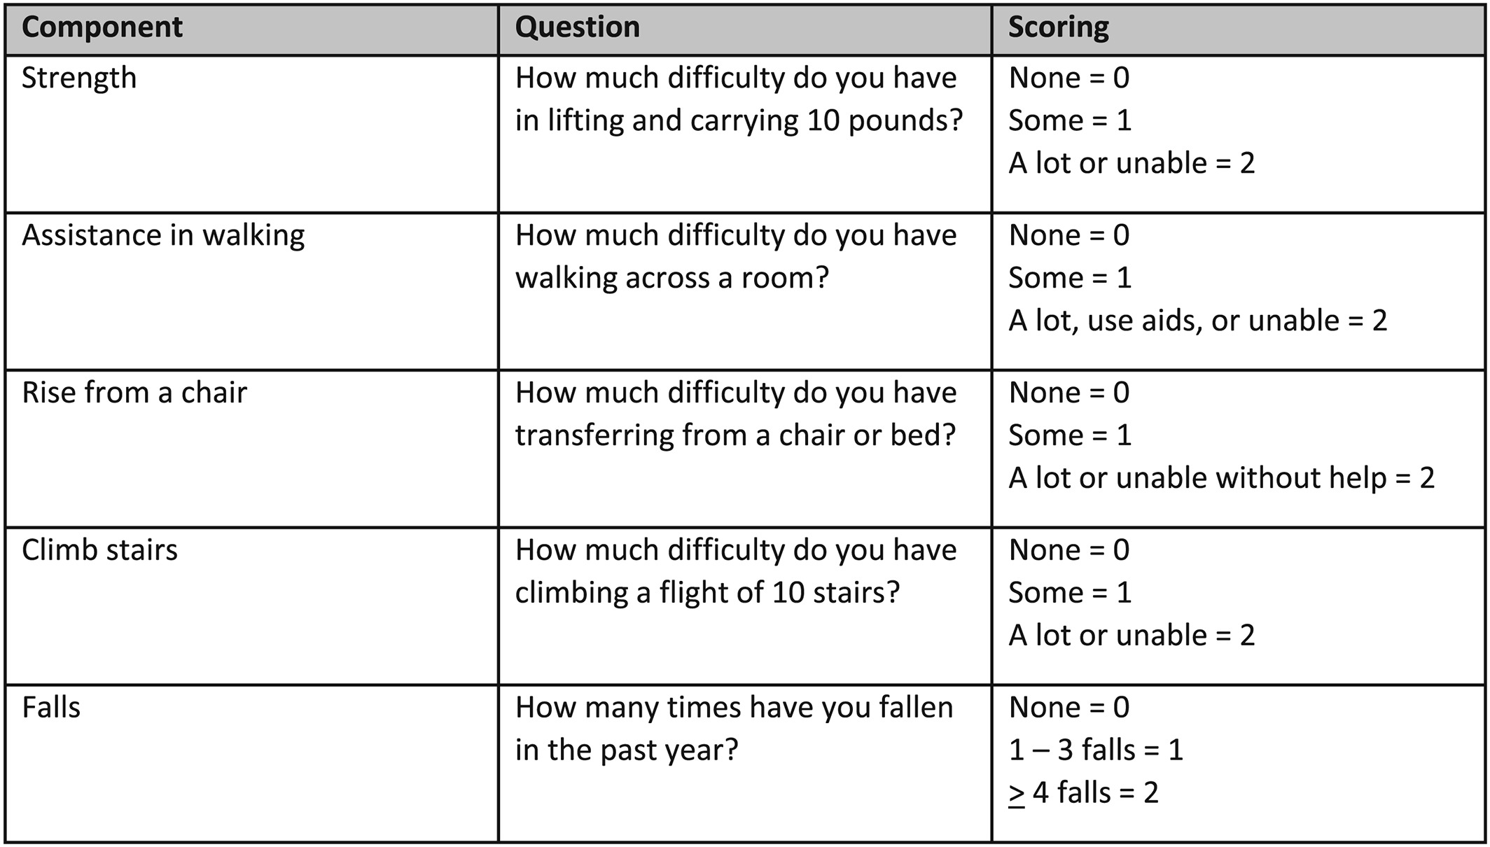
Sarcopenia: SARC-F
Scoring: 1–10 total points possible; 0–2 for each component; 0 = best, 10 = worst; 0–3 healthy; ≥ 4 is symptomatic for sarcopenia
Journal of Cachexia, Sarcopenia and Muscle, Volume: 10, Issue: 5, Pages: 956-961, First published: 15 September 2019, DOI: (10.1002/jcsm.12483)
Notes:
SARC‐F questionnaire (includes scoring).
IF THIS IMAGE HAS BEEN PROVIDED BY OR IS OWNED BY A THIRD PARTY, AS INDICATED IN THE CAPTION LINE, THEN FURTHER PERMISSION MAY BE NEEDED BEFORE ANY FURTHER USE. PLEASE CONTACT WILEY'S PERMISSIONS DEPARTMENT ON PERMISSIONS@WILEY.COM OR USE THE RIGHTSLINK SERVICE BY CLICKING ON THE 'REQUEST PERMISSIONS' LINK ACCOMPANYING THIS ARTICLE. WILEY OR AUTHOR OWNED IMAGES MAY BE USED FOR NON-COMMERCIAL PURPOSES, SUBJECT TO PROPER CITATION OF THE ARTICLE, AUTHOR, AND PUBLISHER.

Slide 17
Management strategies
Comprehensive Geriatric Assessment: multidisciplinary team approach to preserve independence. Has positive affects on polypharm, falls, functional status
Reduction of polypharmacy
Diet (Mediterranean plus concentration on protein and micronutrients)
Exercise prescription for strength/resistance and aerobics stretching etc
Preventing immobility is critical

Slide 18
Management
Exclude any precipitating causes: treatable and or environmental
Improve the clinical manifestations (low activity, strength, exercise tolerance and diet)
Minimize consequences of vulnerability: environmental risk, low social support risk, risk from stressors (acute illness/injury/hospitalization/surgery)

Slide 19
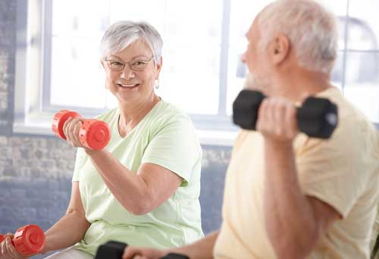
Prevention
Exposure to variety of stressors puts frail older adults at risk of adverse outcomes and precipitates frailty in those at risk.
Key precipitants:
Immobility
Depression/isolation/lonliness
Hospitalization
Surgery
Attention to minimize these precipitants and stress associated

Slide 20
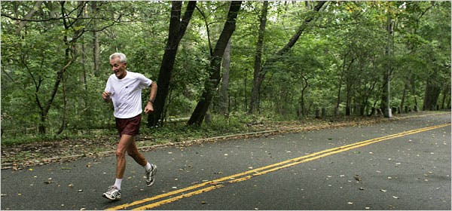
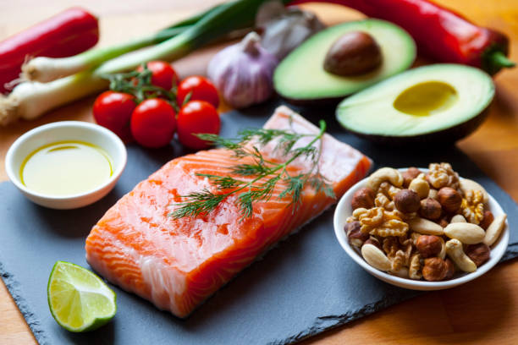
prevention
Maintain physical activity and muscle mass
Mediterranean diet
Focus on protein calories >1.5g/kg/24hr
Some +affects of leucine or beta hydroxy beta methylbutyrate
Correct vitamin D deficiency

Slide 21
Palliative Care
Frailty predicts functional decline and progression of dependency at the end of life
Severe frailty score 4-5 with low albumin, predicts high risk short term mortality
Poor response to therapy end stage frailty most appropriate for palliative care

Slide 22
Patient Case
80 y/o women admitted to hospital for treatment of uncontrolled hypertension. She describes long standing fatigue and poor energy
History: lung disease, heart failure, Aortic stenosis
Routine screening noted worsening of AS
Lost 6lbs in last year
Examination hospital day 3: HR 63, BP 160/70, BMI 18
Difficulty rising from chair and slowed gait

Slide 23
Does she have frailty?
Does she have sarcopenia?
How does this knowledge change treatment? Discharge plan?
What if cardiology says she needs a TAVR?
What if she had horrible knee oa and wanted a TKA?

Slide 24
For which of the following does her frailty put her at increased risk for?
A. extended length of stay
B. admission to ICU
C. exacerbation of heart failure
D. Higher mortality

Slide 25
Which is the most effective frailty screen in clinical practice?
A. Self reported health
B. Gait speed
C. Polypharmacy
D. Assessment by a GP

Slide 26
Which of the following interventions is not endorsed by experts regarding treatment of frailty?
A. Calorie and protein supplementation
B. Hormone supplementation
C. Vitamin D supplementation
D. Reduction in polypharmacy

Slide 27
Thank You
z

