Slide 1
Notes:
I am grateful for the opportunity to connect with you today and share some information about Alzheimer’s and dementia. My name is _________ and I am a volunteer with the Alzheimer’s Association. I volunteer because
{Insert why you volunteer…tell your story to connect with the members of the audience}

Slide 2
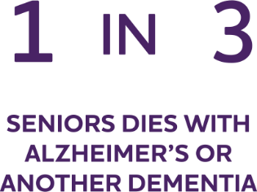
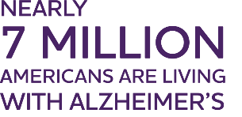
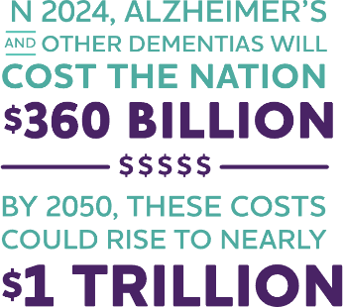
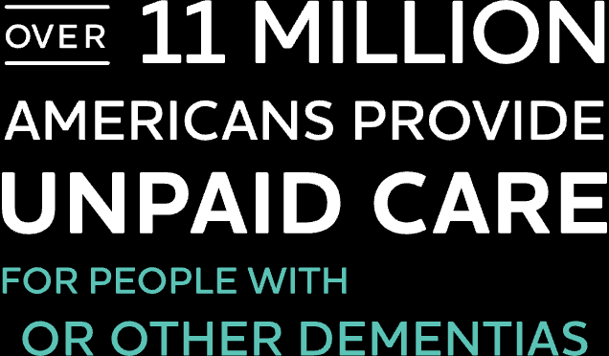
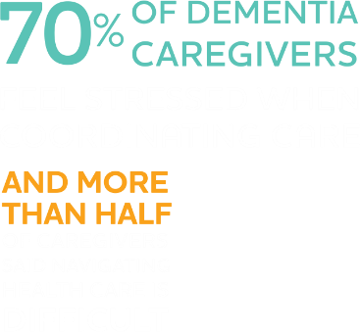
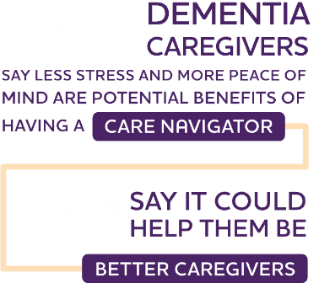
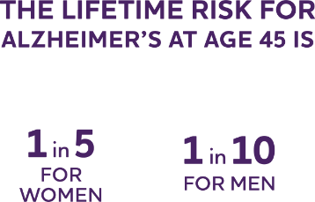
Notes:
In our community Alzheimer’s and dementia have affected many of us, and nationwide, the numbers are staggering. Let’s take a quick look at these highlights why the work we do is so important and needed now more than ever. Here is the latest statistics on Alzheimer’s disease prevalence, mortality, caregiving and cost of care. It’s important to note that these statistics represent Alzheimer’s disease alone and do not reflect all other forms of dementia.

Slide 3
Notes:
As you can see, the numbers are staggering:
Nearly 7 million Americans are living with Alzheimer’s
Over 11 million are providing unpaid care for people living with the disease.
Alzheimer’s is one of the costliest conditions to society.
Left unchecked, Alzheimer's will destroy our finances, our families and our futures.
Fortunately, the Alzheimer’s Association is leading the way to end Alzheimer's and all other dementia around the world and in our community.

Slide 4
Notes:
Just to make sure we’re all on the same page with some important definitions….our mission references Alzheimer’s AND dementia. Let me tell you a bit about dementia and Alzheimer’s.
Dementia is a general term for loss of memory, thinking, language, problem-solving and other abilities that are severe enough to interfere with daily life. Alzheimer's is the most common cause of dementia.
Dementia is not a single disease; it’s an overall term — like heart disease — that covers a wide range of specific medical conditions, including Alzheimer’s disease. Disorders grouped under the general term “dementia” are caused by abnormal brain changes. These changes trigger a decline in thinking skills, also known as cognitive abilities, severe enough to impair daily life and independent function. They also affect behavior, feelings and relationships.
Alzheimer's disease accounts for 60-80% of cases. Vascular dementia, which occurs because of microscopic bleeding and blood vessel blockage in the brain, is the second most common cause of dementia. Those who experience the brain changes of multiple types of dementia simultaneously have mixed dementia. There are many other conditions that can cause symptoms of dementia, including some that are reversible, such as thyroid problems and vitamin deficiencies.

Slide 5
Notes:
Alzheimer's is the most common cause of dementia. It is not a normal part of aging.
The greatest known risk factor for Alzheimer’s is increasing age, and the majority of people with Alzheimer's are 65 and older. Alzheimer’s disease is considered to be younger-onset Alzheimer’s if it affects a person under 65. Younger-onset can also be referred to as early-onset Alzheimer’s. People with younger-onset Alzheimer’s can be in the early, middle or late stage of the disease.
Alzheimer's worsens over time. Alzheimer's is a progressive disease, where dementia symptoms gradually worsen over a number of years. In its early stages, memory loss is mild, but with late-stage Alzheimer's, individuals lose the ability to carry on a conversation and respond to their environment. On average, a person with Alzheimer's lives 4 to 8 years after diagnosis but can live as long as 20 years, depending on other factors.
Often dementia will start out slowly and gradually get worse. If you or someone you know is experiencing memory difficulties or other changes in thinking skills, don't ignore them ~ even if the symptoms are mild. See a doctor soon to determine the cause. There are many benefits to receiving an early and accurate diagnosis, including an opportunity to plan for the future, access support services and explore treatment options.

Slide 6
Notes:
If you notice any of the warning signs of Alzheimer’s disease in yourself or someone you know, schedule an appointment with your doctor.
The earlier someone is diagnosed, the more treatment options may be available. Some medications are only effective in the early stages of the disease. Additionally, when caught early some lifestyle changes, such as controlling blood pressure, stopping smoking, participating in exercise, and staying mentally and socially active, may help preserve cognitive function.
Receiving an early Alzheimer’s diagnosis may help lessen anxieties about why someone is experiencing symptoms. With early detection, families also have the opportunity to maximize time together and access resources and support programs.

Slide 7
Notes:
Because Alzheimer’s and dementia have such profound effects on individuals, families and whole communities, all of us should be equipped to recognize the warning signs.
There are 10 key warning signs and symptoms of Alzheimer’s which can be subtle.
Please note: It’s possible for individuals to experience one or more of these signs in varying degrees. It is not necessary to experience every sign in order to raise concern.
{Read a few from the list. Highlight a couple of signs as it relates to your experience with Alzheimer’s or dementia}

Slide 8
Notes:
There is exciting progress in Alzheimer's and dementia research that is creating promising new treatments for people living with the disease.
The U.S. Food and Drug Administration (FDA) has approved medications for Alzheimer's. These fall into two categories:
•Drugs that temporarily ease some symptoms of Alzheimer's disease.
•Drugs that change disease progression in people living with Alzheimer's. Two FDA-approved treatments demonstrate that removing beta-amyloid, one of the hallmarks of Alzheimer’s disease, from the brain reduces cognitive and functional decline in people living with early Alzheimer’s.
•
Today, there is a worldwide effort underway to find better ways to treat the disease, delay its onset and prevent it from developing.
•
When thinking about any treatment, it is important to have a conversation with a health care professional to determine whether it is appropriate, and weigh potential benefits and risks. A doctor who is experienced in using these medications should monitor people who are taking them and provide information that can help people make informed decisions about their usage and care. To prevent drug interactions and unwanted side effects, it's important that the person's doctor, pharmacist and care team are aware of all medications being taken, including over-the-counter and alternative remedies.

Slide 9
Notes:
In some communities, the risk of Alzheimer's is even greater. Studies show that Black Americans are twice as likely as White Americans to develop Alzheimer’s, and Hispanic Americans are 1.5 times more likely than non-Hispanic White Americans to develop the disease. Members of underserved diverse communities are more likely to endure poverty and have more limited access to quality health care. They are also less likely to pursue a diagnosis, receive support or participate in a clinical trial.
Alzheimer’s also has a disproportionate impact on women. In the United States, more than 11 million women are either living with Alzheimer’s or caring for someone who has it, and almost two-thirds of Americans living with Alzheimer’s are women. Women in their 60s are more than twice as likely to develop Alzheimer’s disease over the rest of their lives as they are to develop breast cancer.
At the Alzheimer's Association®, we believe that diverse perspectives are critical to achieving health equity — meaning that all communities have a fair and just opportunity for early diagnosis and access to risk reduction and quality care. The Association is committed to engaging underrepresented and underserved communities and responding with resources and education to address the disproportionate impact of Alzheimer’s and dementia.

Slide 10
In 2023, over 11 million Americans provided unpaid care for people with Alzheimer’s or other dementias.
Caregivers provided more than 18 billion hours of unpaid care valued at nearly $347 billion.
Impact of Alzheimer’s on Caregivers
Caring for someone living with Alzheimer’s can take a physical, emotional, social and financial toll on family caregivers.
Of the total lifetime cost of caring for someone with dementia, 70% is borne by family caregivers — either through out-of-pocket expenses or from unpaid caregiving.
59% of family caregivers rated the emotional stress of caregiving as high or very high.
Notes:
Adult children and spouses of people living with dementia often serve as primary caregivers. It can be challenging for all family members to accept changes in their roles and responsibilities.
The demands of caregiving can limit a caregiver's ability to take care of themselves. Family caregivers of people with Alzheimer's and related dementias are at greater risk for anxiety, depression, and poorer quality of life than caregivers of people with other conditions.
Additionally, the lifetime cost of care for individuals with Alzheimer’s is more than twice the amount incurred by individuals without Alzheimer’s.

Slide 11
Notes:
In addition to the exciting advancements in treatment, there is more research every day about the importance of brain health to reduce the risk of Alzheimer’s disease and dementia.
There are several risk factors for cognitive decline and dementia. Some, such as age, we can’t control.
Research is still evolving, but evidence is strong that people can reduce their risk of cognitive decline by making key lifestyle changes, including participating in regular physical activity, staying socially engaged, and maintaining good heart health.
When possible, combine these habits to achieve maximum benefit for the brain and body. Start now. It’s never too late or too early to incorporate healthy habits.

Slide 12
Notes:
These 10 healthy habits are good for brain health. Do as many as them as you can for maximum benefit.
{Read a couple from the list and highlight which behaviors you practice regularly}
Stay in School - Education at any stage of life will reduce risk of cognitive decline and dementia. Encourage kids to stay in school and find ways to continue your own learning - at a local library, community college, etc.
Challenge Your Mind - Stay cognitively engaged by trying something new or hard for you. Learn a new skill or try something artistic. Challenging your mind may have short- and long-term benefits for your brain.
Get Moving - Regularly engage in physical activity that increases your heart rate and increases blood flow to your brain and body. Try to find new or more ways to build physical activity activity into your day. Speak with your doctor before beginning a new exercise regimen.
Eat Right - Balanced, healthy eating is good for the brain. This includes eating less saturated far and processed foods; and more vegetable, fruits and lean proteins. Build in healthier food options that make sense for you and your everyday life.
Maintain a Healthy Weight - A healthy weight is important for heart and brain health. There is compelling evidence that midlife obesity increases risk for cognitive decline and possibly dementia.
Control Blood Pressure - High blood pressure is a risk to brain health. Monitor your blood pressure and work with a doctor to keep it under control. Medications can be very effective, and other healthy habits, like healthy eating, being physically active, and getting quality sleep can help too.
Manage Diabetes – Type 2 diabetes is also a risk to brain health. Type 2 diabetes can be prevented or controlled by healthier eating, increasing
physical activity, and medication, if necessary. Work with a healthcare provider to control diabetes.
Protect Your Head- There is solid evidence that brain injuries increase the risk of developing certain forms of dementia, and repeated head injuries may increase risk even more. Protect your head by appropriately wearing helmets and seatbelts and make sure kids ride in approved car seats too. Preventing falls, especially for older adults, is important - try to remove tripping hazards, for example.
Sleep Well - Good quality sleep is important for brain health. If you have a sleep-related problem, like sleep apnea, talk to a doctor. Improve the quality of your daily sleep by minimizing disruptions and making your sleep environment as comfortable as possible (preferred light, temperature, noise level).
Be Smoke-free - There is strong evidence that smoking increases risk of cognitive decline and possibly dementia (for current smokers). Quitting smoking can lower the risk of cognitive decline back to levels similar to those who have not smoked.

Slide 13
Notes:
I want to make sure you know about the ways the Alzheimer’s Association can help you and your community. No matter where you are on your journey, you are not alone.
Our 24/7 Helpline (800.272.3900) is available around the clock, 365 days a year. Through this free service, specialists and master’s-level clinicians offer confidential support and information to people living with dementia, caregivers, families and the public.
The Alzheimer’s Association website (alz.org) offers a wide range of dementia and aging-related resources that connect individuals facing dementia with local programs and services. We also provide easy access to resources, community programs and services in your local community.
Our face-to-face and virtual education and support programs ensure that our services reach all communities. Our education programs include basic, introductory information as well as more advanced caregiver topics and programming for professional care providers. These programs are free and open to the public and delivered by trusted volunteers, staff and community partners to raise awareness and encourage people proactively talk to their doctors about reducing risk, diagnosing dementia early, and undergoing treatment when appropriate. Programs are also available on-demand through our website.
The Association is known for its kind, welcoming and compassionate support for caregivers and people living with dementia. In addition to in-person and virtual support groups, the Alzheimer’s Association ALZConnectedⓇ is a free online community where people living with dementia and those who care for them can connect with others who understand what they’re going through. We also offer a suite of online tools to empower those facing the disease, including ALZNavigator, an interactive online tool that creates custom action plans for users based on their current situation. And through community partnerships, we offer early-stage social engagement programs for those living with Alzheimer’s and dementia.

Slide 14
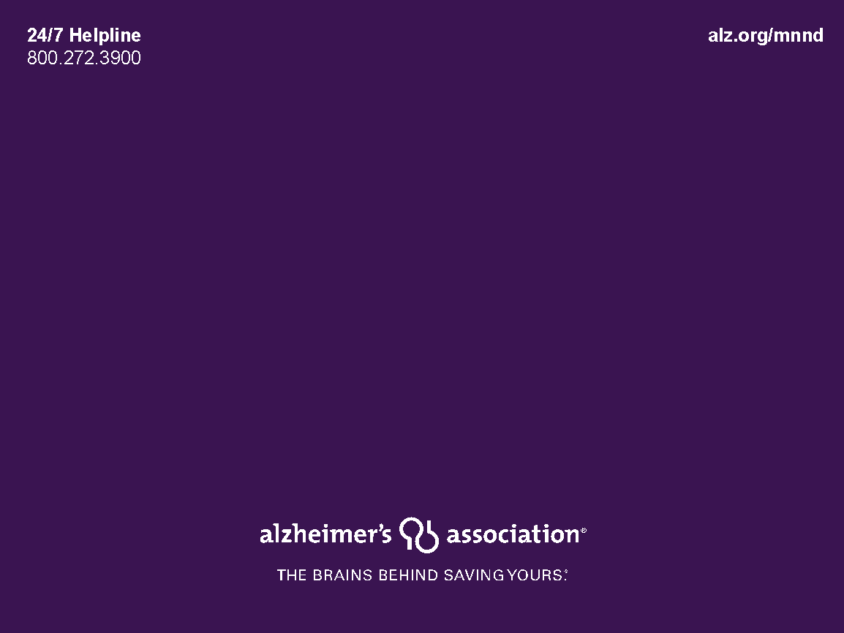
This project is supported by funding through the North Dakota Department of Health and Human Services, Adults and Aging Services Division.
NORTH DAKOTA DEMENTIA CARE SERVICES PROGRAM

Slide 15
ND Dementia Care Services Program
Care Consultation
Health Systems, EMTs and Long Term Care/Community-Based Providers Training
Law Enforcement/First Responder Education
Health Care Provider Outreach
Community Education and Outreach
Build Partnerships

Slide 16
How to Refer to the ND Dementia Care Services Program
Professionals:
Get permission from personal representative (caregiver or POA) and include their name and phone number
Fax release of information to: 701.205.3822
Caregivers:
Call to schedule: 701-258-4933

Slide 17
Notes:
You can help us realize our vision of a world without Alzheimer’s and all other dementia. The Association has a variety of volunteer opportunities available to fit all interests, skills, and experience levels.
You can use your unique talents to make a meaningful impact in your community while connecting with others who share your passion. Whether you want to get involved as an individual, volunteer with your service club, organization, company or group, or you need some support for a family, friend or neighbor, the Alzheimer’s Association is here for you. Contact the Alzheimer’s Association to find the role that’s the best fit for you.

Slide 18
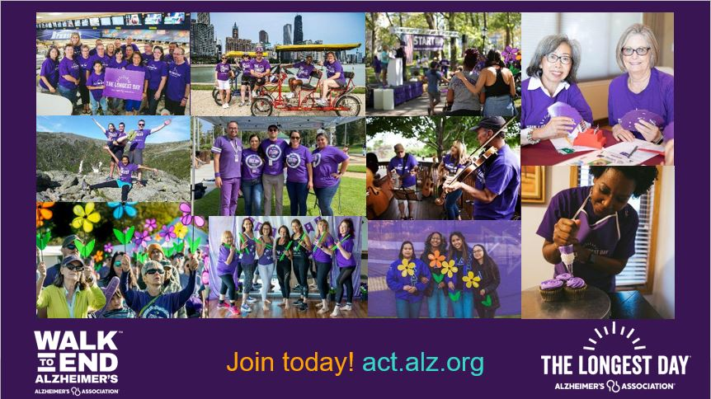
Notes:
To help fuel our mission, we engage volunteers at every level of our organization and raise funds to support our efforts. Often, our fundraising events are the entry point for individuals to volunteer with the Association. Let’s talk a little bit about each of our signature events.
●Held annually in more than 600 communities nationwide, the Alzheimer's Association Walk to End Alzheimer's® is the world's largest fundraiser for Alzheimer's care, support and research. The event calls on participants of all ages and abilities join the fight against the disease.
●The Longest Day is the day with the most light — the summer solstice. Volunteers from across the world fight the darkness of Alzheimer's through a fundraising activity of their choice. Whether you're participating at home, online or in-person, we offer plenty of fun ideas to engage family and friends for The Longest Day.
[TELL YOUR STORY: “As a volunteer, my Walk team brings our family together to honor my XXXX while we raise awareness and funds for the mission.”]

Slide 19
Notes:
I hope you walk away from this presentation having learned something you can use, or share with someone who can. I look forward to hearing from those of you who are inspired to do more to help the Alzheimer’s Association realize Dr. Stone’s vision: A world without Alzheimer’s and all other dementia.

