Slide 1
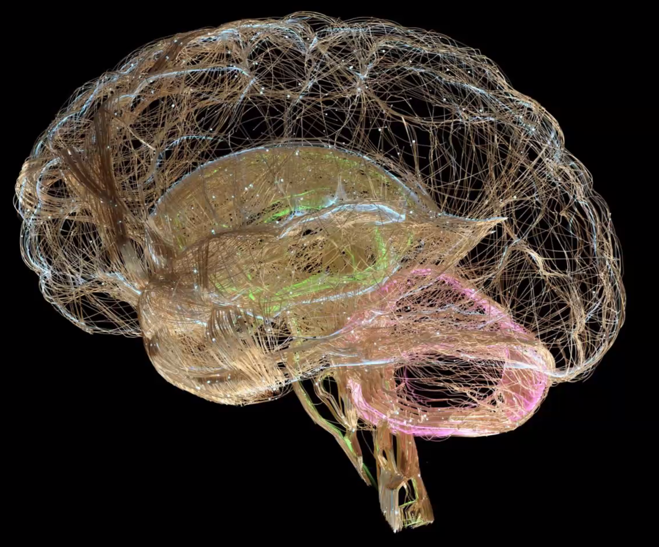
Agitation and Behavioral changes associated with different dementias
Donald Jurivich, DO
gilbertson distinguished professor of geriatrics
University of north dakota

Slide 2
Dakota Geriatrics Workforce Enhancement Program
Vision: To promote healthy lifespans through a better prepared healthcare workforce, healthcare system, and community.

Slide 3
Goals
Report the variety of behavioral issues that accompany different dementias
Describe different ways to assess and monitor behavioral problems as dementias progress
Utilize pharmacological and non pharmacological strategies to address dementia – related behavioral problems

Slide 5
Name different behaviors associated with dementia

Slide 6
Neuropsychiatric Inventory (NPI)

Slide 7
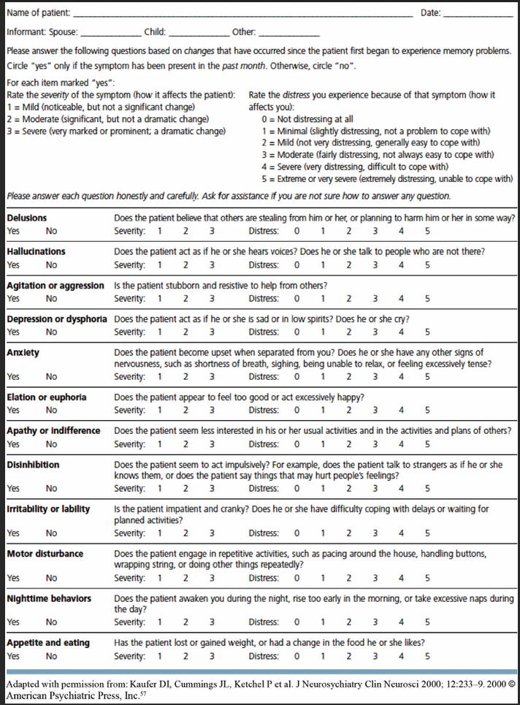

Slide 9
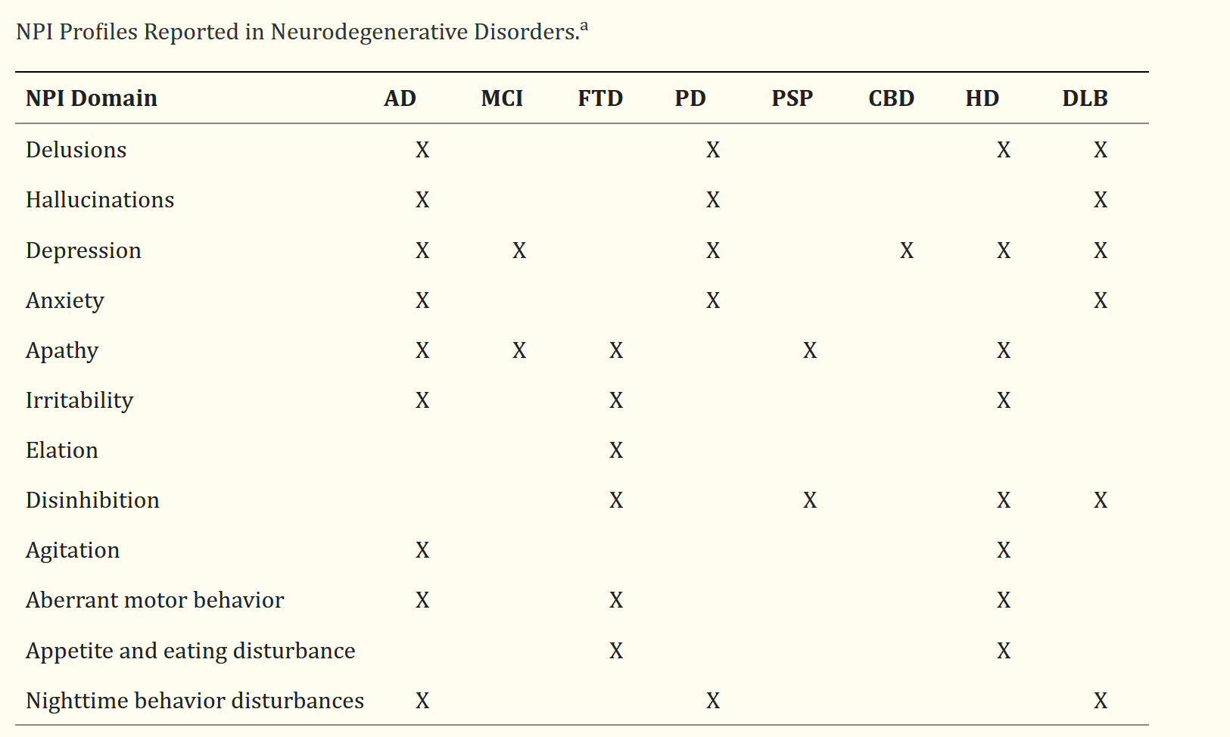

Slide 10
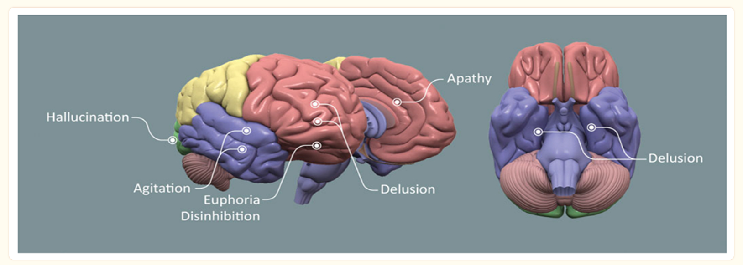

Slide 11
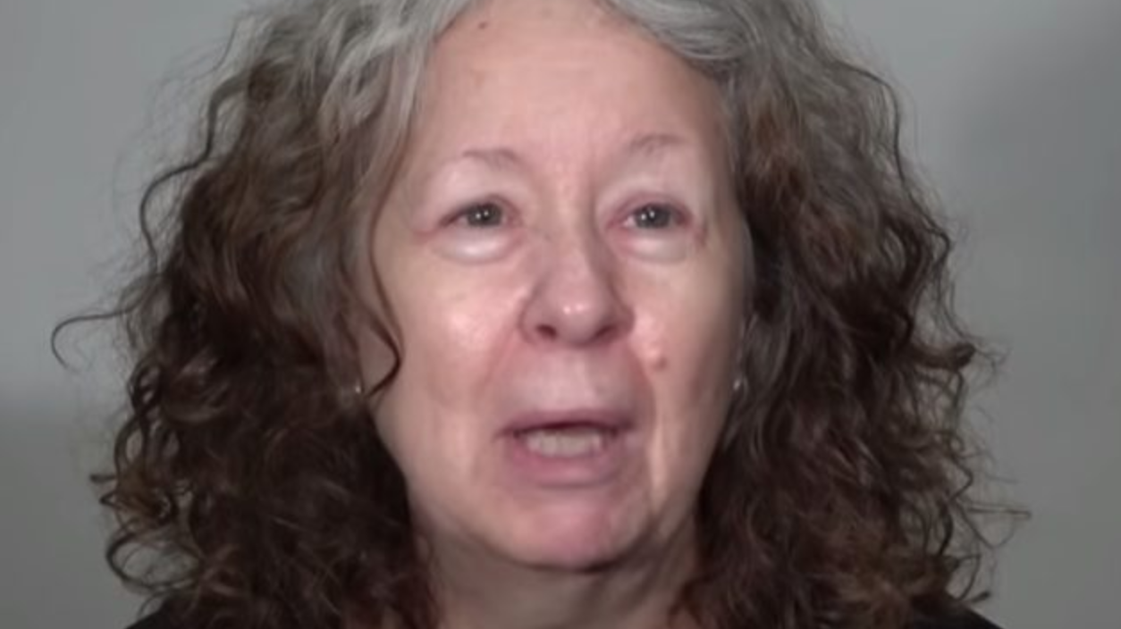
Case Report
62F works as a project manager and after 10 years on the job with excellent reviews she received an end of year reprimand with a personal improvement plan that indicated concerns about personal hygiene, inappropriate comments, and little enthusiasm about work product.

Slide 12
Case Report
Physician visit reveals
Unkempt appearance, comments that the physician “looks like a good kisser”
BP 155 / 88
Oriented to person, place and time
No cogwheeling or back propulsion
CN, sensory and motor intact
SLUMS test 27 / 30, clock draw is off
Sharpened Romberg / balance test is abnormal
Affect: mood is flat, judgement fair – poor.

Slide 13
What is the most likely diagnosis ?
Lewy Body dementia
Alzheimer’s dementia
Vascular dementia
Frontotemporal dementia
Krutzfeld- Jakob disease
Depression

Slide 14
What is the most likely diagnosis ?
Lewy Body dementia
Alzheimer’s dementia
Vascular dementia
Frontotemporal dementia
Krutzfeld- Jakob disease
Depression

Slide 15
What famous British Comedian had Frontotemporal dementia ?

Slide 16
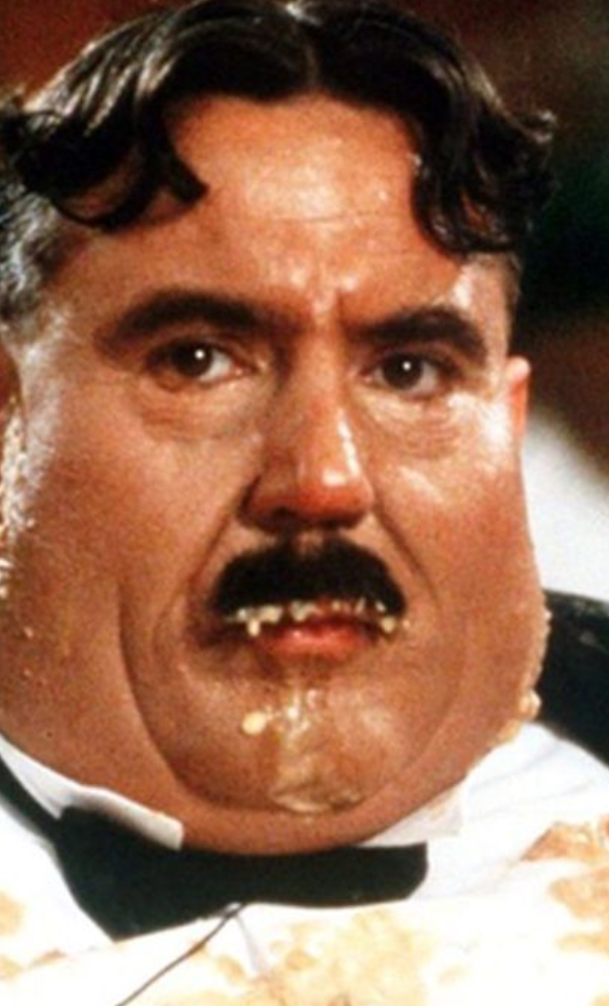
Terry Jones of Monty Python

Slide 17
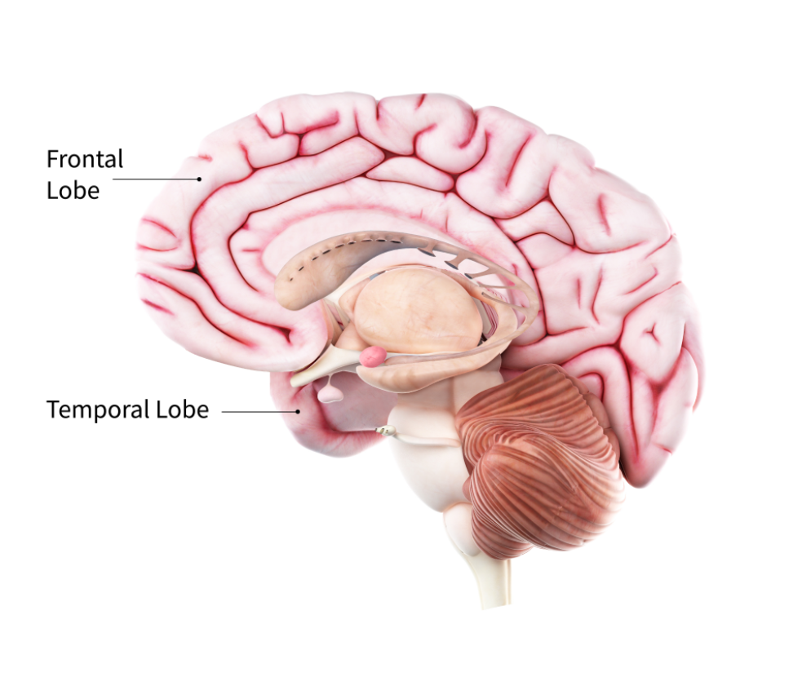
FrontoTemporal Dementia
Socially Inappropriate
No empathy
Poor Judgement
Apathetic
Repetitively compulsive (tapping or clapping)
Poor hygiene
Over eating, especially sweets
Hyperphagia, eating inedible objects
10 – 15 % of all dementias

Slide 18
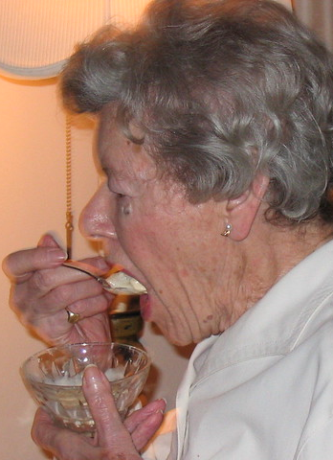
Behavior issues in FTD
Hyperphagia / over eating
Eat inedible objects
Obese
Sweet fetish

Slide 19
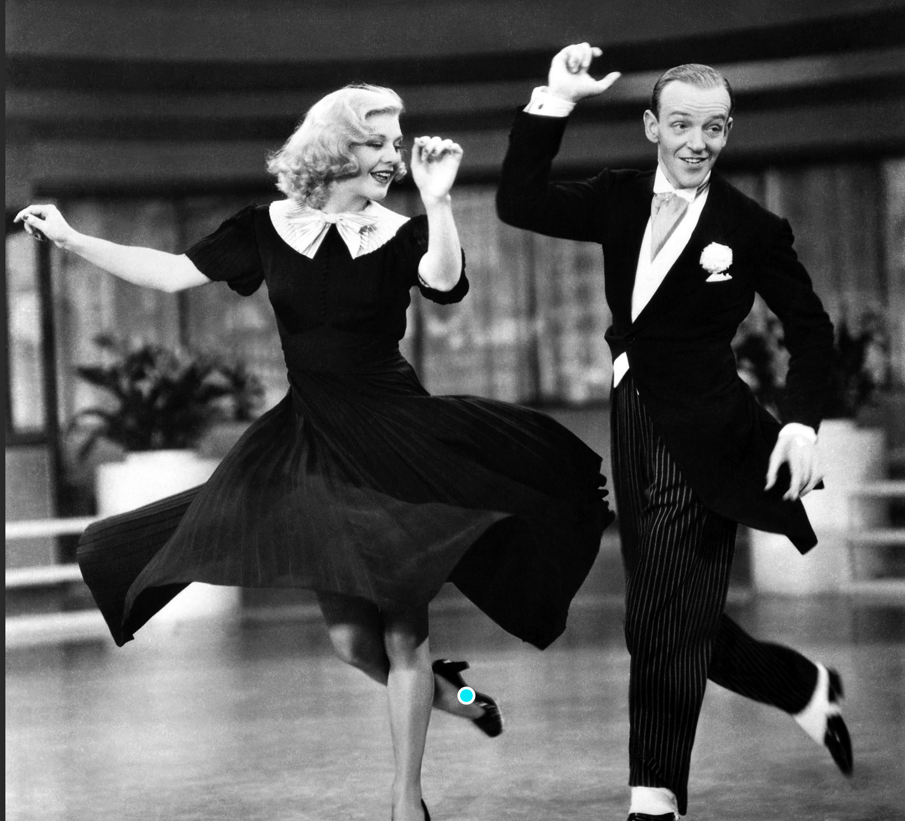
Behavior issues in FTD
Repetitive actions: foot / hand tapping
Compulsive behavior
Ginger Rogers / Fred Astaire
Notes:
Ginger Rogers was quoted as saying that she did all the same dance steps as her partner Fred Astaire except backwards and in heals.

Slide 20
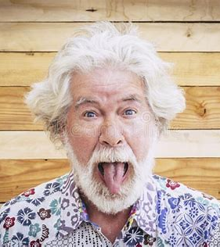
FTD behavior
Socially inappropriate

Slide 21
What famous comedian had Lewy Body Dementia ?

Slide 22
Robin Williams had Lewy Body Dementia

Slide 23
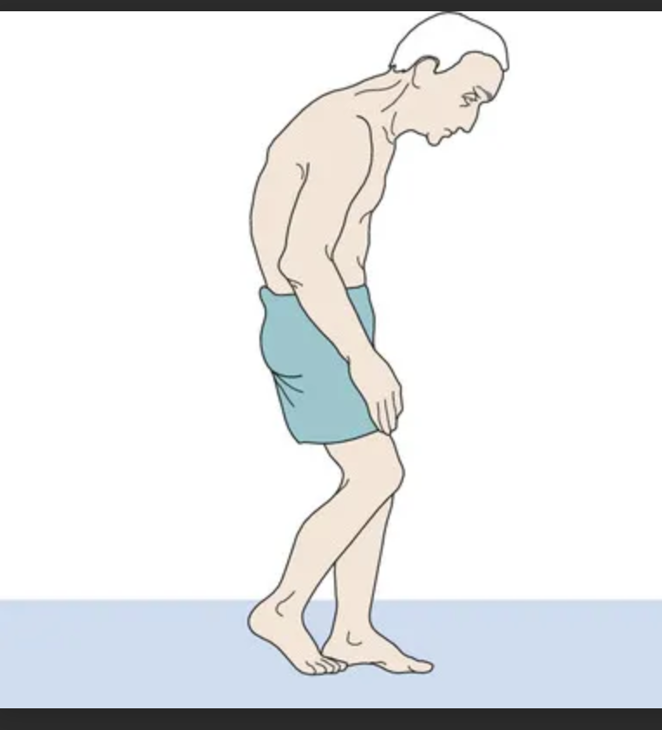
Lewy Body Dementia: movement problems
Stooped posture
Muscle rigidity or stiffness
Shuffling walk, slow movement, or frozen stance
Tremor or shaking, most commonly at rest
Balance problems and falls

Slide 24
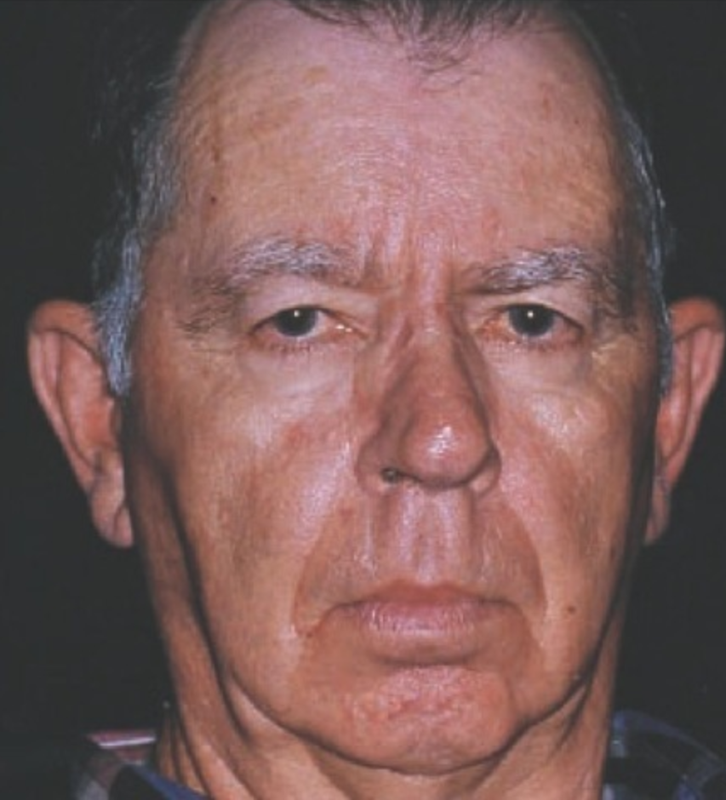
LBD physical attributes
Loss of coordination
Smaller handwriting (micrographia)
Reduced facial expression (masked facies)
Difficulty swallowing
Weak voice

Slide 25
Lewy Body Dementia
Hallucinations: seeing, hearing, smelling or feeling things that are not there (80%)
Delusions: suspicions about spouse or thievery
Paranoia irrational distrust

Slide 26
Lewy Body Dementia
Restless sleep: kicking, punching, yelling, and screaming
Insomnia / day time sleepiness

Slide 27
Lewy Body Dementia
Apathy: listless, not motivated, no socialization
Depression
Roller coaster attention: stare into space, long naps
Anxiety

Slide 28
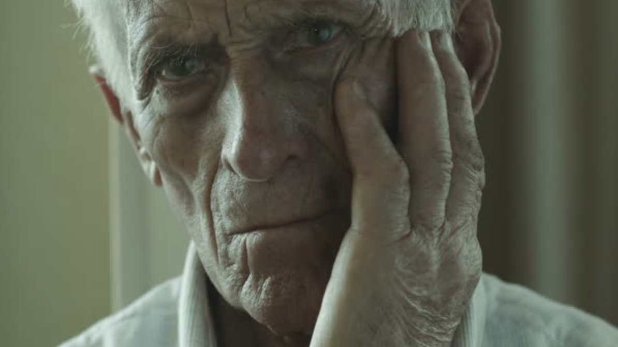
Lewy Body Dementia
Confusion about time & place
Difficulty with language and numbers
Poor judgement
Perseveration / echolalia

Slide 29
Lewy Body Dementia
Agitation or restlessness
Pacing
hand wringing
inability to get settled
irritability

Slide 30
Alzheimer’s Dementia Behavior

Slide 31
Suspicion & Delusions: unreal beliefs
Accusing others of theft
Accuse spouse of infidelity

Slide 32
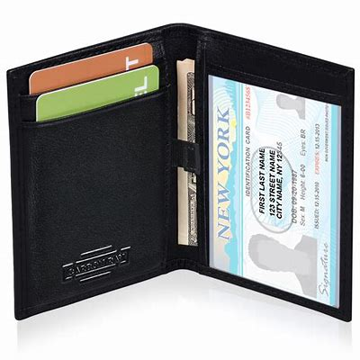
Response to delusions
Don’t take offense. Listen. Reassure that you care
Do not argue or convince. Acknowledge
Offer simple answer. Provide short, simple reflections
Switch focus. Divert to a physical activity
Replace missing item, eg wallet or purse

Slide 33
Aggression
Verbal
Physical
Passive Aggressive

Slide 34
Response to agitation
Identify potential cause
Empiric pain management, e.g., Tylenol
Work with the emotion, not the details of the eruption
Be neutral, don’t show reciprocal anger. Speak slowly and softly
Look to eliminate environmental triggers (e.g., loud children)

Slide 35
Response to agitation
Add relaxation activity: music, massage or exercise
Divert: food or other activity
Step away from agitation
Get assistance if unable to calm, 911 if imminent harm

Slide 36
Anxiety

Slide 37
Responses to anxiety
Remove stressors
Reduce caffeine consumption
Change environment, quieter, TV off
Provide security object (live or plush animal)
Time out
Check for pain, hunger, thirst, constipation, full bladder
Promote physical activity: walk, shop, music / dance, exercise

Slide 38
Practical ideas
Listen before reacting
Ask for permission to interact: “Can I help you ? “ or “Can you help me ? “
Calming voice
Reassurance: “I apologize” “I’m sorry that you are upset”
Avoid open ended questions and Offer simple choices: “Would you like to go for a walk or drive ?”

Slide 39
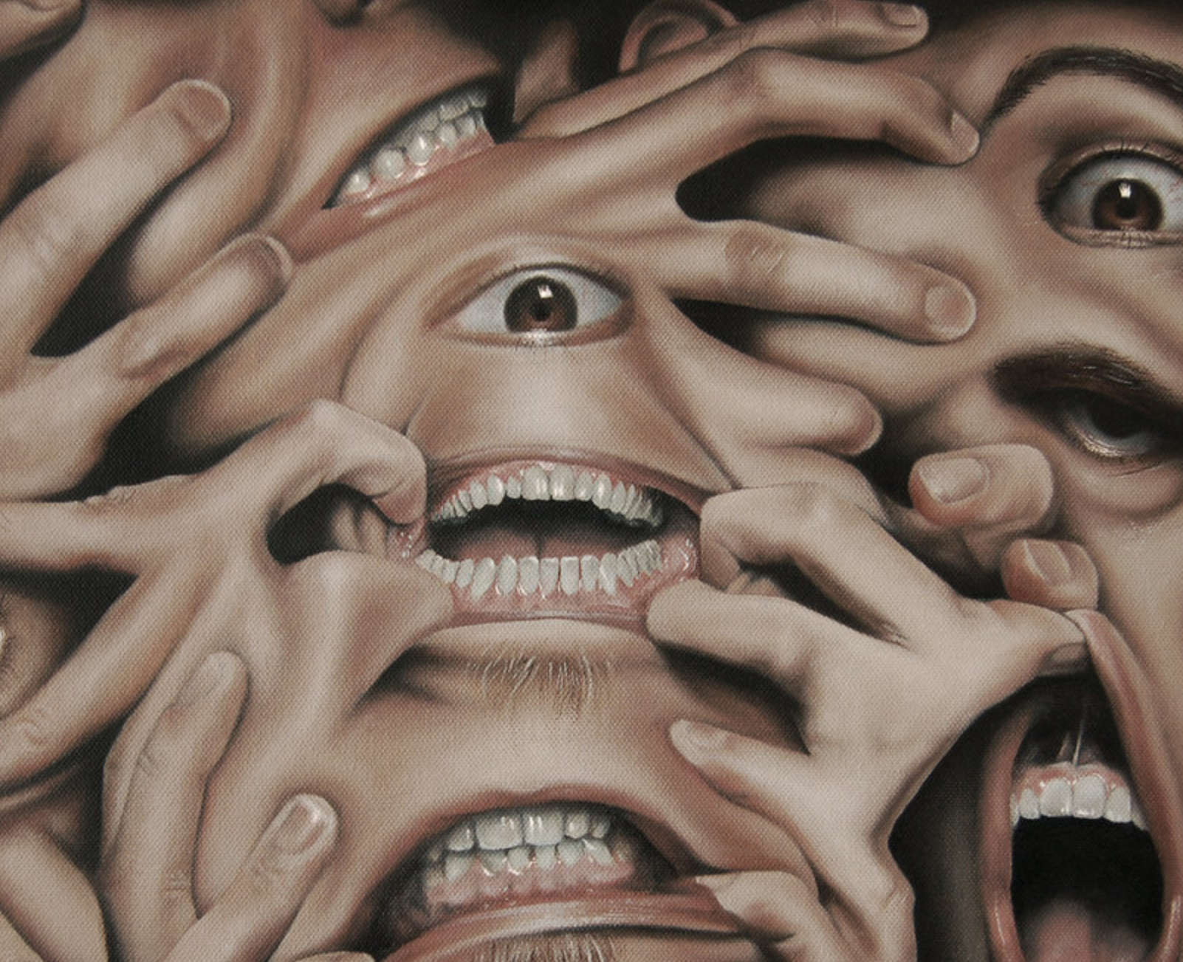
Hallucinations
Seeing insects
Conversation with imagined person
Voices calling

Slide 40
Causes of hallucinations
Neurosensory impairment
Medications: new, escalation, withdrawal
Brain deterioration
Hx of schizophrenia or schizo-affective disorder

Slide 41
Response to hallucinations
Establish how up-setting the situation may be.
Is it escalating and leading to something dangerous ?

Slide 42
Response to hallucinations
Acknowledge what is being seen, heard or felt but report that you do not see or hear the same thing.
“Do you see the man over there ?”
“I know that you see someone, but I do not see anyone right now”

Slide 43
Hallucinations
Gentle touch, do not grab

Slide 44
Identify behavioral triggers
Sounds that might be misinterpreted
TV off
Air conditioner
Lawn mowers
Children playing
Visual stimuli
PTSD: combat experience and images linked to war
Remove mirror

Slide 45
Modify environment
Modify lighting to reduce shadows
Remove mirrors
Put signs with instructions

Slide 46
Depression and apathy
Apathy:
loss of motor drive
manifest as resistance to care
Content to be sedentary

Slide 47
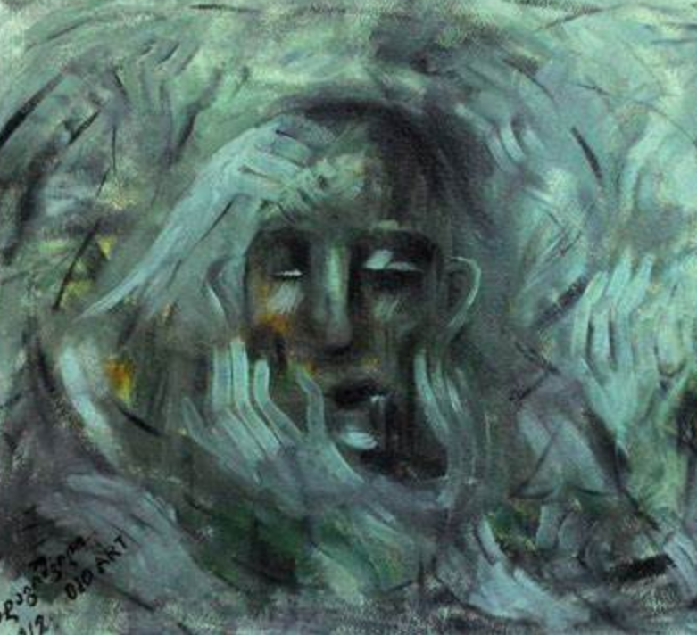
Depression
May precede dementia
Social withdrawal
Poor concentration
Loss of interest in hobbies and activities

Slide 48
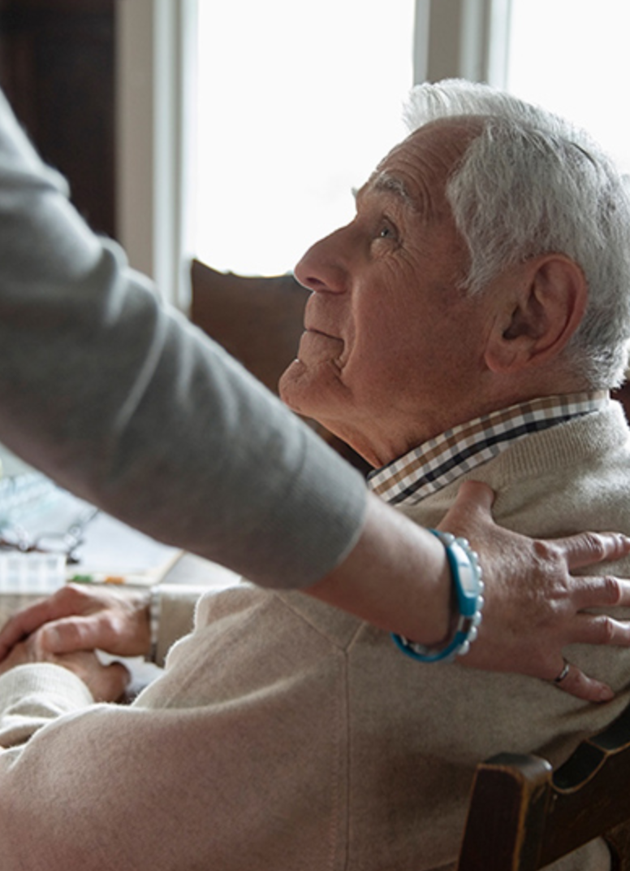
Response to depression
Predictable schedule
Make a list of things to do
Engage in physical activity
Positive reinforcement
Engage in family life
Reassure support, no one will leave them alone

Slide 49
Repetition

Slide 50
Response to repetition
Identify reason for repetition: same time of day ? What is being communicated ?
What is the underlying emotion ?
Transform behavior into an activity
If rubbing hand across a table, get a dust cloth
Toleration
do not admonish
don’t use logic

Slide 51
Response to repetition
Use memory aids
Notes
Calendars
Photographs

Slide 52
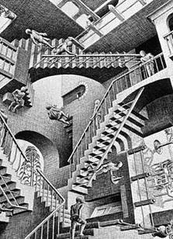
Wandering

Slide 53
Wandering response
Let neighbors know and call
ID bracelet
Search tools
Photo of person at the ready
List of likely places person visits

Slide 54
Wandering response
Plan structured activities during the day
Help with laundry, prepping dinner
Address basic needs
Reduce evening liquids to avoid nocturia
Avoid busy places like shopping malls and unfamiliar places

Slide 55
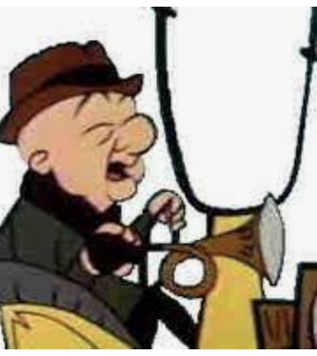
Wandering
If approved to drive, get GPS monitor
With driving cessation, remove car keys

Slide 56
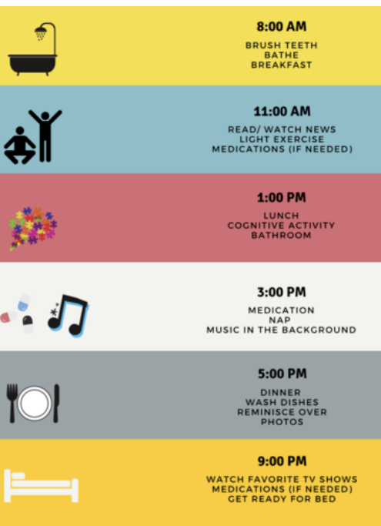
Wandering with early dementia
Set time to “check – in “
Jointly review the day’s schedule of events
Buddy system, companion
Alternative transportation

Slide 57
Wandering in advanced dementia
Revise deadbolts to high or low location
Night lights
Cloth covers over door knobs
Camouflage doors / black tape threshold warning
Warning bells and pressure sensitive mats
Fence / hedges
Safety gaits

Slide 58
When someone goes missing
Wander - patterns follow direction of dominant hand
Most people found within 1.5 miles of home
Check fence lines and brush borders
Return to previous sites of wandering
If not found in 15 minutes, call 911

Slide 59
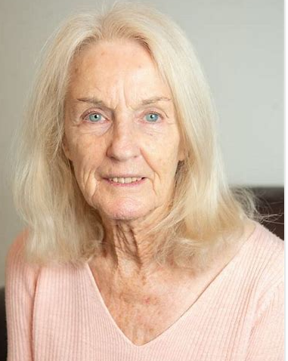

Slide 60
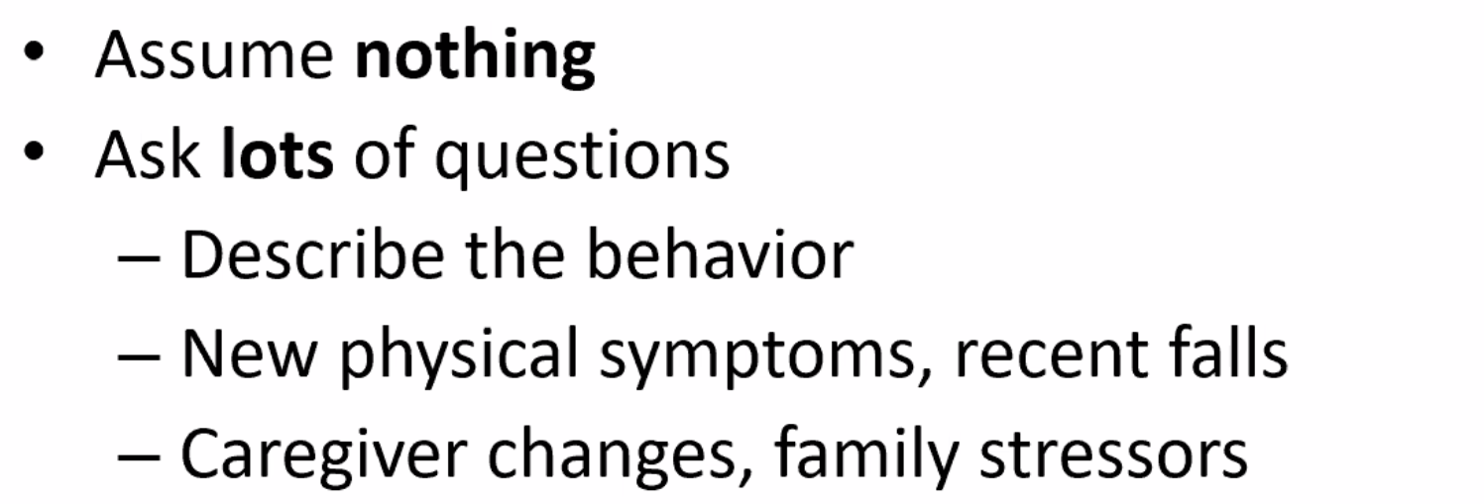

Slide 61
Ask
New Meds ?
Change in medication dose or deprescription ?
Change in alcohol use ?

Slide 62
Identify physical issues
Known pain ?
Non verbal expression of pain ? Grimacing with movement ?
Fever ? Cough ?
Head contusions or bruises ?

Slide 63
How would you manage the situation ?

Slide 64
Case 2
78M retired lawyer with AD is fixated on catching the train to go to his law office
Each day, he attempts to leave the house to go to the commuter train station
On one occasion he leaves the house and is quickly found at the end of the neighborhood block looking confused and frustrated.

Slide 65
What kind of behavior is the person demonstrating ?
How can you prevent this behavior ?
How can you manage the behavior ?

Slide 66
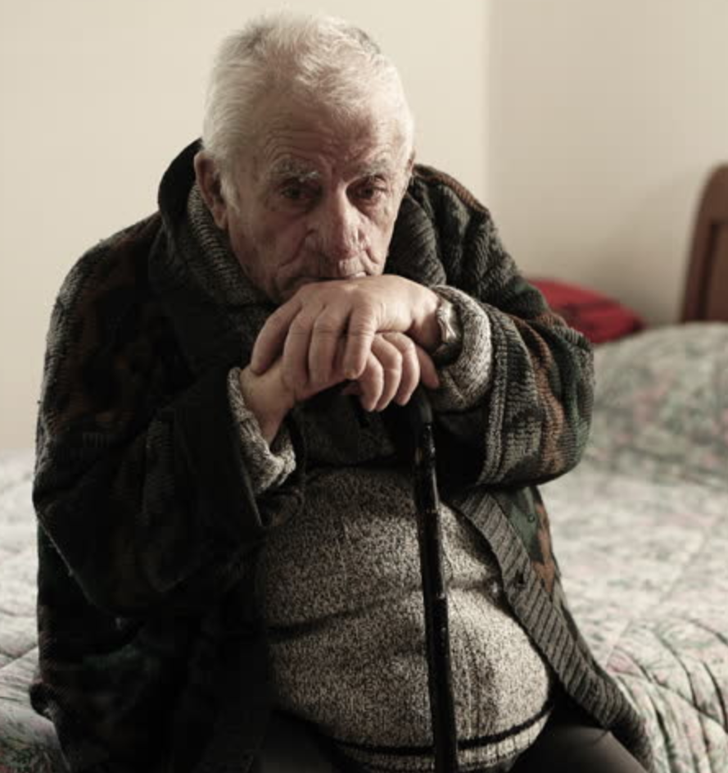
Case 3
82M with mixed vascular and Alzheimer’s Dementia is uncooperative with home health aide regarding shower.
How would you manage hygiene ?

Slide 67
Resources

Slide 68
Summary
Get caregiver training
Form a family strategy of support / respite
Use Alzheimer’s Disease Association resources
ND consultation
National hot line
Support groups and Memory Cafe
Consult Geriatric or Memory Care clinics

