Slide 1
Longevity Medicine
Donald A. Jurivich, D.O.
Eva Gilbertson Distinguished Professor of Geriatrics
Chair, Department of Geriatrics
University of North Dakota

Slide 2
Why are longevity and medical interventions in the aging processes important ?
Aging drives chronic conditions
If we slow or reverse aging we can eliminate chronic diseases
Huge social and economic gains
Maintain functional independence (healthy lifespans) and QOL

Slide 3
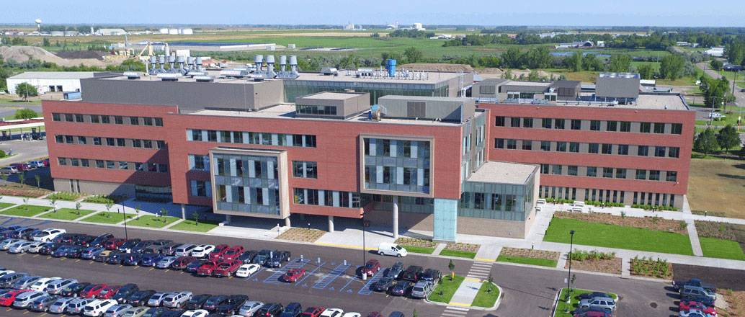
Disclosures
Disclosures
HRSA Geriatric Workforce Enhancement Program

Slide 4
Goals
Understand that aging is a process, not a disease
Report biomarkers of aging and biological age
Describe interventions to delay, halt or reverse aging
Practice key strategies for longevity

Slide 5
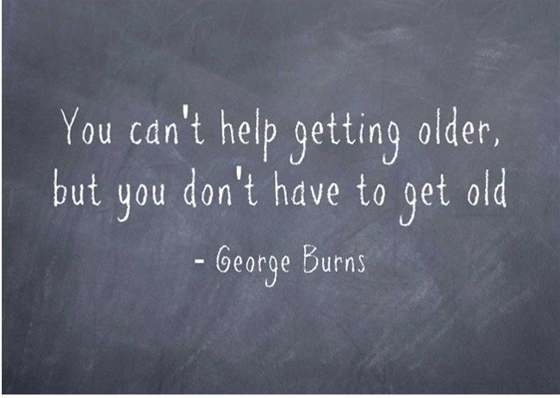
Objectives
Define successful aging ?
Measure biological aging
Invest in the longevity dividend

Slide 6
In the chat box, state the age to which you think you’ll actually live.

Slide 7
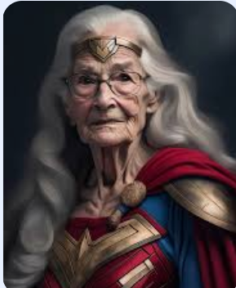
In the chat box state the ideal age that you would like to achieve.

Slide 8
What is aging ?
Functional decline
Accumulation of chronic conditions
Loss of resilience / adaptation over time
Resiliency

Slide 9
The Aging Process
125
100
75
FUNCTION (%)
50
Successful
25
Usual
Accelerated
0
0
25
50
75
100
125
AGE

Slide 10
Postpone Aging
The Immortalist
Notes:
The Immortalist: Aubrey Grey and Bill Andrews

Slide 11
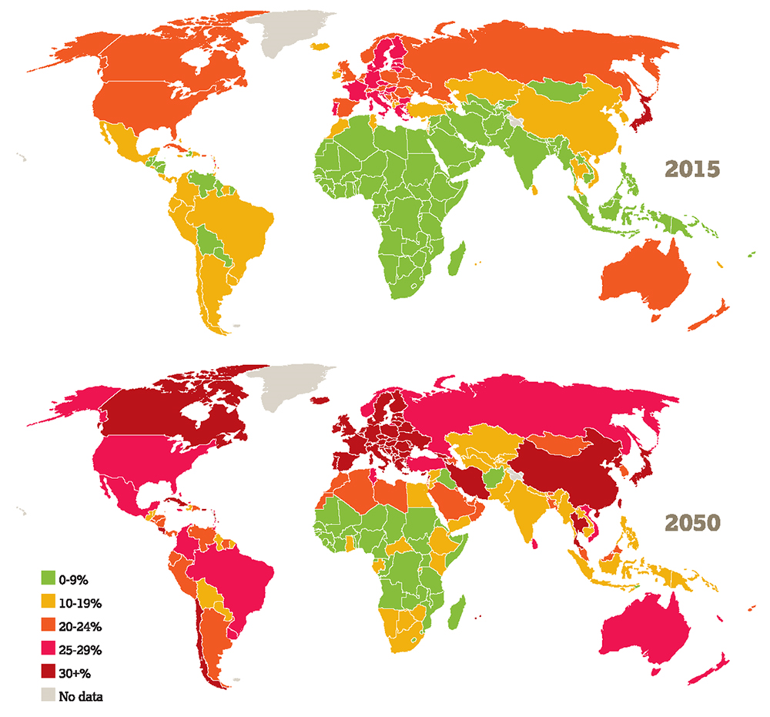
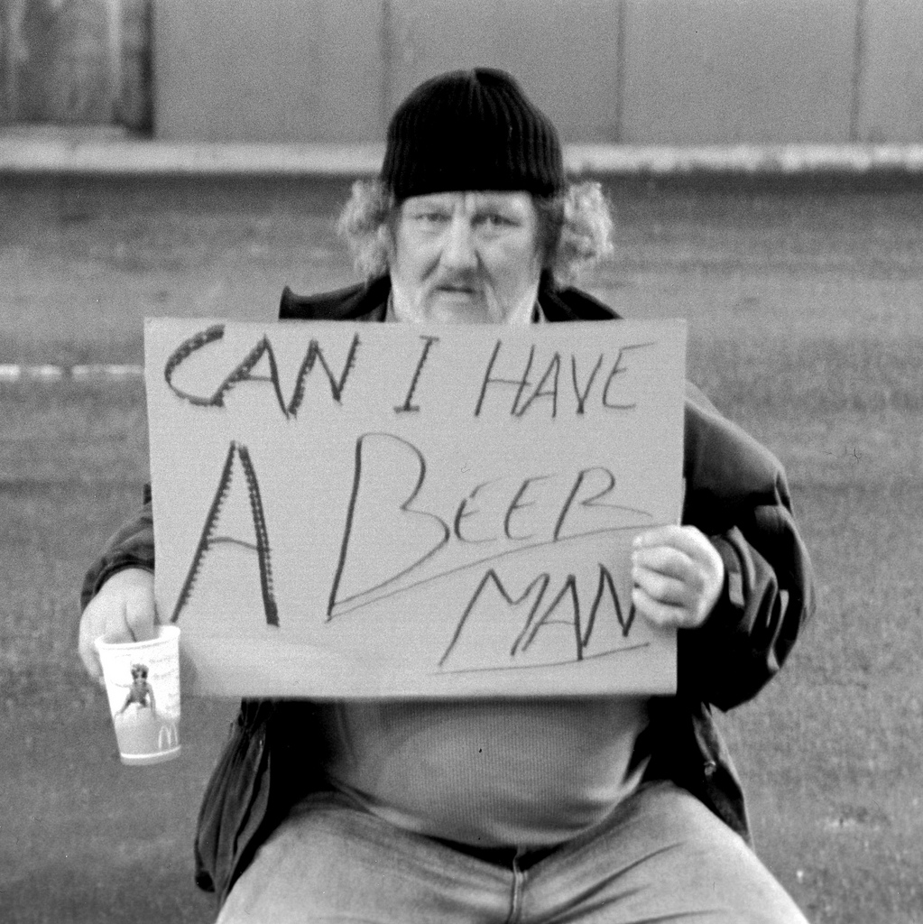
Conundrum
Unprecedented growth in global aging
Subgroups with worsening health in late life
Latent effects of childhood obesity
(doi:10.1056/NEJMsr043743)
Lower life expectancy of poorly educated white men
(doi:10.1377hlthaff.2011.0746)
Percent of population > 65 y/o

Slide 12
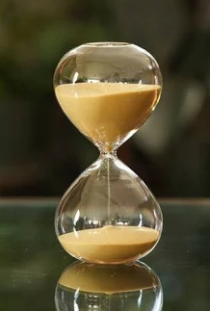
Aging trajectories
Successful
TIME
Unsuccessful

Slide 13
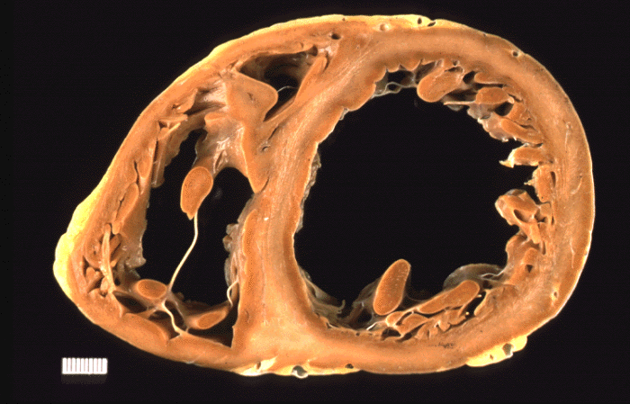
Unsuccessful Aging: physical decay
Notes:
Substance abuse as an aging accelerant
cocaine use accounts for 25% of all MIs in patients between 18 to 45 years old
J point elevation with a “slur” or “notch” at the end of the QRS complex can be early repolarization syndrome rather than MI or pericarditis
Am J Crit Care November 2003 12:562-566

Slide 14
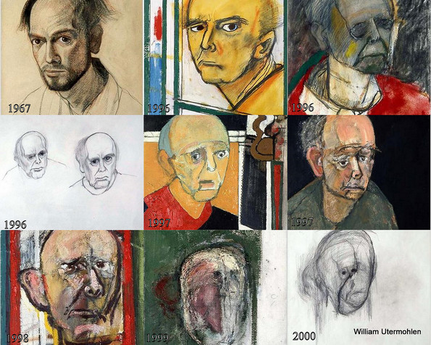
Unsuccessful aging: brain failure
Self – portraits into Alzheimer’s Disease

Slide 15
Unsuccessful aging: psycho – social destitution

Slide 16
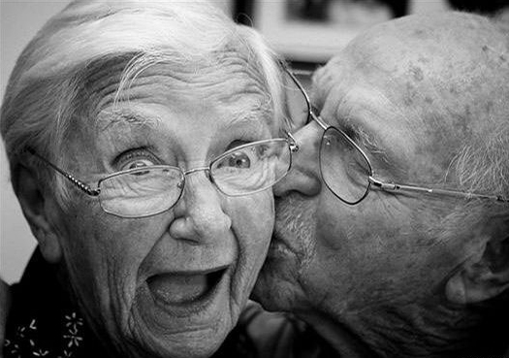
Successful aging
Multi – dimensional
Functional independence
Healthy brain
Psycho – social integrity

Slide 17
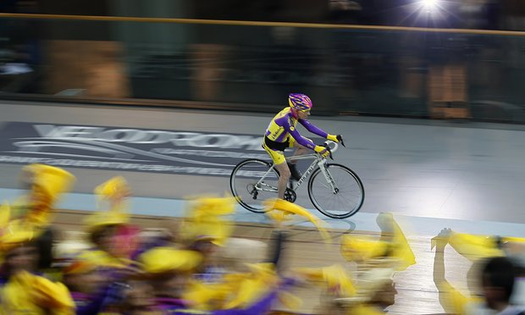
Successful aging: physically robust
Robert Marchand, 105 year old cyclist
Fauja Singh, 104 year old distance runner
Notes:
When asked how he managed to run the 26-mile marathon, 89-year-old Fauja replied: “The first 20 miles are not difficult. As for the last six miles, I run while talking to God.” At 101, he ran the London Marathon in 7 hours and 49 minutes. 104 years old (july 2015)

Slide 18
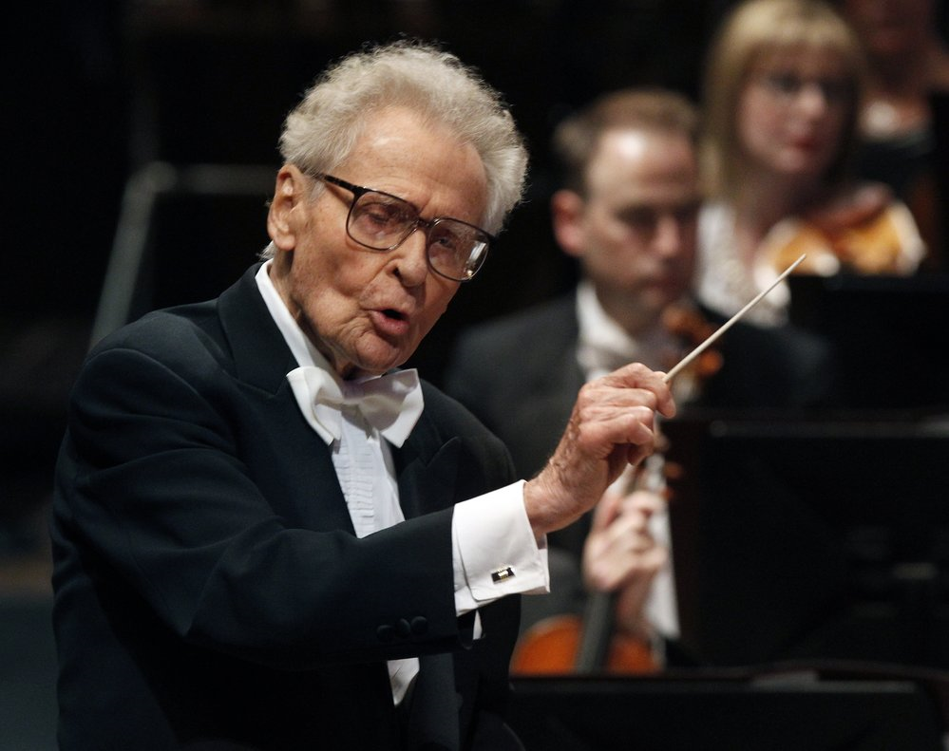
Successful aging: cognitive maintenance
Stanislaw Skrowaczewski (93)
Minnesota Orchestra
Ray H. Crist, PhD (105), former Manhattan Project leader, oldest US professor
Notes:
Stansilaw Skrowaczewski had been the oldest living conductor in 2016.
Scientist Ray Crist was cited as the older professor in the US at 104 at his alma mater, Messiah College in Pennsylvania. In his final 20 years of life, he worked on experiments involving adsorption of toxic metals by plant material and the use of living plants for purifying the environment (phytoremediation). The results of these experiments appeared in twenty-seven journal articles and were reported at ten international conferences .

Slide 19
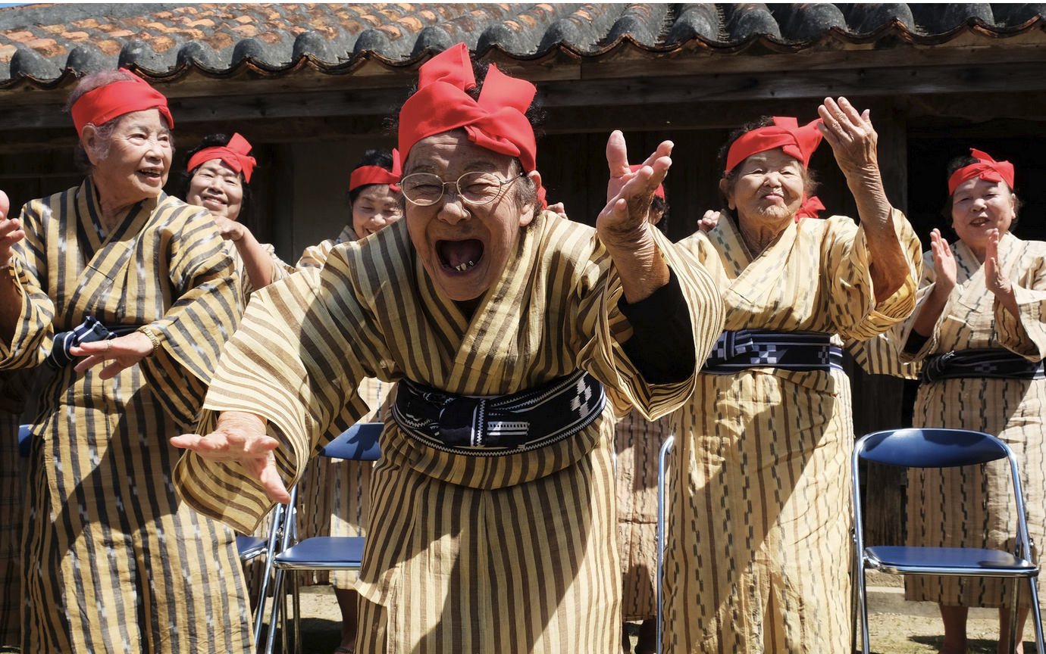
Successful aging: strong psycho – social support
Notes:
Start at 100 seconds
KBG84 Okinawan Geri Pop band

Slide 20
What is Longevity Medicine ?
A medical specialty focused on extending healthspan and lifespan through personalized interventions

Slide 21
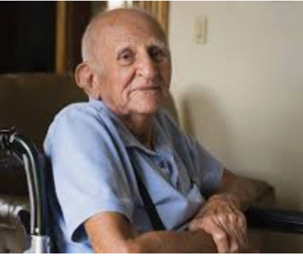
Geriatric Medicine subspecialty ?
Shift from focus on frailty and Geriatric syndromes to prevention and reversal of age – related declines

Slide 22
Difference between functional (years free from disability) and absolute (total years lived) lifespans

Slide 23
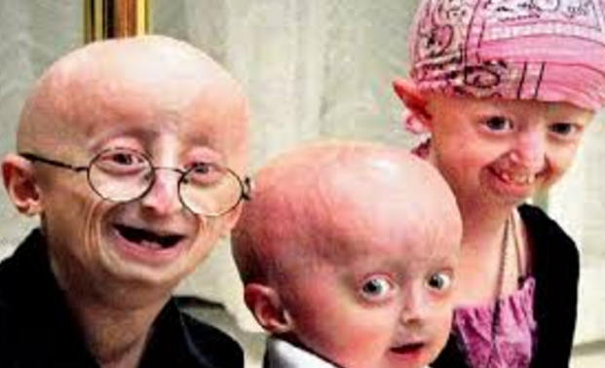
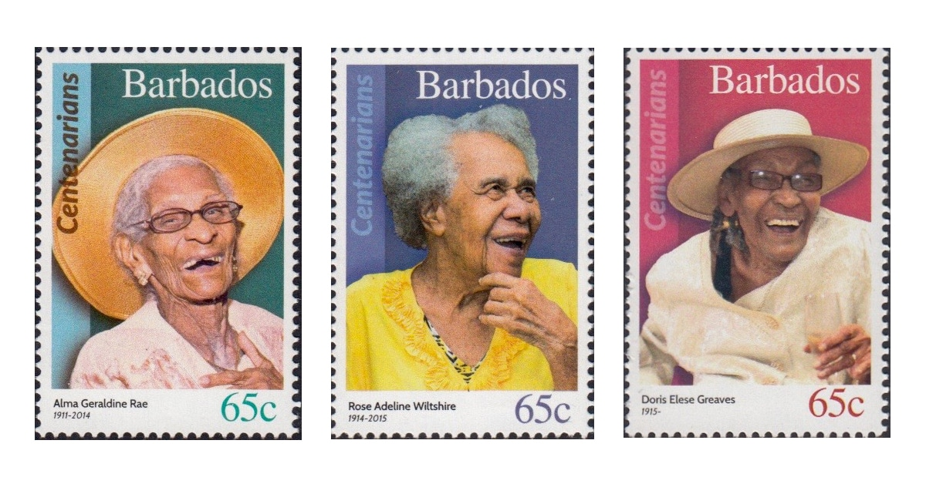
What are determinants of successful aging ?
Genetic versus Environment

Slide 24
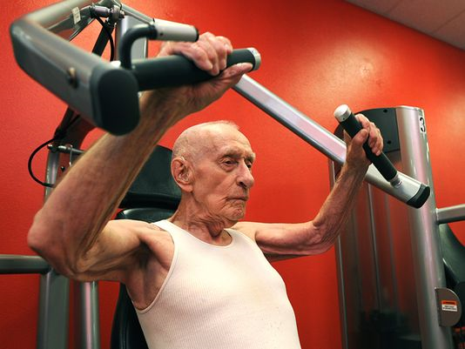
Genetics of aging
Danish twin study: 25% inheritability
Longevity genes vs disease resistance
Human Genet (2006) 119:312
SNP | Function | Disease correlates
APOE / TOMM40 | Lipid metabolism | APOE4 = Alz Dx
CDKN2B / ANRIL | Cell senescence | CAD, DM
ABO | “O” Blood group
SH2B3 / ATXN2 | Lifespan gene | CAD, DM, cancer, ALS
PLOS Genetics (2015) doi: 10.1371/journal.pgen.1005728

Slide 25
Danish twin study
Monozygotic twins 67 years old
Perceived age A = 64 (57 – 70 y.o.)
B = 70 (60 - 85 y.o.)
Dizygotic twins 69 years old
Perceived age C = 64 (59 – 74 y.o.)
D = 76 (69 – 84 y.o.)
PLoS One. 2009; 4(12): e8021. doi: 10.1371/journal.pone.0008021
Notes:
The older twin has thinning of the lips, ashen skin, more wrinkles, and more pronounced labial folds

Slide 26
The older we get, the less we look alike physiologically.

Slide 27
Biological Age
Concept of Biological Age
A measure of physiological function relative to expected age-related decline.
A younger biological age correlates with lower morbidity & mortality risk.

Slide 28
Biological age versus chronic disease risk assessments ?
Chronic Disease assessments entail either blood tests or physiologic measurements
Blood: FBS, HA1c, Lipid Panel, kidney tests
Physiologic: Blood pressure and BMI
Biological Age is a composite of these tests
Normal does not mean Optimal tests.

Slide 29
Methods for Assessing Biological Age:
Epigenetic Clocks (Horvath, Hannum, GrimAge, DunedinPACE)
Telomere Length & Attrition Rate
Proteomic & Metabolomic Biomarkers
Immune System Metrics (inflammaging, T-cell exhaustion)
Functional & Phenotypic Markers (gait speed, grip strength, change in activity, VO2 max)

Slide 30
 | Klemera & Doubal | Pheno AGE (Levine) | Aging AI | Biochemical Biological Age Index | Differential Aging and Health Index
Metabolism | Glucose | Glucose |  | Glucose | FBS
 | Cholesterol |  |  | Cholesterol | HDL,LDL,TG
 | Albumin | Albumin |  | Albumin
Renal | BUN
 | Creatinine | Creatinine |  | Creatinine | Creatinine
Liver |  | Alk phos | bilirubin
 |  |  | ALT / AST | AST, ALT | AST,ALT, GGTP
Heme / Immune | WBC | WBC, Lymph% |  | HgB | HgB
 |  | MCV, RDW
Inflammation | CRP | CRP |  | CRP
 |  |  |  | Uric acid
Physiologic | Blood pressure |  |  | BP, girth or BMI | Girth, SBP, DBP, BMI

Slide 31
Loss of resiliency as a marker
physiological resilience measured as the recovery rate from perturbations such as infections, stress, accidents and cardiovascular events
Only 40% of hospitalized older adults regain their pre – hospitalization functionality

Slide 32
Environment: homeostasis, stress and aging
Health Disturbed Disease Death function
Preserved function
Low cost
Failure Breakdown Compensation Normal
adjustment
Limit of compensatory processes
Prevention Treatment
Permanent disability
High cost
Time →

Slide 33
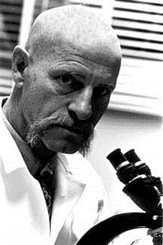
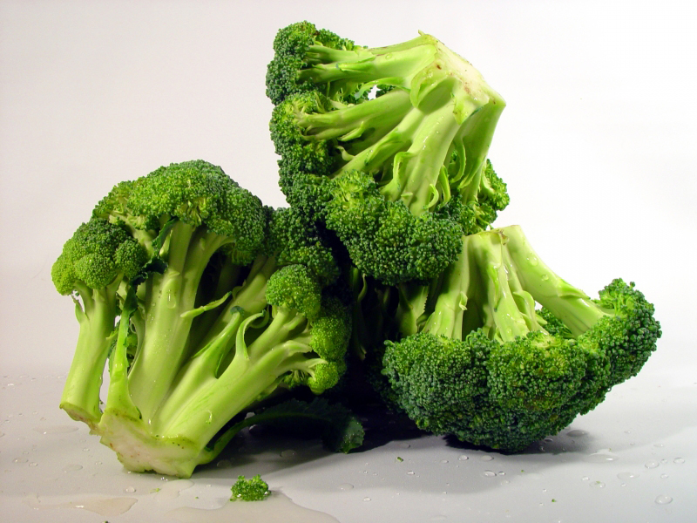
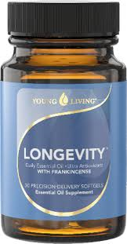
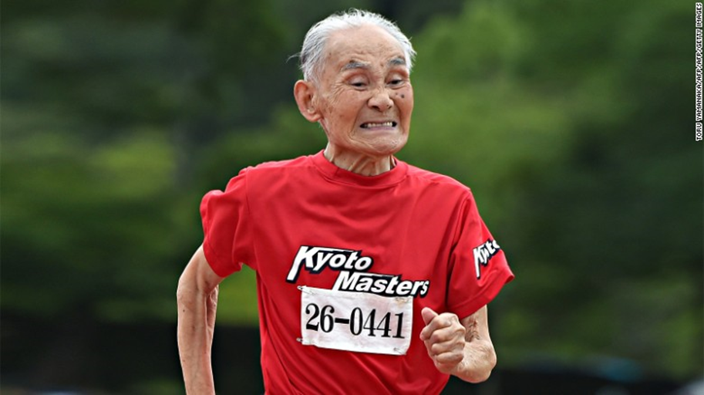
Healthy Longevity interventions
Lifestyle
Behavioral
Pharmacological and Nutraceutical
Roy Walford, MD

Slide 34
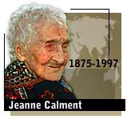
Calment credited her longevity to Port wine, a diet rich in olive oil, and her sense of humor. "I will die laughing," she predicted.

Slide 35
Lifestyle and behavioral interventions
Caloric Restriction & Fasting
CALERIE Trial (Comprehensive Assessment of Long-Term Effects of Reducing Intake of Energy)
lower inflammation
improved cardiometabolic health
Mixed results on primate lifespans:
Wisconsin study: yes
NIA study: no
Both: cognitive and metabolic benefits

Slide 36
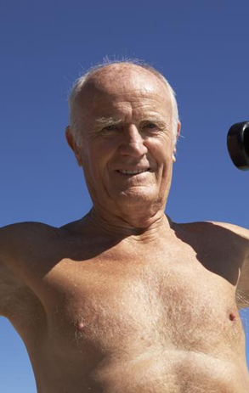
Lifestyle and behavioral interventions
Aerobic vs Strength training ?
Telomerase improved by endurance and HIIT but not strength training Christian Werner et al. European Heart Journal. doi:10.1093/eurheartj/ehy585
Telomere length preserved by strength training and improved mitochondria
High intensity interval training (HIIT)
Improves mitochondrial function (Rogalla, et al)
Improves SBP, HR and balance

Slide 37
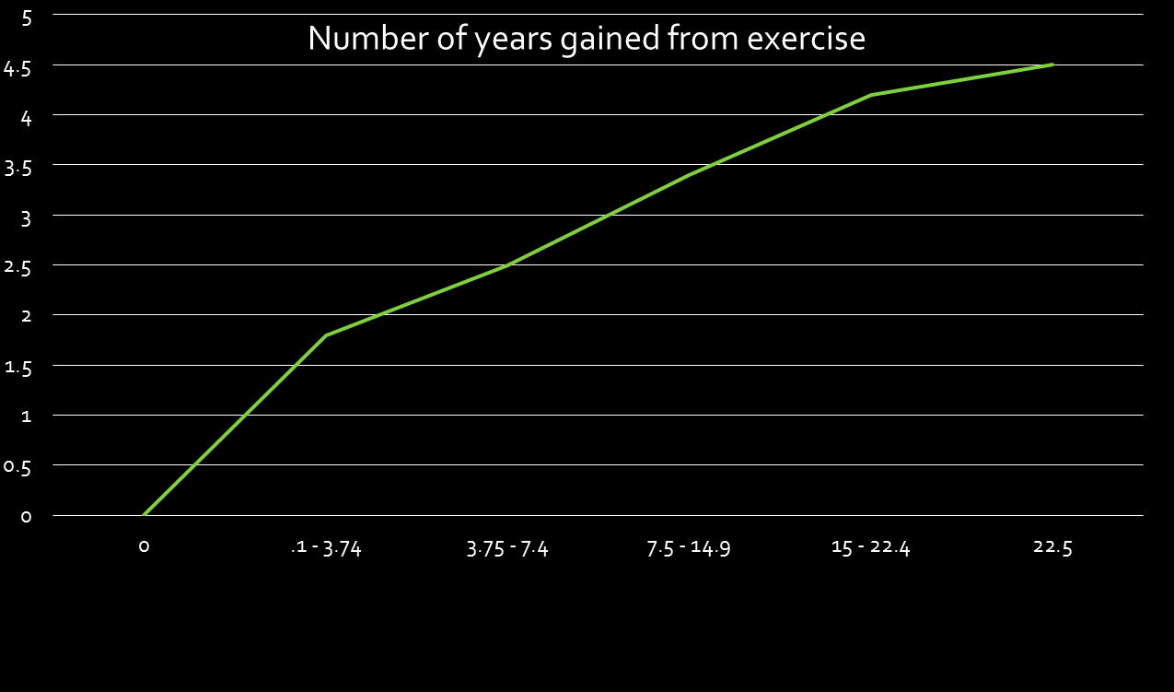
Healthy longevity through exercise
65 year old | Healthy Life Expectancy | Years gained
No exercise | 77.7 years old | ----
Exercise | 83.4 years old | 5.7 years
Exercise intensity (MET – h/wk)
PLOS 2012

Slide 38
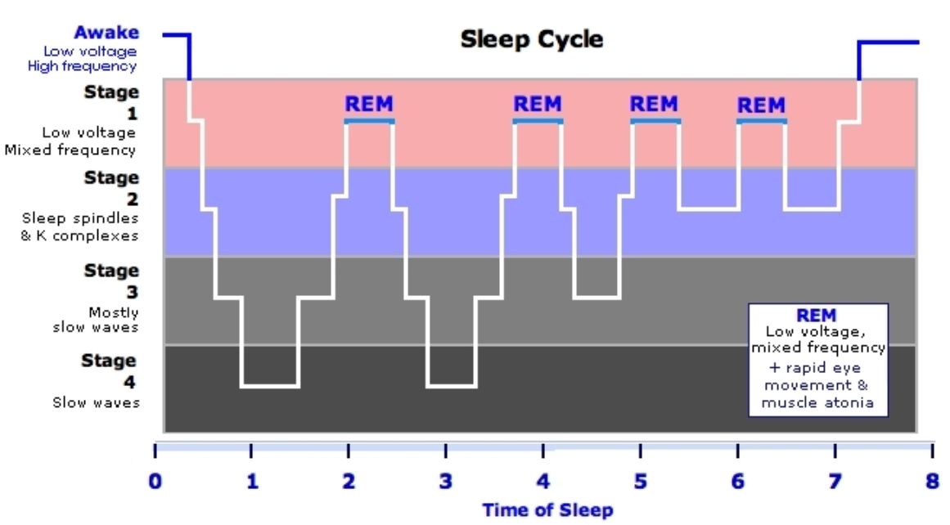
Lifestyle and behavioral interventions
Sleep & Circadian Rhythm Optimization
Poor sleep accelerates epigenetic aging (Lu et al., 2021).

Slide 39
Lifestyle and behavioral interventions
Social & Cognitive Engagement
Harvard Study of Adult Development: Loneliness increases mortality risk.
29% increase heart disease, 32% increased stroke risk (AHA)
26% higher risk of premature death (Holt-Lindstad, et al 2015)

Slide 40
Pharmacological and Nutraceuticals
Senolytics
Quercitin and dastinib
Metabolism / Bioenergetics
Metformin, rapmycin
Stress / anti - oxidants
Resveratrol, CoQ, pterostilbene
Anti – inflammatory / immune modulators
Turmeric, glycine

Slide 41
Pharmacological and Nutraceuticals
Metformin (TAME Trial: Targeting Aging with Metformin)
Activates AMP-activated protein kinase: enzyme enhanced during caloric restriction
Reduces mTOR signaling
Enhance autophagy
Extends mouse lifespan and diabetics live longer on metformin

Slide 42
Pharmacological and Nutraceuticals
Rapamycin & mTOR Inhibitors
Extends animal lifespans
Reduces cell senescence, improves autophagy
Improves mitochondrial function
PEARL trial (Participatory Evaluation of Aging and Rapamycin for Longevity) found 10 mg weekly improved only female lean body mass https://doi.org/10.1007/s11357-023-00818-1
Improved immune function, less IL- 6, better vaccine response Mannick et al., 2018

Slide 43
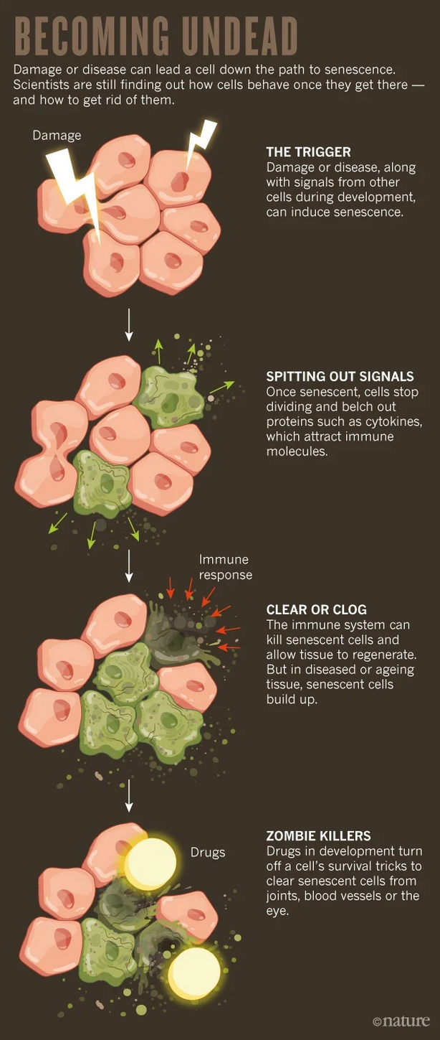
Pharmacological and Nutraceuticals
Senolytics (Dasatinib + Quercetin, Fisetin)
Eliminate “zombie cells”
Increase mouse lifespan by 24% and less frailty
Preliminary human trials show clearance of senescent cells improves function.
Improves idiopathic pulmonary fibrosis

Slide 44
Pharmacological and Nutraceutical
Resveratrol
Preclinical evidence for life extension, improved insulin sensitivity, SIRT1 activation (resembles caloric restriction)
Human studies with mixed evidence
reduced fasting glucose in diabetics, improved HA1C
Memory improvement (200 mg / d) /doi.org/10.1523/JNEUROSCI.0385-14.2014

Slide 45
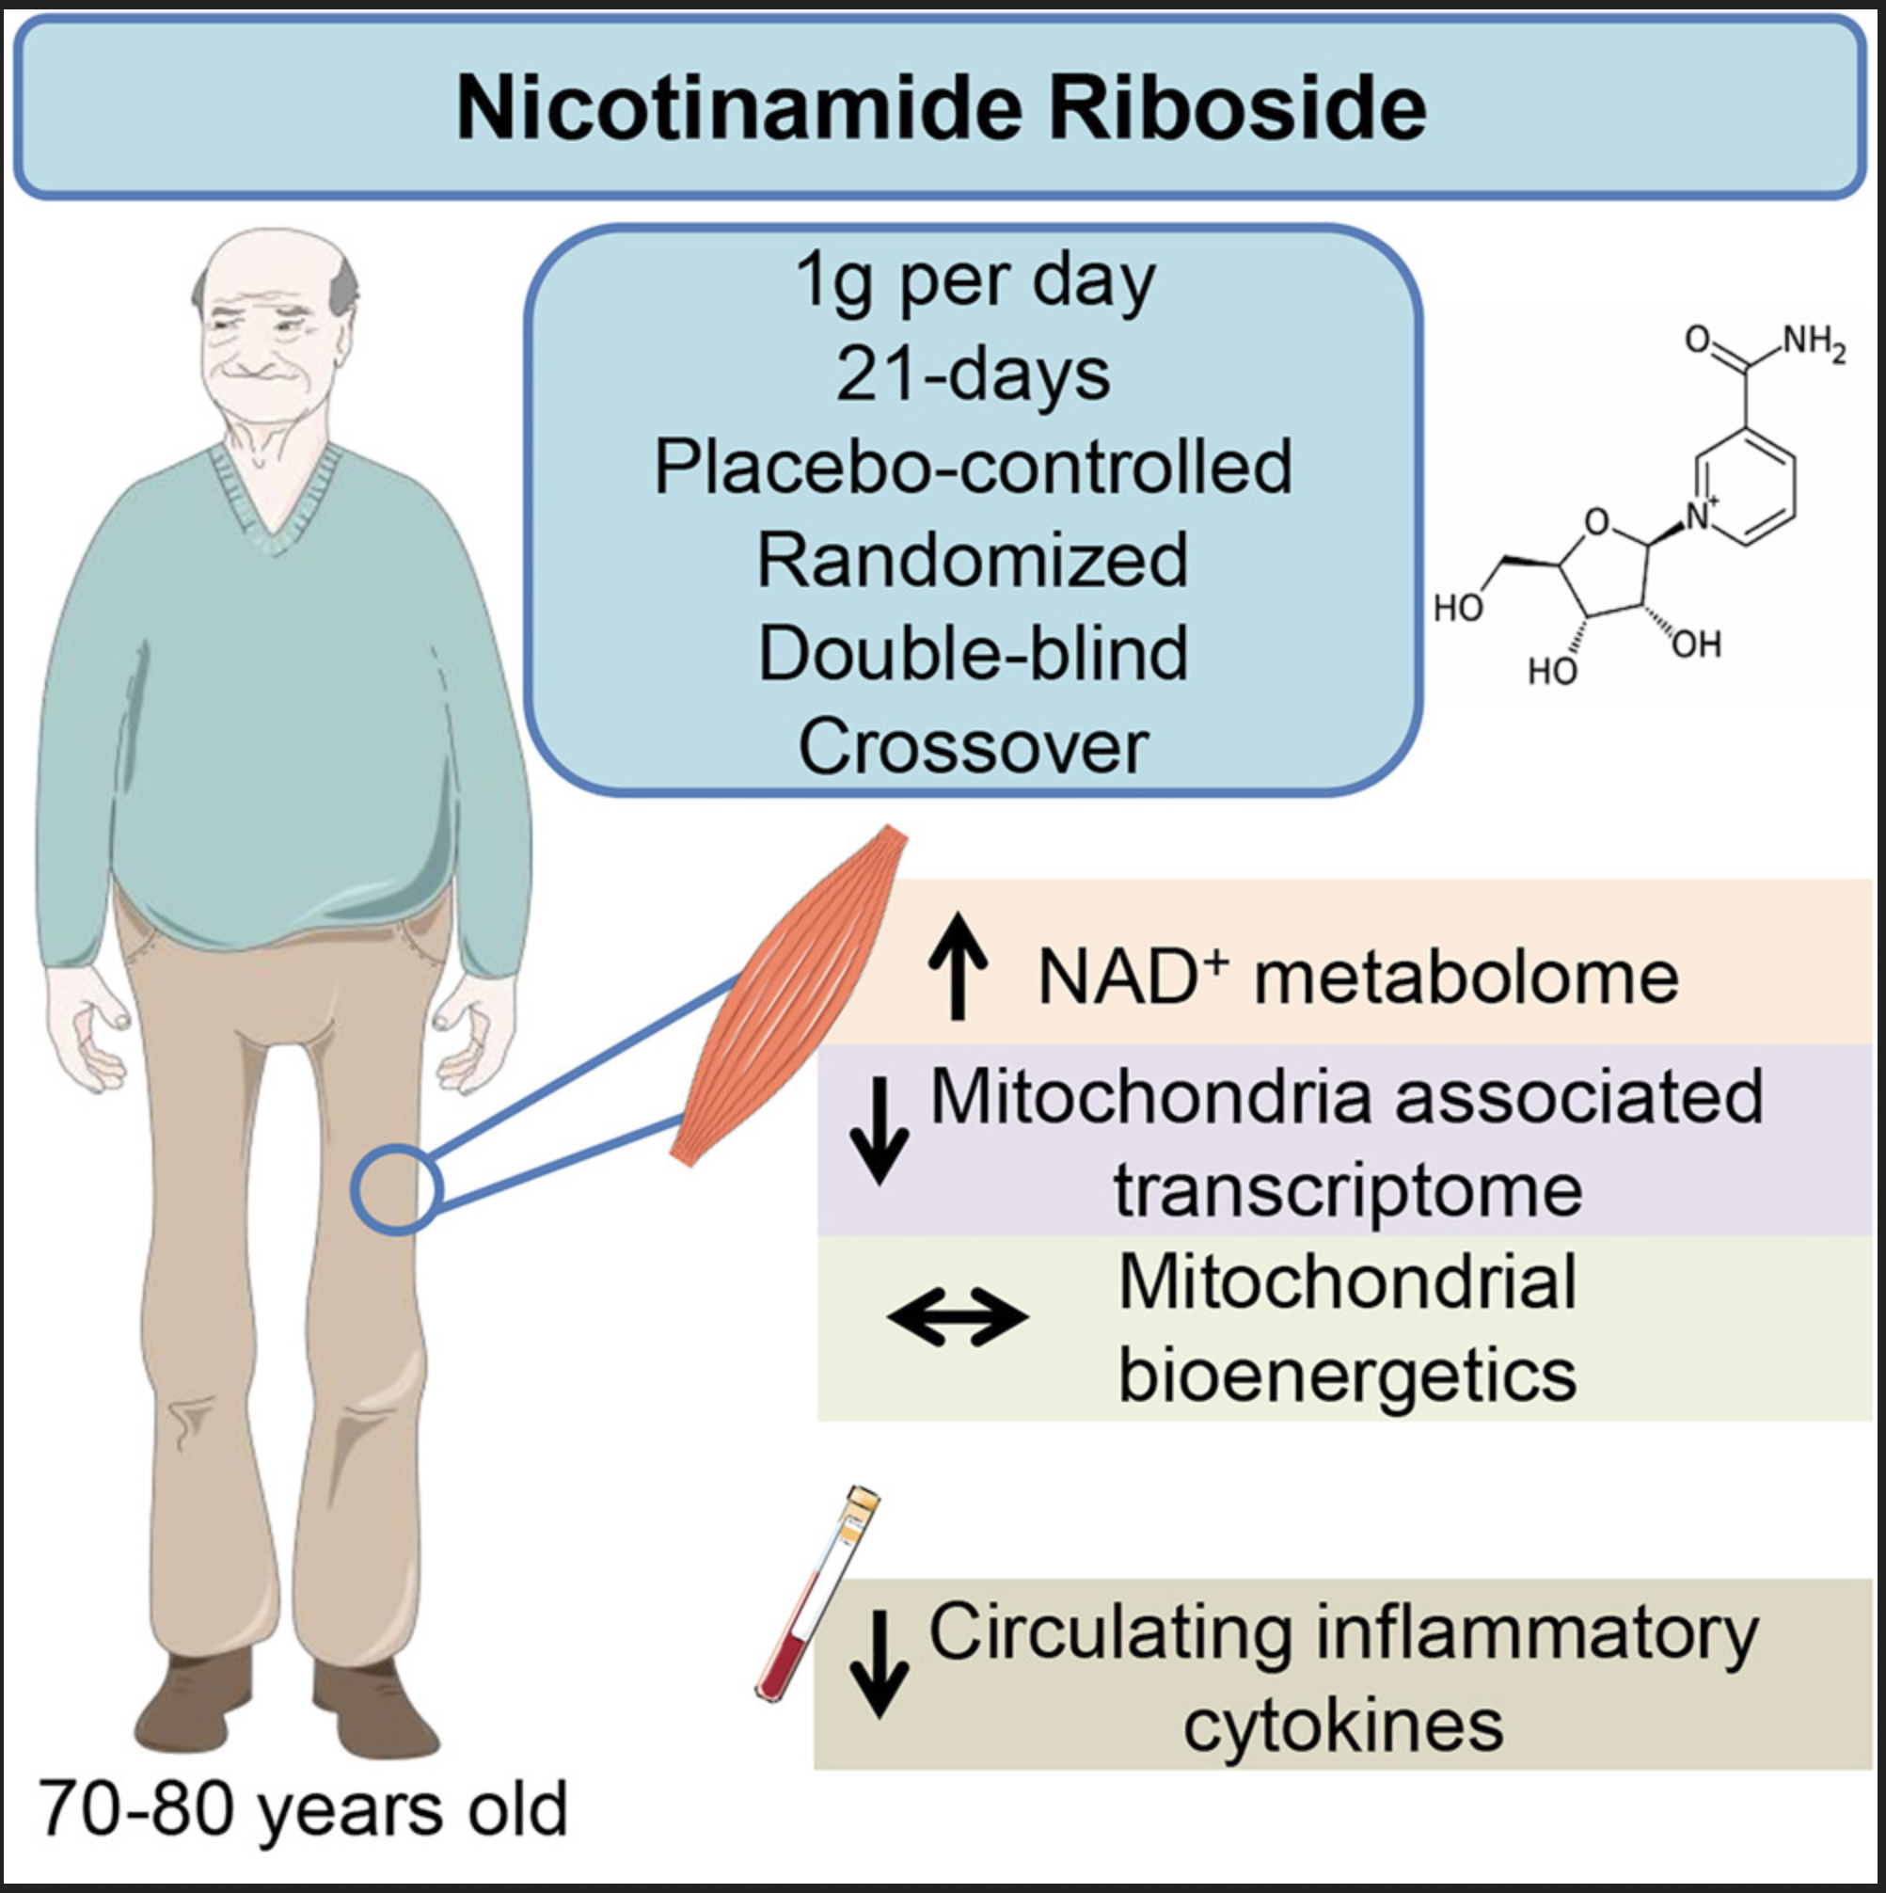
NAD + level enhancement
NR supplementation increase NAD + levels (Martens et al 2018; Airhart et al 2017)
Effects:
Preclinical models improves stress and inflammation (FASEB 31: 5440 2017 and J. Neurochem 158: 311, 2021
Human study: improved endothelial compliance

Slide 46
Interventions That Do Not Significantly Alter Biological Age in Humans
Vitamin D Supplementation (No effect on epigenetic aging).
Multivitamins & Antioxidants
Telomerase Activation Therapies (Limited evidence in human clinical trials).
Telomerase

Slide 47
Emerging Research in Longevity Medicine
Altos Labs & Cellular Reprogramming (Yamanaka Factors)
Partial Epigenetic Reprogramming in Humans
Blood Plasma Exchange & Parabiosis (Conboy et al., 2020)
AI & Biomarker-Based Personalized Longevity Treatments
New Senolytic Drug Trials (UNITY Biotech, Mayo Clinic Studies)
Gene Therapy & CRISPR Approaches for Aging Reversal

Slide 48
Is there a limit to absolute longevity ? Can interventions reverse aging ?
Notes:
Linear fit of 40 year olds from Gerolong and NHANEs studies show, with confidence intervals, 120 to 150 years of maximal life span.

Slide 49
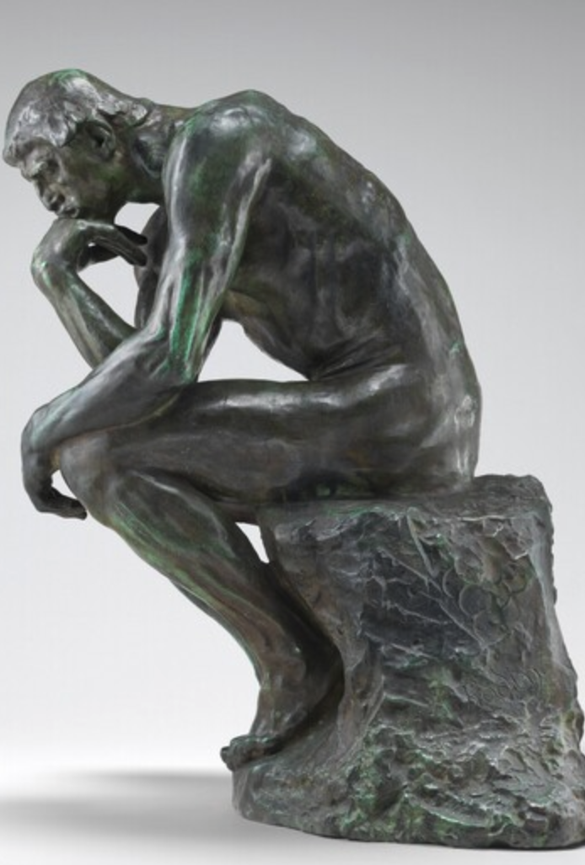
Ethical & Practical Considerations in Longevity Medicine
Who gets access to longevity treatments?
Cost & Healthcare System Burden
Social & Psychological Implications of Extended Lifespan
Balancing Scientific Rigor with Public Hype

Slide 50
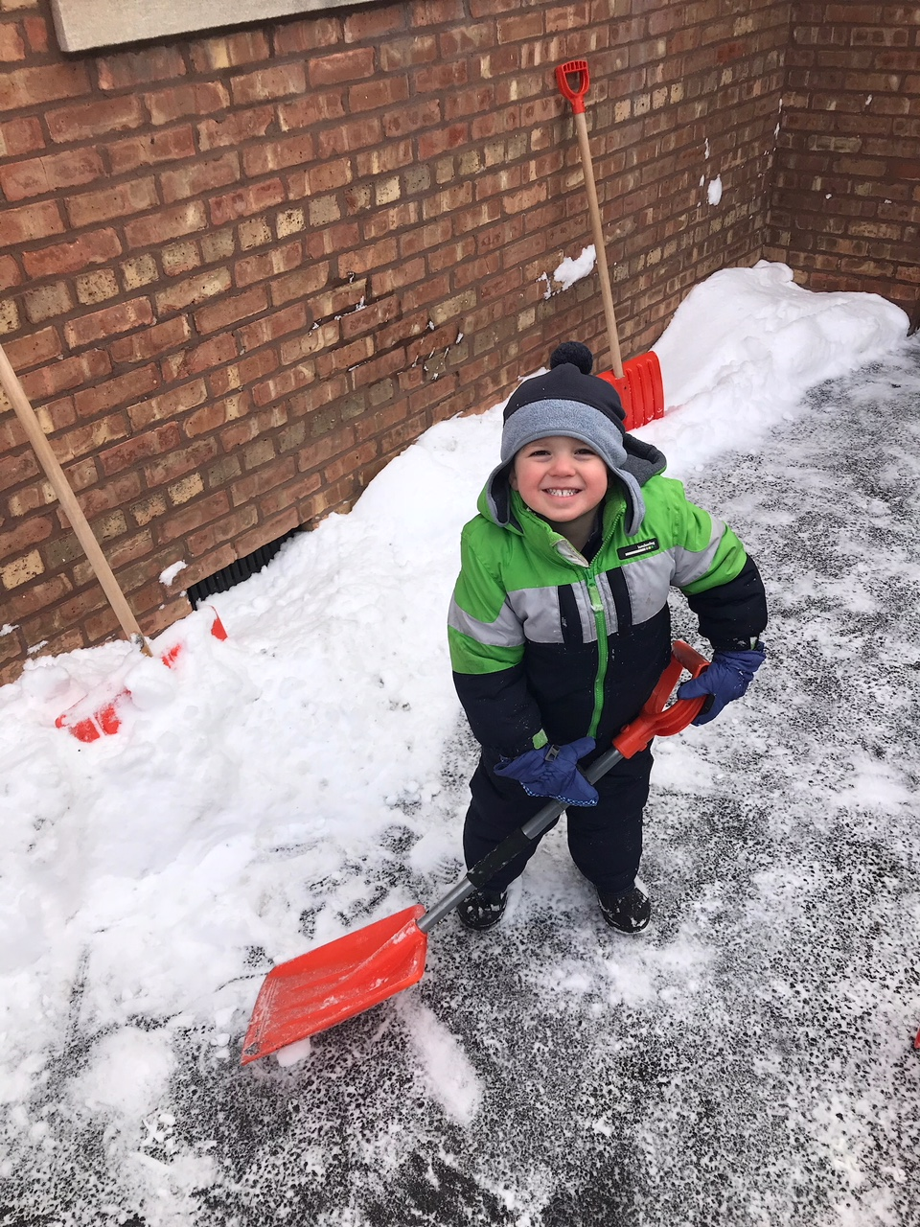
Summary
Biological age and rate of aging are measurable
Anti-aging interventions include diet, physical activity and possibly chemical adjuvants
Prescriptions for healthy lifespans can be part of personalized medicine
The Longevity Dividend seeks to reduce disability and disease in late life by slowing the rate of aging.

