Slide 1
Effects of Depression on Cognition, QOL, and Care Partners
Navigating Dual Diagnosis of Mental Health with People Living with Dementia
Thursday, March 27, 2025
Michael G. Mercury PhD Director, Neuropsychology, West Region
Associate Director, Neurodegenerative Diseases Center, Central DuPage Hospital
Clinical Assistant Professor, Feinberg School of Medicine, Northwestern University
michael.mercury@nm.org

Slide 2
Disclosure
Grant/Research Support: Northwestern Memorial Foundation
The presentation will include discussion of trade names of tests and certain devices in order to improve communication. Neither Dr. Mercury, or any member of his immediate family has a relevant financial interest or other relationship with the manufacturer(s) of any of the products or providers or of any of the services to be discussed.

Slide 3
Goals and Objectives
At the end of this activity, the participant will be able to
1. Describe the cognitive changes associated with depression.
2. Identify the impact of depression on quality of life of people with dementia.
3. Describe the impact of depression on care partners.

Slide 4
Dementia

Slide 5
Case
Elsie Larson is an 82-year-old, right-handed married Caucasian female with 16 years of education, retired from teaching 17 years ago. Since she was about 70, her husband, Don Larson noticed a gradual decline in memory. He wondered if it was a mistake that she had stopped teaching at 65. Now, he is frustrated that she stays home during the day and resists his efforts to get together with friends. Elsie does not think that there is a problem and is angry that Mr. Larson is insisting that she see a doctor.

Slide 6
Mrs. Larson’s Husband
In Mrs. Larson’s case, the husband is identifying a change in behavior that is concerning to him. There is a decline in memory. Mrs. Larson feels overwhelmed at the thought of going out for dinner with friends and prefers to stay at home. Previously, she looked forward to such social activities. She used to cook holiday meals and have her children and grandchildren over.

Slide 7
Dementia
“Umbrella Term” used to describe a condition where two criteria are met:
1. Impaired Neuropsychological Testing: Cognitive Performance 1.5 standard deviations below age and education matched normal.
2. Impaired Activities of Daily Living: Cognitive Performance prevents patients from functioning independently in the community

Slide 8
LAWTON IADLs and Katz ADLs

Slide 9
Types of Dementia

Slide 10
Depression

Slide 11
Depression
(proportion of population in a given time period with depression)
40
Alzheimer’s dementia
Birrer et al. (2004) Am Fam Phys: 69 p. 2375: Alzheimer’s Association (2025), adapted

Slide 12
The Challenge of Accepting Depression
Disease or “Weakness of Character?”
Initially in medicine, depression was considered “functional” whereas the rest of clinical medicine was “organic” and organized under neurology, cardiology, and general medicine
The specialties of Neurology and Neuropsychiatry has helped us to begin to understand the role the brain plays in our thoughts, feelings and actions.
These thoughts, feelings and actions are further influenced by the neurobiology of certain neurological diseases, like stroke, Alzheimer’s disease and Parkinson’s disease.
Yet the stigma of depression continues in this population
( adapted from Schiffer, 1999; Rathje, 2018)

Slide 13
DSM-5-TR diagnostic criteria for a major depressive episode
A. Five (or more) of the following symptoms have been present during the same two-week period and represent a change from previous functioning; at least one of the symptoms is either (1) depressed mood or (2) loss of interest or pleasure.
NOTE: Do not include symptoms that are clearly attributable to another medical condition.
1) Depressed mood most of the day, nearly every day, as indicated by either subjective report (eg, feels sad, empty, hopeless) or observations made by others (eg, appears tearful). (NOTE: In children and adolescents, can be irritable mood.)
2) Markedly diminished interest or pleasure in all, or almost all, activities most of the day, nearly every day (as indicated by either subjective account or observation).
3) Weight: Significant weight loss when not dieting or weight gain (eg, a change of more than 5% of body weight in a month), or decrease or increase in appetite nearly every day. (NOTE: In children, consider failure to make expected weight gain.)
4)Sleep: Insomnia or hypersomnia nearly every day.
5) Psychomotor: Psychomotor agitation or retardation nearly every day (observable by others, not merely subjective feelings of restlessness or being slowed down).
6) Fatigue: Fatigue or loss of energy nearly every day.
7) Worthlessness or guilt: Feelings of worthlessness or excessive or inappropriate guilt (which may be delusional) nearly every day (not merely self-reproach or guilt about being sick).
8) Cognition: Diminished ability to think or concentrate, or indecisiveness, nearly every day (either by their subjective account or as observed by others).
9) Death: Recurrent thoughts of death (not just fear of dying), recurrent suicidal ideation without a specific plan, or a suicide attempt or a specific plan for committing suicide.

Slide 14
How to Remember the Symptoms of Depression
SIG.E.CAPS is a well-known mnemonic listing the symptoms of major depressive disorder, according to the DSM-5. It omits depressed mood.
SIG.E.CAPS stands for:
Sleep: insomnia or hypersomnia
Interest: reduced, with loss of pleasure
Guilt: often unrealistic
Energy: mental and physical fatigue
Concentration: distractibility, memory disturbance, indecisiveness
Appetite: decreased or increased
Psychomotor: retardation or agitation
Suicide: thoughts, plans, behaviors.

Slide 15
Best Screening Test for Depression: the Whooley
Comparable to the PHQ-2

Slide 16
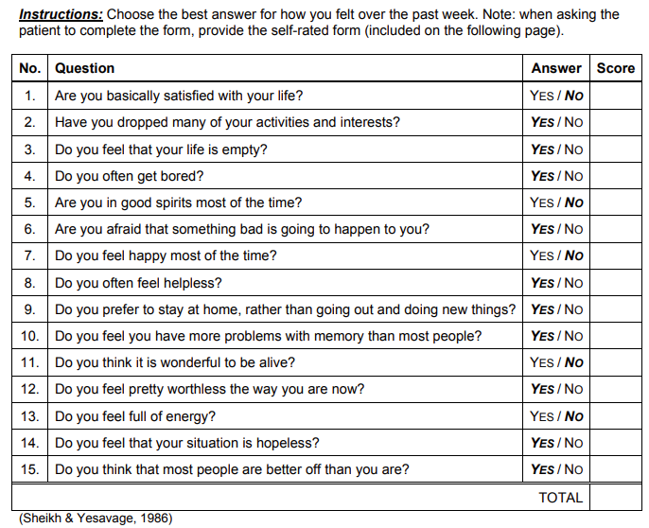
Geriatric Depression Scale – 15 Item

Slide 17
Distinguishing Depression from Dementia
Adapted from Harvard Health Publishing (2024)
People with Depression
People with Dementia
Difficulty concentrating
Retrieval memory problems
More rapid decline in mental functioning
Tend to notice and comment on their memory problems
Usually not disoriented
Writing, speaking, motor skills preserved
Intact concentration with impaired short-term memory (forgetting)
Gradual progression of symptoms over time (r/o infection)
Anosognosia (lack of insight)
Delusional Misidentification Syndrome (Capgras)

Slide 18
Diagnostic Criteria for Depression Compared to Depression in People with Alzheimer‘s Type Dementia
The National Institute of Mental Health
DSM-5-TR
NIMH
A. Depressed Mood and/or Decreased Interest/Pleasure
Two or more of the following for 2 weeks or longer:
Weight change
Sleep
Psychomotor
Fatigue
Worthlessness or guilt
Cognition
Recurrent thoughts of death/suicide
Depressed Mood and/or Decreased Interest/Pleasure
Two or more of the following for 2 weeks or longer
Disruption in appetite
Sleep
Psychomotor
Fatigue
Worthlessness or guilt
Cognition
7. Recurrent thought of death/suicide
Irritability
Social Isolation or withdrawal

Slide 19
Cornell Scale for Depression in Dementia
Alexopoulos et al., 1988
19 item formal interview by clinician of patient and caregiver
Differentiates between symptoms of depression and dementia
It is divided into five categories
Mood related signs
Behavior
Physical signs
Cyclic functions
Ideational disturbances

Slide 20
DEPRESSION IN OLDER ADULTS
15-27% of individuals >65 yrs old living in the community have depressive symptoms.
Look for crying, tearfulness, hopelessness, self-deprecating comments, agitation.
Prevalence in women over 60 yrs old may be twice that of men of same age.
White males over 65 yrs old account for 81% of all suicides annually.
Can amplify cognitive deficits

Slide 21
Comorbid Anxiety
Present in elderly patients with depression and in those with dementia
Anxiety --faulty activation of fight or flight system at times when there is no fear-causing stimulus present.
Symptoms can include nervousness, panic and fear as well as sweating and rapid heartbeat.
An anxiety disorder
You have difficulty functioning and getting through the day
You over-react when something triggers your emotions (e.g. change)
You can’t control your responses to situations
Cognitively has negative impact on attention/concentration
http://www.calmclinic.com/anxiety/symptoms/behavior https://my.clevelandclinic.org/health/diseases/9290-depression, adapted

Slide 22
Pseudodementia
Adapted from Salome et al. 2023
Pseudodementia coined in 1961 by psychiatrist Leslie Kiloh to describe individuals with cognitive deficits suggestive of dementia but which showed a potential for reversal.
Depression is most often associated with pseudodementia
The term has fallen out of favor and we now discuss identification of modifiable or reversible causes of cognitive impairment.
While depression is associated with specific cognitive changes, the intellectual decline that can be misinterpreted as dementia is thought to be related lack of energy or effort.
Elderly with depression can exhibit decreased motivation, slowed processing of information, appear forgetful, and may move slowly. They may not appear depressed.

Slide 23
Depression
Physical Signs
Cognitive Symptoms
Blunted Affect
Psychomotor slowing “Soon evident are the slowed-down responses, near paralysis …. Ultimately the body is affected and feels sapped, drained. (William Styron 1991).
Sleep Disorder
Poor sleep efficiency
Decreased sleep time
Early morning awakening
Decreased Appetite
Increased pain sensitivity
Diminished visual contrast perception
Executive dysfunction
Retrieval memory problems

Slide 24
Cognitive Changes
Simple attention Spared
Executive Functioning Impaired*
Psychomotor Speed Slowed
Language Spared
Memory Impaired free recall
Visuospatial Impaired
*This domain can impact emotional expression and behavior

Slide 25
Cognitive Changes: Executive Functioning
Concentration
Self-regulation/Maintenance of focus
Slowed thinking (bradyphrenia)
Mental flexibility
Multi-tasking
Planning organizing, sequencing
Problem Solving
Effecting closure between tasks (interference)
Apathy (this is a separate disorder from depression)
Initiation (can be mistaken for laziness, depression)
Persistence/follow through

Slide 26
Cognitive Changes: Language (spared)
Word finding
Slow speech pattern
Slowness of thought in conversations

Slide 27
Learning and Memory in Depression
Learning: process of acquiring new information
Memory: persistence of learning that can be retrieved at a later time
- Direct Recall (immediate and delayed)
- Recognition (delayed)
Memory in Depression
People will learn information but immediate recall may be less than delayed recall
Delayed recognition will be normal

Slide 28
Cognitive Changes: Visuospatial
Contrast Sensitivity Reduction (Friedel et al., 2024
Ability to discriminate an object from its background
Diminished Ability to Discriminate Colors (Deisenhammer et al., 2022)

Slide 29
Depression: Differential Diagnosis
Apathy
Demoralization

Slide 30
Apathy in Dementia;
“Doctor, he just sits in front of the TV all day!”
Consequences
Daily functioning – lack of stimulation can hasten cognitive decline
Treatment adherence – medication, exercise
Reduced quality of life – lack of goal-directed behaviors that enrich life
Caregivers distress – undermines emotional connection to the patient

Slide 31
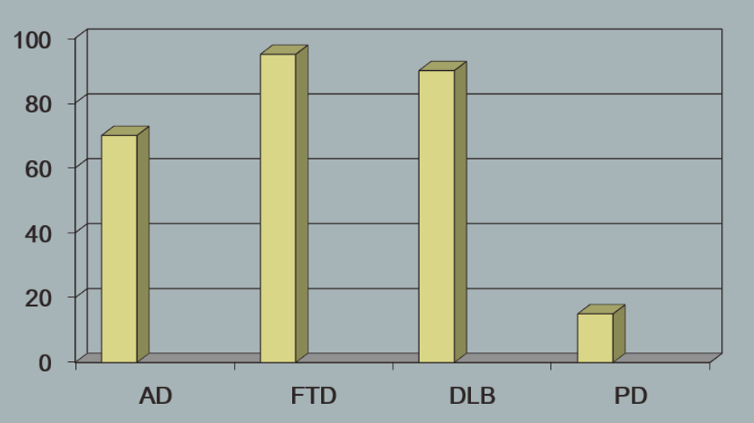
Apathy in Dementia

Slide 32
Apathy: Is it Depression?
Shared among apathy and depression
Diminished interest
Psychomotor slowing
Fatigue/sleeping a lot
Lack of insight
Unique to Depression
Unique to Apathy
Dysphoria (a profound
state of unease or dissatisfaction)
Suicidal ideation
Self-criticism
Guilt
Pessimism
Hopelessness
Sleep Disturbance
Diminished emotional responsivity
Decreased goal oriented thought
Indifference
Low social engagement
Diminished initiation
Poor persistence

Slide 33
Apathy: Decrements in Overt Behavior
Range from mild (e.g. subtle inefficiencies in getting things done at work or at home
To Severe (e.g. impairments in initiating or sustaining goal-directed behavior
Require prompting to perform personal(ADLs) and instrumental activities (IADLs)
Heightened by diminished emotional responsivity
Negative events: (e.g. personal loss, health problems) reacts emotionally indifferent, placid, inappropriately euphoric, affectively shallow or flat
Favorable events: attenuated emotional response

Slide 34
Demoralization vs. Depression (Hamm 2025)
Demoralization
Depression
More emphasis
Lost sense of efficacy, incompetence
Uncertainty, helplessness
Emphasis on external stress more than internal stressor
Avoidance of coping
Decreases as adversity is overcome
e.g. successful pain control, important visit, vacation
Increases as physical symptom distress increases
More responsive to self-compassion and spiritual support
Less likely to respond to antidepressant medication
Life has never had worth or meaning
Illness is punishment for evil things they have done
Perception that burdening others is to the point of causing ruin/pain/suffering
Suicidal ideation rather than passive death wish (desire for hastened death DFHD).

Slide 35
Depression in Dementia
Quality of Life

Slide 36
Quality of Live (QoL)
Depression and cognitive impairment are more common in older adults
QoL does not necessarily decrease with dementia progression
Older adults with depression have greater risk of decreased cognition and of QoL.
Hoe et al., 2010 found decrease in QoL was associated with increase in depressive symptoms in individuals living in a facility
Voros et al., 2020 found a similar relationship with community dwelling individuals.

Slide 37
QoL in People with Dementia in Care Homes
Hoe et al., 2010
Used QOL--AD
Can be used to detect changes in QoL secondary to disease progression and interventions as related to patients and caregivers
QoL is completed by both patients and caregivers
13 questions
Rates life situations using Likert scale: poor, fair, good, excellent
Cornell Scale for Depression in Dementia

Slide 38
Depression and Quality of Life
Depression and cognitive impairment are more common in older adults
Older adults with depression have greater risk of decreased cognition and decreased QoL.
Limitation of many studies is MMSE which does not include executive functioning which is a major cognitive area associated with depression (MoCA released 1996).

Slide 39
Depression
From Care Partner to Caregiver --
Support along the dementia journey

Slide 40
Depression in Caregivers
Depression is not limited to the patient – 20% of family caregivers, twice the rate of the general population.
Some studies show ~60% of family caregivers experience depression
when dementia is involved.
With COVID-19, loneliness (Russell 1996) which is the feeling of
being disconnected from others, is a contributing factor to depression (Gallagher 2020).

Slide 41
Who are the Caregivers?
65% of older adults rely exclusively on family and friends for assistance
66% of caregivers are women, average age 49, married, and employed.
Women are nearly half of all workers, and mothers are the primary breadwinners or co-breadwinners in two-thirds of American families.
Four out of ten caregivers say they had no choice in becoming caregivers.
Women caregivers are almost 6X as likely to suffer from depression or anxiety
Women’s physical health suffers
2/3 don’t take advantage of preventive health services
Sources: Family Caregiver Alliance, The Shriver Report.

Slide 42
Depression in Caregivers
“Taking care of someone with dementia is a long-term responsibility that can be stressful and may lead to depression among family caregivers. Depression and related behavioral and cognitive changes among caregivers could in turn affect the status and prognosis of the dementia patient.” (Huang, 2022).

Slide 43
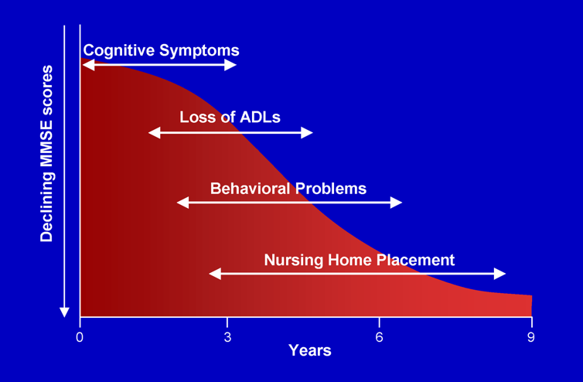
Alzheimer’s Disease Progression
Incontinence Wandering
Nocturnal Symptoms

Slide 44
Case: Family/Caregiver Report
Elsie Larson is demonstrating a gradual decline with no insight into her problems which include memory. IADLs are mostly supported which is consistent with a dementia and not Amnestic Mild Cognitive Impairment (MCI). ADLs indicate she needs assistance with bathing.
The Symptoms of Early Dementia-11 Questionnaire (SED-11Q) reveal she is repeating questions which can be especially stressful to family members. She has difficulty understanding facts which, when queried, includes not being oriented and becoming upset when family members correct her.
The Neuropsychiatric Inventory Questionnaire (NPI-Q) reveals agitation, anxiety, apathy, irritability, nighttime behaviors and appetite/eating.
Mr. Larson is endorsing mild to moderate burden on the Zarit.

Slide 45
WANDERING/GETTING LOST
Wandering:
Stress or fear – overstimulating environment
Searching – for someone or some place (psychosis)
Boredom
Basic needs—looking for bathroom, food, wants to go outside
Past Routines– try to go to work, do chores, buy groceries
If Driving:
Getting lost is complicated by the reaction of the driver (judgment)

Slide 46
Psychosis in Dementia
Delusions
Someone is stealing, spouse is having an affair
misidentification syndrome
I want to go home
Capgrass syndrome: patient says to husband, Don, that the other Don went to the MRI with her.
Hallucinations
Typically visual, most common in Dementia of the Lewy Body Type
Do not be overly concerned if they are not distressing to the patient
Management
Sensory deficits: hearing and vision
hyperthyroidism, disturbances of glucose metabolism, digitalis overdose, anticholinergic side effects, and psychoactive drug overdose

Slide 47
Other Dementia Issues Affecting Caregivers
Anosognosia
Sleep
Appetite
Agitation
Disinhibition

Slide 48
Zarit Caregiver Burden Assessment
Zarit Burden Interview Scoring
Total score range: 0 to 88
0‐21: no to mild burden
21‐40: mild to moderate burden
41‐60: moderate to severe burden
≥ 61: severe burden

Slide 49
WHY IS IT SO HARD FOR PATIENTS TO RECEIVE CARE?
Perspective on what your loved one, the patient, might be feeling
I don’t feel comfortable asking for help.
No one wants to be a burden on others.
It is hard to admit to needing care.
I’m afraid that I’ll ask and no one will be there, or I will be abandoned.
I don’t want to lose my privacy.
I don’t want to feel vulnerable.
I don’t want to lose my dignity.
I am the giver—not the other way around.

Slide 50
HELPING PATIENTS ACCEPT CARE
Dignity and Routine
Appropriate Communication
Mutual Enjoyment
Good Enough
Maximize Strengths
Activities

Slide 51
CAREGIVING: DIGNITY AND ROUTINE
Waiting on the caregiver increases awareness of helplessness, along with the “tedium of anticipation.” Caregiver thinks “After all, she has all day and I have so much to do.” By the time the caregiver arrives, the patient may respond in anger. The caregiver thinks “This is what I get in return?”
Instead give the patient a realistic predictable schedule

Slide 52
CAREGIVING: APPROPRIATE COMMUNICATION
Choices: Giving our patients too many options actually is confusing and overwhelming. At an earlier stage of the disease you may ask, “do you want to do this or that?” Later on you might say, “let’s do this” rather than “do you want to do this?” You are helping our patients manage their world so they can be successful and less anxious.
Getting into the patient’s world: Base communication on what the patient believes is real, do not correct or try to orient. Validate what the patient believes, focus on feelings.
Use active listening techniques where you reflect back what you think the person is feeling and end with a question for confirmation (e.g. “You’re feeling frustrated because you’ve been waiting all day for Bob? Is that right?” Bob is her brother who died 10 years ago).
Redirect the conversation to a new topic or activity (it may be helpful to cue old memories). “I’m sure he’ll be here soon. Why don’t you show me that scrapbook you were thinking of updating. I’m curious to see what you are thinking.” (Notice no choices were given).

Slide 53
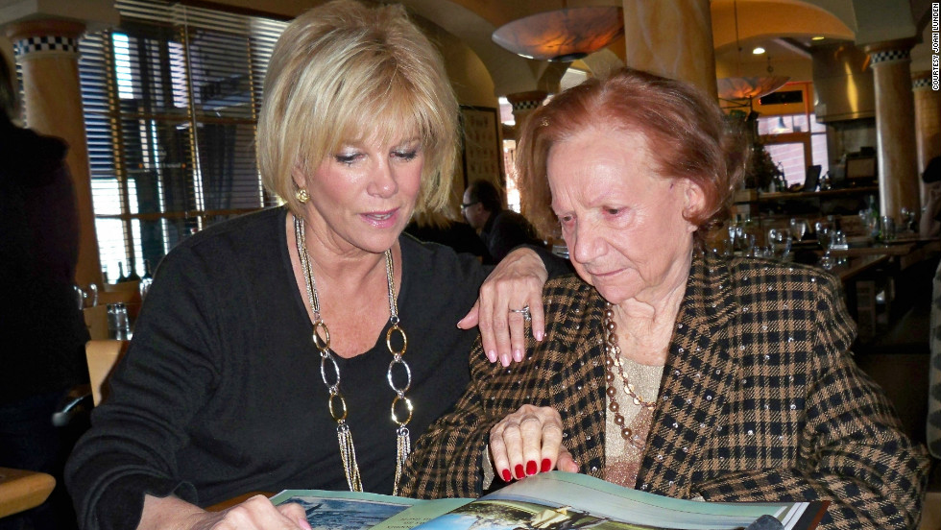
CAREGIVING: MUTUAL ENJOYMENT
Emotional memories are often resilient to forgetting
Fear of Abandonment: Patients fear using up the caregiver’s good will, may try to conceal their needs, limit the amount of help they receive, obsess over signs of weariness in the caregiver, become suspicious that the caregiver’s dedication may be dwindling.
Reassurance Through a Sense of Mutual Enjoyment: The patient needs to know they are more than “a body with endless needs.” Taking time to “savor a favorite piece of music,” rather than striving to get everything done, “the rest of what is done takes place in a context that has been elevated for both people.”

Slide 54
Caregiving: GOOD ENOUGH
Moderation in help: In trying to help, caregivers often take over a patient’s life. The patient may respond with frustration and bitterness.
Honor the patient’s preferences: When independence is threatened (or lost), what may seem trivial or inconsequential, may take on great importance to the patient. When these small requests are honored, there is less shame and anger. The Principal of Negotiated Risk (Debi Crystal MSW LCSW).
Identify giving opportunities: Counter the patient’s feelings of indebtedness, passivity, and uselessness by accepting their offer to help (e.g. fold towels). The Principal of Partial Participation.

Slide 55
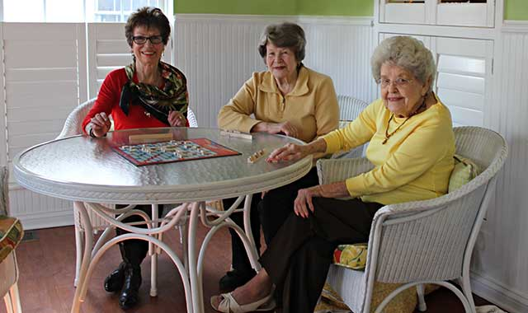
CAREGIVING: MAXIMIZE STRENGTHS
It is important to maximize our patient’s strengths and minimize what is hard for the patient. Setting up an environment where success is more likely and bumping up against memory problem is less likely.
Day programs, if available, are great at doing that. They also provide needed respite for the caregiver.

Slide 56
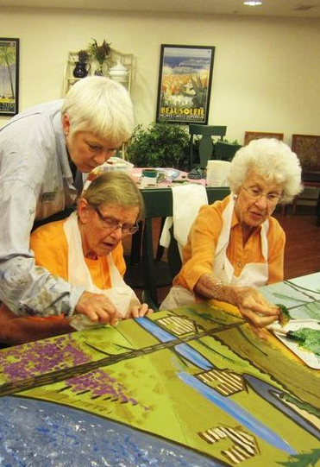
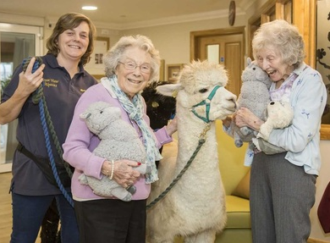
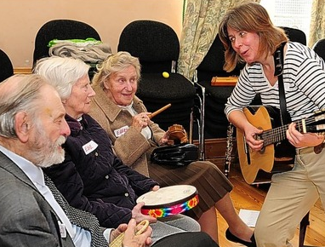
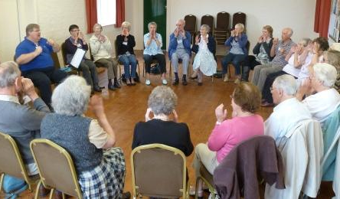
CAREGIVING: Activities
Pet Therapy, Music Therapy, Art Therapy,
Exercise, Sing-along

Slide 57
WHY IS IT SO HARD FOR CAREGIVERS TO ACCEPT HELP?
I don’t feel comfortable asking for help
No one wants to be a burden on others.
It is hard to admit to needing care.
I’m afraid that I’ll ask and no one will be there, or I will be abandoned.
I don’t want to lose my privacy.
I don’t want to feel vulnerable.
I don’t want to lose my dignity.
I am the giver—not the other way around.

Slide 58
CAREGIVER STRESS/BURNOUT
Wendy Lustbader, Medical Social Worker, Affiliate Associate Professor at the University of Washington School of Social Work
The Dance: Giving help eventually embitters us, unless we are compensated by at least appreciation; accepting help degrades us, unless we are convinced that our helpers are getting something in return. (Lustbader, Counting on Kindness)
When you’re not feeling guilty about the amount and quality of your caregiving, you may be feeling resentment toward your loved one. “when you start to feel resentment, you’re probably giving too much. Plus, nobody wants to be resented. They can see it in your face.
http://terranova.org/film-catalog/prescription-for-caregivers-take-care-of-yourself/

Slide 59
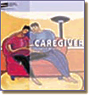
Caregiver: Taking Stock
Wellness is important not only for our patients but also for their families. It is not possible for one person to perform all the duties required for one’s loved one
Determine the needs of the patient
i.e. personal care, daily activities, medical, supervision, organizing home care, organizing medical care, managing finances
Decide what needs you can or would like to meet on your own
Determine what needs can or must be met by others
Identify family and friends to whom you can turn for help
Establish the need for outside professional help
Adapted from http://www.netofcare.org/content/getting_started/taking_stock.asp

Slide 60
SUPPORT GROUPS ARE KEY
Partner with local senior services, social worker, hospital
Group Purpose
Emotional Support
Social and personal support and networking
Information
Education
Invited Speaker
Skills Acquisition
Group Audience
Caregivers
Friends, families, other interested
Employed caregivers
Patients
Newly-Diagnosed/ Early Onset

Slide 61
The Rationale Behind a Support Group
The members are the real experts!
Feeling Safe/Sense of Belonging/Reducing isolation
Place to express feelings/reassurance these feelings are normal
Chance to regain control in the face of a disease that cannot be controlled
A place to find a sense of hope, empathy, and humor
Forum for sharing practical tips and strategies for coping
Gain satisfaction from helping others going through what you have experienced
Education

Slide 62
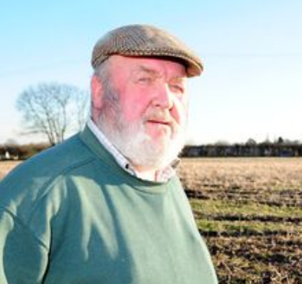
Case: Mr. Larson, caregiver
Mr. Larson is embarking on a long challenging journey of caregiving. He has some solace in having a diagnosis of dementia.
Not correcting Mrs. Larson when she thinks her brother Bob is alive or when she says she wants to go home is frustrating, but he is learning.
He told Mrs. Larson that now that he is retired, he does not have enough to do and so he wants to drive her around. She has stopped driving.
Mr. Larson meets for coffee at the local café every morning with three other men whose wives are having trouble remembering.
Friday nights his daughter brings the grandkids over and Mr. Larson goes bowling with his buddies.
He looks forward to Mrs. Larson’s visit with you every 3 months where he can give you a report of how she (and he) is doing

Slide 63
Quality of Life: Family and Friends
Important for family and friends to take care of themselves so they can help with their loved one.
Develop a network of helpers to provide food, transportation, assistance in the home. These can be informal and formal caregivers.
Designated person to eventually help make medical decisions and legal/financial decisions
Power of attorney for Healthcare
Power of attorney for Finances

Slide 64
Summary
The following were reviewed
1. The cognitive changes associated with depression.
2. The impact of depression on quality of life of people with dementia.
3. The impact of depression on care partners.

Slide 65
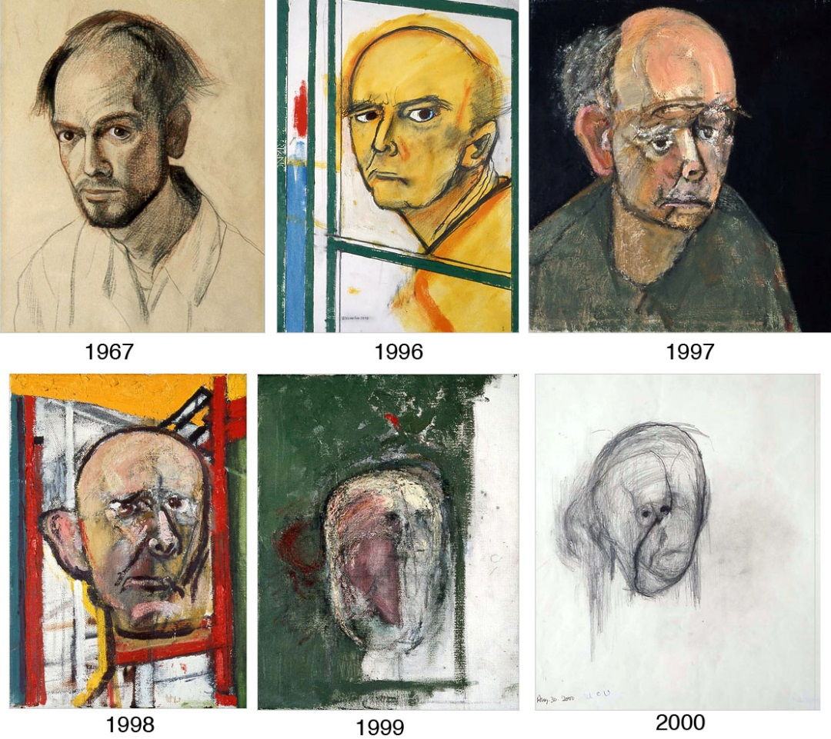
Questions ?
William Utermohlen 1933 -2007 (diagnosed 1995)

