Slide 1
Nutrition Accessibility and Health Outcomes in Aging Adults
Danielle Villano, PhD, RDN, LRD & Olivia Rossland, Dietetic Student

Slide 2
Objectives
This presentation will discuss the connection of nutrition and the 5M’s as it applies to aging adults.
Describe the role malnutrition has on health outcomes
Identify barriers to optimum nutrition in aging adults
Discuss strategies and resources to improve dietary intake

Slide 3

5 M’s of Geriatrics & Nutrition
5 Ms of Age-Friendly Care
What Matters
Medication
Multi-complexity
Mobility
Mentation
Notes:
What matters- What are the patient’s goals, values, preferences? This is very relevant to nutrition as nutrition is one of the most relatable factors of healthcare; we are dependent on nutrition, we all eat to sustatin life when we start seeing undernutrition or excessive intake we start seeing it impact our health negatively. Also food brings us joy and is a part of many celebrations and brings togetherness
I am going to clump mobility and mentation together for the sake of time and because they could each be their own presentation and while they are significantly different, there is plenty of literature that supports a nutrient dense diet is associated with positive mental health and improved mobility. Later in the presentation we will talk about mobility a little more because this is an assessment piece we look at as a nutrition professional. Medication is also significant because many of the chronic conditions that we often see in aging adults are clo

Slide 4
Poll Questions
Do you (or your facility) screen for food inaccessibility?
Do you (or your facility) screen for malnutrition?

Slide 5
Nutrition Intake and Health
Overweight/obesity
Heart disease
Diabetes
Certain types of cancers
Malnutrition
Increased energy and protein needs
Increased macro and micronutrients needs
Nutrition Assessment
Based on previous intake
Medical history

Slide 6
Malnutrition vs Undernutrition
“Malnutrition refers to deficiencies, excess, or imbalances in a person’s intake of energy and/or nutrients.” (World Health Organization, 2024)
Energy-dense is not equal to nutrient-dense
Classifications
Chronic disease-related
Acute disease-related
Non-disease-related: socioeconomical factors, or psychological factors (Dent et al., 2023)
Undernutrition is an insufficient intake of vitamins, minerals, or energy intake
Underweight
Nutrient deficiencies (World Health Organization, 2024)
World Health Organization. Malnutrition. World Health Organization. Published March 1, 2024. https://www.who.int/news-room/fact-sheets/detail/malnutrition
Dent E, Wright ORL, Woo J, Hoogendijk EO. Malnutrition in Older Adults. The Lancet. 2023;401(10380):951-966. doi:https://doi.org/10.1016/s0140-6736(22)02612-5

Slide 7
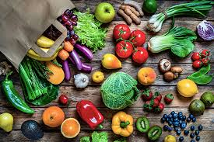
Dietary Guidelines for Older Adults
Fruits & Vegetables
Whole grains
Protein
Adequate fluid intake
Limit
Added sugars
Saturated fats
Sodium
Alcoholic beverages
Individualized assessment
Not “one size fits all”
Therapeutic diets
https://www.dietaryguidelines.gov/
Notes:
2300 mg unless MNT indicates otherwise

Slide 8

Nutrition in Aging Adults
Decrease in intake
Nutrient intake needs increase
Notes:
Calcium, Vitamin D, potassium, dietary fiber, vitamin B12, and protein

Slide 9
Considerations for Aging
Susceptibility from Aging Process
Malnutrition
Biological Aging Process
Increased risk for chronic diseases
Changes in physical and cognitive well-being
Socio-economic changes
Food Safety
Physical decline
Loss of muscle mass & strength
Impaired immune function
Management of chronic diseases
Impaired wound healing
Increased mortality and morbidity
Notes:
Susceptibility: The state or fact of being likely or liable to be influenced or harmed by a particular thing

Slide 10
Malnutrition in Aging Adults
Older adults are at greater risk for chronic diseases
Increased risk for malnutrition
Malnutrition has a greater impact on older adults
Norman K, Hab U, Pirlich M. Malnutrition in older adults—recent advances and remaining challenges. Nutrients. 2021;13(8):2764. doi:https://doi.org/10.3390/nu13082764

Slide 11
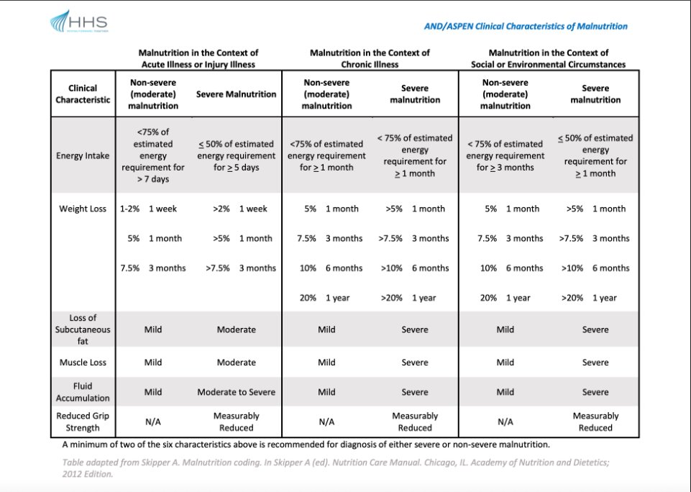
Malnutrition Diagnosis Criteria

Slide 12
Impact on Health
Decreased ability to recover from disease or condition (trauma, surgery, wounds, infection)
Lowers immunity
Increased risk for morbidity and mortality
Increased fall risk
Muscle wasting
Loss of strength
Decrease bone mineral mass
Norman K, Hab U, Pirlich M. Malnutrition in older adults—recent advances and remaining challenges. Nutrients. 2021;13(8):2764. doi:https://doi.org/10.3390/nu13082764

Slide 13
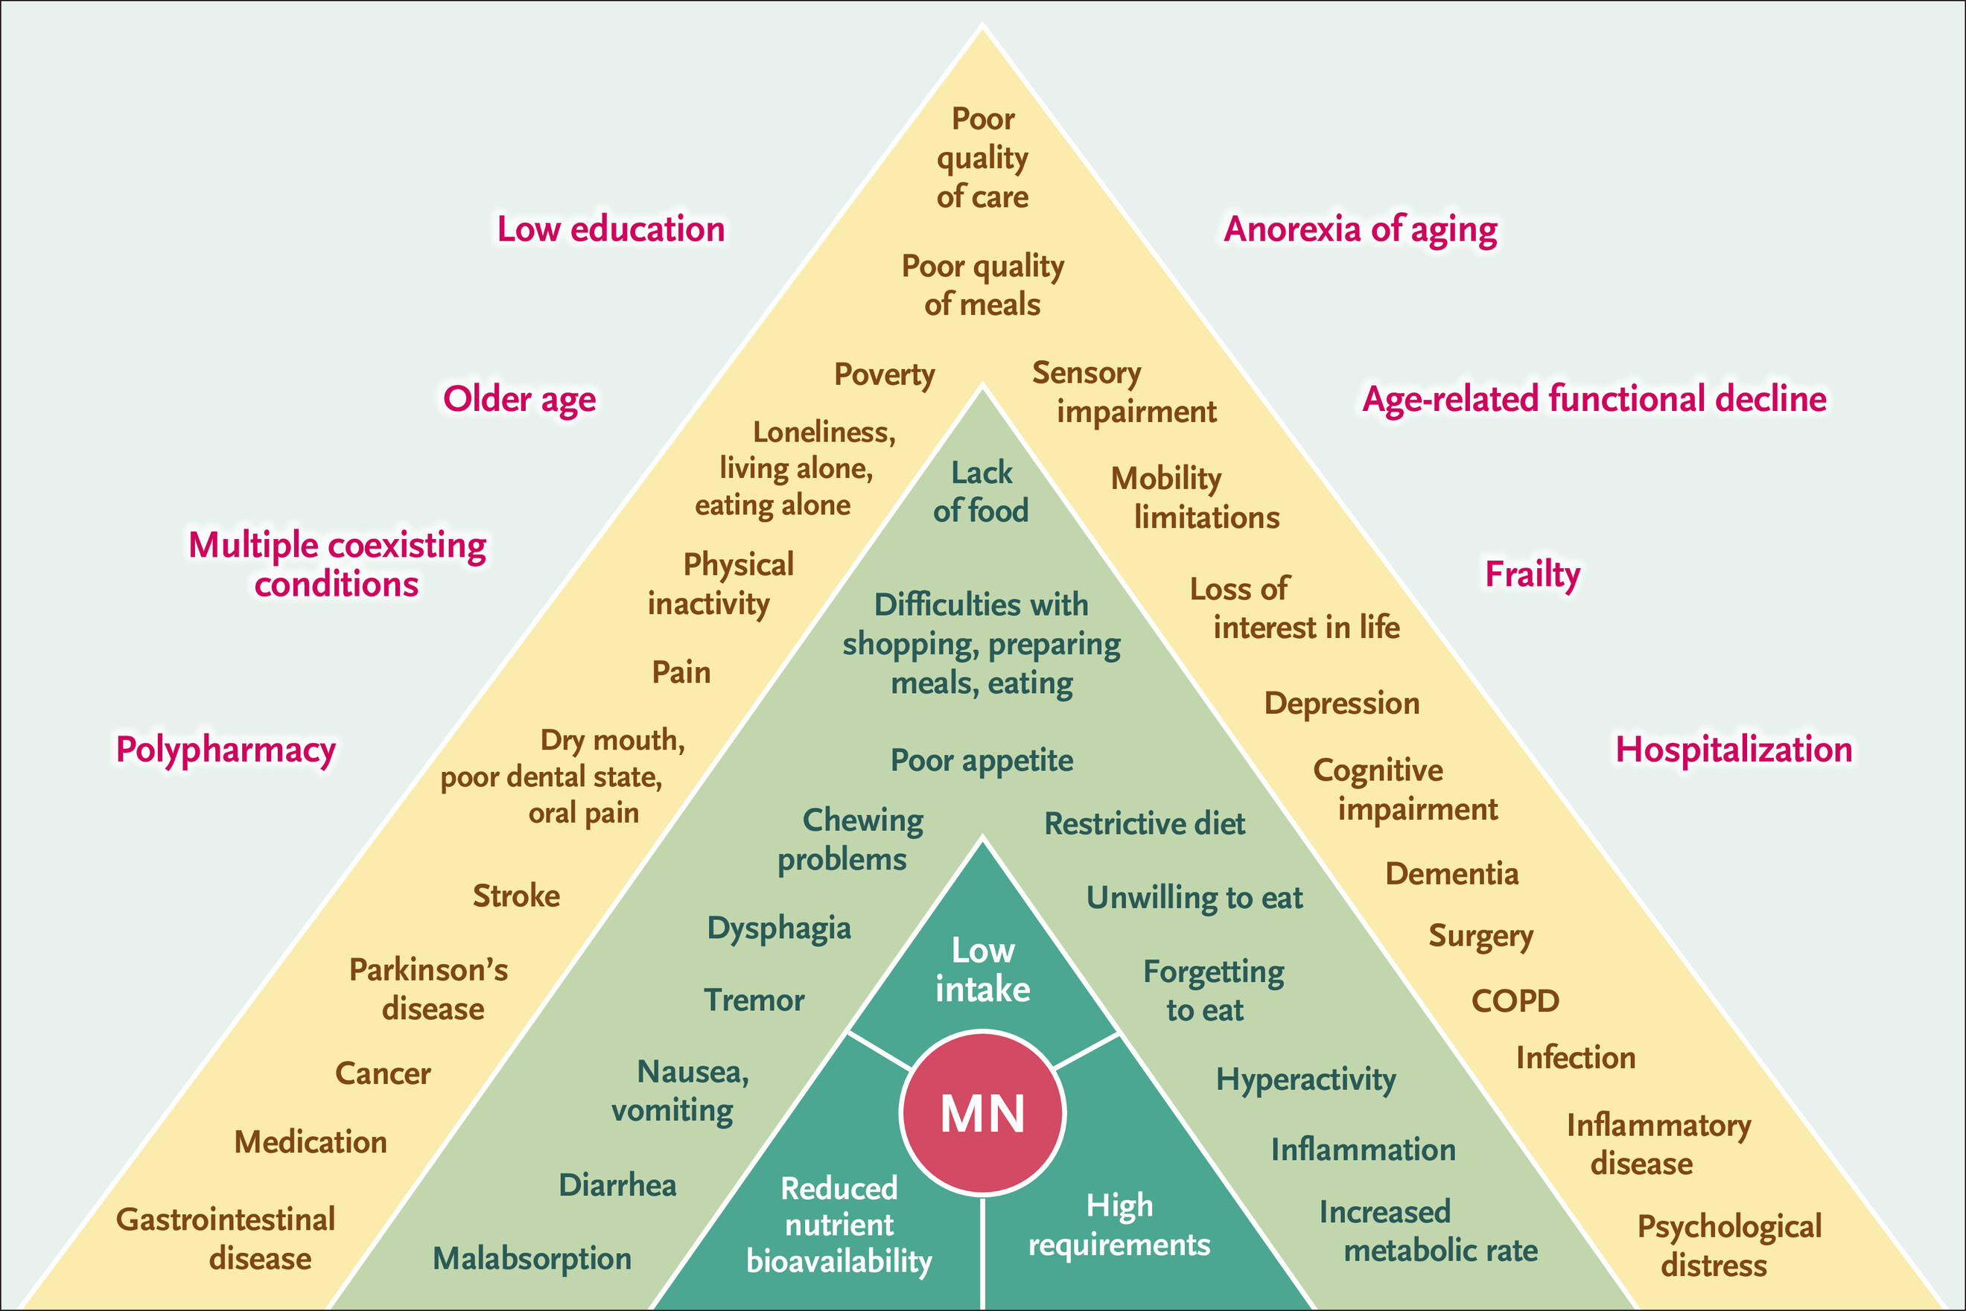
Risk Factors of Malnutrition
Multifactorial
Is food accessible?
Ability to prepare food
Equipment
Recipes
Energy level to prepare food
Cruz-Jentoft, A. & Volkert, D. Malnutrition in Older Adults. N Engl J Med. 2025; 392: 2247. Figure 1: Determinants of Malnutrition in Aged Persons (DoMAP) Model. DOI: 10.1056/NEJMra2412275. Accessed December 23, 2025.
Notes:
https://www.smgg.es/wp-content/uploads/2025/07/desnutricion-en-adultos-mayores-articulo-junio-2025.pdf

Slide 14
Food Insecurity in Older Adults
More than 12 million seniors and older adults experience food insecurity
7.4 million (60 and older)
5.2 million (50-59)
Seniors with a disability are 2-3 x more likely to be food insecure
Those who rent vs own their own home are more likely to be insecure
Those who reside with grandchildren in the home are twice as likely to be food insecure
Counties with high food insecurity are disproportionately rural
Feeding America, Senior Hunger Research. Map the Meal Gap 2025. Accessed from Feeding America Website: https://www.feedingamerica.org/sites/default/files/2025-05/Map%20the%20Meal%20Gap%202025%20Report.pdf December 28, 2025

Slide 15
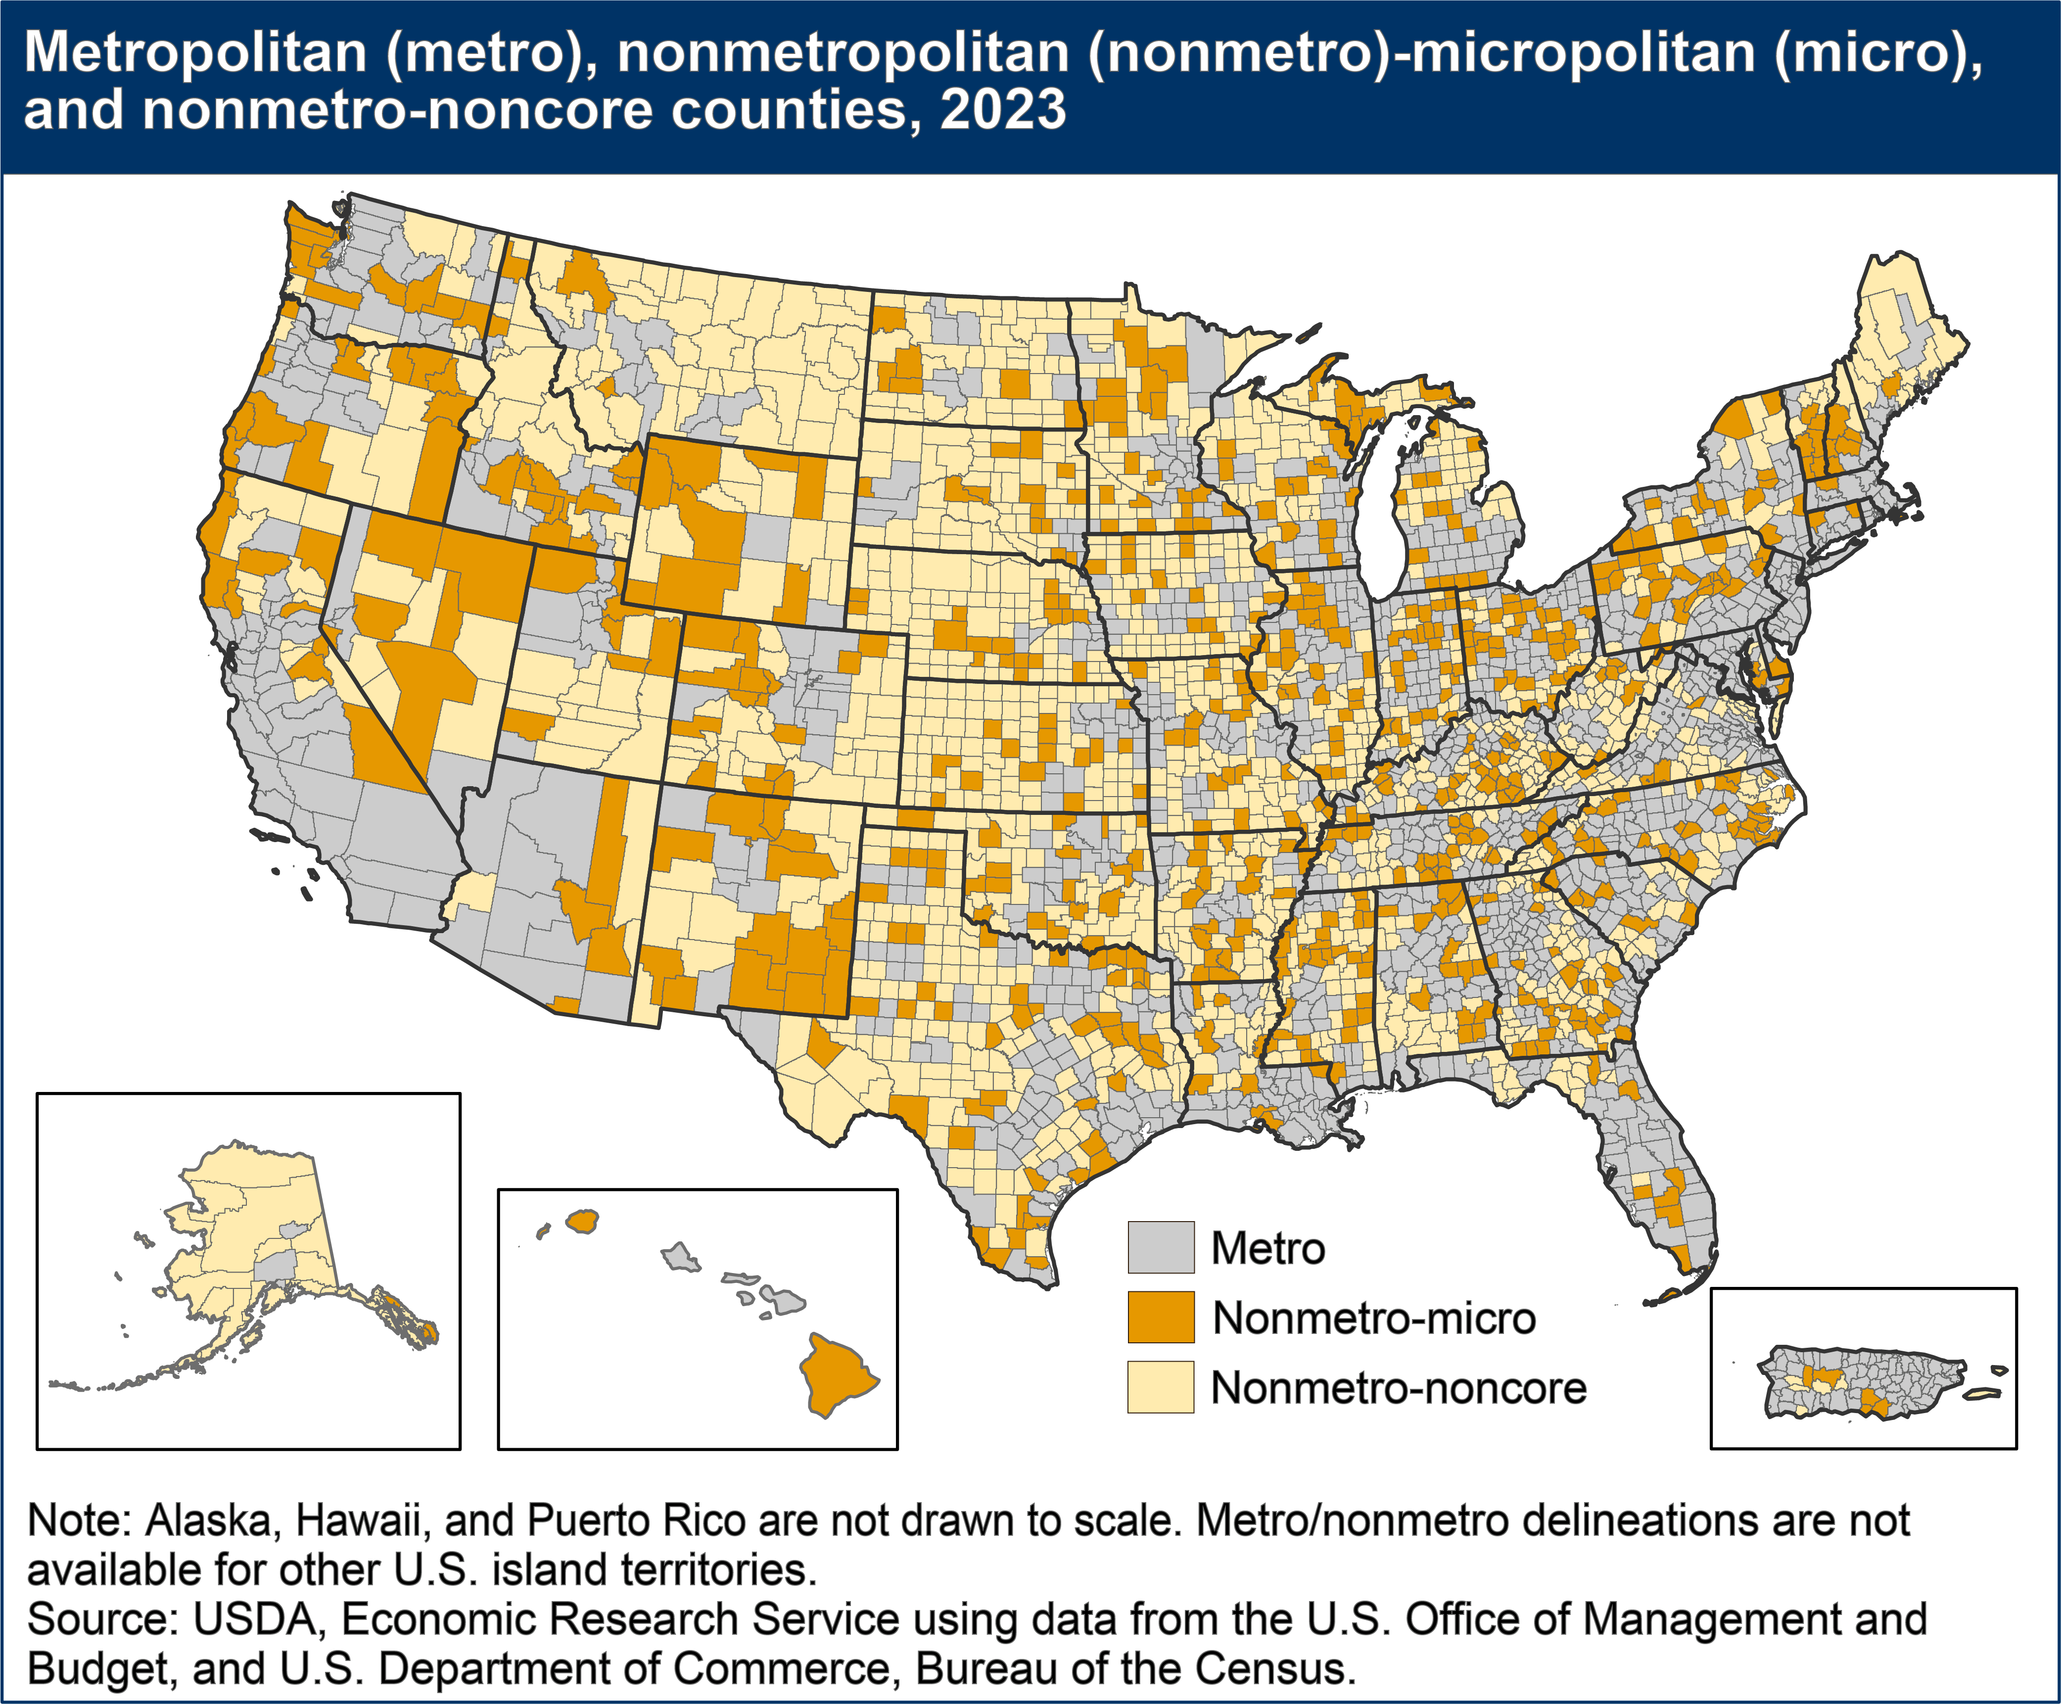
Access to Healthful Food
Distance to food establishment/grocery store
Type of available food establishment(s)
Transportation
What is available at that store
What is affordable
Supplemental programs
Does the person have resources
Does that establishment accept programs
Sanders, A. Rural Classifications – What is Rural? Economic Research Service. U.S. Department of Agriculture. 2025. Accessed December 27, 2025 from https://www.ers.usda.gov/topics/rural-economy-population/rural-classifications/what-is-rural
Notes:
https://www.smgg.es/wp-content/uploads/2025/07/desnutricion-en-adultos-mayores-articulo-junio-2025.pdf

Slide 16
Case Study: Addressing Malnutrition through the Nutrition Care Process
Presented by: Olivia Rossland, UND Student Dietitian

Slide 17
Patient Status
RO
64 y/o
Male
Admitted 11/03/25
ED → Med Surg
Discharged 11/07/25
Presented with
Sepsis secondary to pneumonia​
Failure to thrive​
COPD exacerbation​
Progressive weakness ​
SOB ​
Persistent cough

Slide 18
Social History
Occupation
Unemployed
Ethnic Background
Caucasian
Food Insecurity
Meals on Wheels
Food Pantry/Salvation Army
Transportation
Vehicle nonfunctional
Family Situation
Not married
Social Security money
Girlfriend

Slide 19
Medical/Family History
Medical
COPD, hepatitis C, mental health diagnosis, and cataracts
Family
Cerebral aneurysm, lung cancer, emphysema, and diabetes
Cataract removal procedure and diagnostic colonoscopy

Slide 20
Food & Nutrition-Related History
Prepare meals independently
No food allergies or intolerances
SOB & general weakness
Good appetite
Reported not eaten for two consecutive days
Physical activity

Slide 21
Anthropometric Measurements
Weight/Height
100.3 lb (45.5 kg)
BMI
14.80 kg/m²
UBW/IBW
UBW: 119 lb (54.1 kg)
5’9”
IBW: 160 lb (72.72 kg)

Slide 22
Estimated Energy & Protein Needs
1,236 kcal
1,780 kcal
1,592-1,808 kcal (35-40 kcal/kg)
1,600-1,800 kcal
Calories
Protein
1.2-1.5 g/kg
55-68 grams of protein

Slide 23
Biochemical Data
DATE​ | LAB​ | VALUE​ | RANGE​
11/05/25​ | Calcium (low)​ | 8.3​ | 8.8-10.5​
11/05/25​ | BUN (high)​ | 27​ | 7-22​
11/05/25​ | Hemoglobin (low)​ | 12.9​ | 13-18​
11/05/25​ | RBC (low)​ | 4.27​ | 4.40-5.90​
11/05/25​ | Potassium​ | 4.0​ | 3.6-5.5​
11/05/25​ | Creatinine​ | 0.9​ | 0.6-1.3​
11/05/25​ | Albumin​ | 3.84​ | 3.40-4.70​
Other indicators: CBC, phosphorus, CRP
(Keller, 2019)

Slide 24
Nutrition Focused Physical Findings
Clinical Observations
Severe muscle wasting and fat loss in the orbital, temporal, clavicle, shoulder, and upper arm regions
Adequate dentation
No chewing or swallowing difficulty

Slide 25
Medications
Name of Medication​ | Purpose/Uses​ | Possible Side Effects and/or Drug/Nutrient Interactions​
Benztropine ​ | Parkinson’s Disease Treatment​ | Take without regard to food. Food may decrease GI upset. Caution with alcohol. May decrease appetite and weight. ​
Clonidine​ | Treatment of ADHD ​ | Food does not affect absorption. Avoid dehydration and ensure adequate fluid intake. Possible side effects include dry mouth and constipation. May cause a decrease in appetite. ​
Doxycycline Hyclate ​ | Treatment of GI infection (antibiotic)​ | Take with adequate fluid. Follow with food and avoid lying down for 30 min to decrease esophageal irritation. Take separately from aluminum, calcium or magnesium containing antacids or iron supplement by greater than 2 – 4 hours. Prolonged use may cause nutrient deficiencies. ​
Heparin ​ | Prevention of clotting (anticoagulant) ​ | Chronic alcohol use will increase the risk for bleeding. Long term use may lead to osteopenia. ​
Prednisone ​ | Immunosuppressant; Anti-inflammatory​ | Take separately from bile acid sequestrants. Take with food or milk to decreased GI upset. High fat meals will delay absorption by 5 hours. Caution with alcohol. May cause an increase in blood pressure. ​
Azithromycin​ | Treatment of Respiratory Infection (antibiotic) ​ | Take with food to decrease GI effects. Prolonged use may result in nutrient deficiencies. May cause diarrhea. ​

Slide 26
Nutrition Diagnosis
Severe malnutrition (undernutrition) [NC-4.1] related to pathological of physiological causes that result in increased energy requirements as evidenced by severe muscle wasting and fat loss of temporal, clavicle, shoulder, and of the upper arm regions/reports of PO intake meeting < 75% of estimated energy requirements for ≤ 1 month.
Inadequate energy intake [NI-2.1] related to lack of access to food or artificial nutrition as evidenced by intake not meeting estimated energy requirements.

Slide 27
Nutrition Intervention
Coordinated, multidisciplinary approach
Addressing underlying contributors
Food fortification, nutrient dense foods
(Ji et al., 2022)
(International Malnutrition Task Force, n.d.)

Slide 28
Prescription/Goal/Plan
Prescription
Patient to consume 450-500 kcal at each meal TID, and 300 kcal from ONS.
Goal
Patient to consume 75-100% of all meals and ONS to meet 1,600-1,800 kcal and 55-68 g of protein per day within three days.
Plan
ONS, communication with multidisciplinary team, nutrition education.

Slide 29
Implementation
General diet
Room service
Order double portions
1 CIB shake
2 Ensure Plus
Weight trends
Lab values
Tolerance to oral intake
Reassessed every 3-5 days

Slide 30
Preparing for Beyond the Hospital
Motivational Interviewing
Nutrition Education
Coordination of care
Meal assistance programs
Transportation services
HCBS

Slide 31
Indicators & Outcomes
1,600-1,800 kcal and 55-68 g of protein per day
Pertinent lab values
K, Ca, BUN, Hgb, RBC
Reassessed every 3-5 days
Weight trends
Educational needs

Slide 32
Follow up & Discharge Plans
Case Manager Support
Transportation Services
Nutrition Education
High protein, high calorie, low-cost foods
Meals on Wheels
HCBS
Meal assistance programs
Food Pantry Package

Slide 33

What Can Do as Practitioners
Complete nutrition screening
Food insecurity
Malnutrition
Interprofessional Team
Referral
Resources
Follow up
Advocate
Notes:
If this is inpatient, post-discharge follow-up is essential and prevents readmission

Slide 34
Questions and Thoughts

Slide 35
References Slide 1 of 2
Allen B., Saunders J. 2023, July. Malnutrition and undernutrition: causes, consequences, assessment and management. Science Direct. https://doi.org/10.1016/j.mpmed.2023.04.004 ​
Cleveland Clinic. 2022, May 4. Malnutrition. https://my.clevelandclinic.org/health/diseases/22987-malnutrition ​
Cruz-Jentoft, A. & Volkert, D. Malnutrition in Older Adults. N Engl J Med. 2025; 392: 2247. Figure 1: Determinants of Malnutrition in Aged Persons (DoMAP) Model. DOI: 10.1056/NEJMra2412275. Accessed December 23, 2025.
Dent E, Wright ORL, Woo J, Hoogendijk EO. Malnutrition in Older Adults. The Lancet. 2023;401(10380):951-966. doi:https://doi.org/10.1016/s0140-6736(22)02612-5
Feeding America, Senior Hunger Research. Map the Meal Gap 2025. Accessed from Feeding America Website: https://www.feedingamerica.org/sites/default/files/2025-05/Map%20the%20Meal%20Gap%202025%20Report.pdf December 28, 2025
Harvard Health Publishing. 2025, January 24. Malnutrition in older adults: strategies for addressing the common problem. Harvard Medical School. https://www.health.harvard.edu/nutrition/malnutrition-in-older-adults-strategies-for-addressing-this-common-problem ​
International Malnutrition Task Force. (n.d.). Impatient. https://imtf.org/page/info/malnutrition-management/inpatient/ ​
Ji, T., Zhang, L., Han, R., Peng, L., Shen, S., Liu, X., Shi, Y., Chen, X., Chen, Q., Li, Y., & Ma, L. (2022). Management of Malnutrition Based on Multidisciplinary Team Decision-Making in Chinese Older Adults (3M Study): A Prospective, Multicenter, Randomized, Controlled Study Protocol. Frontiers in nutrition, 9, 851590. https://doi.org/10.3389/fnut.2022.851590 ​
Keller U. (2019). Nutritional Laboratory Markers in Malnutrition. Journal of clinical medicine, 8(6), 775. https://doi.org/10.3390/jcm8060775 ​
Norman K, Hab U, Pirlich M. Malnutrition in older adults—recent advances and remaining challenges. Nutrients. 2021;13(8):2764. doi:https://doi.org/10.3390/nu13082764
NHS Inform. 2025, January 10. Malnutrition. https://www.nhsinform.scot/illnesses-and-conditions/nutritional/malnutrition/
Nutrition and Food Safety Department. 2025, May 7. Malnutrition. World Health Organization. https://www.who.int/news-room/questions-and-answers/item/malnutrition ​
Table adapted from Skipped A. Malnutrition coding. In Skipper A (ed). Nutrition Care Manual. Chicago, IL. Academy of Nutrition and Dietetics; 2012 Edition.
Sanders, A. Rural Classifications – What is Rural? Economic Research Service. U.S. Department of Agriculture. 2025. Accessed December 27, 2025 from https://www.ers.usda.gov/topics/rural-economy-population/rural-classifications/what-is-rural
World Health Organization. Malnutrition. World Health Organization. Published March 1, 2024. https://www.who.int/news-room/fact-sheets/detail/malnutrition

Slide 36
References Slide 2 of 2

