Slide 1





Intimacy and Dementia:
CHALLENGE ACCEPTED
Maggie Syme, PhD, MPH
Massachusetts General Hospital
Harvard Medical School

Slide 2



Intimacy and Dementia:
Status Update

Slide 3
WHAT IS THE GOAL?
Sexual
CITIZENSHIP
“seeking control over one’s body, feelings, relationships: access to representations, relationship, public and socially grounded choices...”
Simpson et al. 2018; Ageing and Society

Slide 4
CHALLENGES (ACCEPTED)
??
??
What’s in the way?
??
02 - WEBSITE
??

Slide 5
Normal Aging
Menopause/decline in estrogen
Health
(medications)
W
What about dementiA?
Andropause/decline in testosterone
Health
(medications)
M
(Dillaway, 2005; DeLamater, 2012; DeLamater & Sill, 2005; Kontula & Haavio-Mannila, 2009; Lindau et al., 2007; Pesce et al., 2002)
**biological males and females

Slide 6
CHALLENGES (ACCEPTED)
??
??
What’s in the way?
CONCEPTUALIZATION
02 - WEBSITE
??

Slide 7
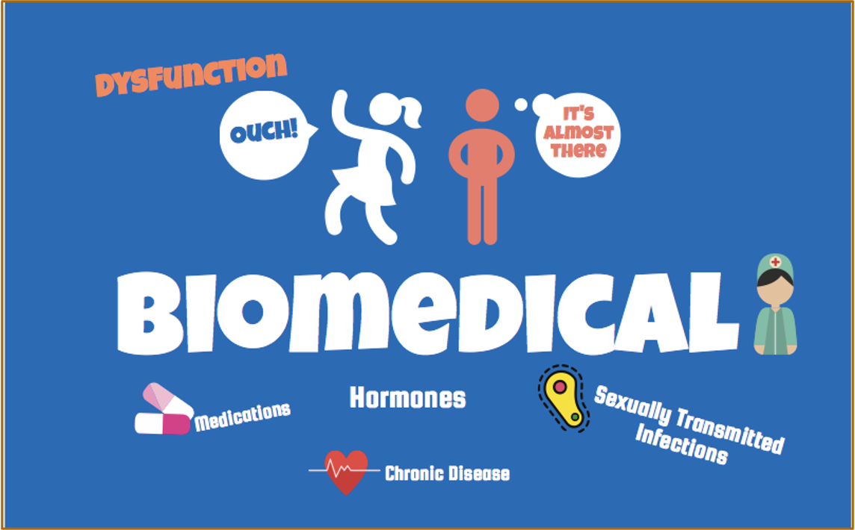
Conceptualization

Slide 8
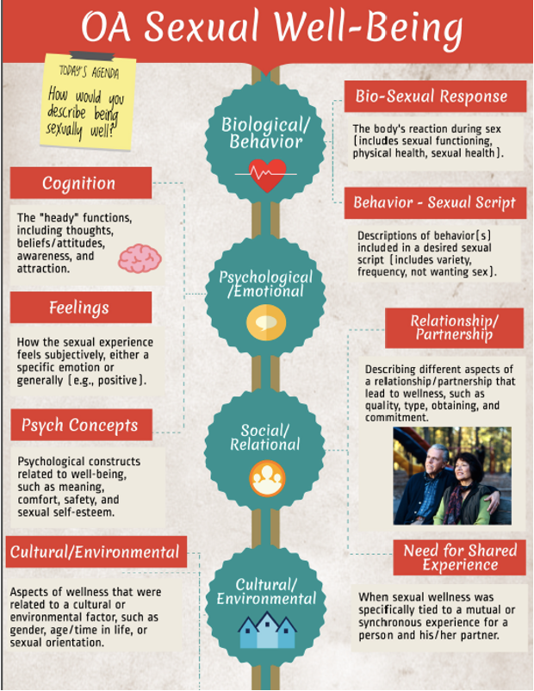
Conceptualization
Biopsychosocial-Cultural
Vs.
Biomedical
What about dementiA?
03 - SOCIAL MEDIA
Syme, M. L., et al., 2018; Journal of Sex Research, 56(7), 832–842. https://doi.org/10.1080/00224499.2018.1456510

Slide 9
CHALLENGES (ACCEPTED)
??
??
What’s in the way?
CONCEPTUALIZATION
02 - WEBSITE
AGEISM

Slide 10
AGEISM
“Ideas, attitudes, beliefs, and practices on the part of individuals that are biased against persons or groups based on their older age.”
(International Longevity Center, 2006)
Stigmatic beliefs and attitudes about aging sexuality, fueled by cultural values, stereotypes, and misconceptions
(embedded across the lifecourse)

Slide 11

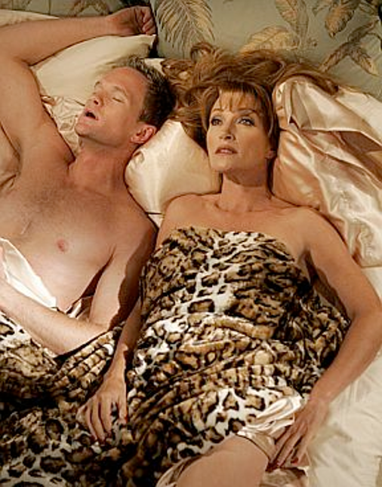
AGEISM
GENDERED STEREOTYPES
OCT
Can you think of counters?
Gerwitz-Meydan et al.; Gerontologist, 2023, Vol. 63, No. 2, 218–230
https://doi.org/10.1093/geront/gnac093

Slide 12



AGEISM
+24K
Stereotype Embodiment Theory
INTERNALIZED
How does it work with intimacy and dementia?
Exposed to messages about aging (and sexuality and intimacy) across the lifecourse
ACTIVATED
Self-relevance of aging sexual stereotypes initiates more concsious activation
ENACTED
Observed direct effects on thoughts, behaviors, feelings
Levy BR, Leifheit-Limson E.; Psychol Aging. 2009 Mar;24(1):230-3. doi: 10.1037/a0014563.

Slide 13
CHALLENGES (ACCEPTED)
??
INCLUSIVITY
What’s in the way?
CONCEPTUALIZATION
02 - WEBSITE
AGESIM

Slide 14
SEXUAL AND GENDER IDENTITY
LGB older adults experience significantly more health disparities and SDOH risk than their heterosexual counterparts (Fredriksen-Goldsen et al., 2013
LGB older adults report similar sexual expression as heterosexual counterparts, some evidence of more sexual health disparities, and similarly no one is asking (Brennan-Ing, et al. 2020)
Evidence that ageism and sexual and gender minority stigmas compound (Lyons et al., 2021)
Sexuality and Aging: Let’s Keep Talking About This, Shall We?
Suzanne Meeks, PhD, FGSA
Gerontologist Special Issue!
Fredrisken-Goldsen et al. October 2013, Vol 103, No. 10 | American Journal of Public Health

Slide 15
CHALLENGES (ACCEPTED)
SEXUAL AUTONOMY
INCLUSIVITY
What’s in the way?
CONCEPTUALIZATION
02 - WEBSITE
AGEISM

Slide 16
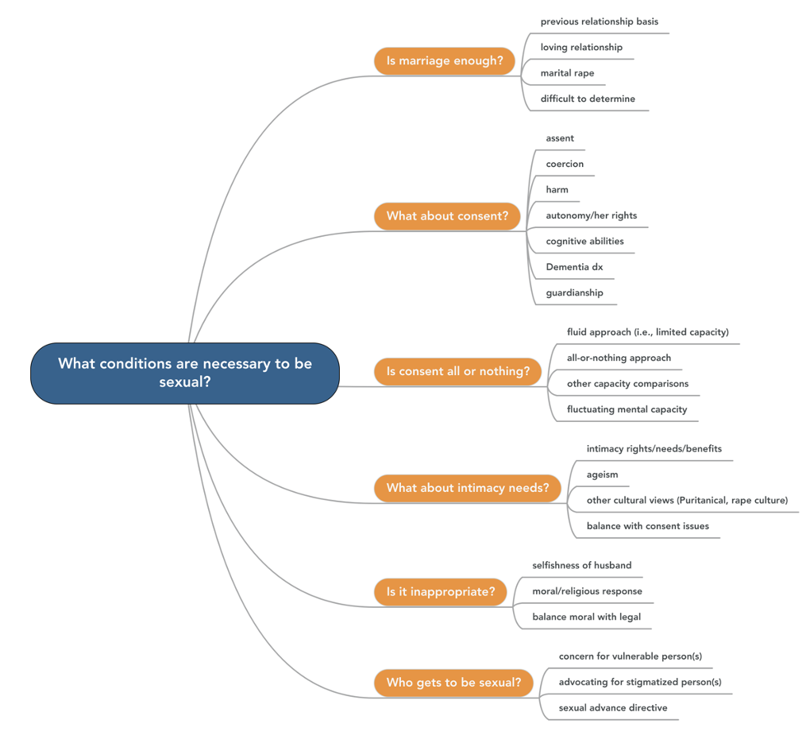
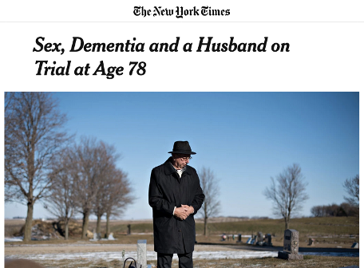
SEXUAL AUTONOMY
N = 1194
Syme ML et al.; 2017 Health Expectations, 20(4), 705–713. https://doi.org/10.1111/hex.12509

Slide 17
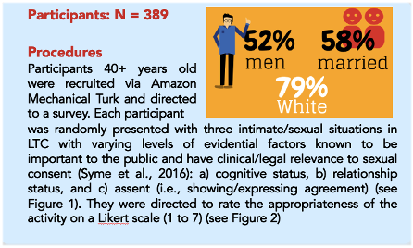
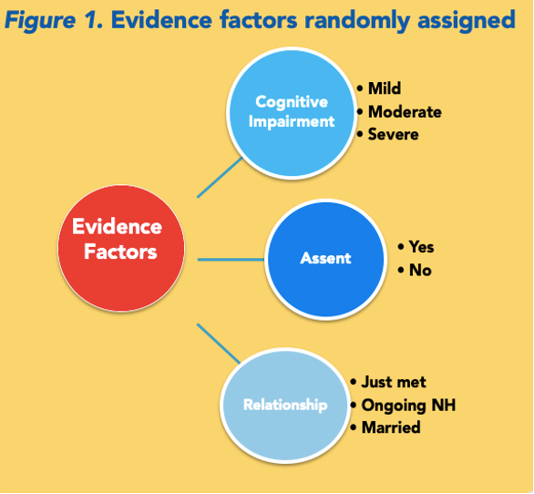
SEXUAL AUTONOMY
PERSON-CENTERED VIEW
The aging public generally support sexual expression in long-term care across situations (M= 5.03, SD = 1.76). The older the consumer the more appropriate the behavior, across situations.
Evidence of a nuanced vs. all-or-nothing approach to sexual expression (increase risk, decrease appropriateness).
Aging public pick up on assent vs. consent and consider it in their decisions.
Cognition is only relevant in the context of relationships vs. sole decisional factor.
N = 389
Syme ML et al.; Gerontologist, 2020:60(4), 725–734. https://doi.org/10.1093/geront/gnz016

Slide 18

SEXUAL AUTONOMY
What factors should determine sexual consent? Assent?
02 - WEBSITE
& what really matters?

Slide 19



Legal Considerations
State Law for Consent
&
Regs for
Health Care
Decision-Making
1. Understanding
4. Morals
Understand nature of the activities
Appreciate risks/benefits
Understand the moral implications
2. Reasoning
5. Marriage
Ability to make informed decision
Weigh risks and benefits
Marital rape is legal in a small number of states
3. Voluntariness
6. Values
Communicate "no" when needed
Absence of coercion
What does the resident value?
Substituted judgement?

Slide 20

Additional Issues
1. Dichotomous?
4. Best Interest
Yes or No, always?
Limited capacity
Who is the client?
Resident centered, autonomy
2. Global?
5. Paternalism
Mis/use of "capacity"
Cognitive screening
"I know better"
Limits to "others"
3. Assent
6. LTC enviro
vs. Consent
Behavioral indicators
Potential limits
Creative alternatives

Slide 21
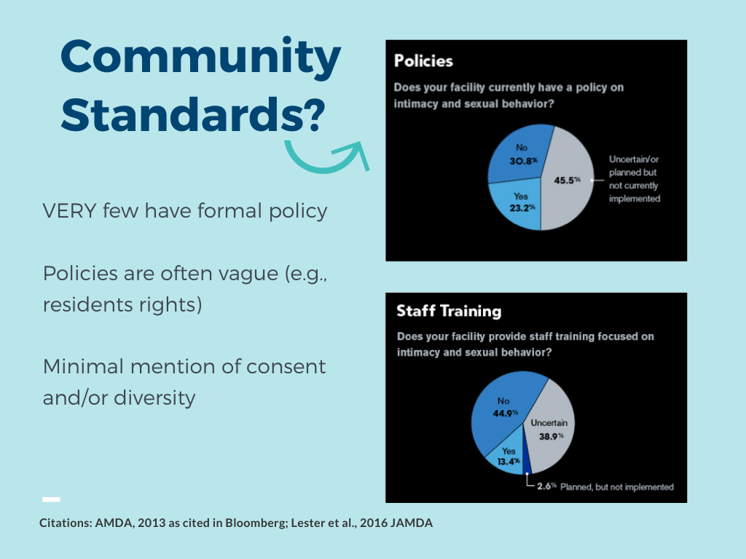
SEXUAL AUTONOMY
02 - WEBSITE

Slide 22
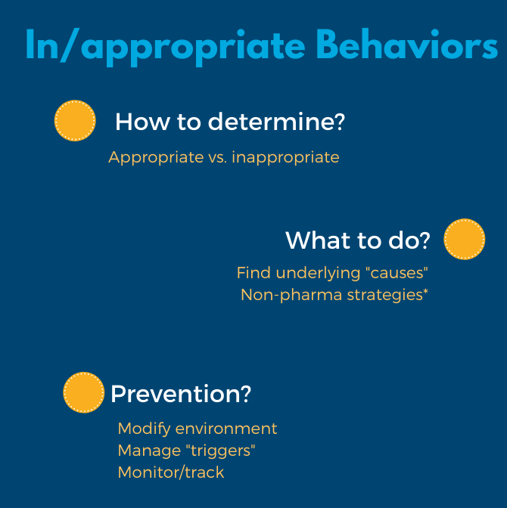
SEXUAL AUTONOMY
02 - WEBSITE

Slide 23
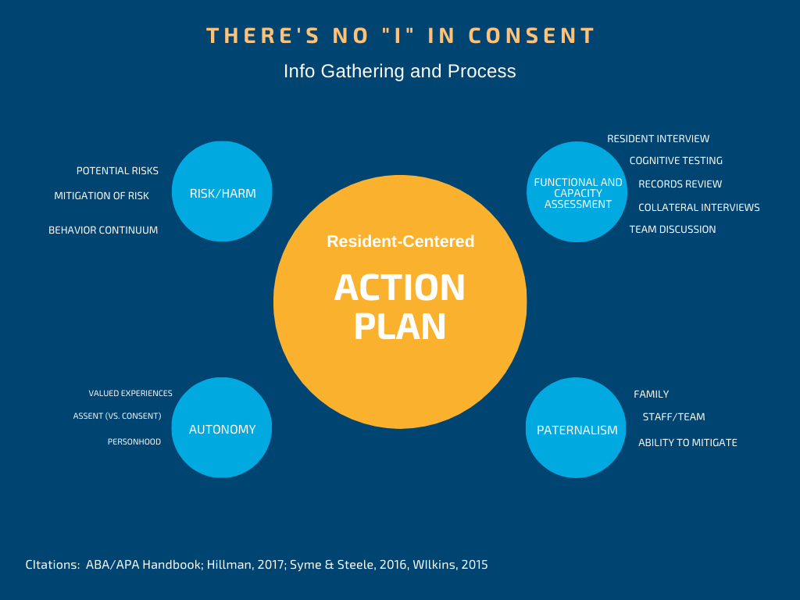

Slide 24



WHERE DO YOU GO
FROM HERE?
START PROCESS
FUNCTIONAL & CAPACITY
1. Interview
2. Testing (choose based on above)
3. Collateral Info
4. TEAM DISCUSSION
Deemed capable, resident-centered plan to support DM documented; follow-up plan
Joint decision that resident may lack capacity to consent to sexual intercourse
REALIZING
SEXUAL CONSENT POTENTIAL
Limited capacity discussion:
1. Benefits
2. Risk and autonomy
3. Least restrictive alternative
Resident-centered plan to support DM documented; follow-up plan
Sources: ABA/APA Handbook; Hillman, 2017; Lichtenberg, 2014; Syme & Steele, 2016; VHCA, 2009; Huitema & Syme 2023

Slide 25
THANK YOU
msyme@mgh.harvard.edu

