Slide 1

Exercise and Dementia
Ryan McGrath, PhD

Slide 2

Before We Begin
Conflicts and disclosures
  None to report

Slide 3
Before We Begin
Learning objectives
  Describe the difference between sedentary and physically inactive
  Acknowledge barriers to physical activity participation
  Describe the role of physical activity participation for dementia

Slide 4
Exercise and Dementia
Greetings!
  Ryan McGrath
    Department of Health, Nutrition, and Exercise Sciences
    North Dakota State University
      Healthy Aging North Dakota (HAND)
        Topics include healthy aging research
    University of North Dakota School of Medicine and Health Sciences

Slide 5




Exercise and Dementia

Slide 6
Exercise and Dementia
Physical activity
  Any bodily movement produced by skeletal muscles that results in energy expenditure (kcal)
Exercise
  Subset of physical activity; planned, structured, and repetitive for a final or intermediate objective for the improvement or maintenance of physical fitness
Physical fitness
  Set of attributes that are health or skill related
Caspersen et al. 1985

Slide 7

Exercise and Dementia
Sedentary behavior
  Any waking behaviors characterized with a low energy expenditure such as sitting, reclining, or lying
Physically inactive
  Not achieving Physical Activity Guidelines
Thivel et al. 2018

Slide 8
Exercise and Dementia
Physical Activity Guidelines for Americans (adults; in brief)
  ≥150 minutes of moderate-to-vigorous physical activity each week
  At least moderate intensity muscle-strengthening activities involving major muscle groups at least two days/week
  Overall move more and sit less
DHHS PAGA 2018

Slide 9
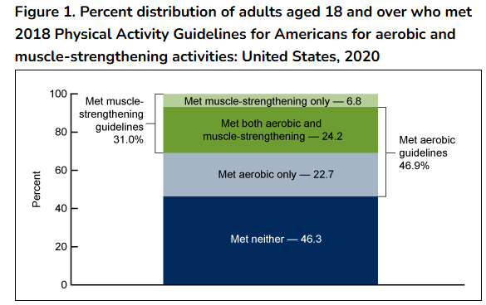
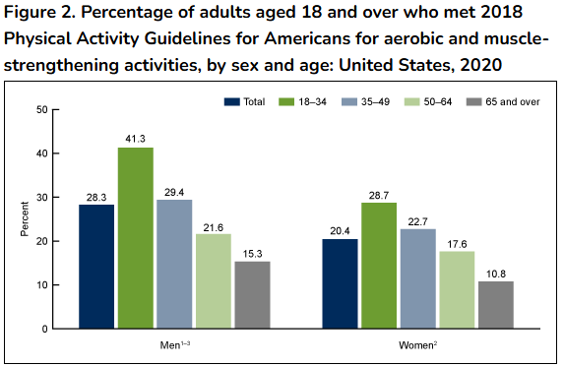
Exercise and Dementia
Elgaddal et al. (2022)

Slide 10
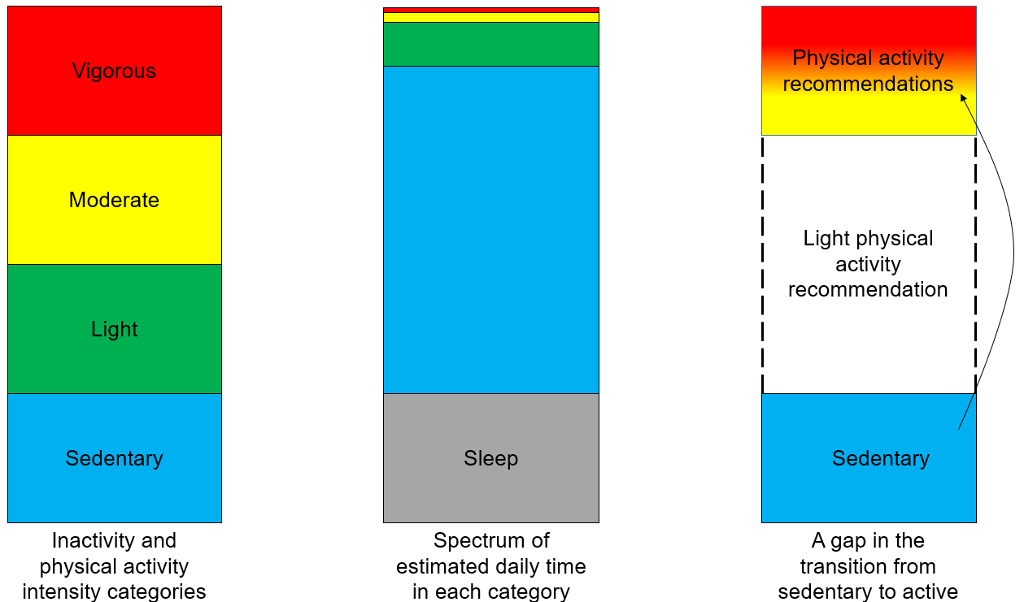
Exercise and Dementia

Slide 11

Exercise and Dementia
Common barriers
  Time
  Social support
  Energy
  Motivation
  Injury risk
  Skill and motor development
  Costs
  Facility access
  Weather
CDC 2025

Slide 12
Exercise and Dementia
Physical activity is generally good for health across the lifespan
  Longevity
  Chronic cardiometabolic disease
  Body composition
  Functional capacity
  Mental health
  Physical fitness
  Falls and injuries
  Brain health
DHHS PAGA 2018

Slide 13
Exercise and Dementia
Physical activity in interventions
  Primary: Reduce the risk of a condition before it begins by targeting modifiable risk factors in persons who are still healthy
  Secondary: Reduce the risk of recurrent conditions in persons who are already diagnosed
  Tertiary: Reducing the long-term impact of a condition by minimizing complications and improving overall quality of life
Keyes et al. 2025

Slide 14
Exercise and Dementia
Physical activity behavior change
  Can be hard
    Challenges exist
    Habits and comfort
    Continuum vs dichotomy
    Decision making is a factor
    Trying something new or previously disliked
Keyes et al. 2025

Slide 15
Exercise and Dementia
Behavior change theory framework exists
  Transtheoretical model
    Health behavior occurs through a persons readiness to change and is demonstrated through stages
      Progress and relapse may occur over time
Precontemplation
“wont”
Contemplation
“may”
Preparation
“intend”
Action
“am”
Maintenance
“have”
Physical Activity Participation
Raihan & Cogburn 2023

Slide 16
Exercise and Dementia
Behavior change theory framework exists
  Self-determination theory
    Motivation to change
      Autonomy
      Competence
      Relatedness
Amotivation
Extrinsic Motivation
Intrinsic Motivation
External Regulation
“Reward” or “Avoid”
Introjected Regulation
“Internal Pressures”
Identified Regulation
“Goal” or “Valued”
Integrated Regulation
“Identify” or “Self”
Self-Determination
Ryan & Deci 2000

Slide 17
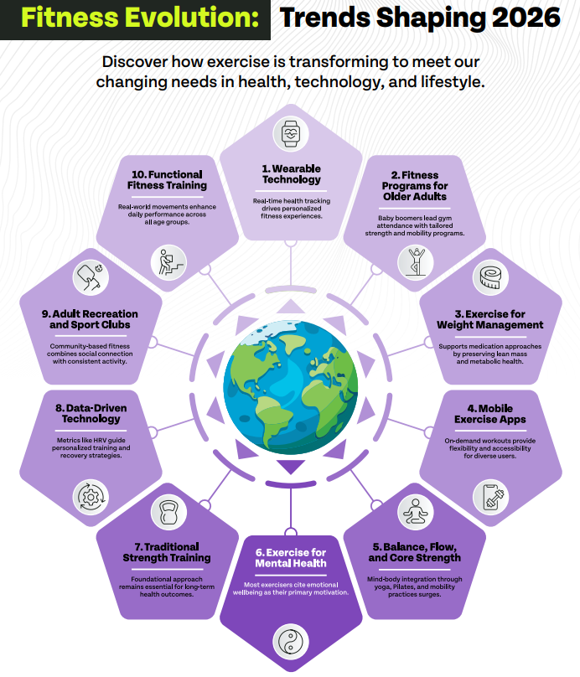
Exercise and Dementia
ACSM

Slide 18
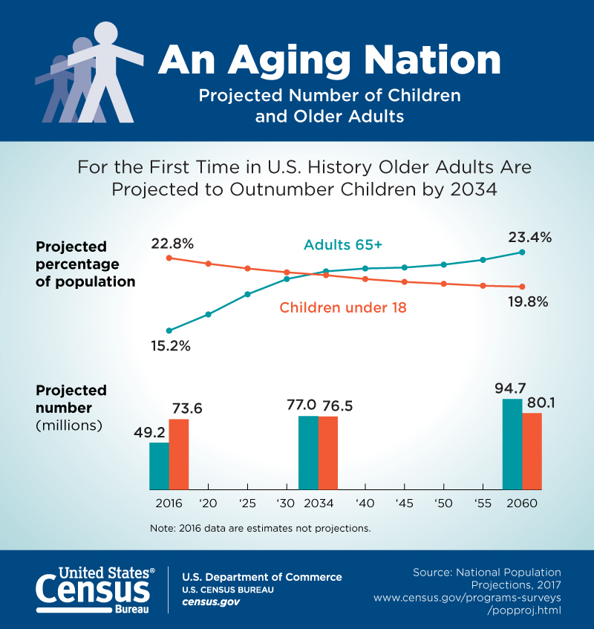
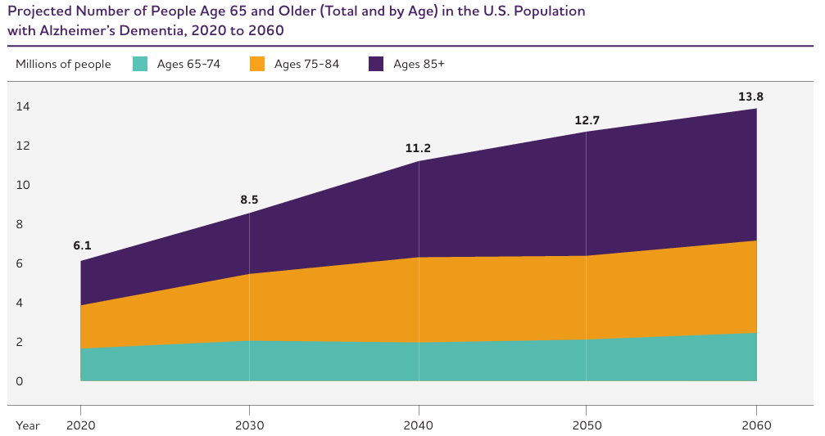
Exercise and Dementia
Alzheimer’s Disease Facts and Figures 2025

Slide 19
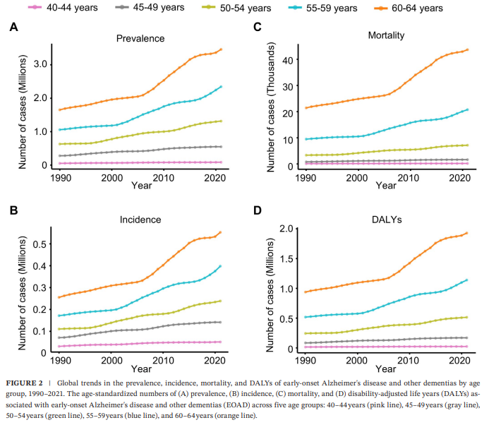
Exercise and Dementia
Zhang et al. 2025

Slide 20
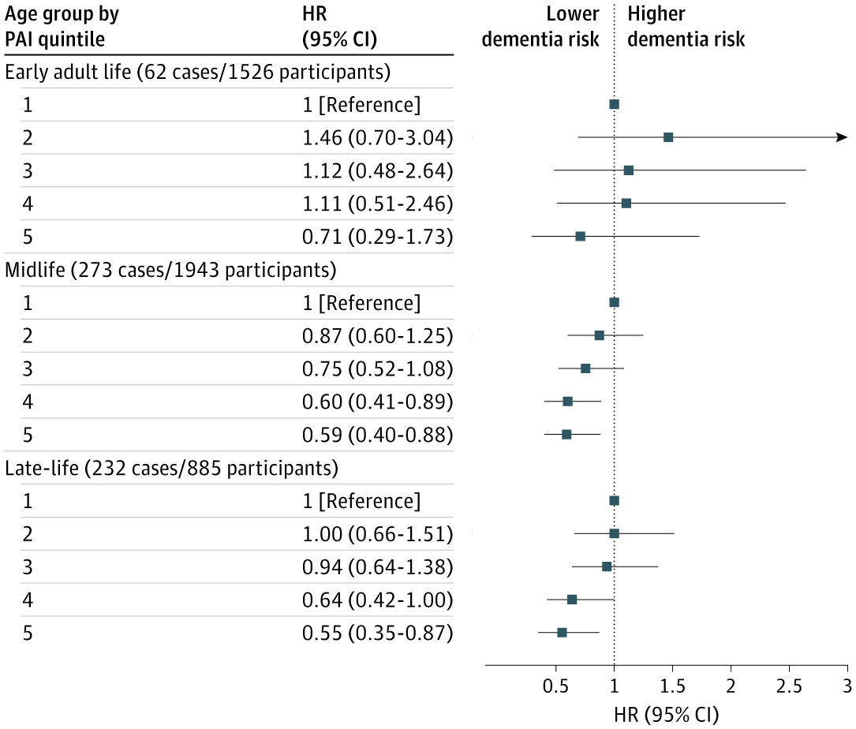
Exercise and Dementia
Marino et al. 2025

Slide 21
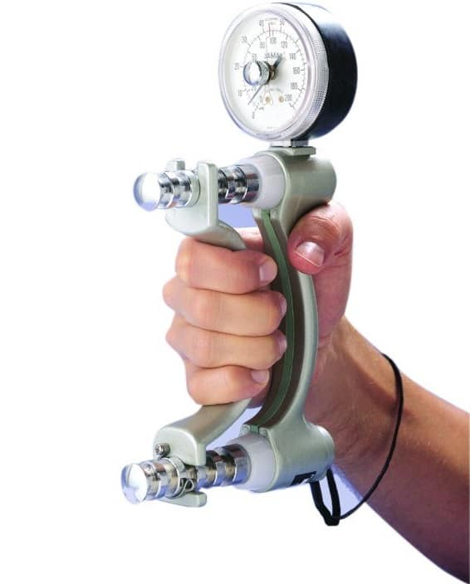
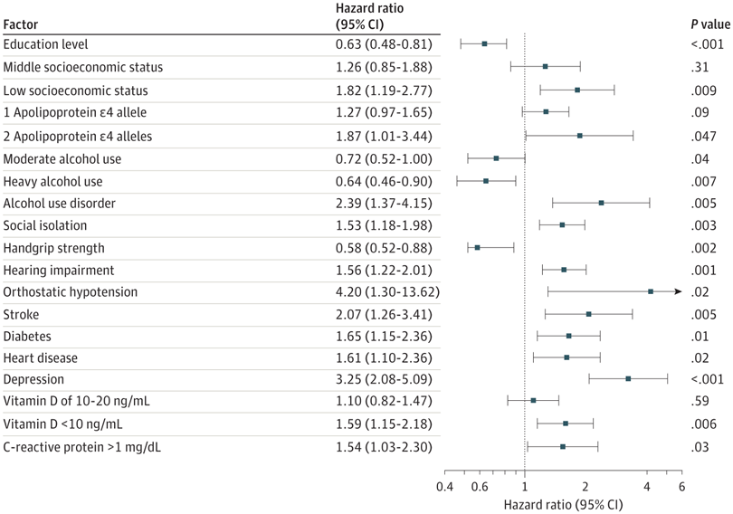
Exercise and Dementia
Hendricks et al. 2024

Slide 22
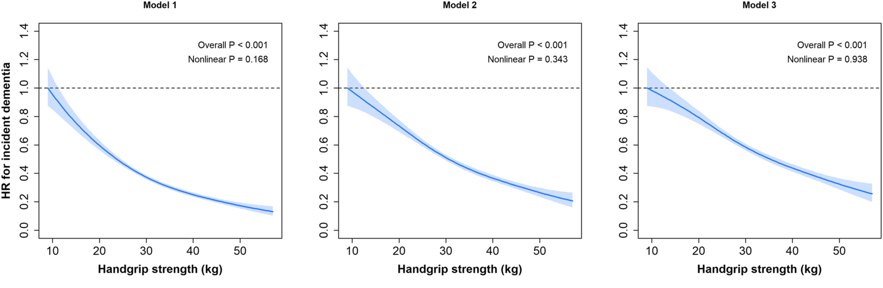
Exercise and Dementia
Esteban-Cornejo et al. 2022

Slide 23
Exercise and Dementia
Physical activity for health, including cognitive function, is encouraged across the lifespan
  POINTER Study
  Supports cognitive function in at-risk older adults
    Physical activity: 30-35 minutes of MVPA for 4x/week; strength and flexibility activity twice a week
    Cognitive activity: Computer-based brain training 3x/week for 30 minutes, regular engagement in intellectual and social activities
    Nutrition: MIND diet adherence
    Monitor: Visit healthcare provider
CDC 2025; Baker et al. 2025

Slide 24
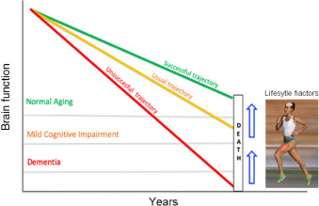
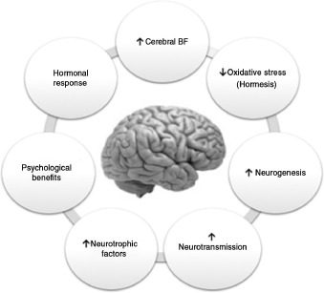
Exercise and Dementia
De la Rosa et al. 2020

Slide 25
Exercise and Dementia
Physical activity for health, including cognitive function, is encouraged across the lifespan
  Role of middle and older age
    Take sedentary breaks
    Frequency; intensity; type; time
    New routine
      Educate
      Encourage
      Prescribe
CDC 2025; Baker et al. 2025

Slide 26
Exercise and Dementia
Physical activity in interventions
  Primary: Reduce the risk of a condition before it begins by targeting modifiable risk factors in persons who are still healthy
  Secondary: Reduce the risk of recurrent conditions in persons who are already diagnosed
  Tertiary: Reducing the long-term impact of a condition by minimizing complications and improving overall quality of life
Keyes et al. 2025

Slide 27
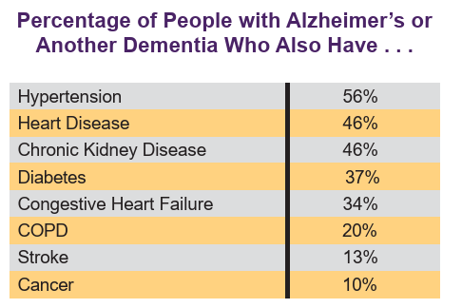
Exercise and Dementia
Prevents or decelerates other health conditions where appropriate
  More than 95% of people with Alzheimer’s disease and other dementias have ≥1 other chronic condition
  Consideration for psychosocial and behavioral factors
Nuzum et al. 2020; Alzheimer’s Association 2022

Slide 28
Exercise and Dementia
Possible benefits of exercise with dementia
  Mood
  Sleep
  Circulation
  Motor skills
  Falls risk
  Behavior
  Communication and social
Dementia Australia/Victoria State Government 2014

Slide 29
Exercise and Dementia
Once enjoyable physical activities might be challenging
  Sensory experiences can help
  Matching activity with what a person with dementia can do safely
  Choose activities that are fun for all
  Provide support to start an activity
  Can activity be done alone or with help?
  Is there frustration?
  Celebrate success!
National Institute on Aging 2024

Slide 30
Exercise and Dementia
Role of light, moderate, and vigorous activity
  Chair activities (yoga, aerobics)
  Walking
  Stretching
  Resistance training
  Dancing (music might be helpful)
  Balloon activities
  Gardening
  Household activities
Alzheimer’s Society 2025

Slide 31
Exercise and Dementia
Engage with a healthcare provider about physical activity and exercise participation
Acknowledgement for other lifestyle factors apart from physical activity
Facilitators and barriers now and in the future
Assessment of physical activity

Slide 32
Thank You!

