Slide 1
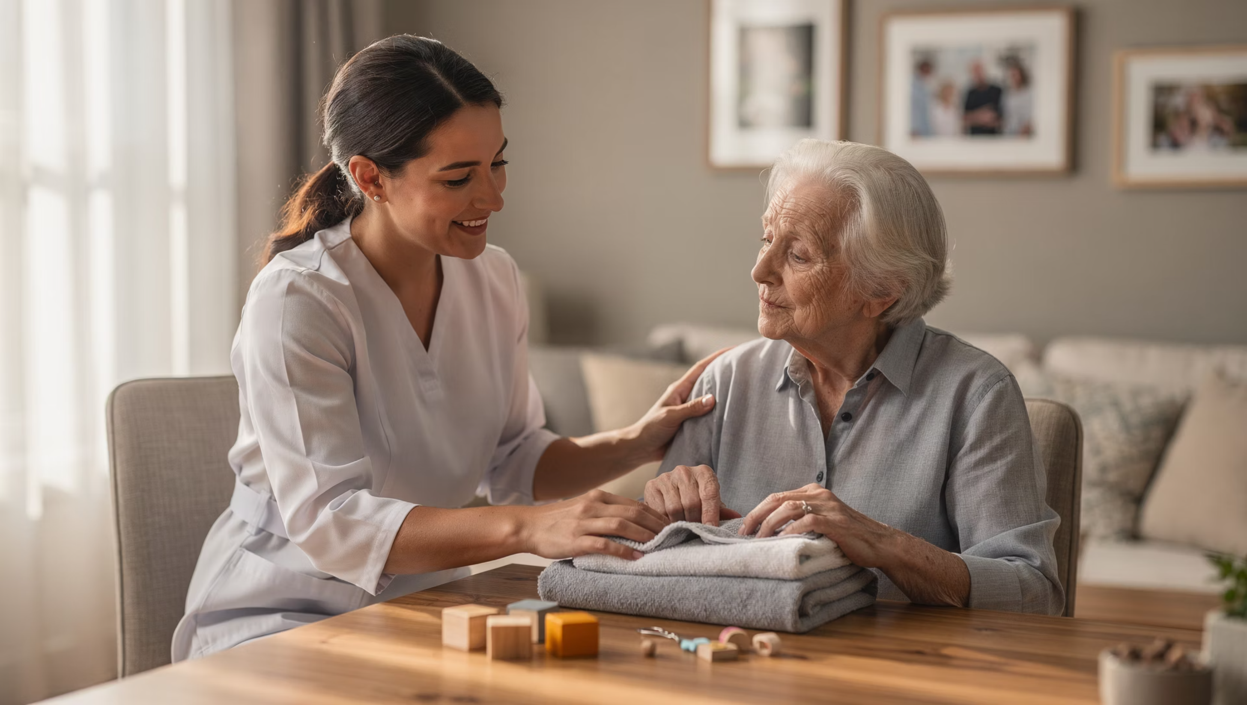
Navigating ADLs & IADLs with People Living with Dementia

Slide 2
Learning Objectives
By the end of this session, participants will be able to:
Explain how dementia impacts ADLs and IADLs
Identify common task, environmental, and communication barriers
Apply practical strategies that preserve dignity and reduce distress
Understand how to shift from "doing for" to "doing with" during daily activities

Slide 3
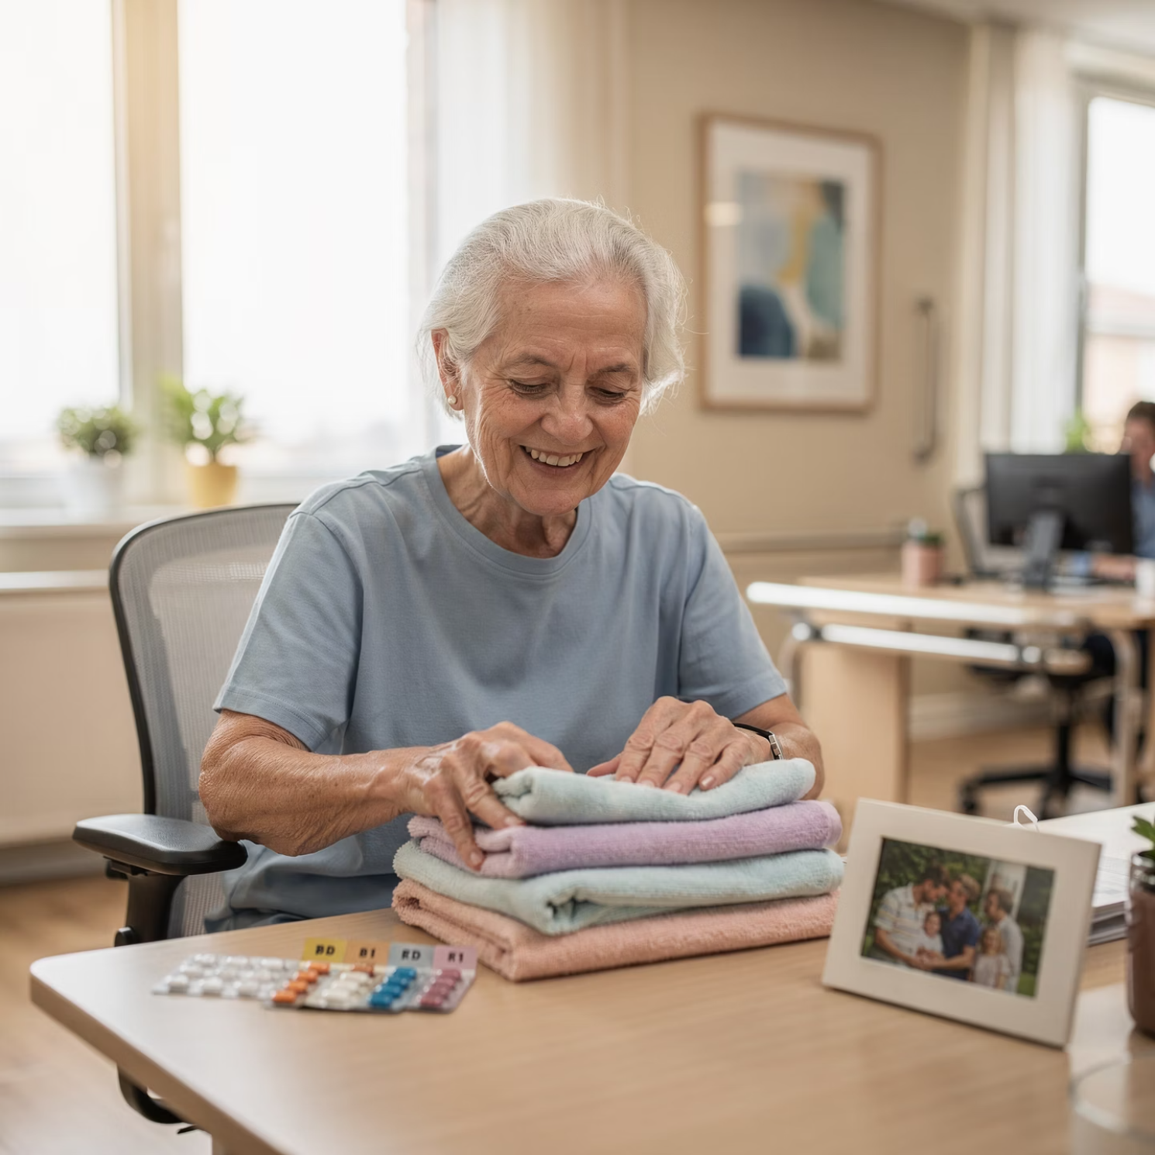
Why Daily Activities Matter
Daily routines provide structure, purpose, and identity
Loss of participation often leads to:
Frustration
Anxiety
Resistance to care
Important to prioritizes engagement over perfection

Slide 4
What Are ADLs & IADLs?
Activities of Daily Living (ADLs)
Instrumental Activities of Daily Living (IADLs)
Bathing
Dressing
Cooking & meal prep
Toileting
Medication management
Eating
Laundry & housekeeping
Mobility
Finances
Transportation

Slide 5





How Dementia Impacts Independence with Daily Tasks
Memory loss → forgotten steps
Executive dysfunction → sequencing errors
Visual-spatial changes → misjudging objects
Sensory changes → overwhelm
Slower processing speed

Slide 6
A Core Principle in Identifying Difficulties with Daily Tasks
The task is not the problem — the fit is
Task demands
Environment
Communication style
Timing and energy level
When these don't match the person's abilities, distress increases.

Slide 7

Signs a Task Is Too Hard
Refusal or agitation
Repeating the same step
Stopping mid-task
Increased dependence
Emotional outbursts
Reframe: These are communication signals, not behavior problems.

Slide 8
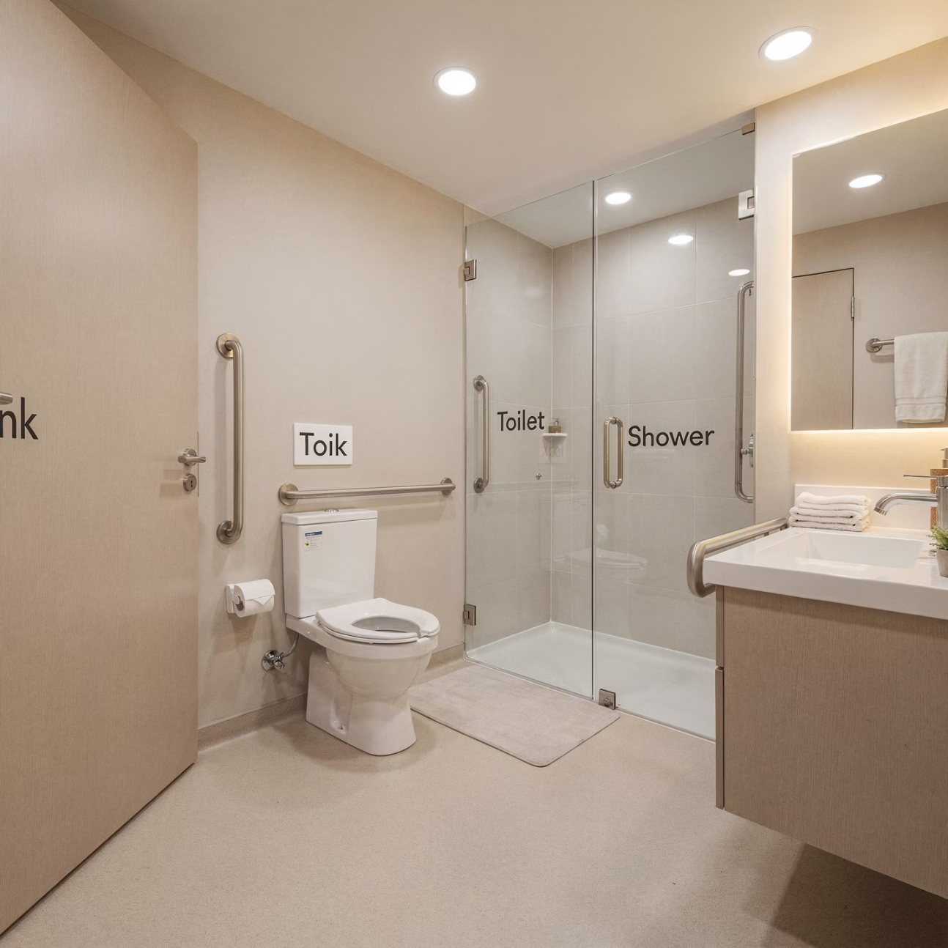
Bathing & Personal Care Challenges
Common difficulties include:
Fear of water
Feeling rushed
Cold or uncomfortable environment
Loss of privacy
Difficulty understanding steps

Slide 9
Bathing Support Strategies
1
2
3
Provide one step at a time
Offer simple choices
Maintain warmth and privacy
4
5
Demonstrate rather than explain
Redefine success (comfort over completion)

Slide 10

Dressing Challenges
Too many clothing options
Difficulty with fasteners
Confusion with sequencing
Fatigue and frustration

Slide 11
Dressing Support Strategies
Lay out clothes in order of use
Limit choices to reduce overwhelm
Use adaptive or easy-fit clothing
Allow extra time
Praise effort, not outcome

Slide 12

Eating & Mealtime Challenges
Difficulty using utensils
Distractibility
Changes in appetite or taste
Fatigue during meals
Trouble recognizing food

Slide 13





Mealtime Support Strategies
Reduce distractions
Use high-contrast plates
Offer finger foods
Provide smaller, frequent meals
Eat together when possible

Slide 14




Why IADLs Decline First
IADLs require:
Judgment and problem-solving
Planning and organization
Multi-step sequencing
Safety awareness
These skills are often affected early in dementia.

Slide 15
Common IADL Safety Concerns
1
2
Missed or double medication doses
Unsafe stove or appliance use
3
4
Financial vulnerability
Driving risks

Slide 16

Supporting IADLs Without Taking Over
Shift from independence to interdependence
Preserve roles and identity
Use visual cues and routines
Supervise discreetly
Focus on success, not speed

Slide 17
Communication Is the Intervention
Effective communication includes:
Calm tone of voice
Short, simple phrases
One instruction at a time
Extra processing time
Avoid correcting or quizzing

Slide 18
What Increases Resistance
Avoid:
Arguing facts
Rushing tasks
Over-explaining
Saying "you already did that"
Taking over too quickly
Preserving dignity reduces distress.

Slide 19

Strengths-Based Reframing
Ask:
Instead of:
What part can they still do?
"They can't do this anymore."
How can the task be adapted?
How do we keep them involved?
"You can't cook anymore."
What parts of meal prep can they still help with?
"Let me do that for you."
How can I support them to do this themselves?
"They're being difficult."
What is the environment or task telling us?

Slide 20
References
Alzheimer's Association. (2024). Dementia care practice recommendations. https://www.alz.org
Alzheimer's Association. (2023). Activities of daily living and dementia. https://www.alz.org
American Occupational Therapy Association. (2020). Occupational therapy practice framework: Domain and process (4th ed.). American Journal of Occupational Therapy, 74(Suppl. 2), 7412410010. https://doi.org/10.5014/ajot.2020.74S2001
Gitlin, L. N., & Corcoran, M. (2005). Managing dementia at home: The role of home environmental modifications. Topics in Geriatric Rehabilitation, 21(1), 18–28.
Gitlin, L. N., Winter, L., Dennis, M. P., Hodgson, N., & Hauck, W. W. (2010). Targeting and managing behavioral symptoms in individuals with dementia. Journal of the American Geriatrics Society, 58(8), 1465–1474. https://doi.org/10.1111/j.1532-5415.2010.02971.x
Law, M., Cooper, B., Strong, S., Stewart, D., Rigby, P., & Letts, L. (1996). The person–environment–occupation model: A transactive approach to occupational performance. Canadian Journal of Occupational Therapy, 63(1), 9–23.

