Slide 1

Hospital care for Elderly
Nida Fathima, MD
Geriatric fellow, UND
Family Medicine, UND

Slide 2
Objectives
- Hazards of hospitalization in older adults.
- Review evidence-based systems that improve care quality in Elderly patients.
- Strategies to reduce harm and improve functional outcomes.

Slide 3
Why does Geriatric care at hospital matter
Acute illness is often a stressful experience for patients and their family caregivers.
People aged 65 years or older, who make up only 16% of the US population, account for 40% of acute-care hospital admissions. Number to increase.
Once hospitalized, older patients are at high risk of loss of Functional independence or a failure to restore physical functioning to baseline.
More vulnerable for hospital-associated disability (HAD). 50% of new-onset
The hostile environment, prolonged bedrest, undernutrition/starvation, immobility/physical restraints/tethers, silo-based care contribute to the risks of functional decline and culminate in a dysfunctional or disabled patient.
In a cohort of 449 adults ≥70 years old discharged after hospitalization for medical illness with new ADL dependence, 36% fully recovered at 1 year, 27% remained dependent, and 37% died.
Notes:
Older patients are at more risk for loss of self-care abilities during an acute illness that results in hospitalization
HAD - disability that was not present 2 weeks before admission. One-third of patients ≥70 years old are discharged wit HAD

Slide 4
Older adults are at more risk due to :
Age
Age Related Changes- loss of muscle mass, strength , aerobic capacity
Reduced physiologic reserve
Impaired baroreceptor reflexes (eg orthostatic hypotension)
Altered pharmacokinetics/pharmacodynamics (Renal and hepatic clearance of medications)
Blunted stress responses
Cognition Vulnerability

Slide 5
Older adults only make up 15% of the US population, but account for 35% of all acute care admissions and nearly 50% of hospital expenditures for adults.

Slide 6
Hazards of Hospitalization in older patients
Delirium- most common
Functional decline- 32% of those over age 70 and approximately 50% of those above age 80 lose physical function (activities of daily living) during a hospitalization.
Institutionalization- Only 44% of patients 85 years and older and 58% of patients 75–84 years old return home . Other Dc to NH, TCU, memory care, hospice care
Increased mortality within 12 months
Other hazards- falls, injury, pressure ulcers, catheter-associated urinary tract infections (CAUTI’s) and adverse drug events , increase morbidity
Health care costs. Average 1-year health care costs were 2.5 times higher among general medical patients age 70+ with delirium compared to patients without delirium .
Delirium and related complications carry a large economic and health burden

Slide 7
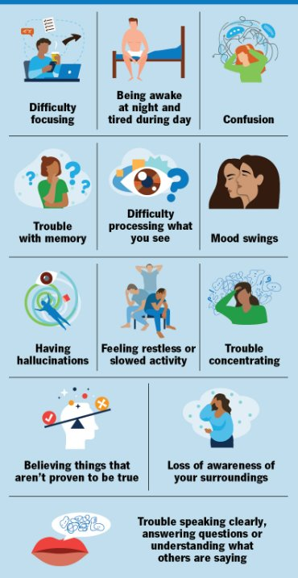
Delirium
Most common complication of hospitalization in elderly- Acute or fluctuating change in mental status – inattention , LOC, disorganized thinking.
Incidence: 29-64%, recognized only 15–35
Higher in ICU and post-op settings.
Delirium Subtypes:
Hypoactive- Decreased movements , reduce responsiveness
Hyperactive- restless, agitated, and hyperalert
Mixed
Hypoactive patients are often not identified or misdiagnosed
Symptoms of delirium can persist for months after hospital discharge.
Dementia is preventable and Priority should be to prevent it

Slide 8
Risk + Factors = Delirium
Predisposing-Age , frailty Baseline cognitive impairment, social isolation, co-morbidities, Depression, Alcohol, Daily ADL’s
Precipitation factors :
Infection- PNA in our patient
Polypharmacy (anticholinergics, benzodiazepines)
Sleep disruption
Immobility- 80-90% in bed , only 43 min oob, i.e 5 hours less , Foley placement
Surgery/anesthesia
Sensory deprivation

Slide 9
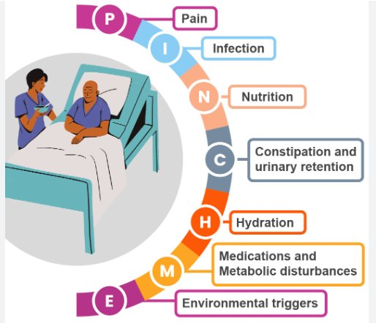
Delirium can be prevented by
Managing the Risk factors
Avoid meds associated
Treat pain infection
Orient patients with cog or sensory impairment
Limit room changes
Avoid excess bed rest, restraints, Foley etc.
Detect and correct urinary retention fecal impaction and metabolic changes
Encourage use of family or “sitters” to monitor and assure safety in confused patients

Slide 10
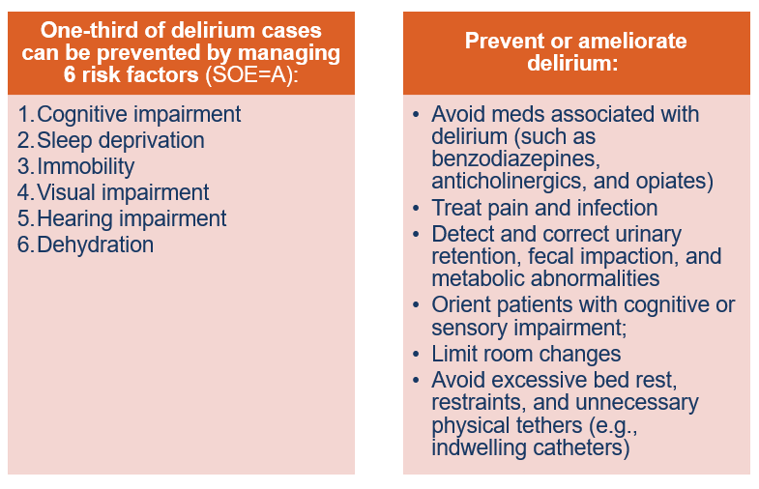

Slide 11
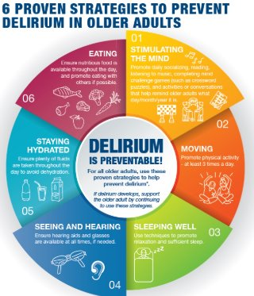

Slide 12
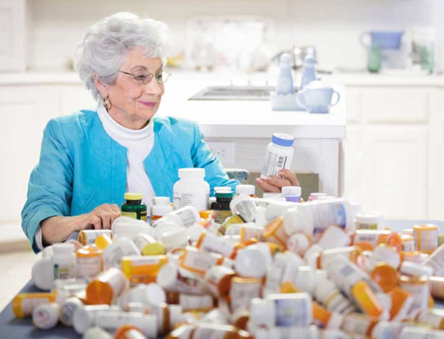
Polypharmacy & Adverse Drug Events (ADE)
Inappropriate medication use likely contributes to the risk of ADEs.
The in-hospital incidence of ADEs was 6.7%.
40% of medications prescribed before admissions were discontinued during hospitalization, and 45% of medications prescribed at discharge were started during hospitalization.
In another study, 88% of older hospitalized patients had at least one clinically significant problem related to prescribing, and 22% had at least one potentially serious and life-threatening problem.
High-Risk Categories
Anticholinergics
Sedative-hypnotics
Opioids
Anticoagulants
Insulin
Notes:
associated with increased morbidity and mortality.

Slide 13
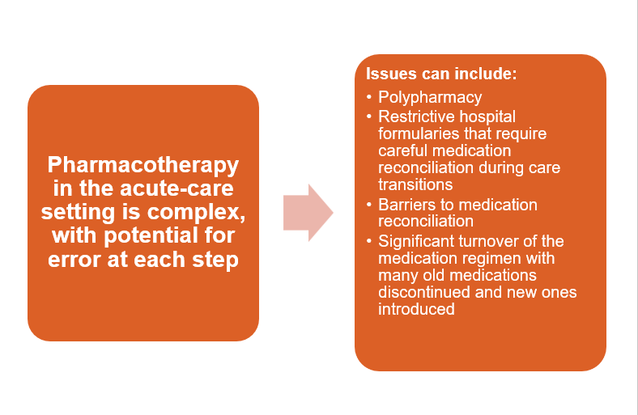

Slide 14
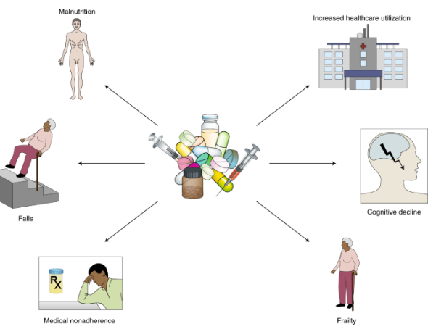
On admission and at discharge completely review a patient’s medication regimen (both prescription & nonprescription meds)
Use of frameworks such as the Beers Criteria helps reduce inappropriate prescribing.
The screening tool of older persons’ potentially inappropriate prescriptions (STOPP/START)
Discontinue or change medications that are:
Unnecessary or duplicative
Low therapeutic value (eg, sedative-hypnotics)
Prescribed at the wrong dose or frequency
Interact with another medication or condition (drug- drug or drug-disease interactions)
Prescribed despite a known allergy
Consultation with a clinical pharmacist improves pharmacotherapy outcomes

Slide 15
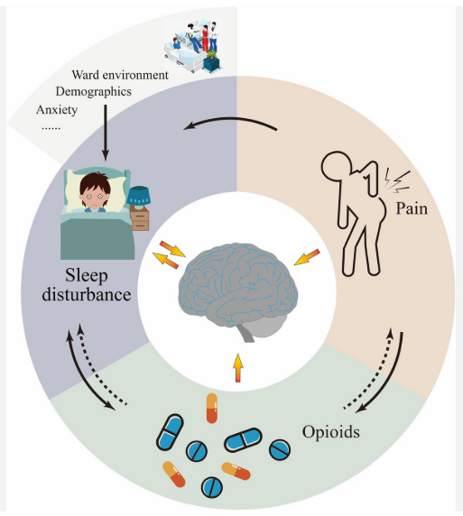
Sleep impairment
Over one-third of hospitalized older patients have trouble sleeping in the hospital
Disruption includes intrinsic (eg, underlying medical illness, mood disorder, medications, drug withdrawal) and extrinsic (eg, low daytime light levels, noise, measuring vital signs, phlebotomy, medication administration) factors
Sleep deprivation is important to prevent, recognize, and address, because it is associated with increased risk of delirium.
Sedatives provide a poor benefit-to-harm ratio (SOE=A). Inappropriately used.
Sleep deprivation in the hospital is best managed non-pharmacologically
Case review - of nonpharmacologic interventions that included using relaxation techniques, promoting good sleep habits, minimizing sleep interruption, and implementing daytime bright light exposure, evidence was insufficient to demonstrate improvements in sleep quality and quantity.
Notes:
Sedative-hypnotic medications are inappropriately prescribed to older hospitalized patients despite the associated risks of delirium, falls, hip fractures, and rebound insomnia, as well as their poor benefit-to-harm ratio (SOE=A). In a review of studies of nonpharmacologic interventions that included using relaxation techniques, promoting good sleep habits, minimizing sleep interruption, and implementing daytime bright light exposure, evidence was insufficient to demonstrate improvements in sleep quality and quantity.

Slide 16
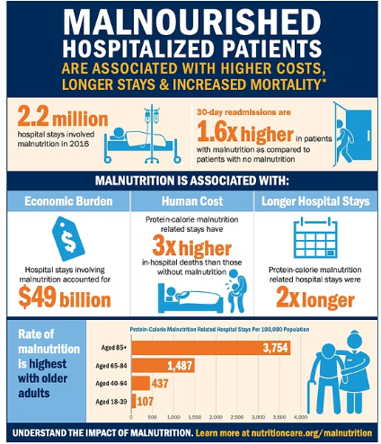
Malnutrition
25% of older patients suffer further nutritional depletion during hospitalization
A study- Vit D deficiency was more common in hospitalized older patients(even without risk factor for it)
Malnutrition is associated with an increased risk of complications, length of stay, readmission, dependence, institutionalization, and death

Slide 17
Clinicians/Nursing should assess malnourished patients for remediable factors:
Difficulty with chewing
Need for dentures
Dysphagia
Medications that impair appetite
Overly restrictive prescribed diet
Unwarranted nothing-by-mouth orders
Depression
Insufficient time or physical ability to eat
Constipation
It is important to maintain fluid and electrolyte balance to meet daily metabolic requirements.

Slide 18
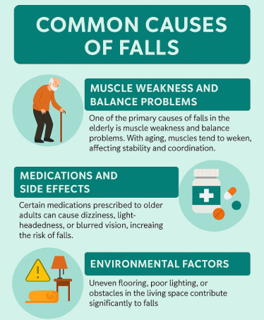
Falls
80% in age 65 and higher in older adults
Within the first 2 days of hospitalization.
Fall is one of the three “never events”
Often multifactorial:
Prolonged bed rest, causes deconditioning -resulting in- bone and muscle loss.
Associated with delirium, medications etc.
Preventable with evidence-based interventions
Notes:
Three conditions designated “never events” for which older hospitalized adults are known to be at greater risk of developing are Stage 3 or 4 hospital-acquired pressure ulcers (HAPUs), injurious falls, and catheter-associated urinary tract infections (CAUTI). reasonably preventable through application of evidence-based interventions

Slide 19
Strategies to promote mobility, which may reduce falls:
Exam - assess the patient’s gait, balance, lower extremity strength, ability to get up from bed, and cognition
  Avoiding restraints and tethers
  Decluttering the environment
  Minimizing medications associated with falls
  Individuals able to walk independently should be encouraged to do so frequently during hospitalization
  Assisting those who walk with difficulty
  Attending to toileting needs
  Addressing sensory impairments
  Providing physical therapy for weakness or gait abnormalities
  Preventing delirium

Slide 20
Pressure Ulcers
The median incidence of pressure injury in the acute-care setting is 15.7%
Within the first 2 days of hospitalization on a medicine service, as many as 6.2% of patients ≥65 years old will develop one or more Pressure Ulcers
Most pressure injuries are on the sacrum and heels
  They are painful, associated with longer stays and delayed return of function, and costly ($37,800–$70,000 per case, or an estimated $11 billion nationally in 2009)
PU risk-assessment scales include the Braden and Norton scales

Slide 21
Risk factors- Older age, Low body weight, Physical and sensory impairment, Incontinence, Malnutrition, Conditions that impair circulation
Patients at risk should have their skin inspected at least daily, focusing on areas of bony prominences( sacrum and heels )
Use support surfaces.
For patients at higher risk, more advanced static mattresses and overlays were better than standard mattresses for preventing PUs.
Although there is a good evidence base for repositioning, the optimal interval for repositioning remains to be determined.

Slide 22
CAUTI’s
Urinary catheters (UC) are often inappropriately inserted. UC are 1 of 5 precipitating factors for delirium identified.
associated with longer hospital stay and incidence of bacteriuria is 3%–8% per catheter-day

Slide 23
The most effective way to reduce CAUTI is to limit UCs to those with a clear indication and to remove the catheter as soon as it is no longer necessary.
Reminder systems and multimodal strategies (train, care and alternatives) are helpful.
It has been estimated that 25%–75% of CAUTI cases are preventable with use of multimodal strategies.
Appropriate indications for a UC include:
  Acute urinary retention or bladder outlet obstruction
  Peri-operatively for selected procedures
  Open sacral or perineal wounds in incontinent patients
  Prolonged immobility due to unstable thoracic, lumbar, pelvic fractures
  For comfort at end-of- life as needed.
  Inserting a UC to measure urinary output is inappropriate in most cases

Slide 24
Long-Term Impact of hospitalization:
Increased LOS
Functional decline- 30–50% of older adults lose ability to perform at least one ADL during hospitalization.
Often unrelated to admitting diagnosis
Inability to return to previous setting
Higher mortality
Long-term cognitive impairment
Caregiver burden
Readmissions

Slide 25
Optimal care of geriatric inpatients
Care for hospitalized older adults requires a systematic approach, not simply disease-based management.
Geriatric Evaluation and Management (GEM) Unit
Acute Care for Elders (ACE) Unit
Hospital Elder Life Program (HELP)
Surgical Co-Management
Nurses Improving Care of Health System Elders (NICHE)
Assess, evaluate, and address for geriatric syndromes (cognitive impairment, sensory deficits, depression, venous thromboembolism prophylaxis, code status discussions)

Slide 26
Geriatric Evaluation and Management (GEM) Unit.
GEM units were developed and pioneered in Veterans Affairs Medical Centers
Integrates comprehensive geriatric assessment & interprofessional team-based care. Functional, Cognitive, Psychological, Social, Environmental domains
For older patients who have stabilized during acute hospitalization
Outcomes demonstrated
Less functional decline
Lower risk of institutionalization at 1 year
No benefit in mortality, re-admissions, or length of stay

Slide 27
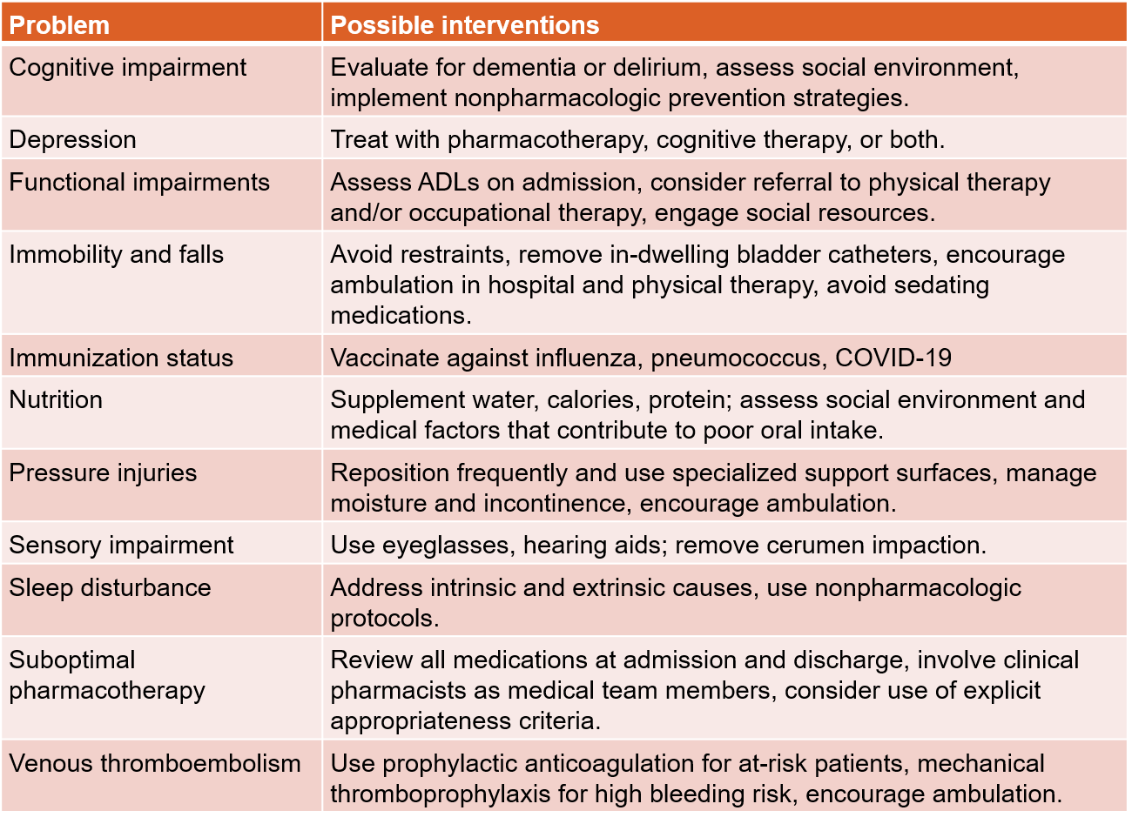

Slide 28
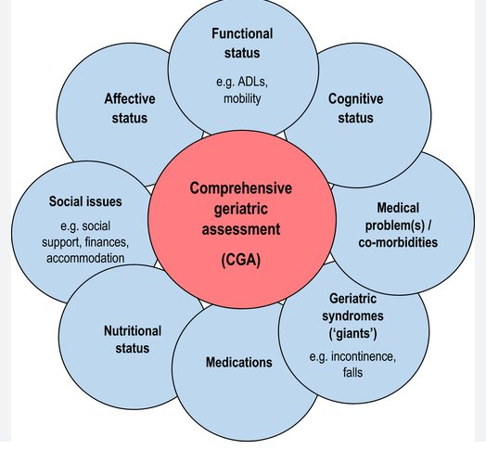

Slide 29
Acute Care for Elders (ACE) Units
The Acute Care for Elders (ACE) unit is an evidence-based model of care designed to reduce incidence of functional decline for older adults during hospitalizations. Two randomized-controlled trials demonstrate significantly greater independence in performance of activities of daily living (ADLs) in patients aged 70 or above who are admitted to the ACE unit compared to similar patients admitted to usual care. In addition, patients on ACE units compared to usual care, are more likely to have shorter length of hospital stay and reduced costs.
Four components:
Environment promoting mobility and orientation- to facilitate patients’ physical and cognitive functioning. PT/OT, Shift from: "Bed rest unless necessary” To: "Mobility unless contraindicated”
Interprofessional patient-centered care with nursing-initiated protocols
Early social work intervention & discharge planning to facilitate return to the community- Assess, f/u, meds on dc, communication, Patient education
Medication review optimize medication management, assure patient safety and medical standards of care.
Notes:
Patient-centered care assessment conducted by an interdisciplinary team (IDT) with protocols to assess, restore or maintain physical functioning: activities of daily living (ADLs), mobility, continence, nutrition, skin integrity, mood, sleep and or cognition.

Slide 30
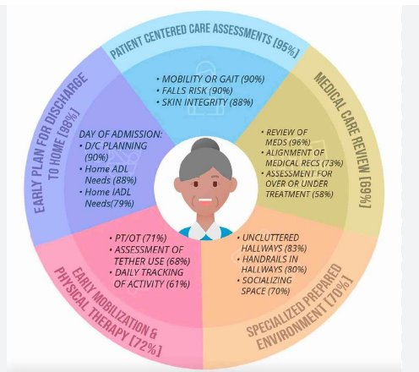

Slide 31
Reduced functional decline
Shorter LOS- Reduced nursing home placement
Lower costs without increased readmission
Increase odds of living at home at discharge and 3 months after discharge.
Studies have shown more success of the ACE Unit model when it is located on one specialized unit with dedicated staff compared with ACE-like care for older patients on several different units
Improved patient satisfaction
Randomized trials show higher rates of improved ADLs at discharge in ACE patients vs usual care (34% vs 24%).
Some analyses show cost savings and fewer 30-day readmissions.
Sustained ACE quality programs report consistent 30-day readmission rates <10% and favorable mortality indices.

Slide 32
AGS CoCare
Co-management of surgical patients by surgeons/ortho and hospitalists or geriatricians
Hip fracture co-management is one model. (improve periop care of hip fractures)
Components: standardized protocols and order sets, frequent communication between surgeon and geriatrician, early discharge planning, and clear delineation of responsibilities
Outcomes demonstrated
Reduced length of stay
Reduced complication rates, readmissions & mortality
Reduced cost

Slide 33
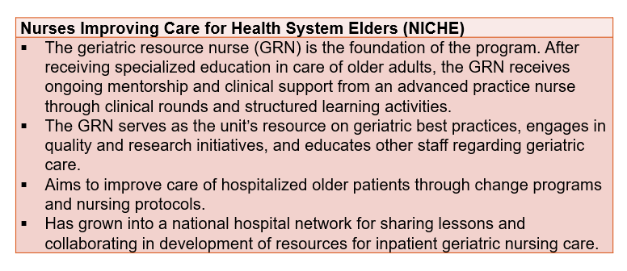
CNA geriatric aid

Slide 34
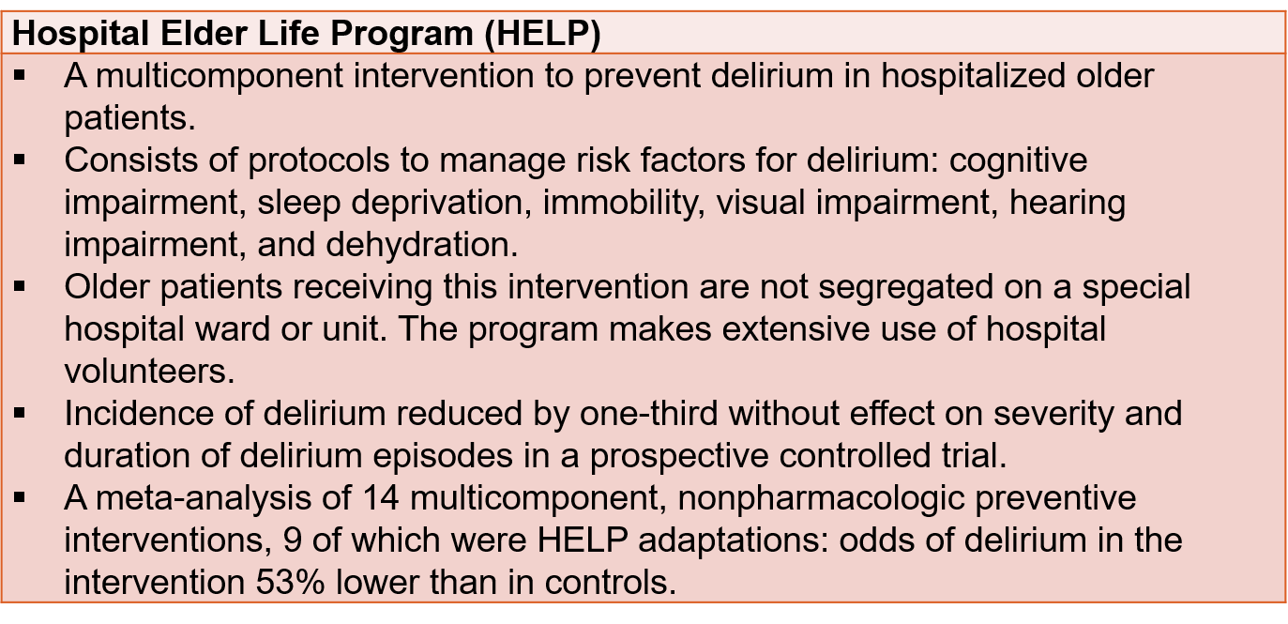

Outcomes
Reduced delirium incidence
Reduced falls
Cost savings
Improved patient satisfaction
Statistically significant reductions in delirium and related events.
Notes:
instructing volunteers to deliver daily orientation, early mobilization, feeding assistance, therapeutic activities, a non-pharmacological sleep protocol, and hearing/vision adaptations that helps maintain a maximal level of independence during their stay and upon leaving the hospital.

Slide 35
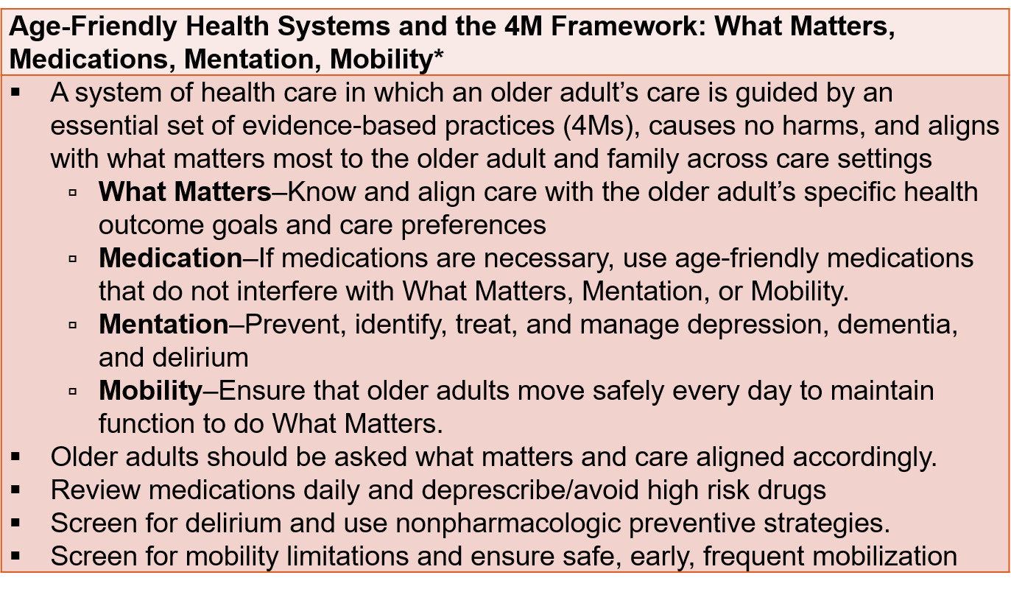
An initiative of the John A. Hartford Foundation and the Institute for Healthcare Improvement in partnership with the American Hospital Association and the Catholic Health Association of the United States (http://www.ihi.org/Engage/Initiatives/Age-Friendly-Health-Systems/Pages/default.as)

Slide 36
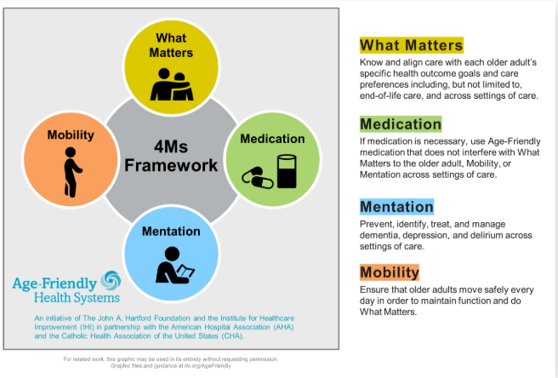
4 M’s
Our health needs become more complex as we get older, and what matters most to us may vary also.

Slide 37
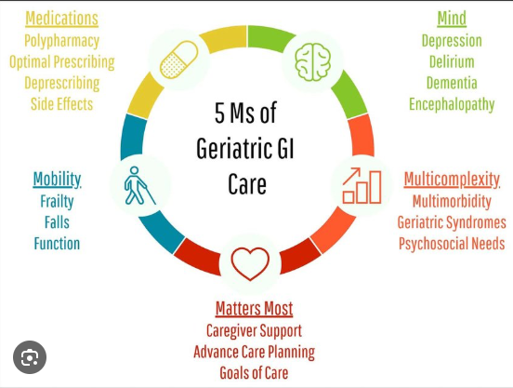

Slide 38
Hospital-at-Home Models
Type of hospital care that enables some patients who need less acute care to receive that care in their homes.
These patients still require some acute level services but are generally stable.
Examples: Intravenous therapy or oncology patients requiring ongoing chemotherapy, IV diuresis etc.
This care delivery model has been shown to improve clinical outcomes as well as improved patient satisfaction.
Outcomes:
Lower delirium rates
Higher patient satisfaction
Reduced functional decline
Lower cost
No difference in 6-month mortality or readmission but may reduce likelihood of nursing home care
Notes:
The major difference perceived by older people between home care and hospital care was feeling safer in the hospital than at home.

Slide 39
Choosing Wisely Program
Recommendations based on the American Board of Internal Medicine Foundation’s Choosing Wisely® Campaign
Eating and Feeding: Do not recommend percutaneous feeding tubes in patients with advanced dementia; instead, offer oral assisted feeding.
Avoid prescription appetite stimulants or high-calorie supplements to treat anorexia or cachexia in older adults; instead, optimize social supports, provide feeding assistance, and clarify goals and expectations
Prevent delirium:
Avoid physical restraints to manage behavioral symptoms of hospitalized older adults with delirium.
Do not use benzodiazepines or other sedative-hypnotics in older adults as first choice for insomnia, agitation, or delirium.

Slide 40
There is also evidence from randomized trials that integrating informal caregivers into discharge planning results in fewer readmissions at 90 days and 180 days, shorter rehospitalization, and lower care costs after discharge.

Slide 41
Other important assessments
Evaluate for sensory deficits
Evaluate for mood – PHq-2 , F/u after dc
Assess for DVT- Patients hospitalized for illness other than DVT who subsequently developed DVT were more likely to be elderly than nonelderly. Despite this, older patients receive DVT prophylaxis <50% of the time.
Capacity
Code status Physician Orders for Life-Sustaining Treatment (POLST) allow for patient wishes to be translated by a health care provider into actionable medical orders – GO FAR calculator

Slide 42
Patient with Dementia
Older people with dementia are hospitalized at 3× the rate of those without dementia.
Patients with dementia required more nursing care, longer hospitalizations, and were more likely to develop delirium, functional decline, and discharge to a nursing home
When patients with dementia develop delirium, looking for untreated pain as a possible cause is appropriate.
Evaluate using the Mini-Cog, MoCA, SLUMS, or MMSE (Note: MMSE and MoCA are proprietary)
When dementia is a possibility, exclude reversible causes, treat pain, and evaluate decision making capacity

Slide 43
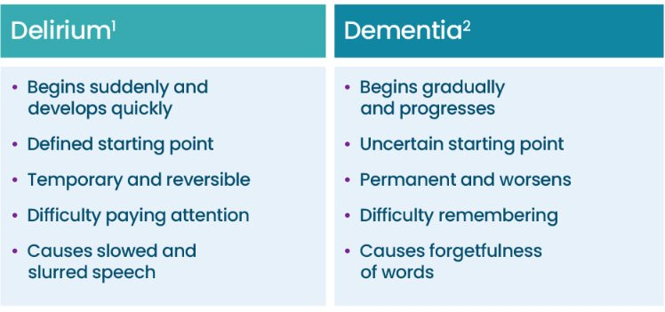

Slide 44
Summary of system-based approach outcomes :
Increased likelihood of discharge home instead of a facility
Decreased incidence of delirium,
Decreased mortality risk,
Shortened hospital length of stay (LOS)
Lower or equal costs of hospital care.

Slide 45
Geriatric Emergency Department Collaborative (GEDC)
Collaborative approach of AGS, ACEP, ENA, SAEM, supported by John A Hartford foundation and Gary and Mary West health institute.
Annually, there is nearly one ED visit for every two older Americans.
Older adults also are at increased risk for serious complications in the ED compared to younger people.
Additionally, ED environments, which are often characterized by bright lights, fast pace of activity, and loud noises, can be disorienting to older adults and potentially interfere with the effectiveness of care.
Delirium screening
Fall risk assessment
Medication review
Avoid unnecessary admissions

Slide 46
Key Takeaways
“The goal is not just survival of hospitalization, but preservation of function, dignity, and independence.”
Hospitalization is a high-risk event for older adults. 50% new onset HAD
Functional decline is common and often preventable.
Delirium prevention must be proactive.
Polypharmacy is modifiable.
Systems-based approaches improve outcomes.
Mobility and interdisciplinary care are essential.
Geriatric-focused models are cost-effective and evidence-based.
Notes:
Hospitalization accounts for 50% of new-onset disability in frail older adults

Slide 47
A 79-year-old man is hospitalized after surgery for hip fracture.
History includes:
Hypertension
Mild cognitive impairment
On day 2 after surgery, he pulls out an intravenous line and refuses medications.
The nurse requests administration of haloperidol.
On examination:
He is oriented to self. He is somnolent, although easily aroused, and has difficulty reciting days of the week backward.

Slide 48
Which of the following is most likely to result from administering haloperidol to this patient?
Longer hospital stay
Increased short-term mortality
Increased risk of drug interactions
Reduction in severity of symptoms

Slide 49
Answer: Increased risk of drug interactions.
Antipsychotics do not reduce delirium severity, resolve symptoms, or alter mortality , or LOS
Despite the limited evidence of efficacy and the known associated risks in frail older adults, use of antipsychotics exceeds 70%–80% for management of delirium in hospitalized patients.
Notes:
antipsychotics do not reduce delirium severity, resolve symptoms, or alter mortality , or LOS

Slide 50
An 80-year-old man is brought to the hospital after he fell on his way to the bathroom; he remained on the ground for 4 hours before his son found him.
History includes:
Benign prostatic hyperplasia
Type 2 diabetes mellitus
Current medications:
Tamsulosin nightly,
Metformin
Aspirin
He describes stable nocturia, but has no dysuria, frequency, urgency, hematuria, flank pain, fever, palpitations, light headedness, or chest pain.
He has lower leg pain.

Slide 51
On examination:
Vital signs are normal.
He is attentive, alert, and oriented to person, place, time, and situation.
There is deep tissue injury over the left greater trochanter.
Laboratory findings include:
WBC count of 8,000/µL
Creatine kinase of 10,000 U/L
Blood urea nitrogen:creatinine ratio of 30:1.2.
Urinalysis shows WBC count of 10–20/high-power field
Preliminary urine culture results indicate 105 colony-forming units (cfu)/mL gram-negative rods
Plain-film radiography reveals distal tibia fracture

Slide 52
Which one of the following is the most appropriate management regarding the urinalysis findings?
Intravenous ceftriaxone 1,000 mg/d for 3 days
Oral trimethoprim-sulfamethoxazole for 7 days
Oral trimethoprim-sulfamethoxazole for 3 days

Slide 53
Answer: No antibiotic treatment

Slide 54
Questions ?

