Slide 1
Interprofessional Management of Complex Older Adults with Type 2 Diabetes
Stephanie Weyrauch, PT, DPT, MSCI
MovementX
Billings, MT
Eric L. Johnson, MD
University of North Dakota School of Medicine and Health Sciences
Professor, Director of Interprofessional Education
Assistant Medical Director, Altru Diabetes Center
Grand Forks, North Dakota

Slide 2
DISCLOSURES
Stephanie Weyrauch and Eric Johnson have no financial or other conflict(s) of interest relevant to this activity.

Slide 3
LEARNING OBJECTIVES
At the conclusion of this activity, the participant will be able to:
Identify individualized patient targets and therapeutic approaches for diabetes management in older adults.
Recognize geriatric syndromes, musculoskeletal impairments and comorbidities in older adults that may adversely impact diabetes self-management and quality of life.
Apply current research to best reach optimal prescription of exercise-based interventions in older adults with diabetes.
Integrate an effective team-based clinical approach in the management of patients with diabetes.

Slide 4
Target and Management Goals
Focus on Primary and Secondary Prevention
Lifestyle Changes
  Identify and address barriers to exercise
  Self management education and support
  Nutrition
  Smoking cessation
  Psychosocial care
Coaching- can originate from a variety of sources

Slide 5
Team Based Care in Older Adults
Fall prevention, maintenance of function
Attention to complications and conditions that would lead to functional impairment
Nutrition management and intervention
Social determinants of health, i.e., food security, transportation
Psychological screening- mild cognitive impairment, depression, anxiety, dementia

Slide 6
Diabetes Complications
Macrovascular Complications
Cardiovascular disease
  Coronary Heart disease (CHD)
  Stroke
  Peripheral arterial disease (PAD)/amputation

Slide 7
Diabetes Complications
Microvascular Complications
Eye disease (retinopathy)
Kidney disease (nephropathy)
Nerve disease (neuropathy)

Slide 8
Avoiding Complications
Blood glucose control
Blood pressure control
Lipid management

Slide 9
Diabetes In America
34 million have diabetes (about 90% are type 2)
Expect about 1/3 of population to have diabetes by 2050
Over a million new cases per year
96 million have prediabetes
Racial/ethnic/geographic disparities
CDC National Diabetes Statistics Report
www.cdc.gov/diabetes/data/statistics-report/index.html
Accessed August 31, 2023

Slide 10
Diabetes Increases With Age
Adults ages 18-44 years, 4 percent had diabetes
Adults ages 45-64 years, 17 percent had diabetes
Adults ages 65 years and older, 25 percent had diabetes

Slide 11
Diabetes Diagnosis
Category FPG (mg/dL) 2h 75gOGTT A1C
Normal <100 <140 <5.7
Prediabetes 100-125 140-199 5.7-6.4
Diabetes >126** >200 >6.5
Or patients with classic hyperglycemic symptoms with plasma glucose >200
** On 2 separate occasions
American Diabetes Association

Slide 12
Tight glucose control vs looser control
“Tight” blood glucose control may not be appropriate
Hypoglycemia and Hyperglycemia can lead to falls and/or mental status changes
Hyperglycemia can lead to dehydration and promotes infection
For older more complex adults, an A1C of <8 may be a more appropriate goal (younger adults A1C <7)

Slide 13

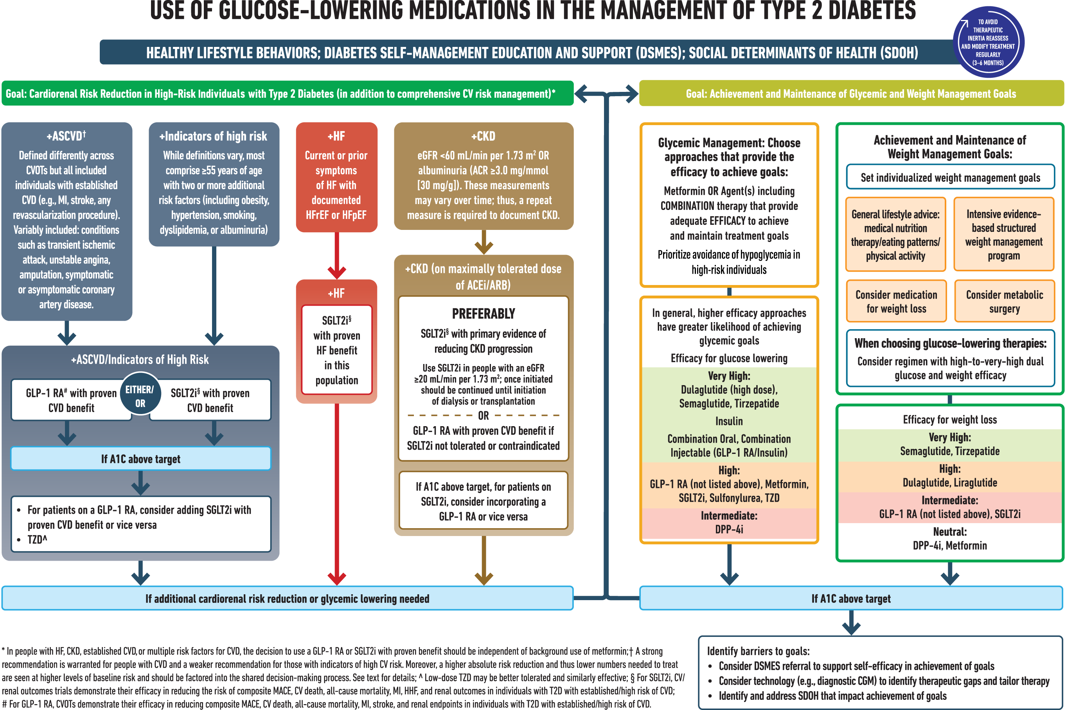
From: 9. Pharmacologic Approaches to Glycemic Treatment: Standards of Care in Diabetes—2024
Diabetes Care. 2024;47(Supplement_1):S158-S178. doi:10.2337/dc24-S009
Date of Download: 12/29/2023
Copyright © 2023 American Diabetes Association. All rights reserved.

Slide 14
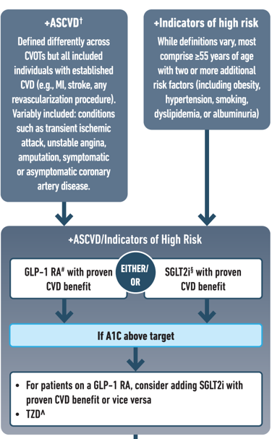
Choosing glucose-lowering medication in people with CVD
Notes:
For people with established atherosclerotic cardiovascular disease or indicators of high risk our recommendation is to choose a GLP-1 receptor agonist or an SGLT-2 inhibitor with proven cardiovascular benefit. In case HbA1c remains above target one should add an agent from the other category or pioglitazone as deemed necessary. Our recommendation is based on the favourable results of cardiovascular outcomes trials that established the favourable effect of GLP-1 receptor agonists and SGLT-2 inhibitors on a series of hard clinical outcomes including major adverse cardiovascular events and all-cause mortality.

Slide 15
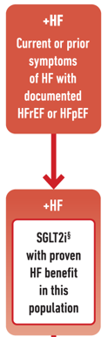
Choosing glucose-lowering medication in people with heart failure
In people with heart failure SGLT2i should be used because they improve heart failure and kidney outcomes
Notes:
For individuals with heart failure our recommendation is that SGLT2i with proven benefit should be used because they improve heart failure and kidney outcomes.

Slide 16
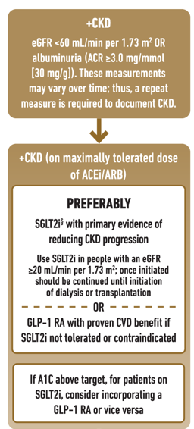
Choosing glucose-lowering medication in people with chronic kidney disease

Slide 17
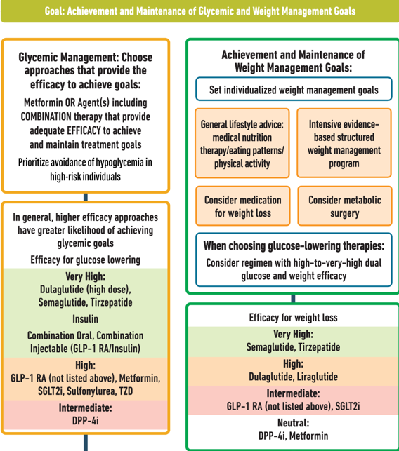
Choosing glucose-lowering medication in people with need for efficacy in reaching glycemic and weight management goals
Notes:
For revision suggestion: Metformin OR Agent with adequate EFFICACY to achieve and maintain glycemic goals OR Combination therapy
DPP4-I

Slide 18
Considerations with Common NonInsulin Type 2
Diabetes Medications-Summary
Metformin
Cheap, initial for most, no hypoglycemia, positive long term data, GI and renal considerations, weight neutral/loss
Sulfonylureas (SU)
Cheap, potent, weight gain, hypoglycemia, renal considerations
Thiazolidinediones (TZD)
Weight gain, CHF, edema, no hypoglycemia, renal considerations
Dipeptidyl peptidase (DPP)-4 inhibitors (gliptins)
Weight neutral, no hypoglycemia, renal considerations for some, CHF signal with saxagliptin and alogliptin
Sodium glucose co-transporter (SGLT)-2 inhibitors
Potent, weight loss, no hypoglycemia, renal considerations, UTI/yeast infection risk, lower BP (watch for orthostasis), positive CVD benefit with empagliflozin,dapagliflozin, and canagliflozin, amputation risk with canagliflozin, DKA (can be normoglycemic),
Glucagon-like peptide (GLP)-1 agonists
Injectable, potent, weight loss, pancreatitis risk, thyroid C-cell tumor risk, no hypoglycemia, positive CVD benefit with liraglutide, dulaglutide, and semaglutide (also oral form)

Slide 19
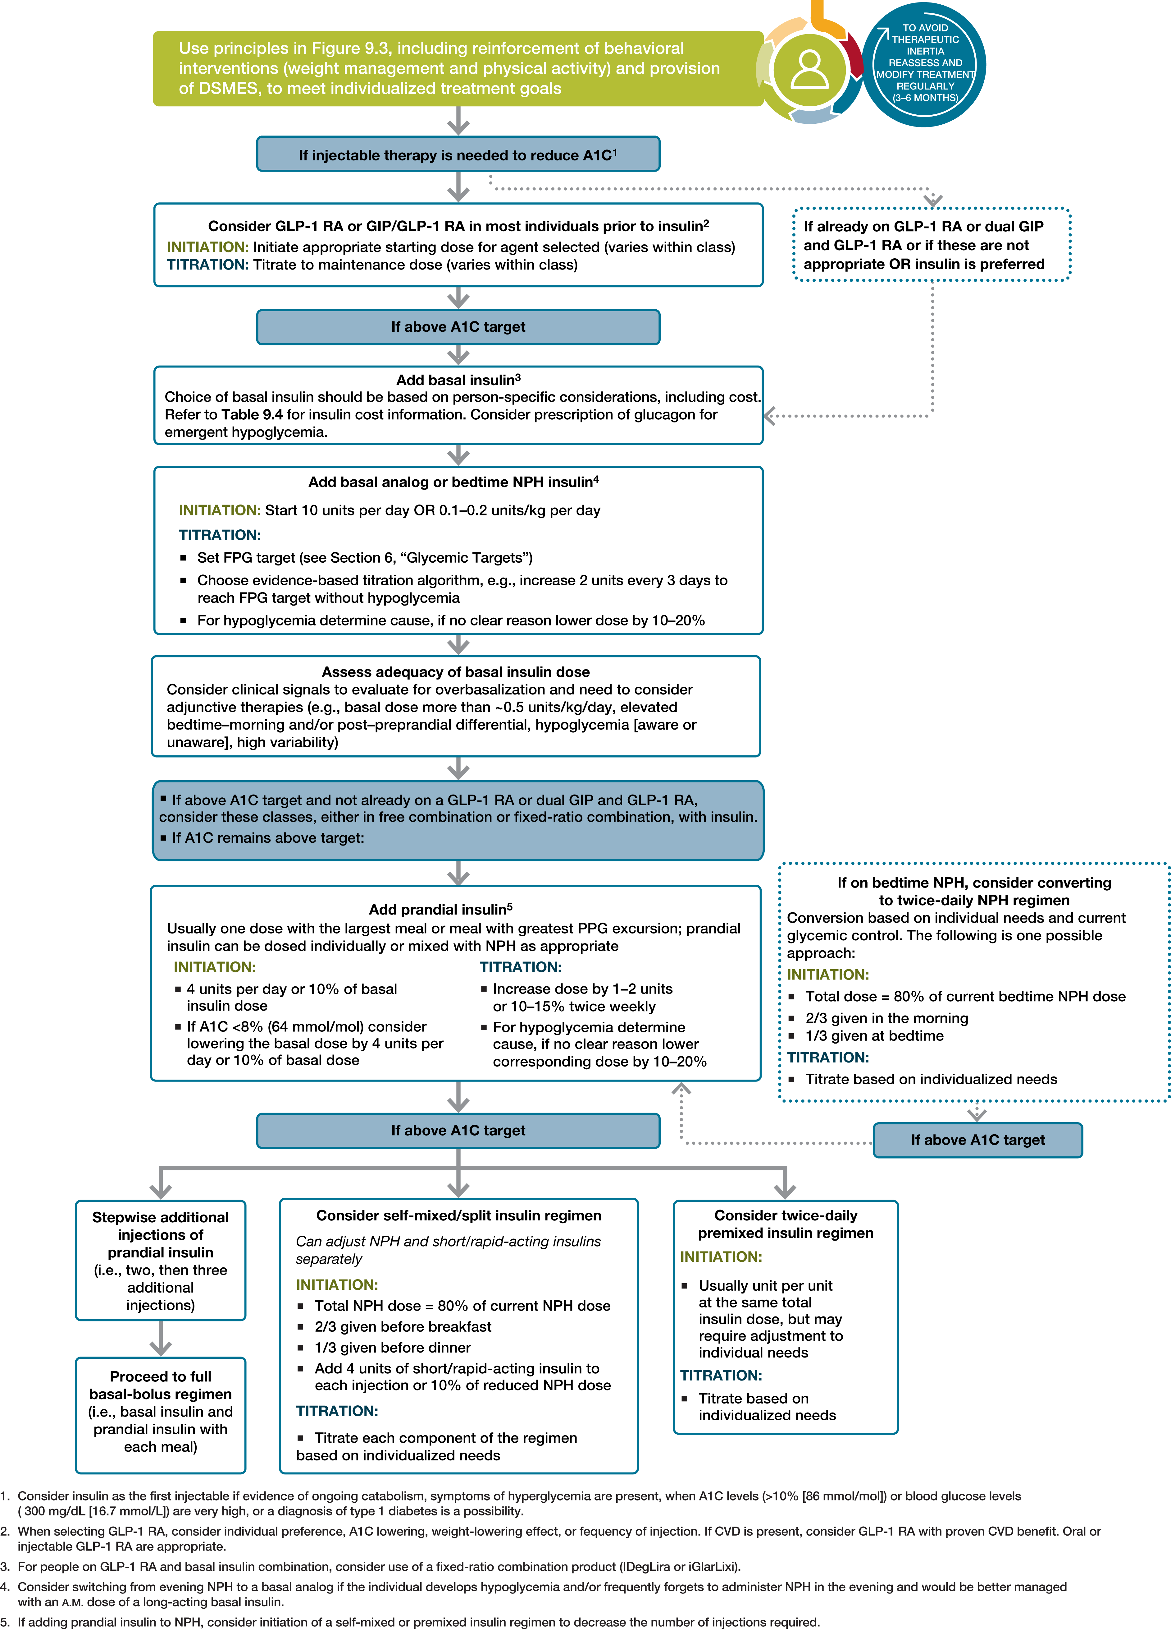
From: 9. Pharmacologic Approaches to Glycemic Treatment: Standards of Care in Diabetes—2023
Diabetes Care. 2022;46(Supplement_1):S140-S157. doi:10.2337/dc23-S009
Date of Download: 8/31/2023
Copyright © 2023 American Diabetes Association. All rights reserved.

Slide 20
Medication Choices in Older Adults
Avoid sulfonylureas due to hypoglycemia
Consider age-related renal disease-many medications can’t be used in advanced age-related or diabetes-related renal disease
Be mindful of polypharmacy
Single daily injection of basal insulin may work for many patients
Stringent control usually not needed
SGLT-2- UTI, yeast infections
GLP-1- GI side effects
Garber AJ et al. Endocr Pract. 2018; 24:91-120.
.

Slide 21
Geriatric Considerations in Diabetes
Older adults who are functional, cognitively intact, and have significant life expectancy should receive diabetes care with goals similar to those developed for younger adults
Glycemic goals for some older adults might reasonably be relaxed, using individual criteria, but hyperglycemia leading to symptoms or risk of acute hyperglycemic complications should be avoided in all patients
Renal disease, cardiovascular disease, congestive heart failure

Slide 22
Blood Pressure
Done at every visit (x2?)
Target is <130/<80 if can be safely attained
Consider weight loss if BP >120/>80
Lowering blood pressure reduces CVD and kidney disease
Watch for orthostasis, can lead to falls
Overly aggressive BP management not appropriate for many older adults
Beta-blockers and some calcium channel blockers can decrease pulse or affect maximum pulse rate
“Looser” BP goals may be appropriate with fall risk

Slide 23
Lipid Management-Secondary Prevention in Older Adults
For patients with diabetes aged 40–75 years without atherosclerotic cardiovascular disease, use moderate-intensity statin therapy in addition to lifestyle therapy.
In adults with diabetes aged >75 years already on statin therapy, it is reasonable to continue statin treatment
In adults with diabetes aged >75 years, it may be reasonable to initiate statin therapy after discussion of potential benefits and risks

Slide 24
Summary: targets in older adults
A1C <7.5-8.5 with little or no hypoglycemia for many, but some may warrant tighter control
BP<130/<80, but some may warrant tighter (or less rigid) control
Lipids-statin for most, perhaps case by case after age 75
Aspirin benefit vs risk may tilt toward risk in older adults
Need to know renal status for many diabetes medications

Slide 25
Diabetes Labs/Screening
A1C: 2-4 times yearly
Chemistry panel, to include renal and hepatic 1-2 times yearly, PRN
Urine for microalbumin annually
CBC annually, particularly if on aspirin and/or renal disease
Lipids only for monitoring compliance
Celiac screening in type 1 periodically
Thyroid screening usually annual in type 1

Slide 26
Diabetes Foot Exam
Every visit: visual inspection of skin, nails, lesions, color, deformity (i.e., hammertoes, charcot joint), edema
Annual complete foot exam: skin, nails, lesions, color, pulses, deformity, edema, 10gm monofilament sensitivity, 128 vibratory sensation
Any provider can look at feet in appropriate setting
https://www.ihs.gov/diabetes/clinician-resources/soc/foot-care1/

Slide 27
Why Is Prediabetes Important?
96 million people have prediabetes
Blood sugars are abnormal, but not high enough to be diagnosed with diabetes
Lifestyle can prevent over half of prediabetes cases converting to type 2 diabetes(and the complications that go with it!)
150 minutes of exercise/week, weight loss of 5-7%
CDC Prediabetes - Your Chance to Prevent Type 2 Diabetes
https://www.cdc.gov/diabetes/basics/prediabetes.html Accessed August 31,2023

Slide 28
Lifestyle Interventions
Refer patients with prediabetes to an intensive behavioral lifestyle intervention program modeled on the Diabetes Prevention Program (DPP) to achieve and maintain 7% loss of initial body weight and increase moderate intensity physical activity (such as brisk walking) to at least 150 min/week. Not all older adults will be able to do this
A variety of eating patterns are acceptable for persons with prediabetes.
Optimal nutrition and protein intake is recommended for older adults; regular exercise, including aerobic activity and resistance training, should be encouraged in all older adults who can safely engage in such activities

Slide 29
Evidence Supporting Diabetes Prevention
Finnish Diabetes Prevention Study (DPS)
  N Engl J Med 2001; 344:1343-1350
  https://www.nejm.org/doi/full/10.1056/NEJM200105033441801
Diabetes Prevention Program (DPP)
  N Engl J Med 2002; 346:393-403
  https://www.nejm.org/doi/full/10.1056/NEJMoa012512

Slide 30
Screening and treatment for comorbidities in older adults
Neurocognitive dysfunction
Psychiatric conditions
Cardiovascular disease
Cerebrovascular disease
Hypertension
Renal disease
Musculoskeletal conditions
Neuropathy
Vision
Any provider can stay aware of any or all of these in appropriate settings

Slide 31
Older Adults with Diabetes are also at High Risk for:
Polypharmacy
Urinary incontinence
Persistent pain- neuropathic, arthritis
Vision impairment
Hearing impairment
Falls

Slide 32
Neurocognitive Dysfunction/Psychiatric Conditions
Dementia/Cognitive Impairment
  Screening for early detection of mild cognitive impairment or dementia should be performed for adults 65 years of age or older at the initial visit and annually as appropriate

Slide 33
Role of the Physical Therapist in Diabetes Care: Screening
Regularly screen for diabetes-related complications and educate patient on their risk
  Psychosocial factors
    Depression
    Anxiety disorders
    Disordered eating
    Dementia/cognitive disorders
Table from Harris MH, Schootman M JOSPT 2020
Notes:
Story on how I got into treating people with diabetes. First patient in hospital for diabetic foot ulcers.
Generalist. See lots of people with diabetes or are referred to me due to diabetes. As PTs it is important for us to do regular screening these patients for various comorbidies.
Two questions (see above) for depression referral
Outcome measures: depression-axiety stress scale which has been validated in people over 65 years of age. MDC 7 on depression and stress subscale and 10.12 on total score. Shirley Ryan lab website
Brief psychiatric rating scale anxiety/depression/suicidal ideation
Mini Mental Status Examination – best studied for cognitive disorders, validated older community dwelling, hospitalized and institutionalized adults

Slide 34
Role of the Physical Therapist in Diabetes Care: Screening
Regularly screen for diabetes-related complications and educate patient on their risk
  Socioeconomic factors
  General complications
Table from Harris MH, Schootman M JOSPT 2020
Notes:
Want to get these patients to excerise be more active. We need to assess for barriers for physical activity
Parks? Sidewalks? Safety?
Customize their physical activity program based off their goals and the community resources they have access to
Monitor blood pressure and glucose, especially at initial visit. If you don’t have a glucose monitor in your clinic, I highly recommend you get one.
Ask about A1c is, typical glucose, that AM To see if checking regularly
Educate patient about importance of checking their glucose regularly
Monitoring response to physical activity
Ask about diet. This affects diabetic control and weight loss if that is a goal
Medications have implications for exercise

Slide 35
Role of the Physical Therapist in Diabetes Care: Screening
Regularly screen for diabetes-related complications and educate patient on their risk
  Cardiovascular complications
    Peripheral vascular disease
    Eye disease
    Autonomic neuropathy
Table from Harris MH, Schootman M JOSPT 2020
Notes:
Foot examination – prevent ulcers and amputations
Retinal disease has implications for exercise – no jumping activities

Slide 36
Role of the Physical Therapist in Diabetes Care: Screening
Regularly screen for diabetes-related complications and educate patient on their risk
  Kidney disease
  Peripheral Neuropathy
  Skin breakdown
Table from Harris MH, Schootman M JOSPT 2020
Notes:
Kidney disease is important to screen for. Won’t know kidney labs. But will be able to tell you if they have been monitored for kidney issues.

Slide 37
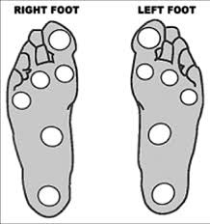
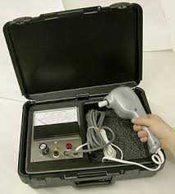
Role of the Physical Therapist in Diabetes Care: Screening
Regularly screen for diabetes-related complications and educate patient on their risk
  Kidney disease
  Peripheral Neuropathy
  Skin breakdown
Table from Harris MH, Schootman M JOSPT 2020
Notes:
PVD can lead to ulceration of the feet. Another condition that can increase risk for foot ulcerations is peripheral neuropathy of the feet. As physical therapists, this is something that we MUST do with all of our patients with diabetes. How you can do this is through a Semmes Weinstein Monofilaments test. If you don’t have these, you should get them in your clinic. They are very helpful. If a patient cannot feel the 5.07 monofilament then they have lost protective sensation. Which means they will not be able to feel when they say burn their feet on the pavement when walking around barefoot outside on a hot summer day. If sensation is absent, then the patient will not be able to feel the 6.10 monofilament. This can increase their risk for ulcers and ampulatation. Tuning fork to screen for vibration sense and if you are really fancy you can get a biotheiometer which measures the voltage that feet can feel. Picture out here. Achilles reflex test is a really quick on to do. Test their calf strength and ankle strength.
Typically people with diabetes will get regular foot examinations by a podiatrist. If they are getting those, it is still good to screen for your information as well.
Daily foot check. Want to prevent progression of wounds. If lack protective sensation, may need to refer them out for special shoes to wear to prevent ulcers in the feet

Slide 38
Role of the Physical Therapist in Diabetes Care: Screening
Regularly screen for diabetes-related complications and educate patient on their risk
  Musculoskeletal complications
Table from Harris MH, Schootman M JOSPT 2020
Notes:
Experts at this: MSK conditions
Arthritis, weakness, lack of flexibility
Specific things to think about when a patient comes in with diabetes.

Slide 39
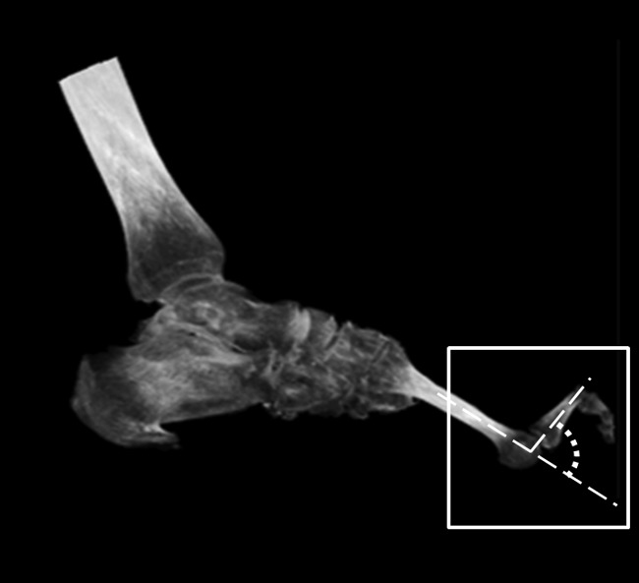
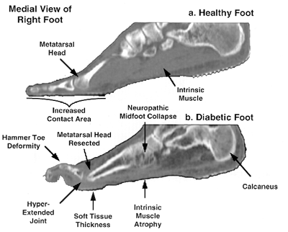
Role of the Physical Therapist in Diabetes Care: Screening
Regularly screen for diabetes-related complications and educate patient on their risk
  Musculoskeletal complications
Figure from Cheuy VA et al Phys Ther 2016
Table from Harris MH, Schootman M JOSPT 2020
Notes:
ankle dorsiflexion ROM does have an influence in controlling for the relationship between severity of deformity and MTPJ extension. The relationship between limited ankle dorsiflexion and MTPJ extension suggests an increase in extensor digitorum longus muscle recruitment during the ankle dorsiflexion task and an inability of the intrinsic muscles and MTPJ joint capsules to stabilize the MTPJ. Intrinsic foot muscle deterioration can destabilize the MTPJ because there is no longer a flexion force to act as an antagonist to the extensor digitorum longus muscle. A progressive exercise and movement retraining program may help to improve intrinsic foot muscle strength, ankle dorsiflexion ROM, and extensor digitorum longus muscle length and reduce MTPJ extension with active dorsiflexion to minimize MTPJ deformity.

Slide 40
Role of the Physical Therapist in Diabetes Care: Screening
Regularly screen for diabetes-related complications and educate patient on their risk
  Musculoskeletal complications
Table from Harris MH, Schootman M JOSPT 2020

Slide 41
The Diabetes Team
Physician: Primary Care, Diabetologist, Endocrinologist
Other Medical Provider: Physician Assistant, Nurse Practitioner, APRN
Other appropriate specialists (pharmacist, ophthalmologist, nephrologist, cardiologist, behavioral health specialist, podiatrist, occupational therapist, physical therapist, social worker, dentist)

Slide 42
The Diabetes Team
Diabetes Nurse Educator or Certified Diabetes Care and Education Specialist (CDCES)
Registered Dietician
The patient!

Slide 43
My Practice- Dr. Johnson: Post-COVID-19
I am doing about 50% telehealth
Persons with diabetes are known to be high risk. Patient acceptance of expanded telehealth services was nearly immediate
Relaxation and modification of billing and coding rules have made this a viable option
Patients will likely continue to demand this service in the future
Going back to “normal” seems unlikely
Still need to consider some elements that must be done in person (i.e., comprehensive foot exams)
Some kind of blend of virtual and in person
Notes:
Dr. Johnson and Dr. Weyrauch will talk about how their practice has changed due to COVID. Dr. Weyrauch is doing combination of telehealth and in person, most of which is exercise based.

Slide 44

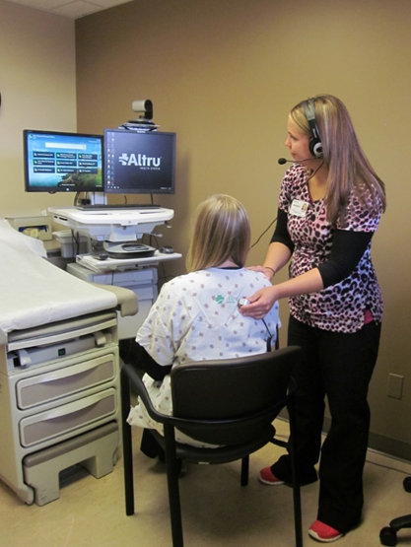
Typical visits we are doing now from our diabetes clinic
Virtual visit: usually patient is in their home
Older adults often need a facilitator.
At home- family member or friend
In clinic- nurse or medical assistant, sometimes CDCES
Classic facility to facility telemedicine

Slide 45
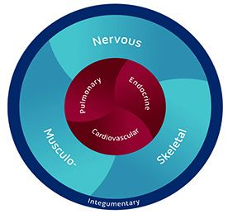
Role of the Physical Therapist in Diabetes Care: Treatment
80% of patients referred to outpatient PT have diabetes, risk factors for diabetes, or prediabetes
  Only 2% of referrals are for diabetes as primary condition
  High prevalence for patients in other settings as well
Diabetes impacts most body systems that produce movement
Notes:
Musculoskeletal system, nervous system, endocrine system, pulmonary system, cardiovascular system and integumentary system
Other settings as well: acute care, neuro rehab, SNFs → one of the best treatments for diabetes is physical activity

Slide 46
Role of the Physical Therapist in Diabetes Care: Treatment
Provide guidance on physical activity participation
  Moderate levels of activity, including brisk walking results in 12% reduction in diabetic complications and can decrease blood pressure by 10 mm Hg
Encourage diets higher in whole grains, green leafy vegetables
  Decrease intake of refined grains, red and processed meats, sugar sweetened beverages
Notes:
People who achieve recommended levels of moderate activity are 30% less likely to develop diabetes. This includes brisk walking for 2.5 hours per week. (Do they have a safe place to walk?)
12% reduction in diabetic complications with 10mm-Hg decrease in blood pressure
Mediterranean diet with supplementation of EVOO may reduce diabetes risk by 40% compared to fat-controlled diet

Slide 47
Exercise Prescription for Older Adults with Diabetes
150 minutes/week of moderate to vigorous intensity aerobic activity spread over 3 days per week with no more than 2 consecutive days without activity
2-3 sessions/week of resistance exercise training
2-3 sessions/week of flexibility and balance training
Decrease sitting time and encourage physical activity throughout the day.
Customize program to patient’s specific goals, preferred activities, comorbidities and risk of complications
Notes:
Also recommendation for Prediabetes
Flexibility in great toe and ankle can impact patient’s health due to increased risk for ulceration. Balance affected by neuropathy, meds

Slide 48
Effect of Exercise on HbA1c
Systematic review and meta-analysis of 47 RCTs and 2215 patients comparing structure exercise training or physical activity advice in patients with type 2 diabetes
  23 RCTs with structured exercise training, 24 RCTs with physical activity advice
  848 patients participated in structured aerobic exercise, 261 patients participated in structured resistance exercise, 404 patients participated in combined structured exercise, 7025 patients given physical activity advice
  Primary outcome analyzed was HbA1c levels
Notes:
Other inclusions required: >18 years that evaluated HbA1c for outcome, reported means/differences between means and dispersion values of HbA1c at baseline and post intervention
Only individuals able to exercise with no clinical manifestations limiting physical activity (This is a concern)
Many studies had under the recommended 150 minutes of physical activity as the weekly duration.
Some studies (10) had patients who did not have major complications from their diabetes, only a few studies included neuropathy. Most common complication was hypertension
Mean ages ranged from 50-70 years
Heterogeneneity was explained by baseline HBA1c (most common), exercise frequency, total time spent in exercise during the study, weekly exercise duration of >150 minutes/week of 150 minutes or less per week
Physical activity advice alone was not associated with HBA1 changes compared to control

Slide 49
Effect of Exercise on HbA1c
Systematic review and meta-analysis of 47 RCTs and 2215 patients comparing structure exercise training or physical activity advice in patients with type 2 diabetes
  Structured aerobic, resistance or combined exercise training
    Decline of HbA1c of 0.67%
  Structured exercise duration >150 minutes/week greater benefit than <150 minutes/week
    Decline of HbA1c of 0.89% vs 0.36%, respectively
  Structured exercise training demonstrated more pronounced HbA1c reduction compared to physical activity advice
    Physical activity advice was beneficial ONLY if combined with dietary recommendations (0.43% reduction in HbA1c)
Notes:
Aerobic, resistance and combined training each are associated with reduction in HbA1c and the magnitude is similar across all 3 exercise modalities
Structured exercise of >150 minutes per week is associated with greater declines of HbA1c when compared to 150 minutes or less in patients with type 2 diabetes
Guidelines may be underdosed?
These findings did not demonstrate that more intensive exercise than moderate intensity was associated with greater declines in HbA1c
Baseline HbA1c differences between studies explained the heterogeneity between studies, potentially underscoring the greater magnitude of intervention effects on HbA1c among people with baseline levels >7% compared to <7%.
Physical activity advice was associated with less declines in HbA1c compared to structured exercise training
Physical activity advice is only associated with HbA1c reduction when accompanied by dietary cointervention
Limitations:
Unblinded data extraction
High heterogeneity identified in meta-analysis especially with structured exercise training
Mainly due to baseline HbA1c and amounts of exercise between studies
General study quality was low, reflecting increased risk of bias

Slide 50
Exercise Prescription for Older Adults with Diabetes
Structured exercise consisting of aerobic training, resistance training or the combination of the two for at least 12 weeks with dosage of >150 minutes per week
  associated with improved glycemic control in patients with Type 2 Diabetes
Table from Harris MH, Schootman M JOSPT 2020
Notes:
These are just some ideas on ways you can customize a patient’s exercise program based on their comorbidities and their goals. You want to make sure you are taking a good history and asking them what they want to achieve with physical therapy and their diabetic control. You want to encourage them to gradually increase their physical activity to 150 minutes per week whether that be inside and outside physical therapy, but over time you want to wean them into being more independent.
You want to monitor their blood pressure and glucose during their session. If they do have any history of foot ulcers or currently have a foot ulcer, you may need to minimize the load on the lower extremity. So doing nonweightbearing activities, but as we will see later, weightbearing activities is okay in patient’s with peripheral neuropathy but if they have any type of open sore, that is when you will want to encourage non-weightbearing exercise.
Autonomic neuropathy or medications (beta blockers, nitrates, calcium channel blockers, digoxin, diuretics, ACE inhibitors) that blunts heart rate and blood pressure: Use RPE in addition to heartrate and blood pressure to monitor exercise response
Proliferative and severe non proliferative diabetic retinopathy – high intensity aerobic exercise may be contraindicated
Obesity- resistance training has same benefits as aerobic exercise and is often better tolerated by those who are obese or untrained.

Slide 51
Exercise Prescription for Older Adults with Diabetes
Table from Colberg SR et al DIABETES CARE 2016
Table from Harris MH, Schootman M JOSPT 2020
Notes:
This is the recommendation of dosage and prescription of exercise by the American Diabetes Association divided into exercise type, intensity, duration, frequency and progression.
With aerobic exercise, we obviously want to start off with a duration that is tolerated by the patient targeting large muscle groups and gradually increasing the duration of the activity. You can use Borg scale to figure out the intensity of the activity which we typically want to shoot for 12-16. You also want to gradually increase the frequency of this activity to 3-7 days per week as we talked about before.
With resistance training, we want to start with high repetition and low weight and work our way to low repetition and high weight to increase strength. The duration would be 8-10 exercises 1-3 sets, nearing fatigue. As the patient continues to build strength, you can continue to increase resistance and make sure they hit that target number each time.
For stretching and balance, we want to make sure we are hitting the ankle and foot for sure but also making sure we are targeting the lower extremity in general as well. We want them to do some type of static or dynamic stretch for 10-30 seconds with a couple of repeitions and you can use this as a guide on how to progress that
Autonomic neuropathy or medications (beta blockers, nitrates, calcium channel blockers, digoxin, diuretics, ACE inhibitors) that blunts heart rate and blood pressure: Use RPE in addition to heartrate and blood pressure to monitor exercise response
Proliferative and severe non proliferative diabetic retinopathy – high intensity aerobic exercise may be contraindicated
Obesity- resistance training has same benefits as aerobic exercise and is often better tolerated by those who are obese or untrained.

Slide 52
Exercise Prescription for Older Adults with Diabetes
Example program: Stretching
Protocol from Mueller M et al Arch Phys Med Rehab 2012. Photos from Medbridge, Inc
Notes:
This is an example stretching program that I like to use with my patients. It covers all the lower extremity muscle groups that we’ve talked about. Depending on the patient, I will do a combination of weightbearing and nonweightbearing or I may do all weightbearing or all nonweightbearing. It just depends on how they are presenting.
This program is based off a protocol from a randomized controlled trial which looked at weightbearing vs nonweightbearing exercise in patients with peripheral neuropathy who had diabetes.
Based off protocol from RCT
WB vs NWB in patients with DM and peripheral neuropathy

Slide 53
Exercise Prescription for Older Adults with Diabetes
Example NWBing program: Balance & Strengthening
Table from Mueller M et al Arch Phys Med Rehab 2012
Notes:
From the same study, this is an example of a balance and strengthening program they used in the study. This is the non-weightbearing group. As you can see, they targeted the lower extremity in these exercises

Slide 54
Exercise Prescription for Older Adults with Diabetes
Example NWBing program: Balance & Strengthening
Table from Mueller M et al Arch Phys Med Rehab 2012
Notes:
Here are more of the exercises they had the patients do.

Slide 55
Exercise Prescription for Older Adults with Diabetes
Example WBing program: Balance & Strengthening
Table from Mueller M et al Arch Phys Med Rehab 2012
Notes:
For the weightbearing group, these were the exercises they prescribed for balance and strengthening. And I do use a lot of these with my patients.

Slide 56
Exercise Prescription for Older Adults with Diabetes
Example WBing program: Balance & Strengthening
Table from Mueller M et al Arch Phys Med Rehab 2012
Notes:
When they looked at the differences in the amount of foot ulcers between the 2 groups, there were no differences. Based on these results, they concluded that weightbearing exercise was safe for patients with diabetic neuropathy, pending they had no foot wounds at the start of the program.
No differences in the amount of ulcerations between two groups
Wbing exercise safe pending no wounds

Slide 57
Exercise Considerations for Older Adults On Medications for Diabetes and Other Comorbidities
Table from Colberg SR et al DIABETES CARE 2016
Notes:
This goes well with what Dr. Johnson talked about earlier. Some other considerations, all healthcare providers need to understand what medications cause hypo or hyperglycemia. And I think this table does a really good job describing what those are and how the dose of the medication needs to be adjusted by the physician or things you need to be thinking about when prescribing exercise.
Understand what medications affect hypo and hyperglycemia
Beta blockers- check glucose before and afterwards, has something on hand to check this

Slide 58

Case Studies
Case #1: History
  76 y/o female with moderate Alzheimer’s dementia in LTC
  Ambulates 300’ CGA with FWW, BBS: 35/56
  Long standing type 2 diabetes
  History of CVA- left sided weakness
  Neuropathy
  CKD
  HTN
  Dyslipidemia

Slide 59
Case Studies
Case #1: Labs
  A1C 9.9
  BP 176/94, pulses range from 52-98
  Orthostatic BP 141/89
  Serum creatinine 1.7, GFR 38 (Stage 3 CKD)
  Lipids: TC 246, TG’s 260, HDL 31, LDL 135
  Weekly blood sugars usually 250+

Slide 60
Case Studies
Case #1: Medications
  Glargine 52 units daily
  Lisinopril 20 mg daily
  Metoprolol Succinate 25mg daily
  Atorvastatin 10mg daily
  Donepezil 5 mg daily
  Lorazepam 1mg TID
  Risperdal 0.5 mg BID

Slide 61
Case Studies
Case #1: Mobility and Nutrition
  Eating- fair with assist of 1, likes to “indulge” at birthday parties
  No known hypoglycemia, but occasional “behaviors”
  Sleeps a lot during many days
  Going to physical therapy 2x/week to decrease her fall risk
What next?
Notes:
“Behaviors”
Psych?
Low blood sugars not being captured?
Infection? (i.e., UTI)
Bradycardia?
Should consider all of these in this patient
“Daytime sleepiness”
Should consider all of these factors
Doesn’t have bradycardia, UTI, has frequent falls
Blood sugar increased testing (QID x 3 days) shows all blood sugars >250, 2 hours post “birthday party” 425

Slide 62
Case Studies
Case #1: Medical Management
  Insulin modifications
  Blood pressure medication modifications
  Statin/aspirin considerations
Notes:
INSULIN: Daytime sleepiness may be from elevated blood sugars
Increasing basal insulin doesn’t address post-meal blood sugars
Could start by adding an injection of rapid acting insulin with each meal- small doses to start
Also a “prn” rapid actinginsulin dose with birthday party (1 to 4 units)
Target FBS 100-180 (probably can’t report hypoglycemia accurately)
Target 2 hour post-meal or random blood sugars to be <200-220
Target A1C 7.5-8.0 without significant hypoglycemia
If unpredictable eater, can give mealtime insulin after meal and only if meal eaten

Slide 63
Case Studies
Case #1: Insulin Modifications
  Daytime sleepiness may be from elevated blood sugars
  Increasing basal insulin doesn’t address post-meal blood sugars
  Could start by adding an injection of rapid acting insulin with each meal- small doses to start or a GLP-1 if appropriate
  Also a “prn” rapid acting insulin dose with birthday party (1 to 4 units)
Notes:
“Behaviors”
Psych?
Low blood sugars not being captured?
Infection? (i.e., UTI)
Bradycardia?
Should consider all of these in this patient
“Daytime sleepiness”
Should consider all of these factors
Doesn’t have bradycardia, UTI, has frequent falls
Blood sugar increased testing (QID x 3 days) shows all blood sugars >250, 2 hours post “birthday party” 425

Slide 64
Case Studies
Case #1: BP Medication Modifications
  Could move metoprolol to hs
  New guideline suggests if on more than 1 med, 1 med should be given in evening
  Always consider fall risk
  Orthostatic BP is a factor in this patient
What about statin and aspirin?
  Case by case, could prevent another massive stroke in this patient

Slide 65
Case Studies
Case #1: Physiotherapy Management
  Use of Nustep for aerobic exercise, consider walking program with nursing
  Resistance training in seated or standing positions
  Balance activities to assist with independence for ADLs
  Consider co-treating with OT to manage dementia symptoms

Slide 66

Case Study
History
  67 yo M with 15-year history of Type 2 diabetes
  Lives in community with spouse, works as a supervisor at local engineering firm
  Left knee OA
  CKD
  HTN
  Dyslipidemia
  Peripheral neuropathy

Slide 67
Case Study
Medications
  Detemir 26 units injected daily AM
  Dulaglutide 1.5mg injected weekly
  Metformin
  Lisinopril 20mg daily, blood pressure is 138/82, orthostatic 105/60
  Atorvastatin 40 mg daily
  ASA 81mg daily

Slide 68
Case Study
Patient Goals
What next?
Improve control of diabetes
  Regularly checks blood sugars which range from 60-220 mg/dL
  Occasional overnight lows
Go for walks with spouse (limited by knee pain)

Slide 69
Case Study
Physiotherapy Management
Treat knee OA
  Focus on improving ROM and mobility
Start with nonweightbearing aerobic program
  As knee OA improves, transition to weightbearing
Address strength deficits with resistance program
Education on checking feet daily
Address balance deficits
Notes:
Cortisone shots contraindicated?

Slide 70
Conclusions
Older adults with diabetes are a heterogeneous population
Targets need to be individualized
Physical therapists are an important member of the diabetes care team
  Screen for complications/co-morbidities
  Treatment should focus on primary and secondary prevention of complications/co-morbidities that would lead to functional impairment
  Lifestyle change is goal when treating people with diabetes
  Refer to member of healthcare team as needed

Slide 71

Thank you!
Stephanie Weyrauch, PT, DPT, MSCI
MovementX
Billings, MT
Stephanie.Weyrauch@movement-x.com
Twitter/IG: @TheSteph21
Eric Johnson, MD
University of North Dakota School of Medicine and Health Sciences
Altru Diabetes Center
Grand Forks, ND
eric.l.johnson@und.edu

Slide 72
References
American Diabetes Association. Classification and Diagnosis of Diabetes: Standards of Care in Diabetes-2023. Diabetes Care. 2023 Jan 1;46(Suppl 1):S19-S40. doi: 10.2337/dc23-S002.
American Diabetes Association. Pharmacologic Approaches to Glycemic Treatment: Standards of Care in Diabetes-2023. Diabetes Care. 2023 Jan 1;46(Suppl 1):S140-S157. doi: 10.2337/dc23-S009.
American Diabetes Association. Comprehensive Medical Evaluation and Assessment of Comorbidities: Standards of Care in Diabetes-2023. Diabetes Care. 2023 Jan 1;46(Suppl 1):S49-S67. doi: 10.2337/dc23-S004.
American Diabetes Association. Prevention or Delay of Type 2 Diabetes and Associated Comorbidities: Standards of Care in Diabetes-2023. Diabetes Care 2023;46(Suppl. 1):S41-S48.
American Diabetes Association. Cardiovascular disease and risk management: Standards of Care in Diabetes-2023. Diabetes Care 2023;46(Suppl. 1):S158-S190
American Diabetes Association. Older Adults: Standards of Care in Diabetes-2023. Diabetes Care. 2023 Jan 1;46(Suppl 1):S216-S229. doi: 10.2337/dc23-S013.
American Diabetes Association. Chronic Kidney Disease and Risk Management: Standards of Care in Diabetes-2023. Diabetes Care. 2023 Jan 1;46(Suppl 1):S191-S202.

Slide 73
References
Cheuy VA, Hastings MK, Mueller MJ. Metatarsophalangeal Hyperextension Movement Pattern Related to Diabetic Forefoot Deformity. Phys Ther. 2016 Aug; 96(8): 1143–1151.
Colberg SR, Sigal RJ, Yardley JE, Riddell MC, Dunstan DW, Dempsey PC et al. Physical Activity/Exercise and Diabetes: A Position Statement of the American Diabetes Association. Diabetes Care. 2016; 39: 2065-2079.
Harris-Hayes M, Schootman M, Schootman JC, Hastings MK. The Role of Physical Therapists in Fighting the Type 2 Diabetes Epidemic. J Ortho Sports Phys Ther. 2019; 50(1): 5-16.
Kanchanasamut W & Pensri P. Effects of weightbearing exercise on a mini trampoline on foot mobility, plantar pressure and sensation of diabetic neurpathic feet; a preliminary study. Diabetic Foot & Ankle. 2017;8(1):1-10.

Slide 74
References
Lavie CJ, Ozemek C, Carbone S, Kattzmarzyk PT, Blar SN. Sedentary Behavior, Exercise, and Cardiovascular Health. Circ Res. 2019 Mar 124 (5), 799-815.
LeRoith D, Biessels GJ, Braithwaite SS, Casanueva FF, Draznin B, Halter JB et al. Treatment of Diabetes in Older Adults: An Endocrine Society Clinical Practice Guideline. J Clin Endocrinol Metab. 2019 May; 104(5): 1520–1574.
Mueller MJ, Tuttle LJ, LeMaster JW, Strube MJ, McGill JB, Hastings MK, et al. Weightbearing versus nonweightbearing exercise for persons with diabetes and peripheral neuropathy: a randomized controlled trial. Arch Phys Med Rehabil. 2013 May;94(5): 829-38.
Yanai H, Adachi H, Masui Y, Katsuyama H, Kawaguchi A, Hakoshima M, et al. Exercise Therapy for Patients with Type 2 Diabetes: A Narrative Review. J Clin Med Res. 2018; 10(5): 365-69.

Slide 75

References
Volume 46 Issue Supplement_1 | Diabetes Care | American Diabetes Association (diabetesjournals.org)

Slide 76
OBTAINING CME/CE CREDIT
Credit is only given to attendees who:
Successfully complete the entire course/session.
Evaluate the course – by completing an online survey.
After you have completed the session evaluations and post-tests, and evaluate the overall program, you will be able to download your certificate from you task page.
The evaluation will close 30 days after the end of the enduring activity.

Slide 77


ACRM.org

Slide 78


24 – 29 SEPTEMBER 2021

Slide 79


